Slide 1

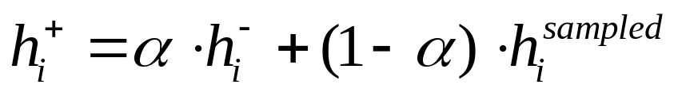
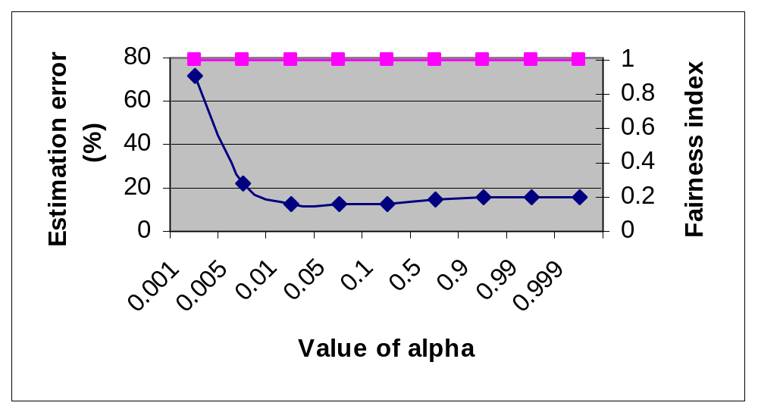
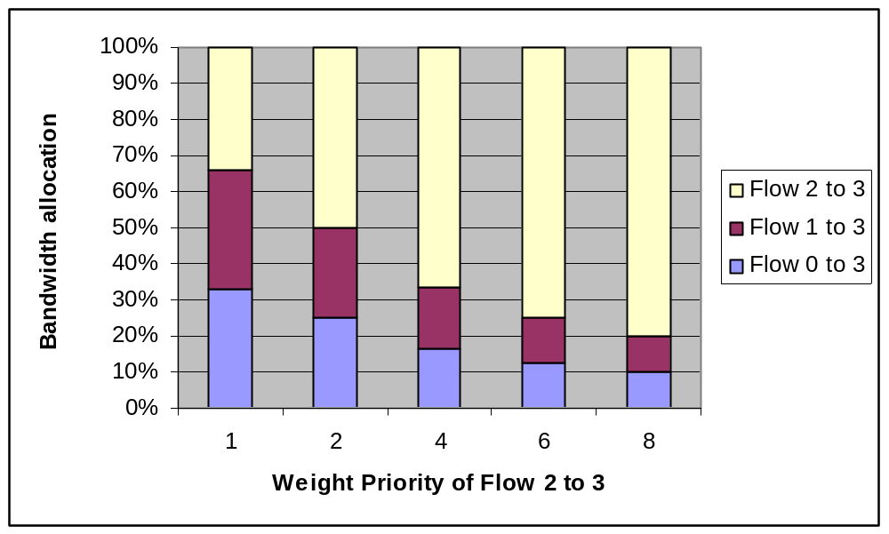
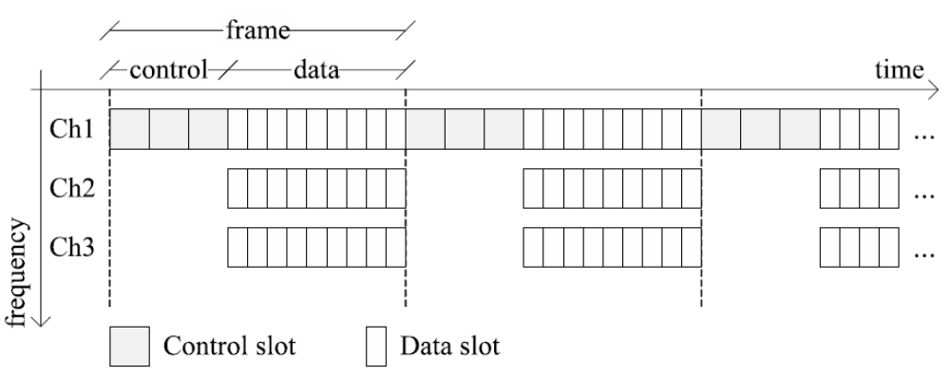
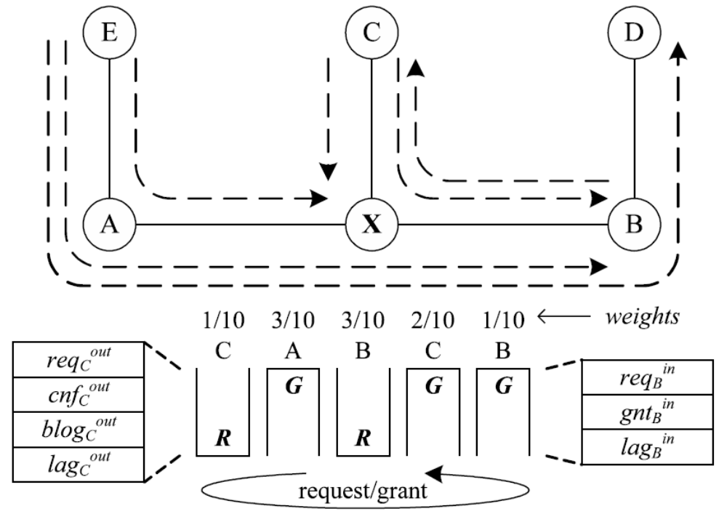
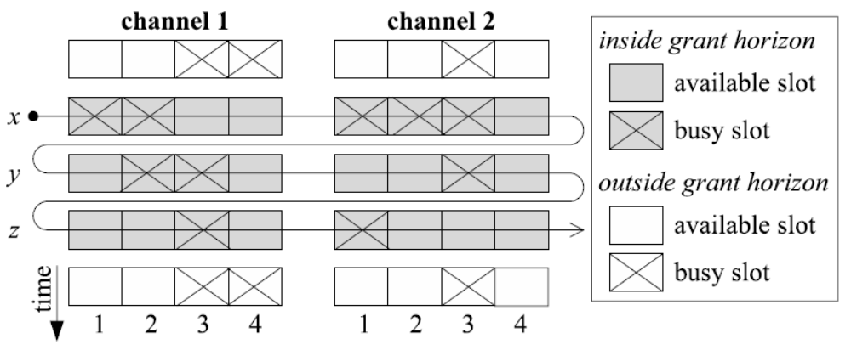
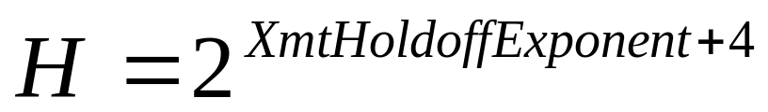
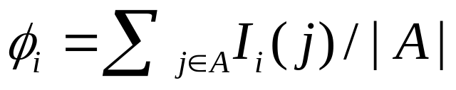
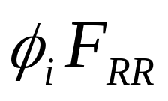
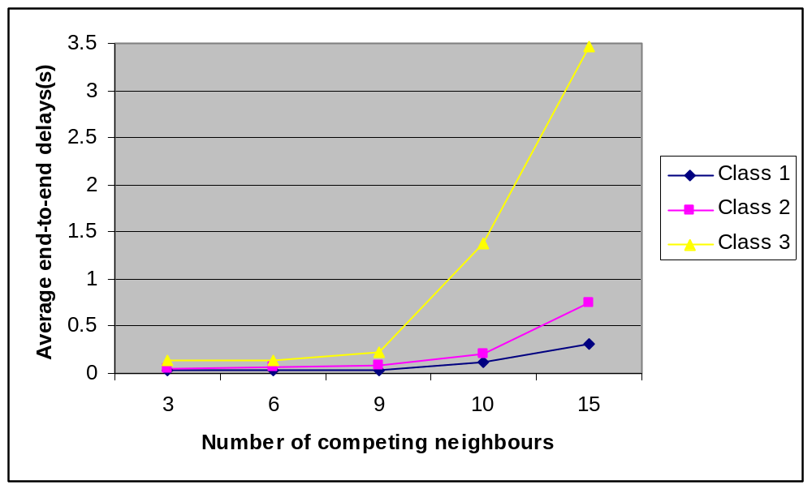
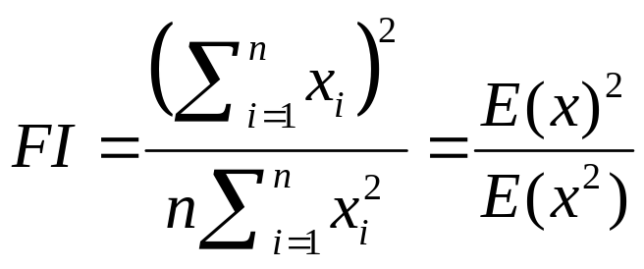
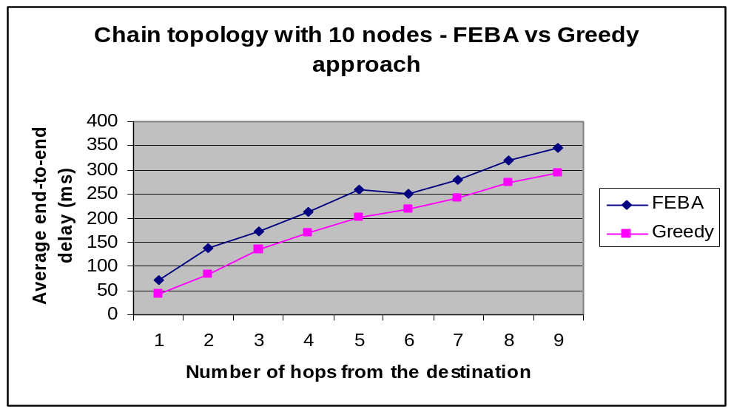
Fair End-to-end Bandwidth Allocation (FEBA)
algorithm observation and improvement
H.N. Truong, T.T.T. Do, D. Tran
Motivation and Background
Influence of α on grant horizon & FEBA performance
In FEBA, each node uses a different grant horizon, depending on the neighbors’ control latency h which is estimated by
Wireless Mesh Networks are dynamically self-organized and self-configured networks, in which the nodes automatically form an ad hoc network and maintain the mesh connectivity.
Fairness is a desirable property for any MAC protocol employed as the backhaul tier of a WMN.
FEBA has significantly improved the bandwidth balance in IEEE 802.16 mesh network for different network topologies
(3)
The optimized value for α should be in the range of 0.01 to 0.05
The error estimation of h does not affect the overall performance of FEBA – “fairness index”
Nodes access control slots less frequently, they are allowed to assign grants over larger frame windows.
Objectives
To investigate the impact of other system parameters on performance of FEBA.
To improve the FEBA algorithm based on observation via simulation results.
FEBA improvement
Prioritizing traffic flows in FEBA
Modified FEBA for QoS differentiation in WiMAX
FEBA overview
Assigning different value to indicator function I_{i}(j) in expression (1) allows different priority levels for each flow
Add 3-bit field in the header of each flow’s packet header to indicate its priority level
At each node, maintain a table of priority to help calculate the weight for each queue
FEBA algorithm
for IEEE 802.16 nodes
negotiate bandwidth in a multi-channel environment.
assign in a round-robin fashion
provide a fair bandwidth allocation in terms of:
• throughput
• end-to-end traffic flows
Bandwidth request/grant in FEBA
A weight Φ_{i} is assigned for each active queue i (requesting & granting), which is computed so that the amount of service is proportional to the number of traffic flows under service:
Each queue i is entitled to grant/request up to bytes to/from neighbor i.
The granter should not schedule data slots too early (wait for confirmation), not too late.
Bandwidth request/grant procedures
1. Randomly select a channel;
2. Find 1st available slot in 1st frame of the grant horizon;
3. If no slots are available, move to the next channel;
4. If all channels have been searched, move to next
available frame of the grant horizon.
TABLE I
PRIORITIY TABLE AND CORRESPONDING SERVICE
Index Priority I_{i}(j) Corresponding service
0 1 FTP file transfer
1 2 UDP tunnel
2 4 Internet web browsing
3 6 VoIP
4 8 Video conferencing
5 16
6 32
7 64
For priority which is greater than 8, we can reserve for future use with higher-data-rate real time application.
Fig. Bandwidth allocation among three flows with different values of weight priority for flow 2 to 3
Fig. IEEE 802.16 Mesh – Channels, Frames and Subframes
In IEEE 802.16-2004 standard, XmtHoldoffExponent defines the MSH-DSCH transmission interval.
Transmission hold off time: the interval that a node is not allowed to transmit after the current transmission time
(4)
Fig. Bandwidth request/grant data structure at node X
Fig. Grant allocation of data slots within the grant horizon.
H is one of the reasons that affect the delay of FEBA
Proposed solution: Differentiate XmtHoldoffExponent for each node to provide services with different QoS
XmtHoldoffExponent has a size of three bits, we can provide up to eight different classes of services with the value of XmtHoldoffExponent between 0 and 7.
(1)
A node with lower priority sends request at a lower frequency -> larger delay
Nodes will lose more transmission opportunities as the number of competing neighbors increase -> delay increases with node density
Fig. Average delay in terms of the competing nodes for three classes of service
Class 1: real-time application with strict delay constraint (VoIP or Video conference)
Class 2: flexible delay (web browsing)
Class 3: best-effort application (email)
FEBA observation
Advantages
High bandwidth fairness index which is
used to measure bandwidth balancing.
Disadvantages
MAC throughput is lower than
Greedy approach
Average end-to-end delay is
longer than Greedy
Conclusion
(2)
FEBA not only provides bandwidth balancing among traffic flows but also makes the mesh network become load balanced
2 ways to improve FEBA are proposed: prioritizing the traffic flows and differentiating the QoS for each node in the network.
A QoS differentiation scheme is also suggested for IEEE 802.16 Mesh Network.
Reference: Cicconetti, C., Akyildiz, I.F.; Lenzini, L. Bandwidth Balancing in Multi-Channel IEEE 802.16 Wireless MeshNetworks. INFOCOM 2007.

