Slide 1



Slide 2
Make Your Own Learning Card
Course: System Thinking

Slide 3





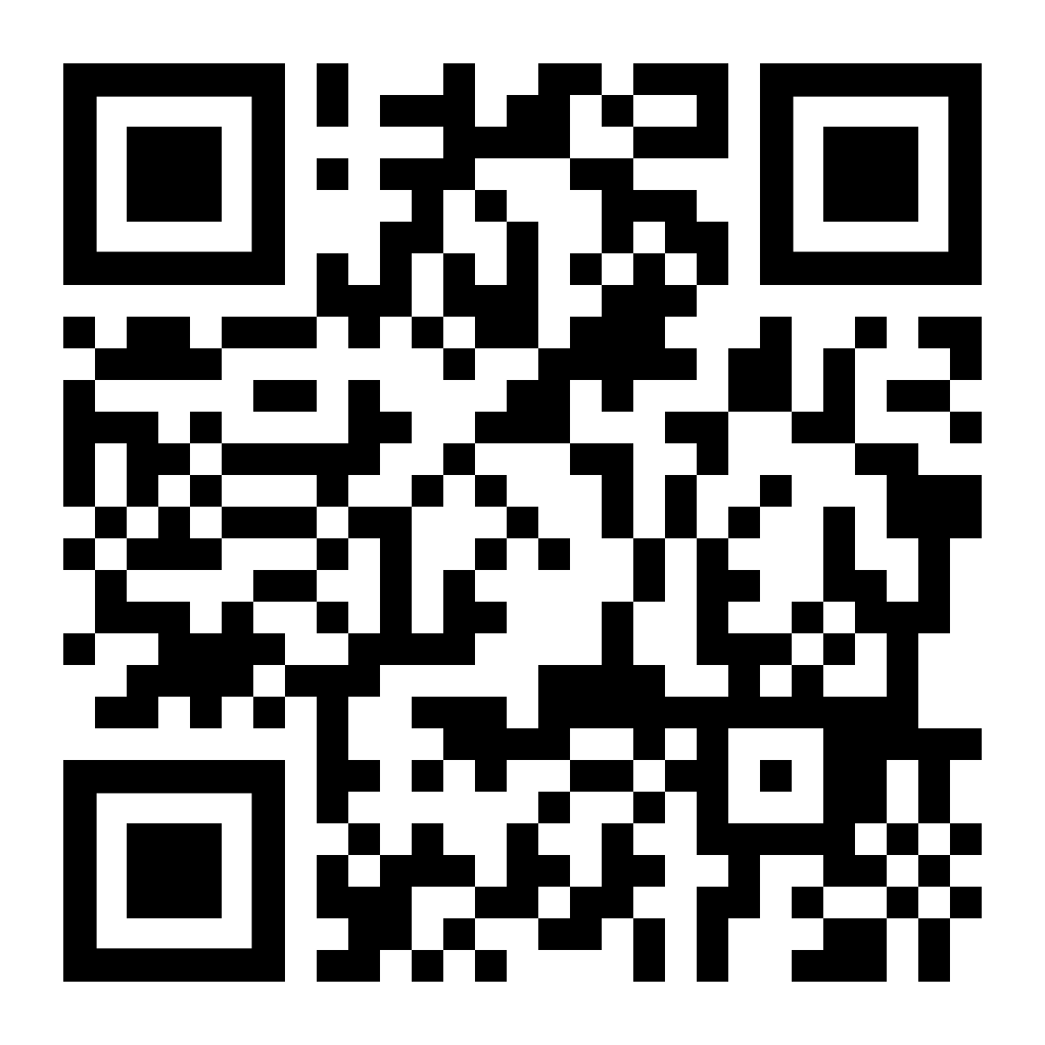


Learning Card Format
Reflection Icon
HEAD: Use your mind to see and listen.
Observe
Feel
Act
Observe
HEART: Use your heart to understand.
Short Response
Feel
HAND: Use your hands to make and prototype.
Act
Main Inspiration Visual
Information Code
(Connecting to MIT xPRO dashboard)
Complementary Visual
Notes
(Anything you want to share with us)
Key Takeaway
Notes:
Interesting finding 1….
Interesting finding 2….
Interesting finding 3….
Interesting finding 4….
Front Side
Back Side
Learning Point
Provocative Questions

Slide 4
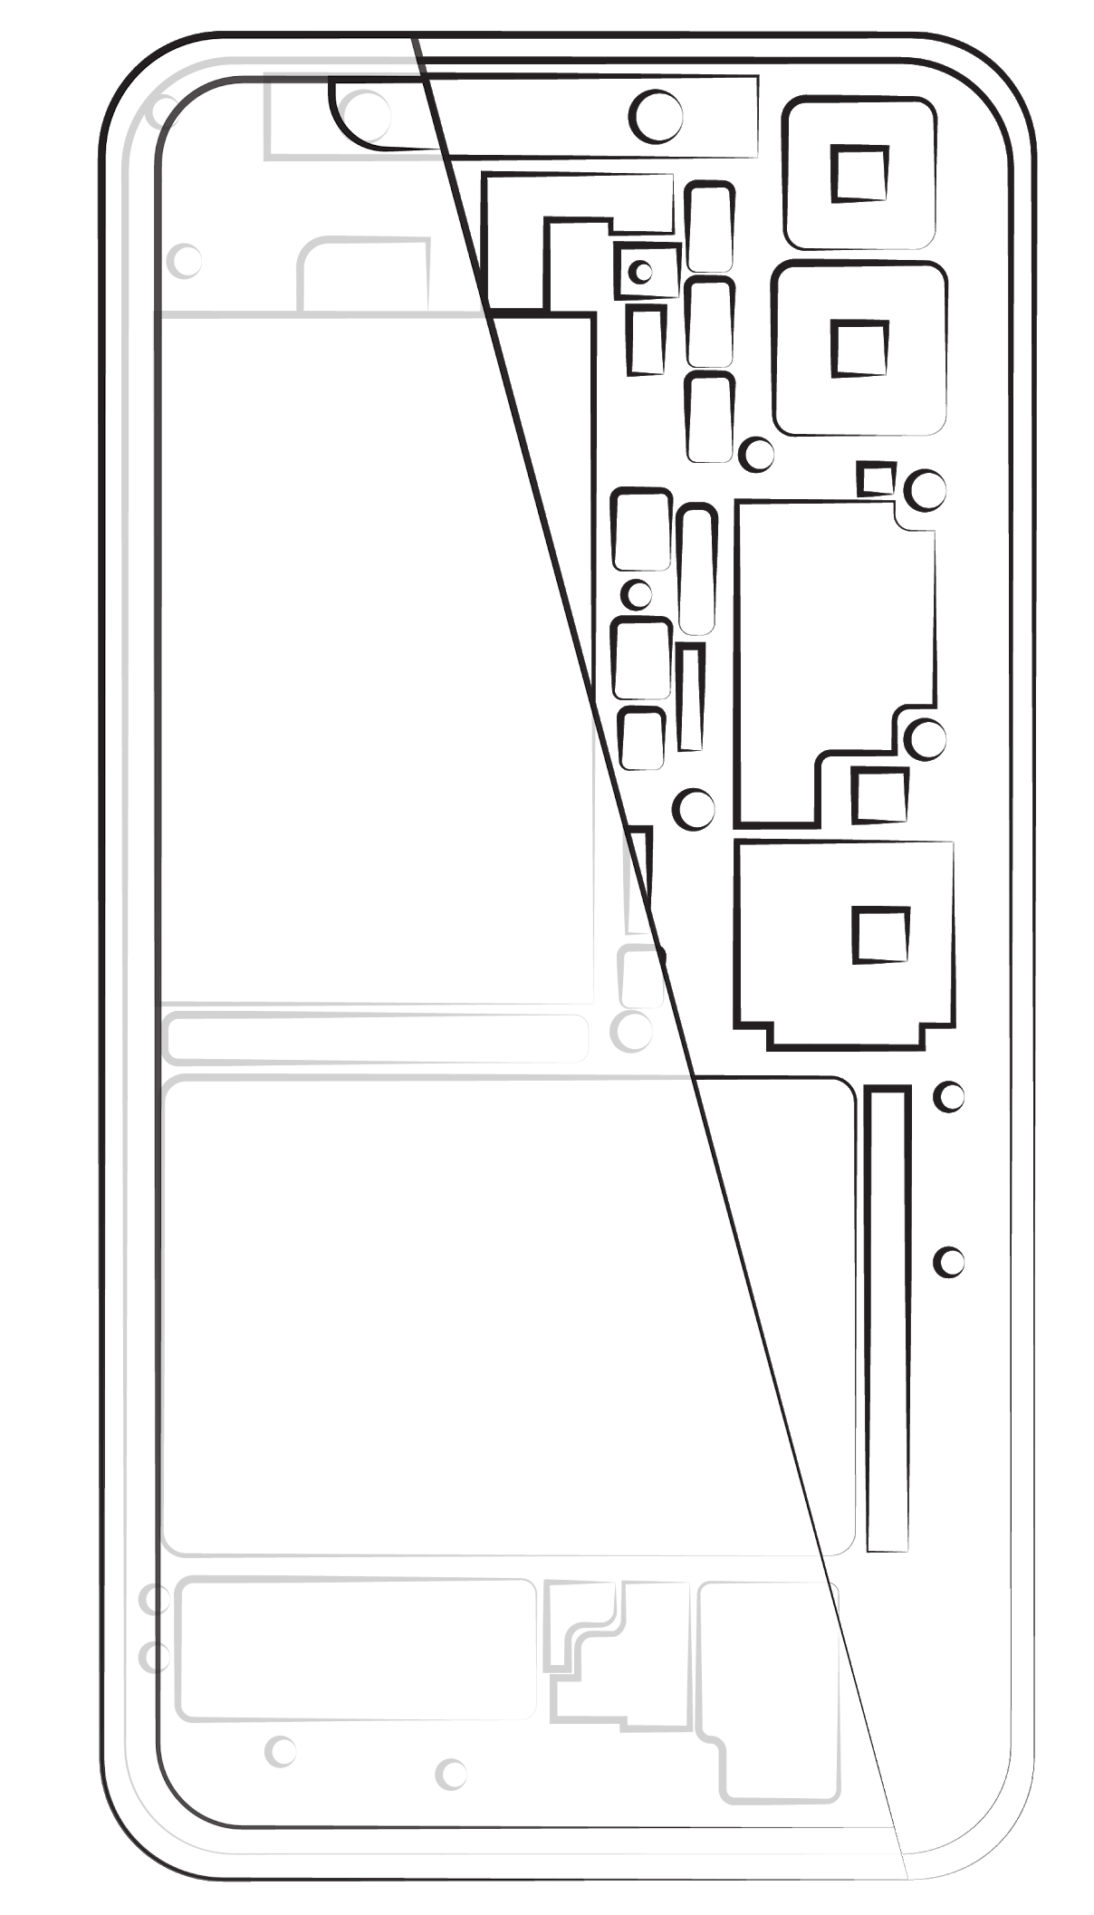
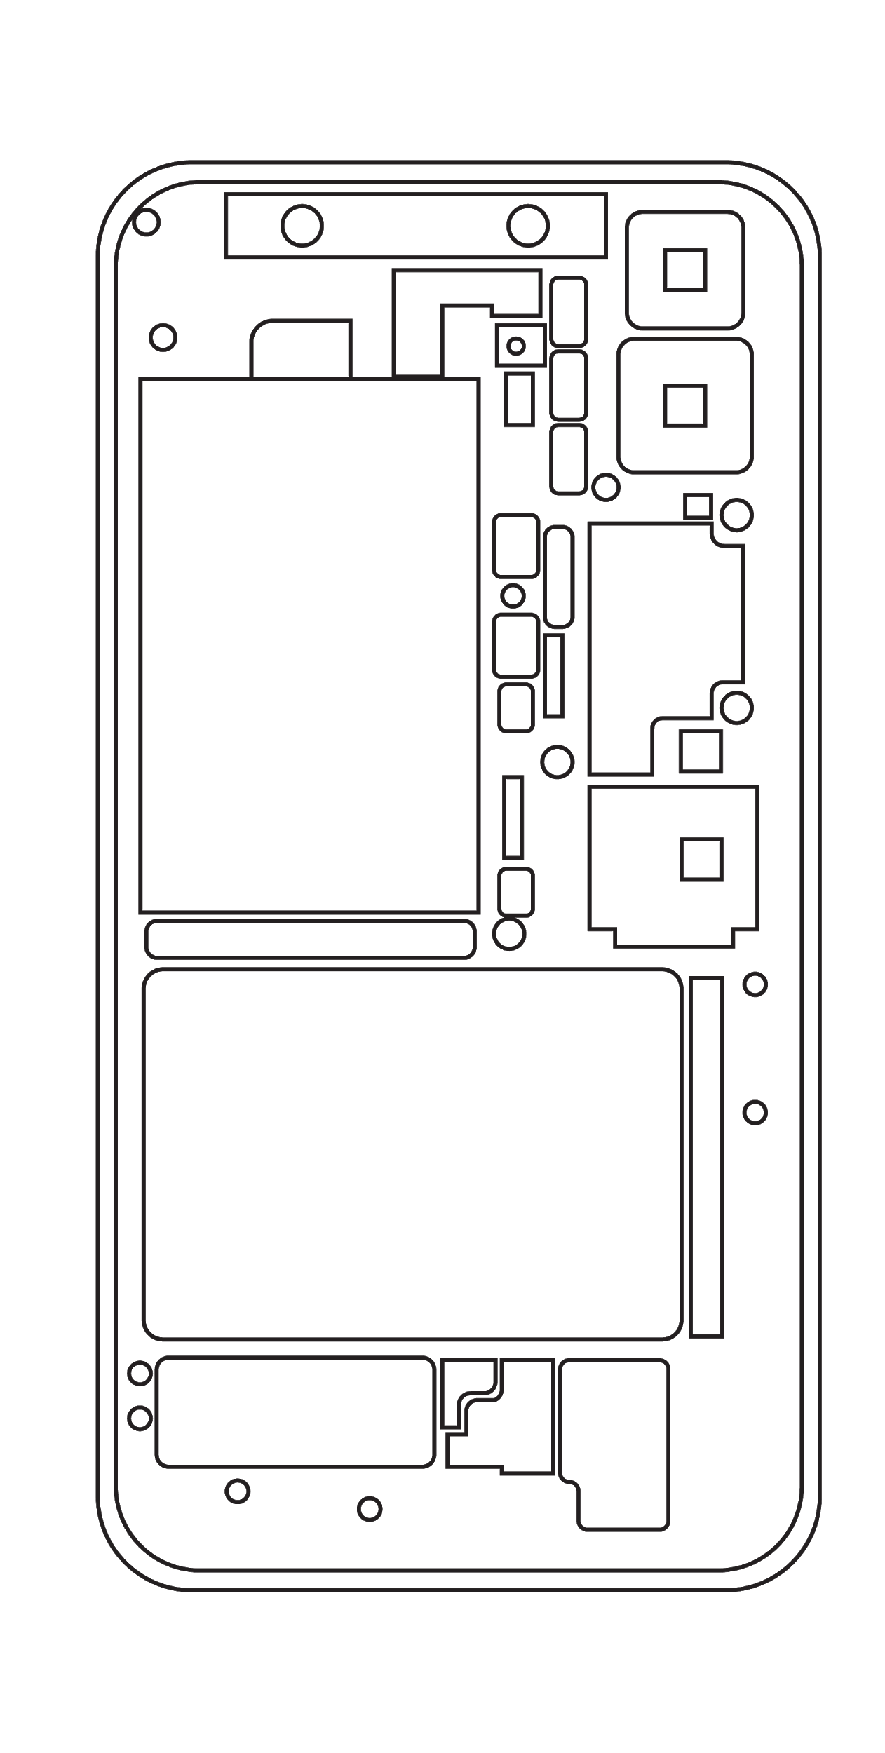
Example
Observe
Feel
Act
Smartphones are becoming more complex as we ask more from them.
Camera
5G antenna
Li-ion Battery
GPS receiver
Processor
Front Side
Taptic Engine
Accelerometer
Back Side
Speaker
Key Takeaways
Headset port
Notes:
More focus on complexity, not decomposition. Complexity is the key.
Are you a system thinker?
Are you use system thinking?
Are you able to deal with the complexity of the system? How do you deal with it?
Systems have interrelated entities and deliver new function
System thinking is thinking of things as systems
Systems are becoming more complex as we ask more from them
System thinking helps make complex things appear simple
System thinking expands the scope of thinking and avoids stovepipes
System thinking is thinking of things as systems. What system are you thinking about?
Notes:
Add Ed’s notes to key takeaway

Slide 5

( Your Name ) Learning Card
HEAD: Use your mind to see and listen.
Observe
Feel
Act
Observe
HEART: Use your heart to understand.
XXXX….
Feel
Short Response
HAND: Use your hands to make and prototype.
Act
Main Inspiration Visual
Complementary Visual
Front Side
Back Side
Key Takeaways
Notes:
Interesting finding 1….
Interesting finding 2….
Interesting finding 3….
Interesting finding 4….
Learning point 1
Learning point 2
Learning point 3
Learning point 4
XXXX….
Provocative Questions
Notes:
Add Ed’s notes to key takeaway

