Slide 1
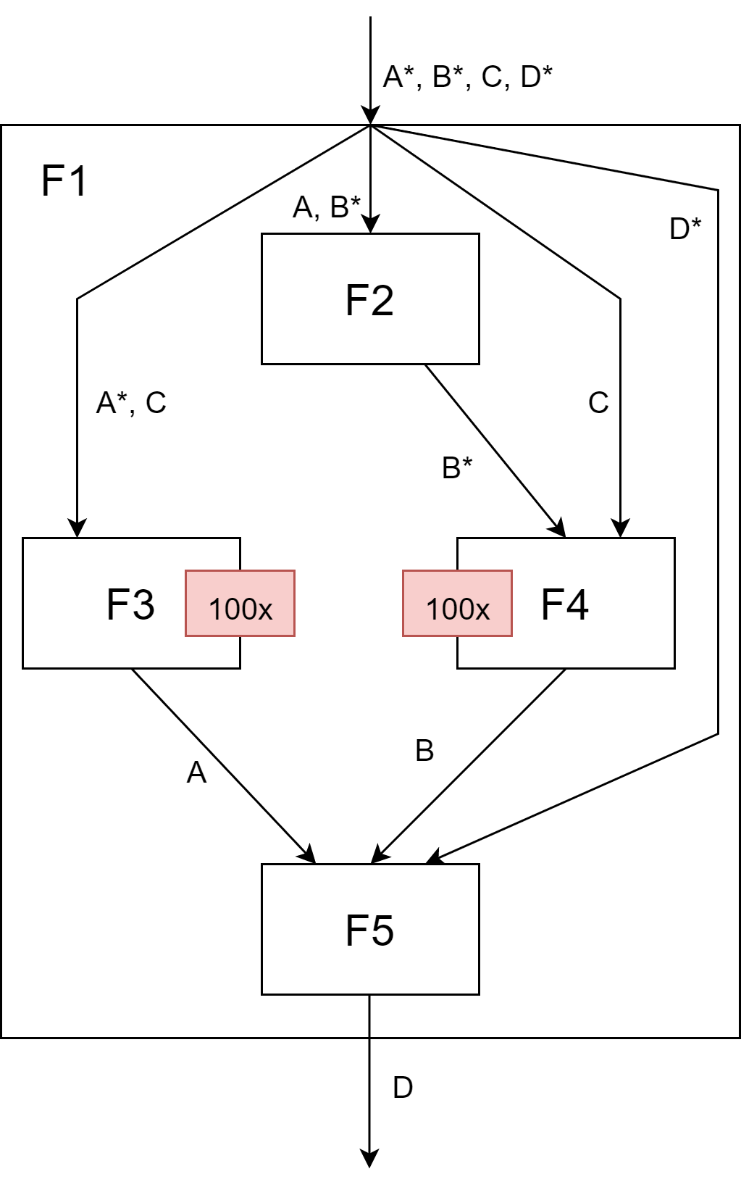
Task Graph
void f1(int A[100], int B[100], int C[100], int D[100])
{
// modifies B
f2(A, B);
for (int i = 0; i < 100; i++)
{
// modifies A
f3(A, C[i]);
// modifies B
f4(B, C[i]);
}
// modifies D
f5(A, B, D);
}

Slide 2
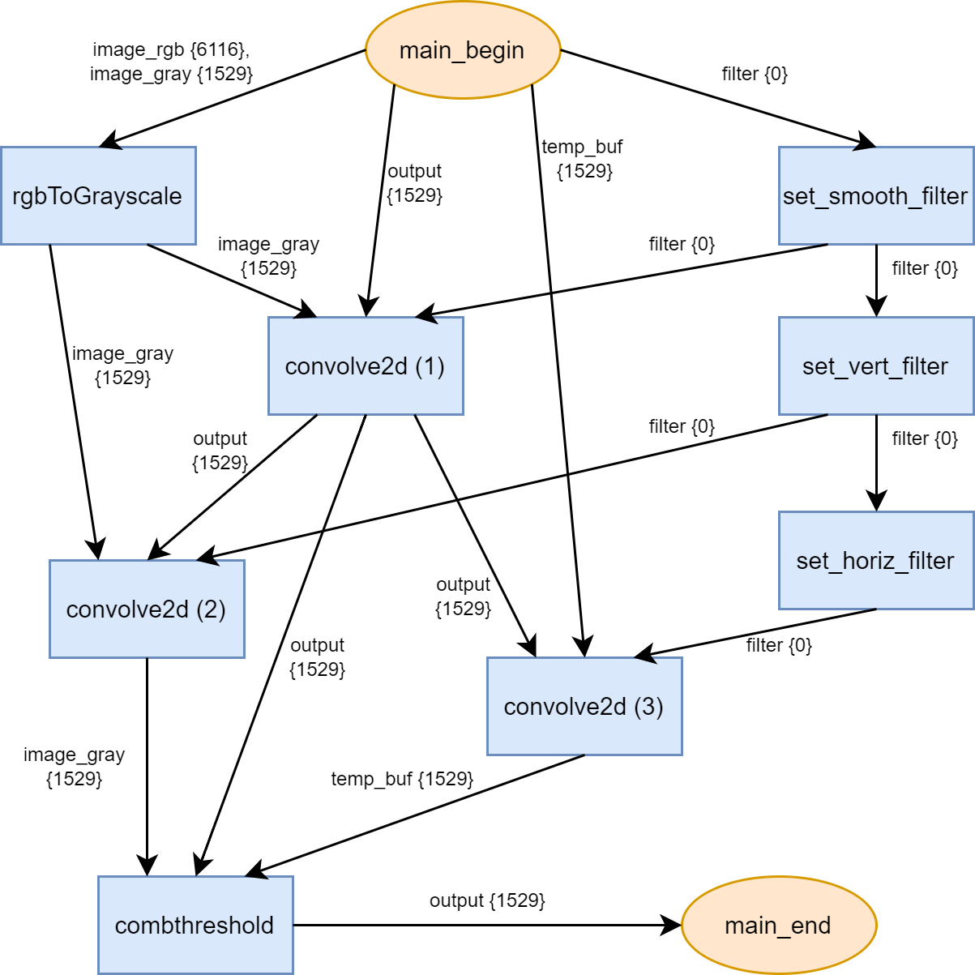
General statistics
17 communication tasks
8 regular tasks
2 special tasks
Calls to math.h functions: 0
Calls to external functions (e.g., printf): 0

Slide 3
Size of largest clusters (in tasks)
A cluster consists of tasks possibly to implement in hardware
Maximum size here is 8 (all tasks can form a cluster, except for main_begin and main_end)

Slide 4
Array usage (read or write)
image_rgb: 2
image_gray: 3
filter: 7
output: 6
temp_buf: 3

Slide 5
Distance to array production
rgbToGrayscale: - image_rgb: 1 - image_gray: 1
convolve2d (1): - image_gray: 2 - output: 1 - filter: 2 convolve2d (2):
- image_gray: 2 - output: 2 - filter: 3
convolve2d (3): - output: 2 - temp_buf: 1 - filter: 4
combthreshold: - image_gray: 3 - output: 2 - temp_buf: 2
set_smooth_filter: - filter: 1
set_vert_filter: - filter: 2
set_horiz_filter: - filter: 3

Slide 6
Distance to array consumption
rgbToGrayscale: - image_rgb: 0 - image_gray: 2
convolve2d (1): - image_gray: 0 - output: 2 - filter: 0
convolve2d (2): - image_gray: 1 - output: 0 - filter: 0
convolve2d (3): - output: 0 - temp_buf: 1 - filter: 0
combthreshold: - image_gray: 0 - output: 1 - temp_buf: 0
set_smooth_filter: - filter: 3
set_vert_filter: - filter: 2
set_horiz_filter: - filter: 1

Slide 7
Producer-consumer relations
Number of consumer-producer relations between tasks (i.e., one task produces results in the same order as the following task consumes them)
There are none

Slide 8
Tasks using/calling resources not supported by hardware
Number of tasks that have no available implementation (e.g., printf, system calls)
There are none (main_begin and main_end use them, but they are, by definition, SW tasks)

Slide 9
Task level parallelism
Pairs of tasks that can be executed in parallel (i.e., have no data dependencies to each other)
convolve2d (2) and convolve2d(3)
rgbToGrayscale and set_smooth_filter
convolve2d (1) and set_vert_filter
convolve2d (2) and set_horiz_filter

Slide 10
Task exit points
Number of possible exit points in a task (e.g., conditional premature return statements)
rgbToGrayscale: 1
convolve2d (1): 1
convolve2d (2): 1
convolve2d (3): 1
combthreshold: 1
set_smooth_filter: 1
set_vert_filter: 1
set_horiz_filter: 1

Slide 11
Conditional tasks
Tasks that may only execute depending on a condition
There are none.

Slide 12
Task Read/write ratio
For a task, find the ratio between the data that must be communicated to the task for read purposes, and the data that the task modifies (i.e. cost of input / cost of output)
Note that some inputs may never be read, only written to
rgbToGrayscale: 5
convolve2d (1): 2
convolve2d (2): 2
convolve2d (3): 2
combthreshold: 3
set_smooth_filter: 0
set_vert_filter: 0
set_horiz_filter: 0

Slide 13
Cost of minimum cut
Cost of the data communicated in the graph's minimum cut
4587 (1529 * 3)

Slide 14
Number of tasks per hierarchical level
1st level: 10
(main_end and main_begin could also be seen as its own hierarchical level)

Slide 15
Critical path length
Measured in terms of tasks
6 tasks:
main_begin -> rgbToGrayscale-> convolve2d (1) -> convolve2d (2) -> combthreshold -> main_end
or
main_begin -> rgbToGrayscale-> convolve2d (1) -> convolve2d (3) -> combthreshold -> main_end

