Slide 1

Programming for Visual Artists
2024/2025
Department of Art and Media

Slide 2

Recap
Some Creative Coding background
Tools
Boilerplate
Processing 101
– Colors, background, shapes

Slide 3

Some things to check
GitHub Pages: https://pages.github.com/
Hugo: https://gohugo.io/
Processing reference: https://processing.org/reference

Slide 4
CPU (Central Processing Unit) – Located on the motherboard, inside the CPU socket, usually under a heatsink and fan.
RAM (Random Access Memory) – Installed in RAM slots on the motherboard.
ROM (Read-Only Memory) – Usually built into the motherboard as
firmware (BIOS/UEFI) or in specialized chips.
GPU (Graphics Processing Unit) – Can be integrated into the CPU (integrated graphics) or installed as a dedicated graphics card in a PCIe slot on the motherboard.
SSD (Solid State Drive) – Can be located in an M.2 slot on the motherboard (for NVMe SSDs) or connected via SATA ports (for 2.5- inch SSDs).
HDD (Hard Disk Drive) – Installed in a drive bay inside the computer case and connected via SATA ports on the motherboard.
VRAM (Video RAM) – Located on the GPU (inside a dedicated graphics card). Integrated graphics use part of the system RAM as VRAM.
ALU (Arithmetic Logic Unit) – A component inside the CPU, responsible for arithmetic and logic operations.
Cache – A small, high-speed memory located inside the CPU, used to store frequently accessed data for faster processing (L1, L2, and L3 cache).
Some basics

Slide 5

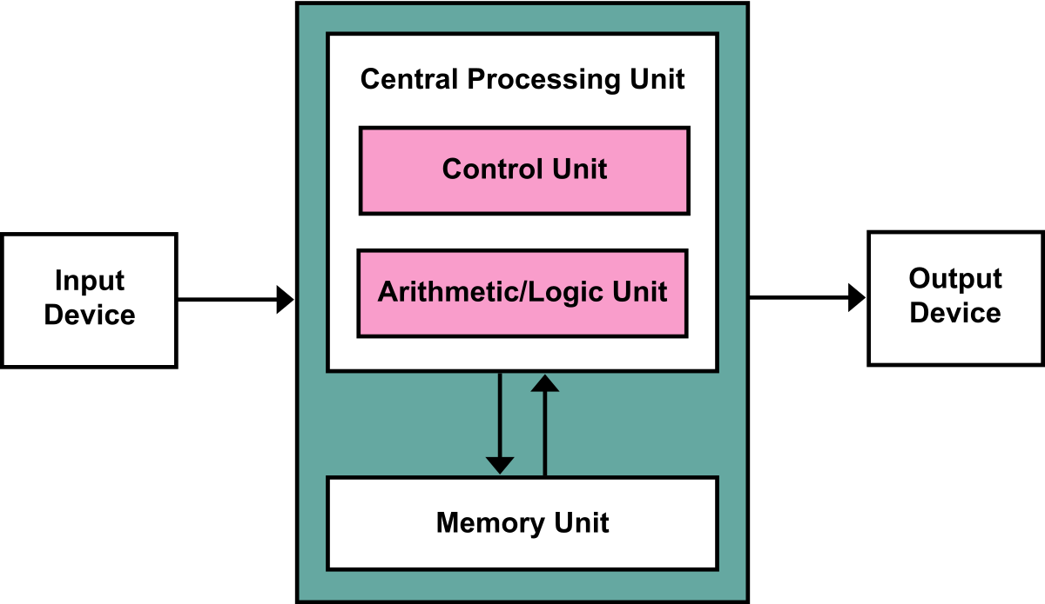
The Von Neumann architecture is a computer design model proposed by John von Neumann in 1945. It describes a system where a single memory unit stores both data and program instructions. The CPU fetches instructions and data from memory, processes them, and writes the results back. This model uses a control unit, ALU,
registers, memory (RAM), and input/output devices. A key characteristic is the Von Neumann bottleneck, where the shared memory bus can slow down processing due to limited data transfer speeds. This architecture is widely used in modern
computers, from PCs to smartphones.
Used in Traditional CPUs like x86)! For ARM processors, Harvard architecture is used!
Some basics
•

Slide 6

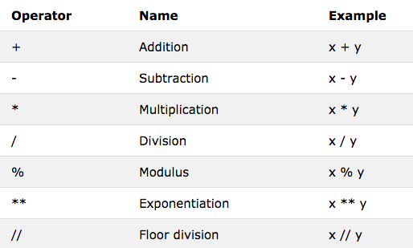
Some basics

Slide 7
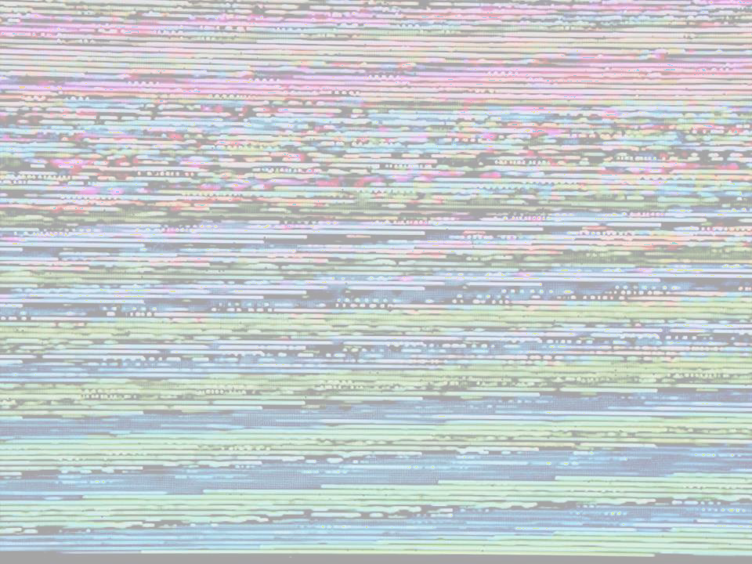

Welcome
Recap
Today’s Goals
Drawing and Interaction
Cartesian Coordinate System Colour Theory basics Interactivity
BREAK (10:30–10:45)
Coding tasks
Shapes follow the mouse and change colour Invert movement and dynamic background
Q&A
Brief display of sketches
For tomorrow…

Slide 8
mouseX and mouseY are built-in variables in Processing that store the current horizontal (x) and vertical (y) position of your mouse cursor, respectively.
These values are updated automatically as you move your mouse around within the window.
You can use these variables to create interactive experiences in your Processing sketches.
Drawing & Interaction

Slide 9
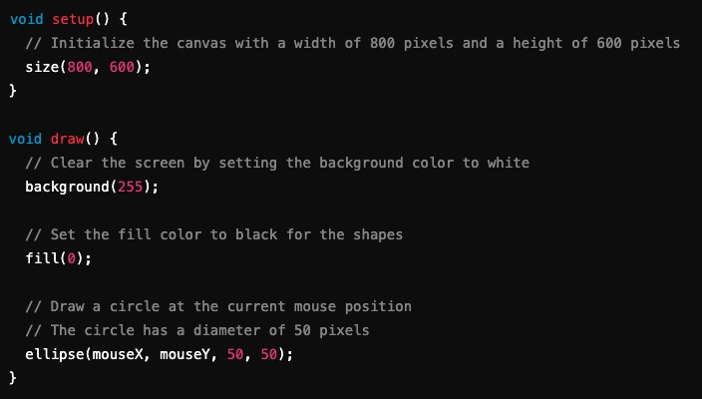
Drawing & Interaction
In this example, whenever you move your mouse around within the window, a black circle will follow its cursor.
The ellipse() function is called with mouseX and mouseY as arguments, which means that it's drawing the circle at the current position of the mouse.
Since these positions are updated continuously in real-time, this creates an interactive experience where moving your mouse results in a visual response on the screen.

Slide 10

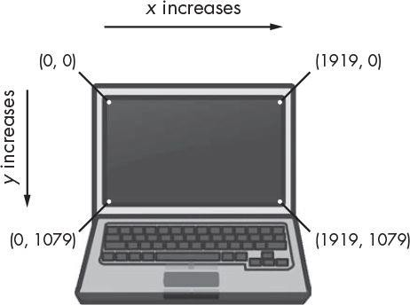
Interaction - coordinates
In Processing (and others too), the coordinate system is Cartesian, with the x-axis representing width and the y-axis representing height.
In Processing, the origin (0,0) is at the top-left corner. The x-axis increases to the right, and the y-axis increases downward.
For an 800×600 canvas, (800,0) is the top-right corner, and (0,600) is the bottom-left. Negative coordinates position elements off-screen.
Understanding the coordinate system helps accurately position objects in Processing. By specifying (x, y) coordinates, objects maintain their placement, enabling dynamic and responsive designs that adapt to different screen sizes.

Slide 11

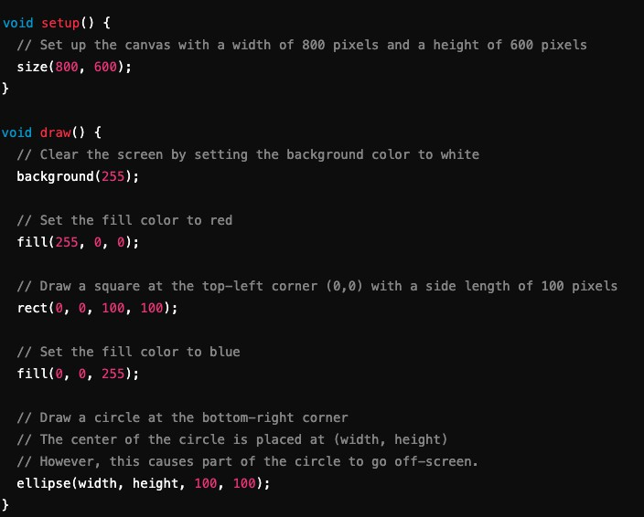
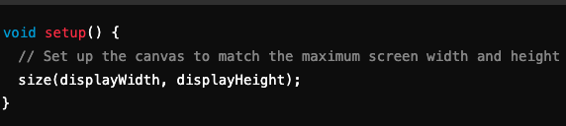
Drawing & Interaction - coordinates
This example uses rect() to draw a square and ellipse() to draw a circle.
The red square is positioned at (0,0), while the blue circle is placed at (width, height) to stay at the bottom right.
Using width and height ensures correct positioning even if the canvas size changes.
These principles apply to more complex designs and animations.
To dynamically adapt the sketch to the full screen, use displayWidth and displayHeight for the screen resolution.
In newer versions of Processing this was
substituted by fullScreen()!

Slide 12
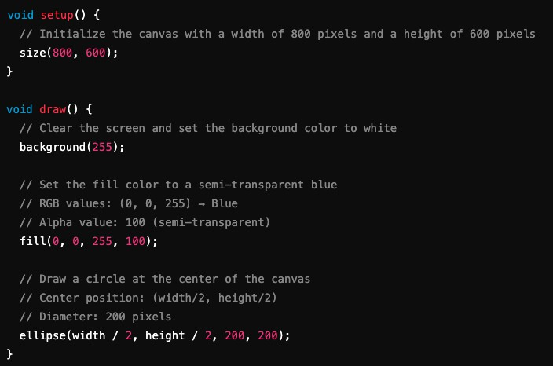
Drawing & Interaction - color theory basics
Colour theory studies properties like hue, saturation, brightness, and contrast.
Colours enhance visuals and convey meaning.
The RGB model (Red-Green- Blue) represents colours using values from 0 to 255, allowing over 16 million combinations.
An optional alpha channel (0– 255) controls transparency for blending effects.

Slide 13
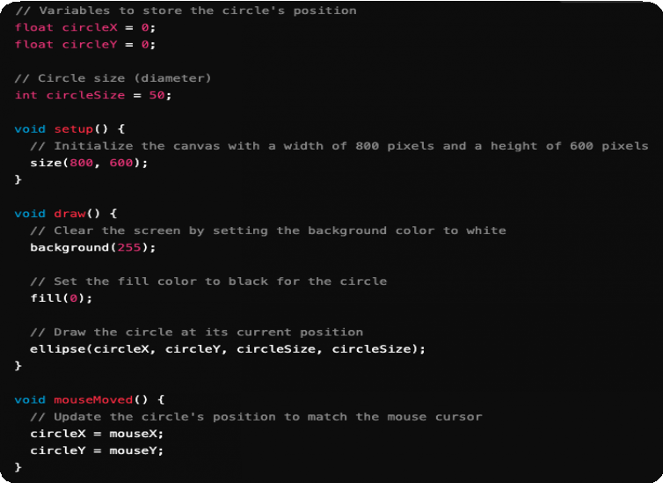
Drawing & Interaction - interactivity
In Processing, you can handle mouse and keyboard events to create interactive animations that respond to user input in real-time.
In this example, the mouseMoved() function updates a black circle's position to match the cursor, creating an animation where the circle follows the mouse.

Slide 14
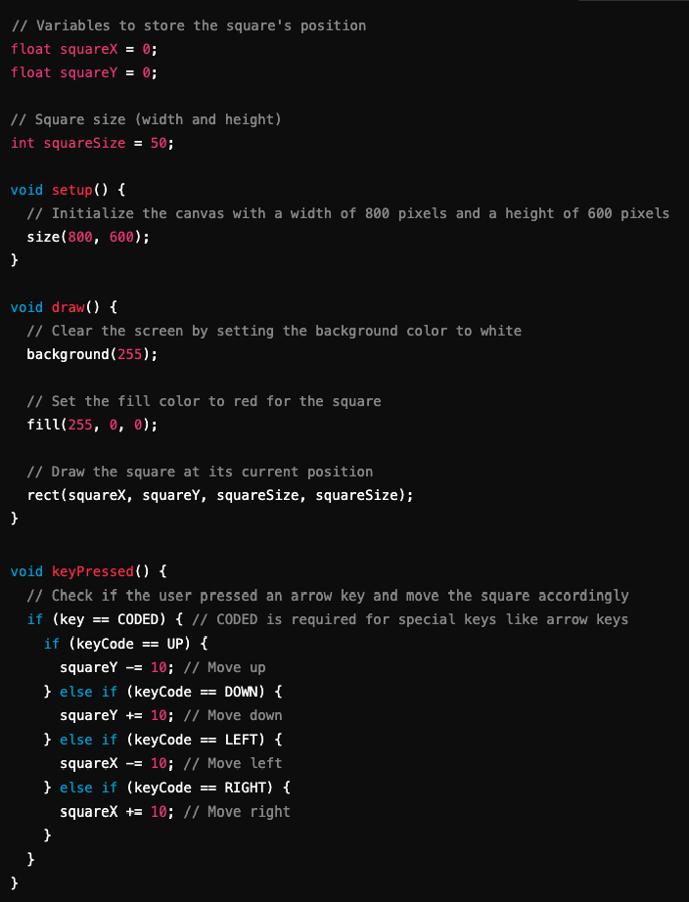
Drawing & Interaction - interactivity
The keyPressed() function detects when a user presses an arrow key, updating a red square’s position to create movement.
Handling mouse and keyboard events allows for dynamic, interactive animations in Processing.
Experimenting with event handlers
enhances interactivity.

Slide 15
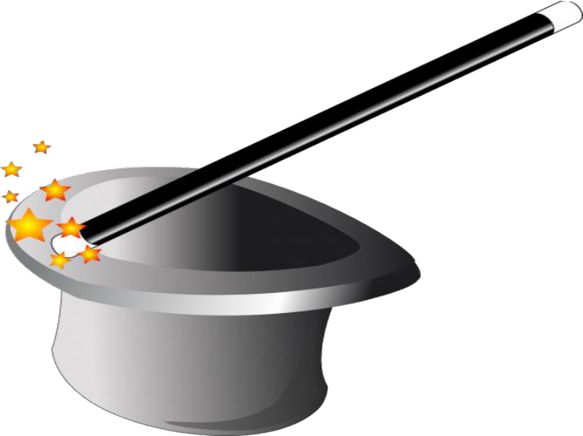
Drawing & Interaction - interactivity
Some Mouse Event Functions in Processing:
mousePressed()
mouseReleased() mouseClicked() mouseMoved() mouseDragged()
mouseWheel(MouseEvent event)
Some Keyboard Event Functions in Processing:
keyPressed() keyReleased() keyTyped()

Slide 16


Drawing & Interaction – about animation
Animation in Processing enables dynamic visuals. Key techniques include:
Easing functions: Smooth transitions by
controlling animation speed.
(Smooth Movement)
Keyframes: Define specific points in time for smooth interpolation.
(Smooth Animation between Points)
Looping & bouncing: Repeat sequences or
add elasticity for lively effects. (Back-and-Forth Motion)
Particle systems: Simulate multiple particles
for effects like smoke or fire.
(Simulating Multiple Particles)
Timeline-based animation: Define property changes over time for complex transitions. (Controlling Multiple Properties Over Time)
These techniques enhance animation complexity
and visual appeal.

Slide 17
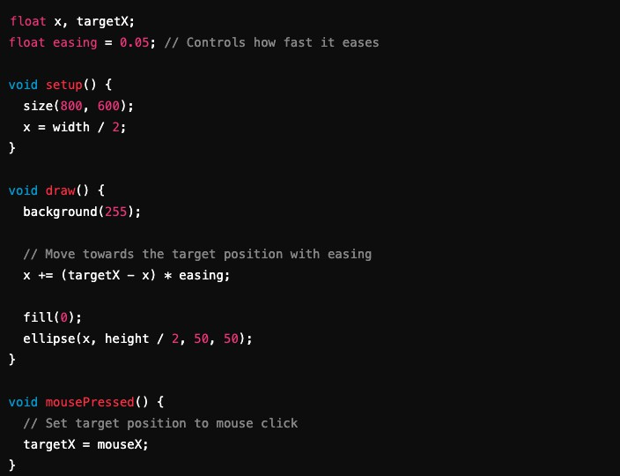
Easing Functions (Smooth Movement)
Drawing & Interaction – some examples

Slide 18
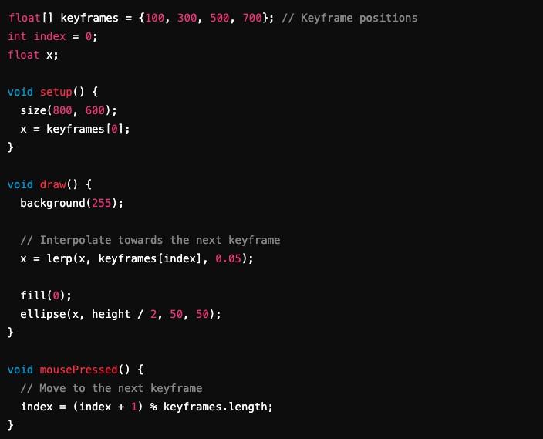
Keyframes
(Smooth Animation between Points)
Drawing & Interaction – some examples

Slide 19
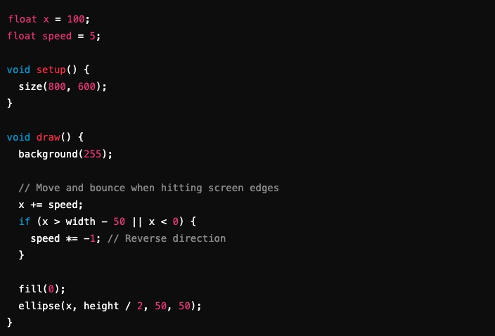
Looping & Bouncing (Back-and-Forth Motion)
Drawing & Interaction – some examples

Slide 20
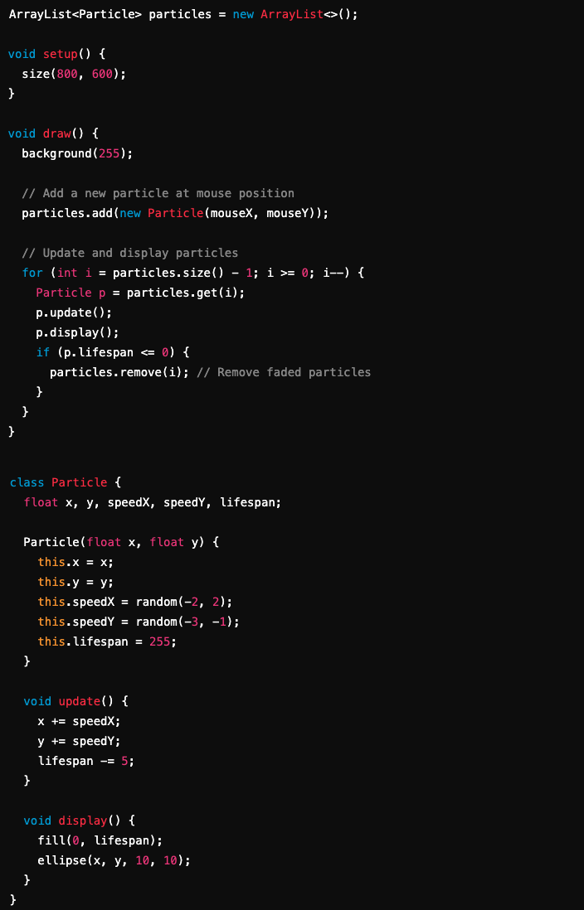
Particle System
(Simulating Multiple Particles)
Drawing & Interaction – some examples

Slide 21
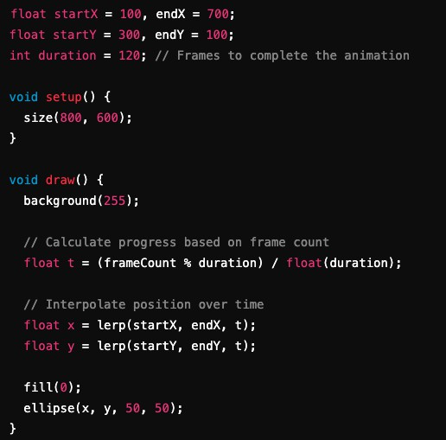
Timeline-Based Animation
(Controlling Multiple Properties Over Time)
Drawing & Interaction – some examples

Slide 22

Break
15 min.!
Please don’t be late!

Slide 23
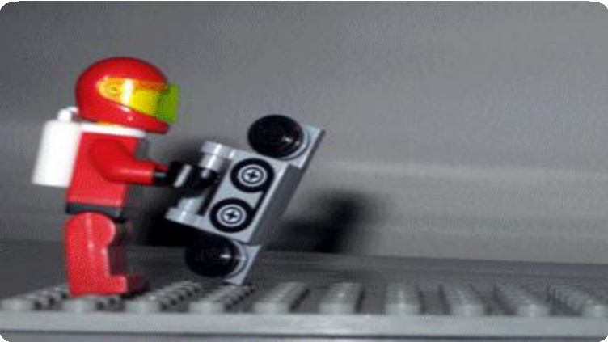
Hands-On Exercise!
Objectives:
Shapes follow the mouse or change colour with mouse position.
Invert movement for second shape, and dynamic background.
Experiment! Try out things!
Get an example from here: https://github.com/ptiagomp/aalto- programming-visual-artists-24- 25/tree/main/Session-02_25022025
(if bored, check for the “extra” files!)

Slide 24

Share your feedback!
Am I going too fast or too slow? Is this too easy or too hard?
Discussion & Q&A
Next week’s topics:
Control Structures (loops, conditionals), Transformations.
Functions, Modular code.
Don’t forget the assignments!

