Slide 1
Question 1
How does the number of inspections change over time (use month as the level of temporal granularity)? Does the number of inspections increase or decrease over time? Are there any peak times? Is there any seasonal effect (like inspections being more common during certain seasons or months)?

Slide 2
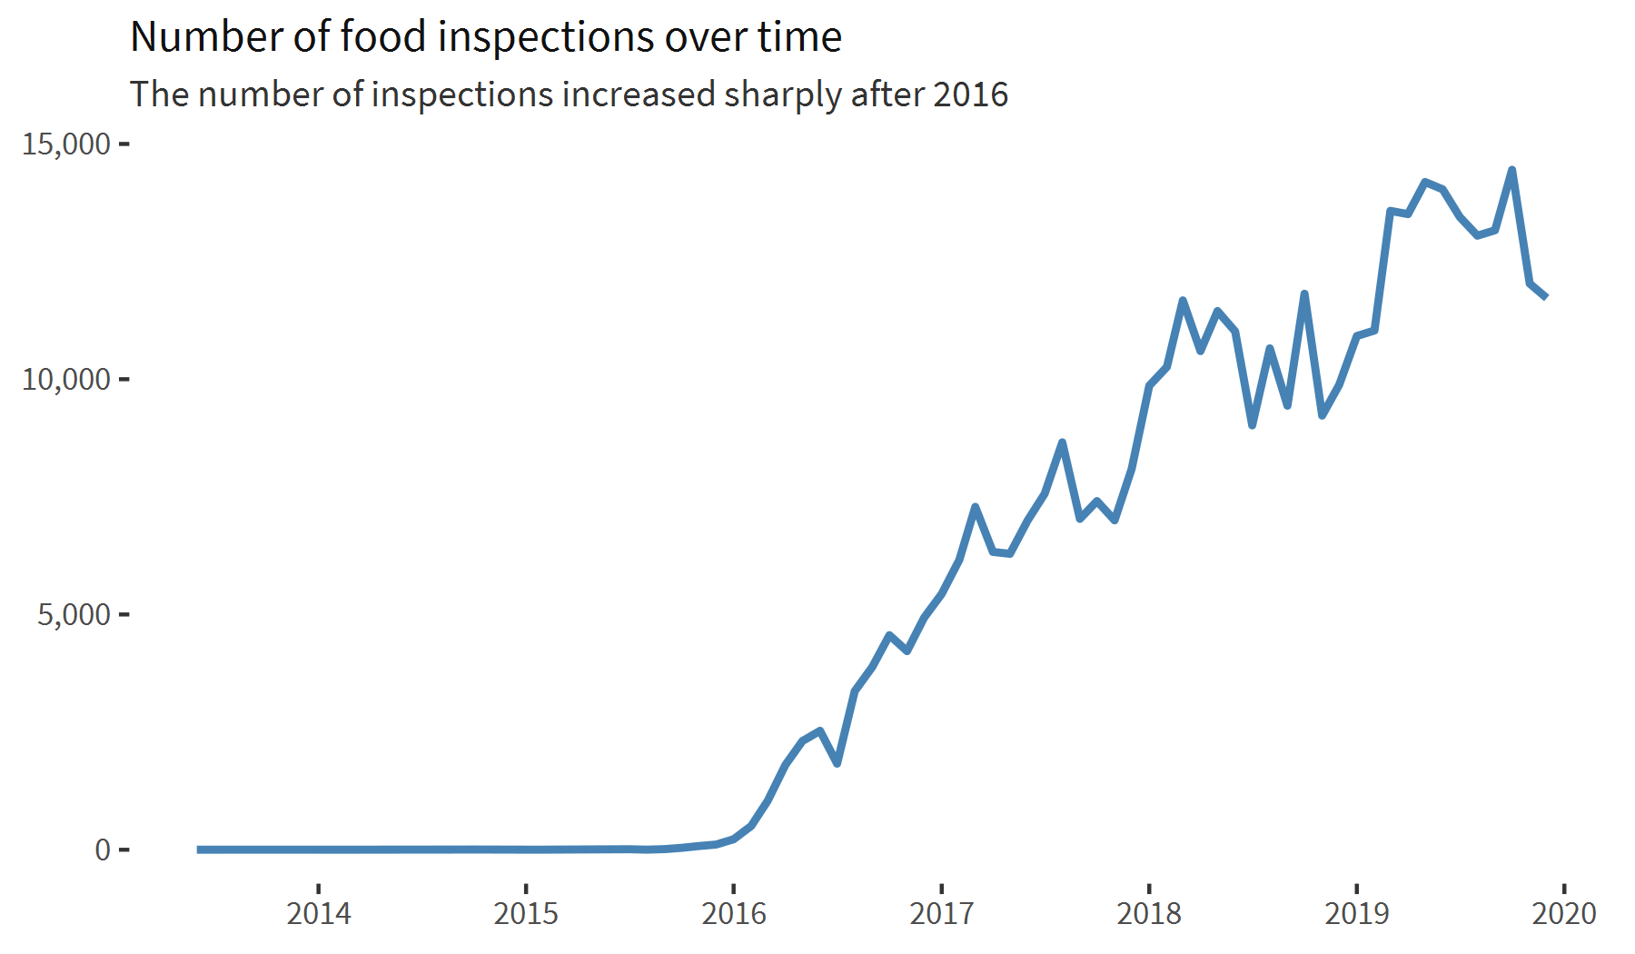

Slide 3
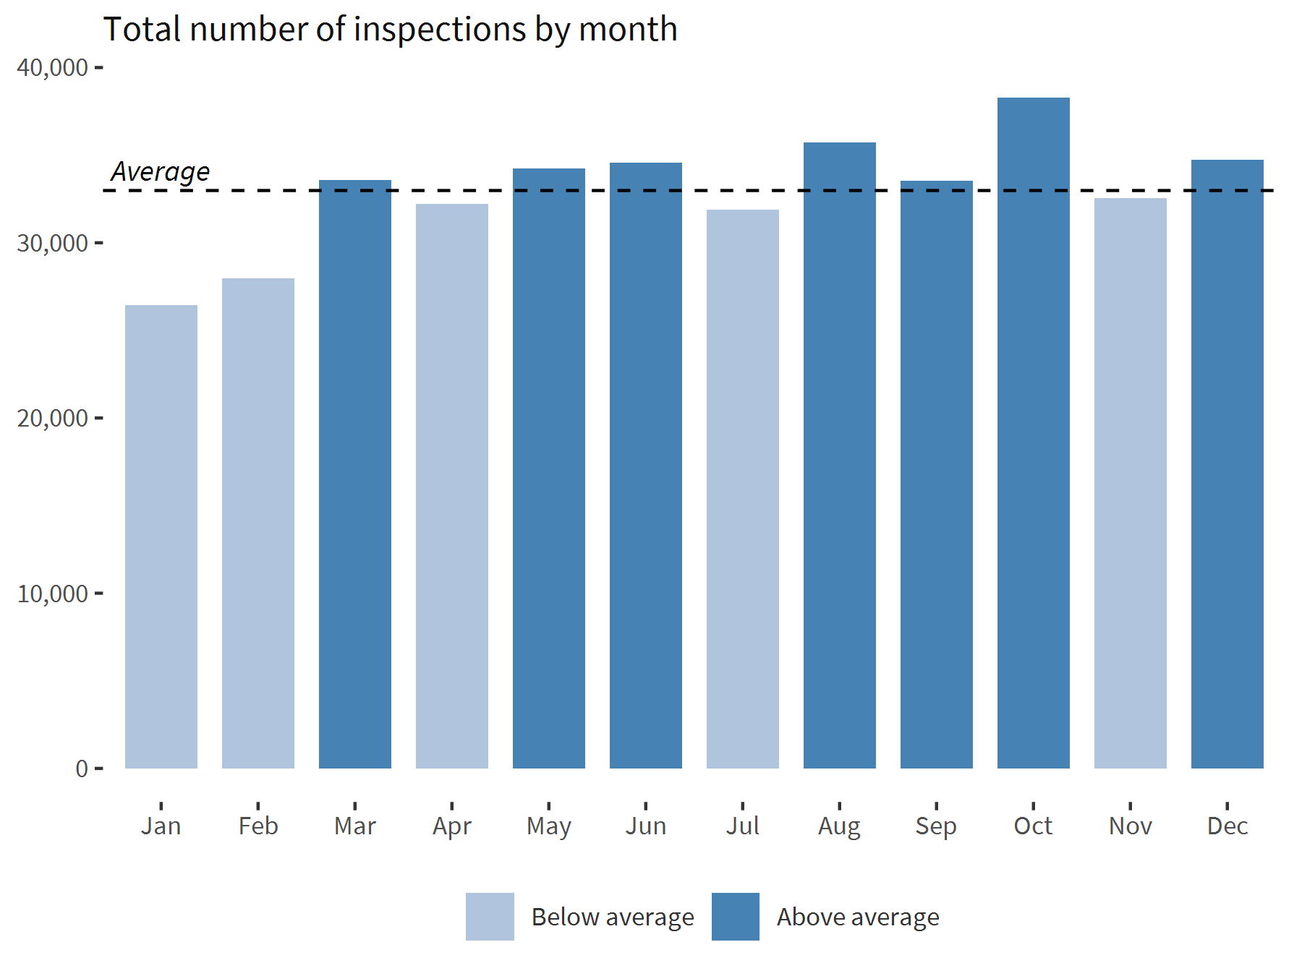

Slide 4
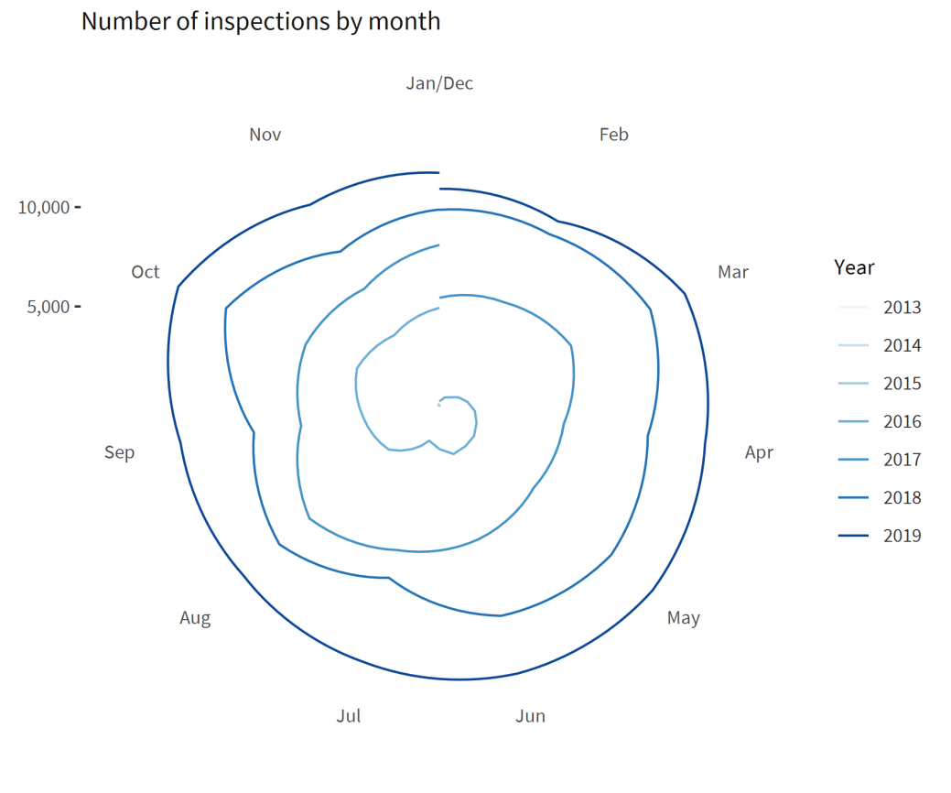
Comments
The line chart shows the number of inspections by month, in a continuous scale. A line chart is very well suited in this case, since it allows us to perceive patterns in time.
To answer the question about seasonal effects, I first transformed the line chart to polar coordinates, since it would probably show any evident recurring pattern along the years:

Slide 5
Comments
But there was no distinctive pattern that would “jump to the eye”, so instead I chose to design a more conventional bar chart, showing the total number of inspections by month, regardless of the year. Additionally, I included a line indicating the monthly average, highlighting the months above this average.

Slide 6
Question 2
Is there any difference in how the number of inspections changes over time in the 5 different boroughs of New York City?

Slide 7
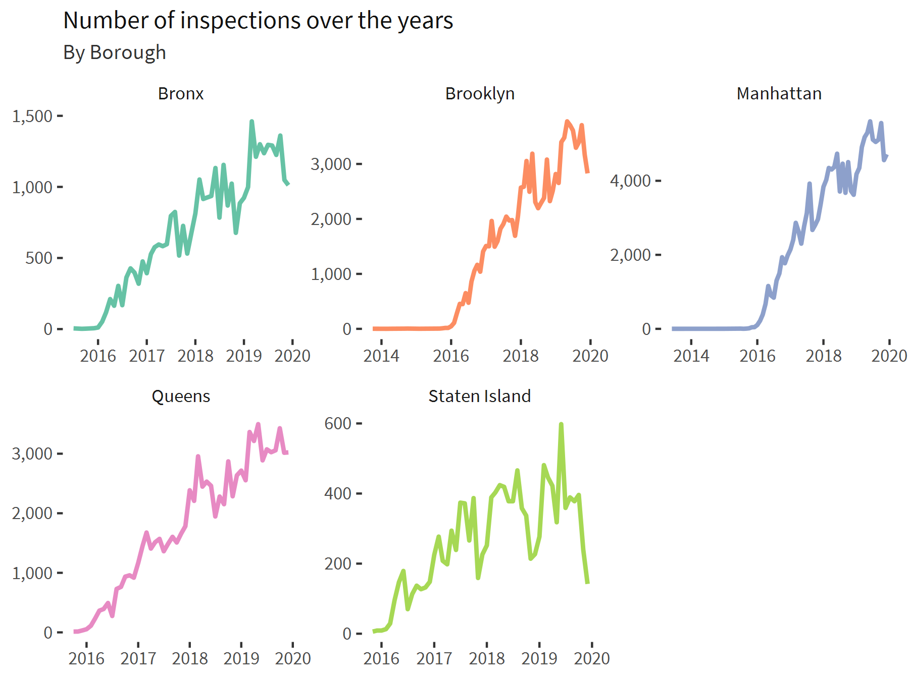

Slide 8
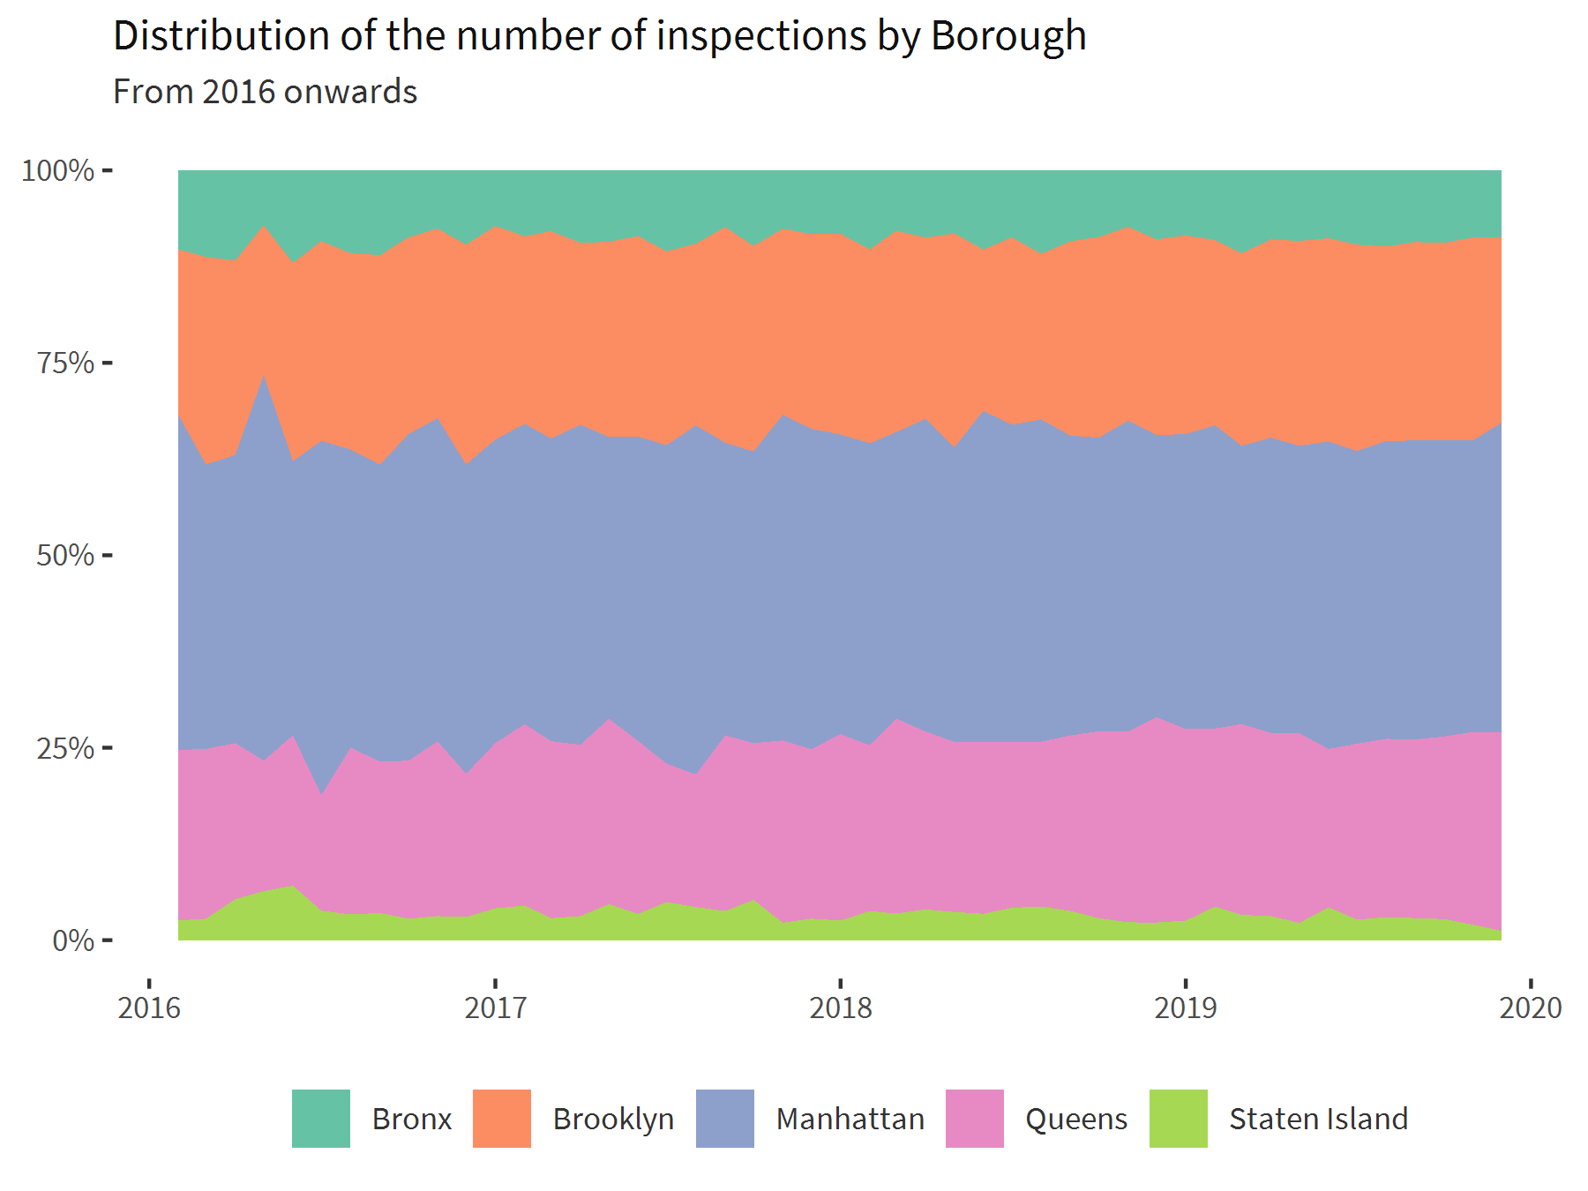

Slide 9
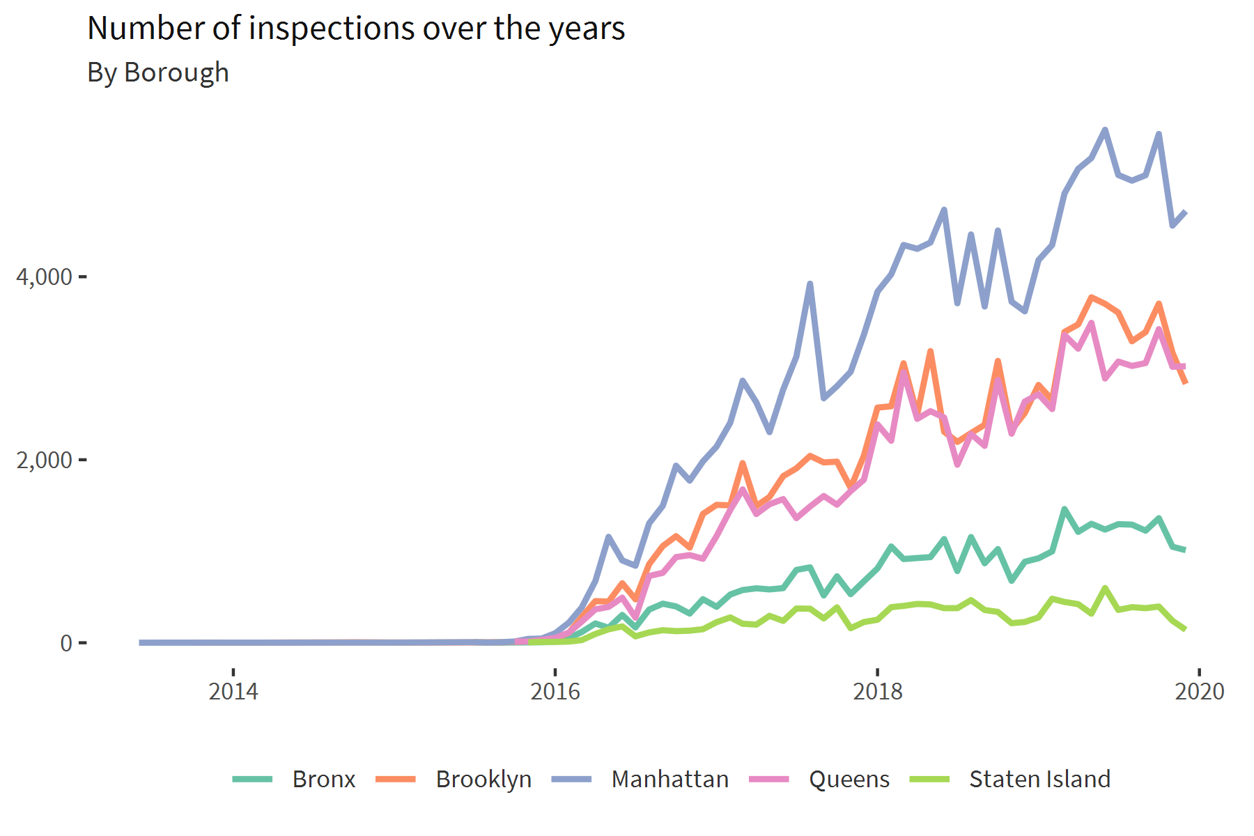
Comments
Here, to show the patterns for each borough, the immediate idea would be to plot a line chart with multiple lines representing the boroughs :

Slide 10
Comments
But I actually in the end chose to use a faceted version of the chart, with free scales, to show that the pattern is very similar for every borough.
To demonstrate this further, I also plotted the distribution of the number of inspections by borough, to show that the percentage of inspections at each borough is more or less stable over the years. I disregarded the years prior to 2016, because the number of inspections in general clearly took off on this year (see chart on the previous slide).

Slide 11
Question 3
How are cuisines types distributed across the New York area? Are there geographical areas where certain cuisines tend to concentrate (that is are there any areas where certain cuisines are more prevalent than others)? NOTE: focus only on the top 5 most frequent “Cuisine Description” categories.

Slide 12
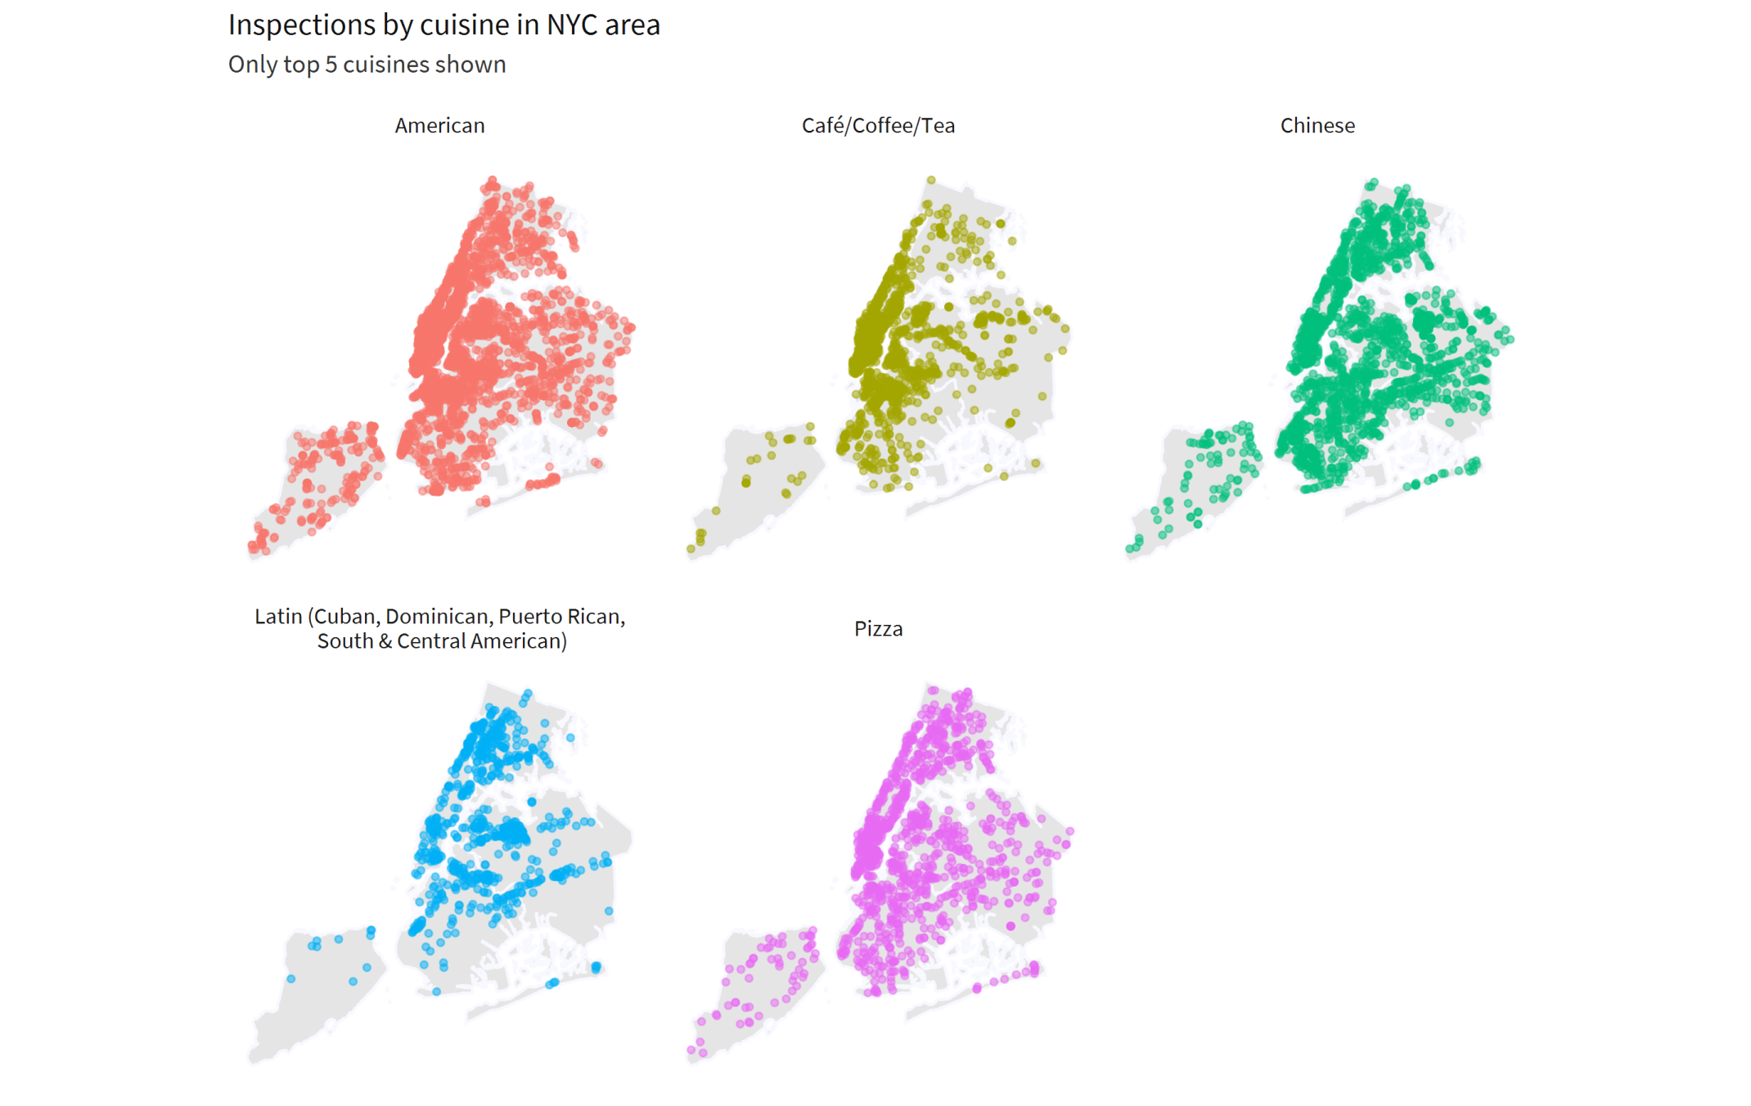

Slide 13
Comments
Again I chose to use a faceted version of the chart, to avoid cluttering.

Slide 14
Question 4
How does the average score compare across different cuisine types? Are there cuisines that tend to have consistently lower/higher average scores compared to the others? NOTE: focus only on the top 5 most frequent “Cuisine Description” categories.

Slide 15
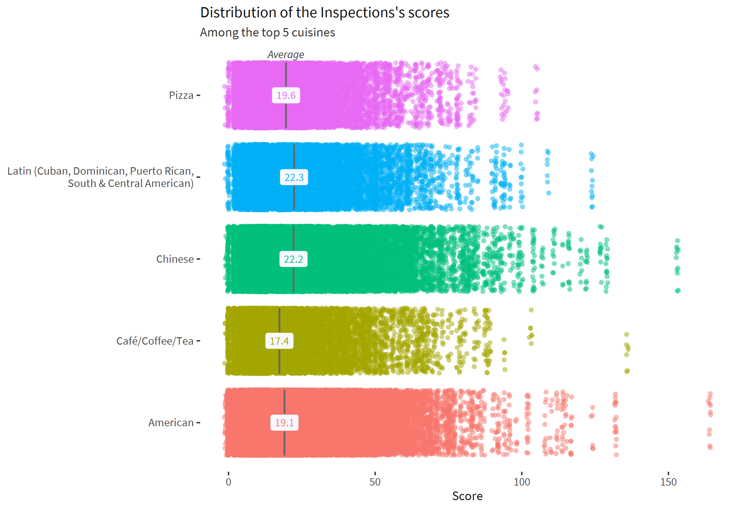

Slide 16
Comments
Instead of simply plotting the average scores by cuisines, I chose to also show the full distribution of the scores, since averages are sensitive to extreme values.

Slide 17
Question 5
Is there a relationship between cuisine type and violation? For instance, do some cuisine types tend to have more of some type of violations that other cuisine types?

Slide 18
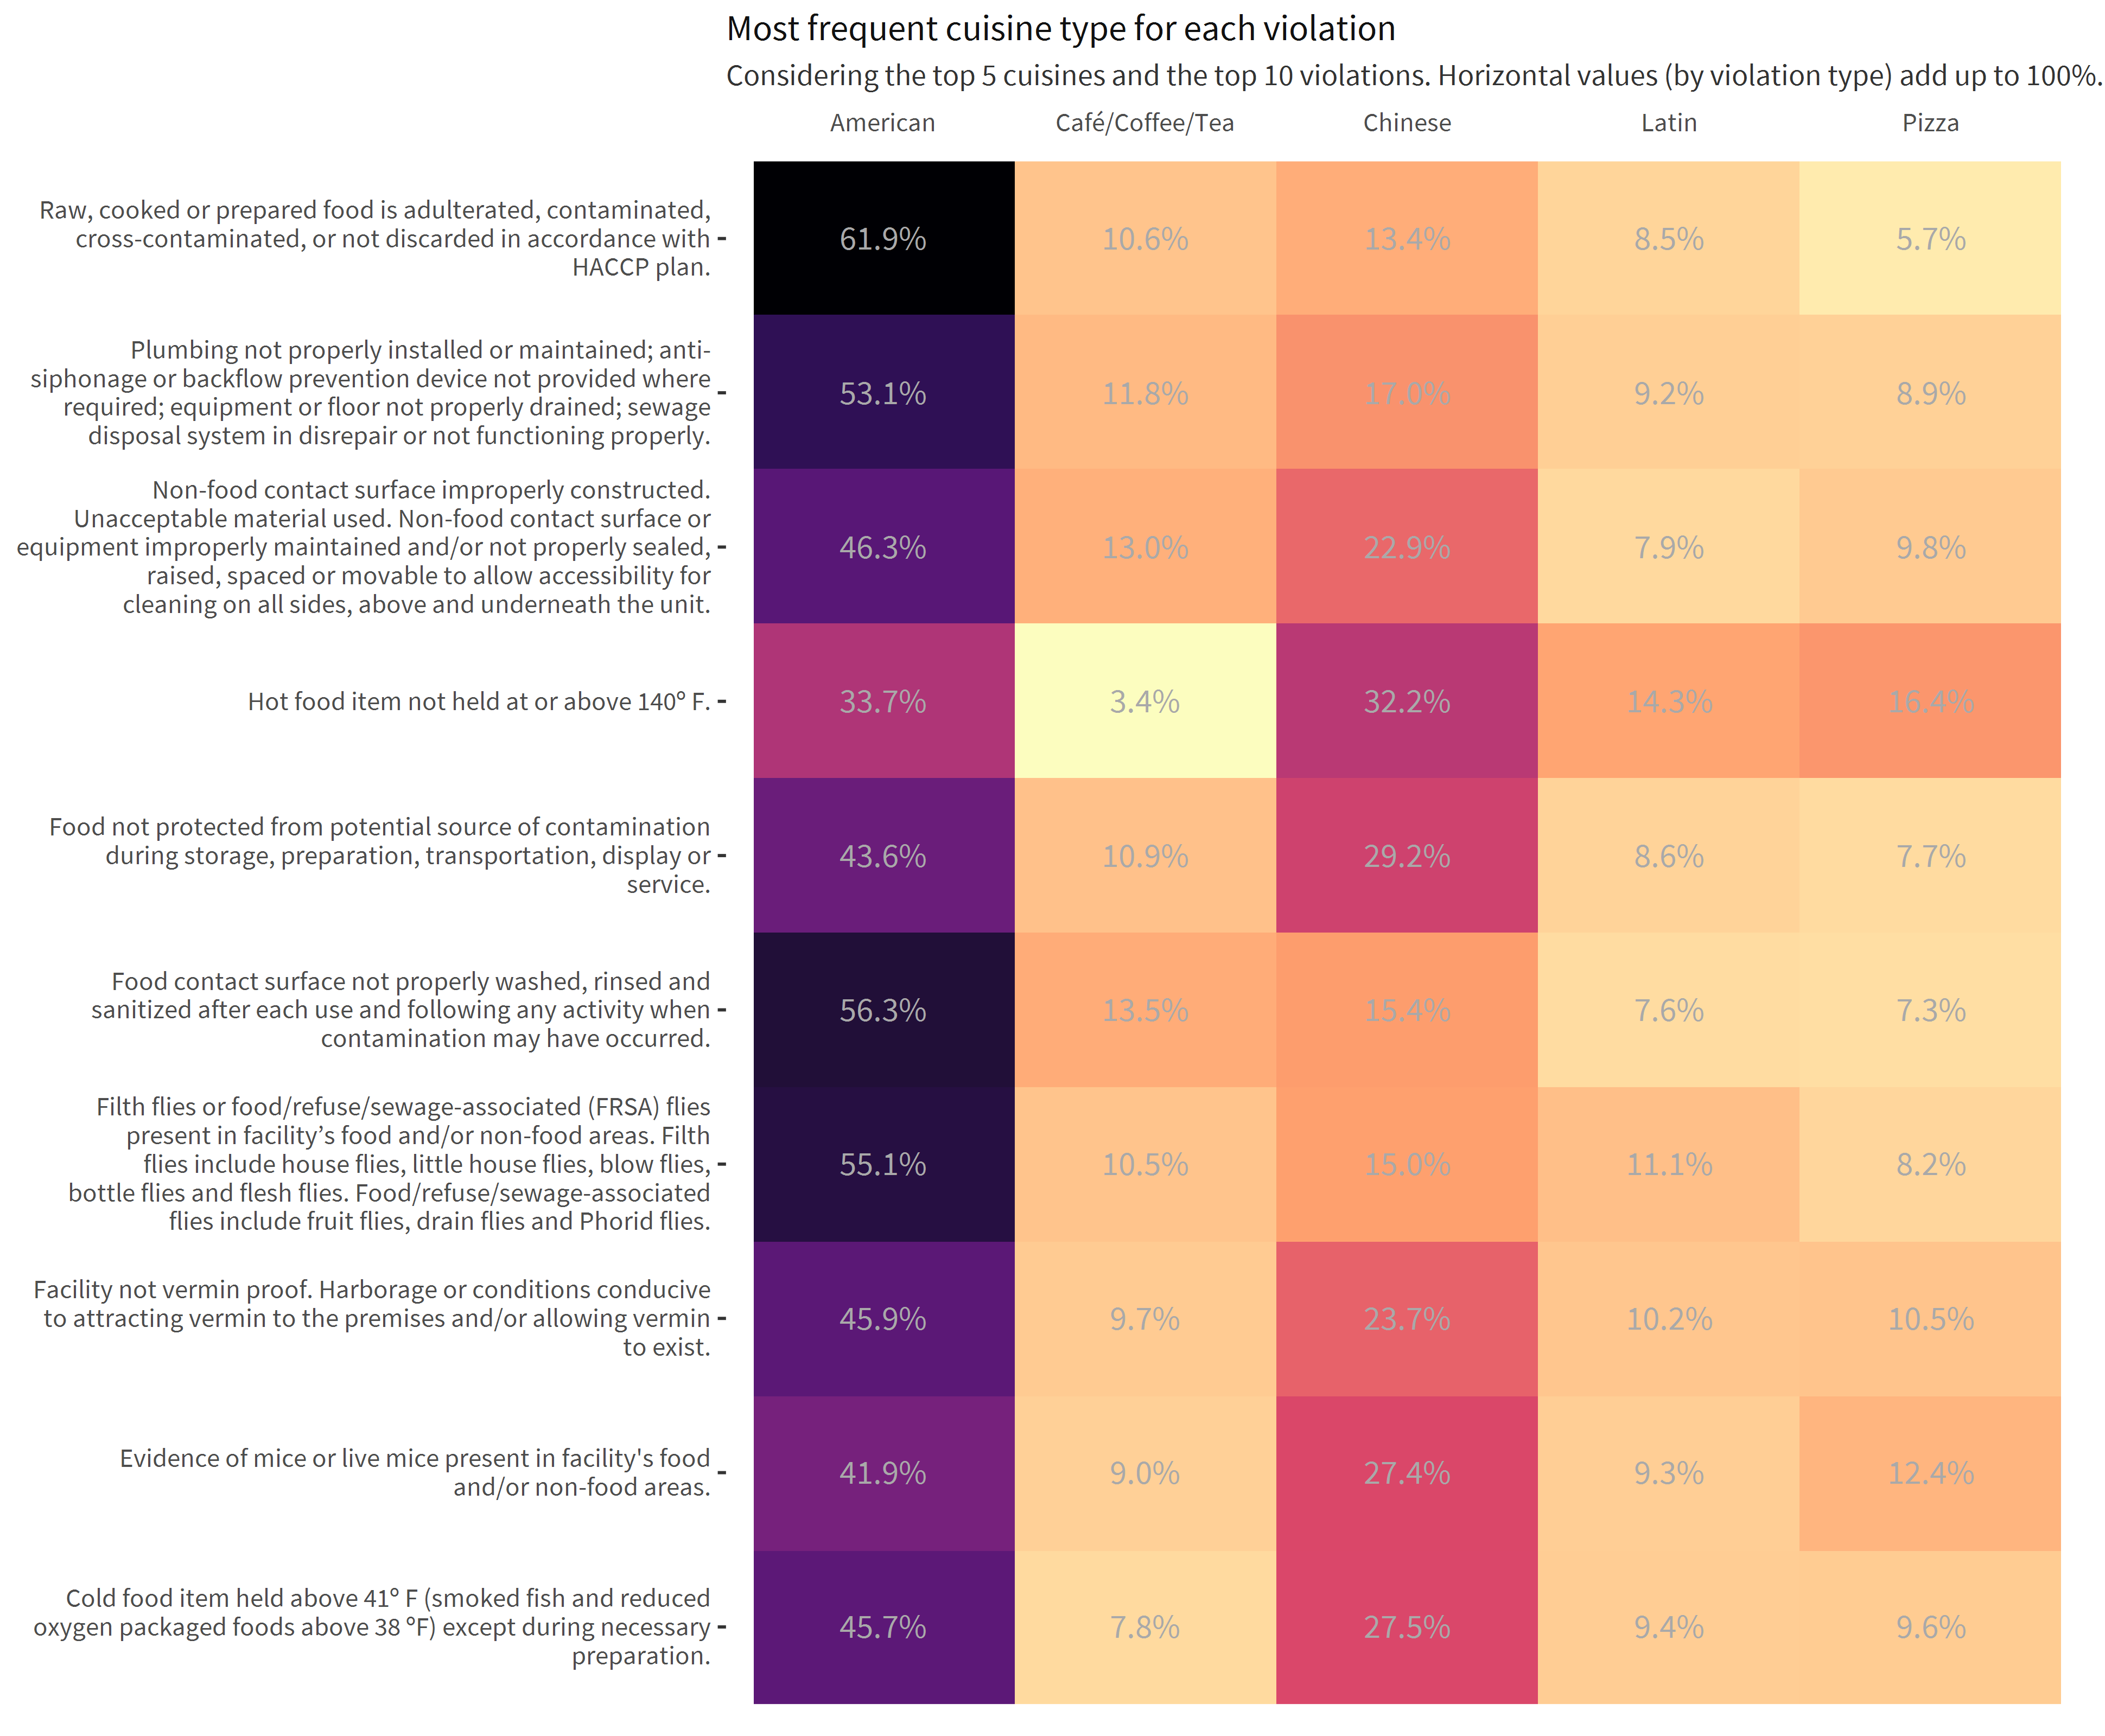

Slide 19
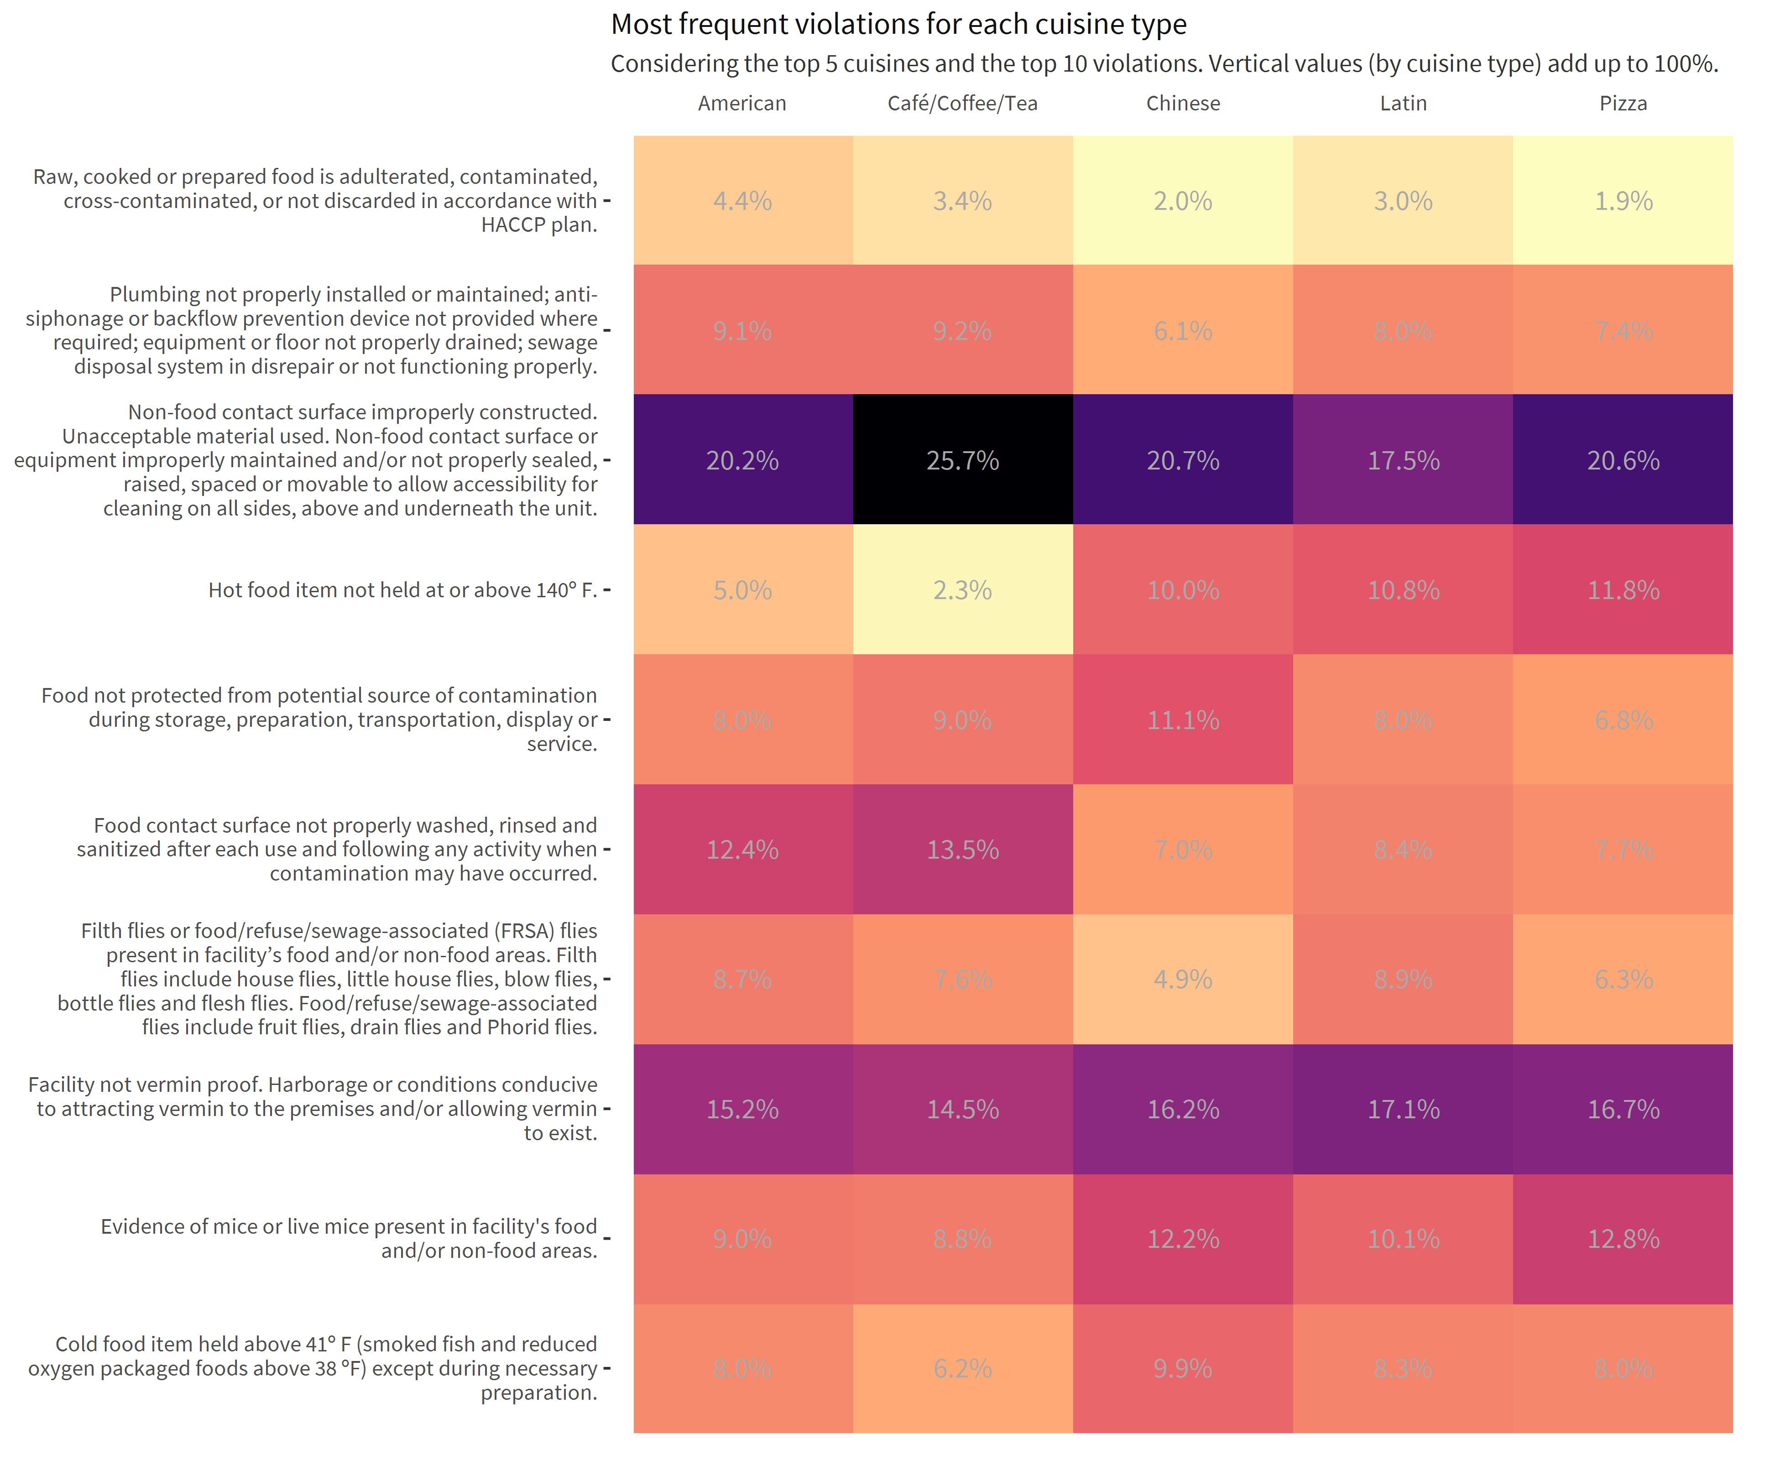

Slide 20
Comments
Here, I first plotted, for each infraction, the cuisine types that incurred in more infractions. But since “American” cuisine is the most prevalent cuisine in the dataset, the plot would be somewhat unbiased.
To fix that, I decided to plot a chart showing the most frequent violation for each cuisine type. The difference is subtle, but the resulting plot is very different from the first one (and more interesting).

