Slide 1
My name is Tiago.

Slide 2
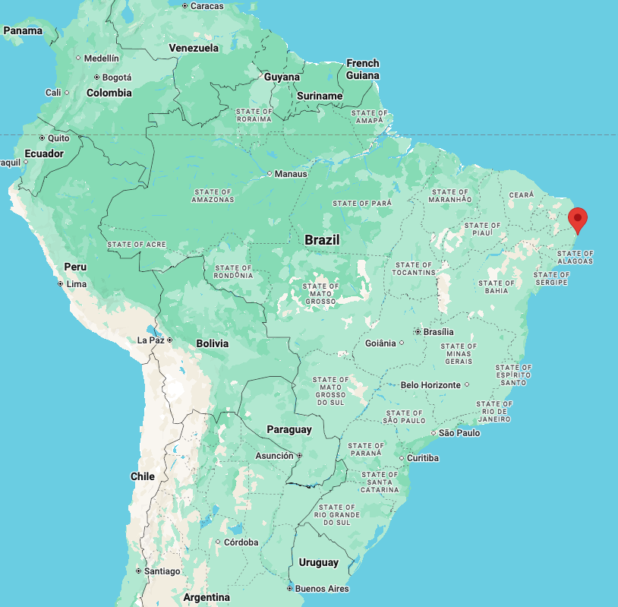
I was born here.

Slide 3
But I grew up here.

Slide 4
Recife, PE
Imbituba, SC

Slide 5
Did basic and intermediate English there, during
many years.
Imbituba, SC

Slide 6
Did basic and intermediate English there, during
many years.
Then we received a German exchange student, who stayed with us for one year.
Imbituba, SC

Slide 7
Impact on my English skills
Did basic and intermediate English there, during
many years.
Then we received a German exchange student, who stayed with us for one year.
<<
Imbituba, SC

Slide 8
At some point I went back here. High school and university (Electronics Engineering).

Slide 9
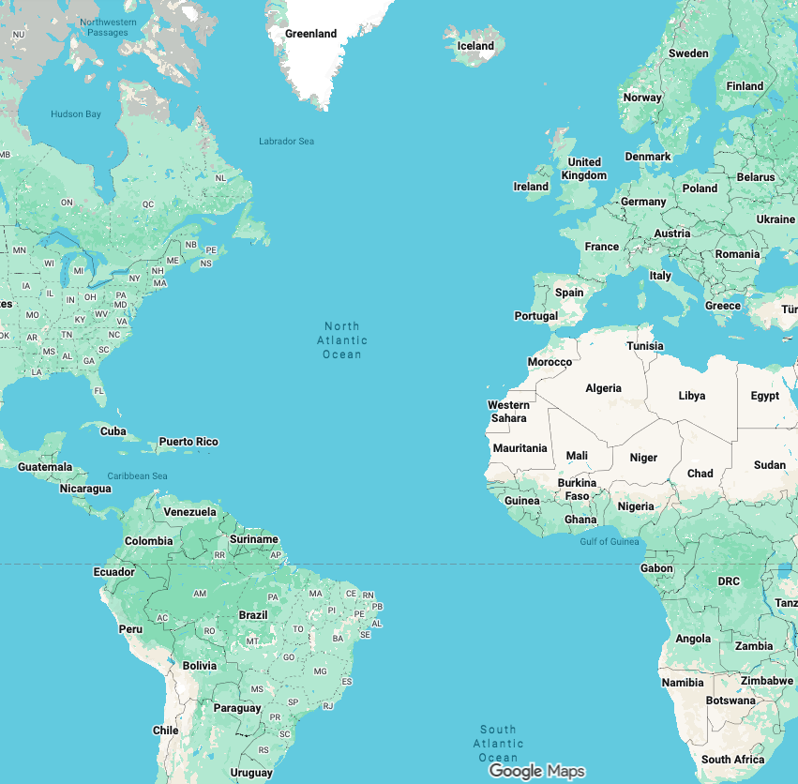
And then I got a scholarship and went to France, for an exchange year.

Slide 10
And then I got a scholarship and went to France, for an exchange year.
(not much English here. But it helped to make many American friends – and a girlfriend)

Slide 11
Came back to finish my University degree…
But then, before graduation…

Slide 12
I went to Germany to do one two internships.

Slide 13
I went to Germany to do one two internships.
(English helped me a lot here, I actually didn’t speak any German)

Slide 14
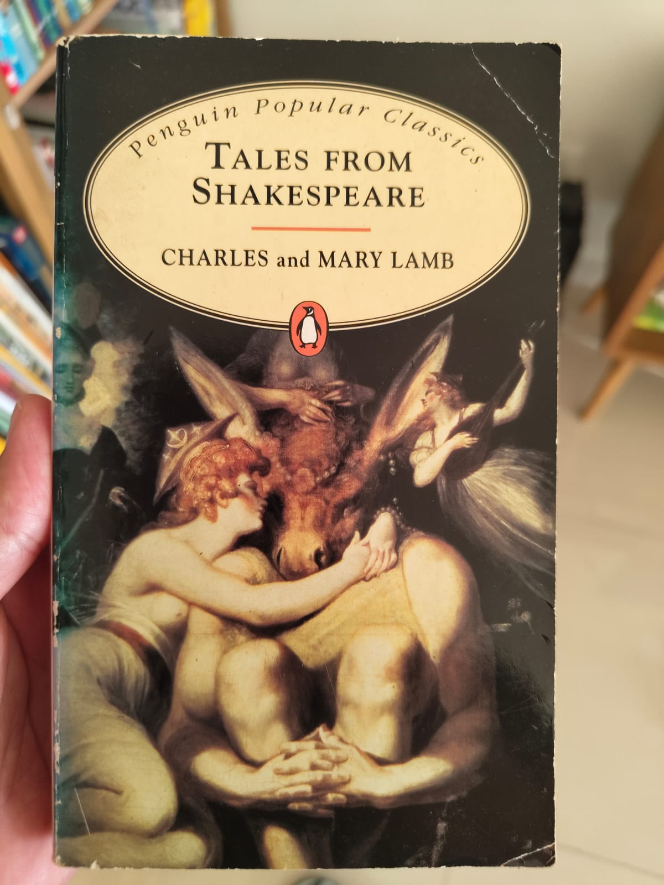
I went to Germany for one two internships.
(English helped me a lot here, I actually didn’t speak any German)

Slide 15
Came back to Brazil, moved to Brasilia, started working for the government.
Having a good command of English opened many doors for me (interaction with foreign officials, international organizations such as The World Bank, OECD etc.).

Slide 16
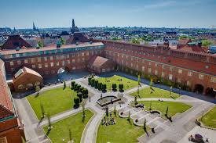
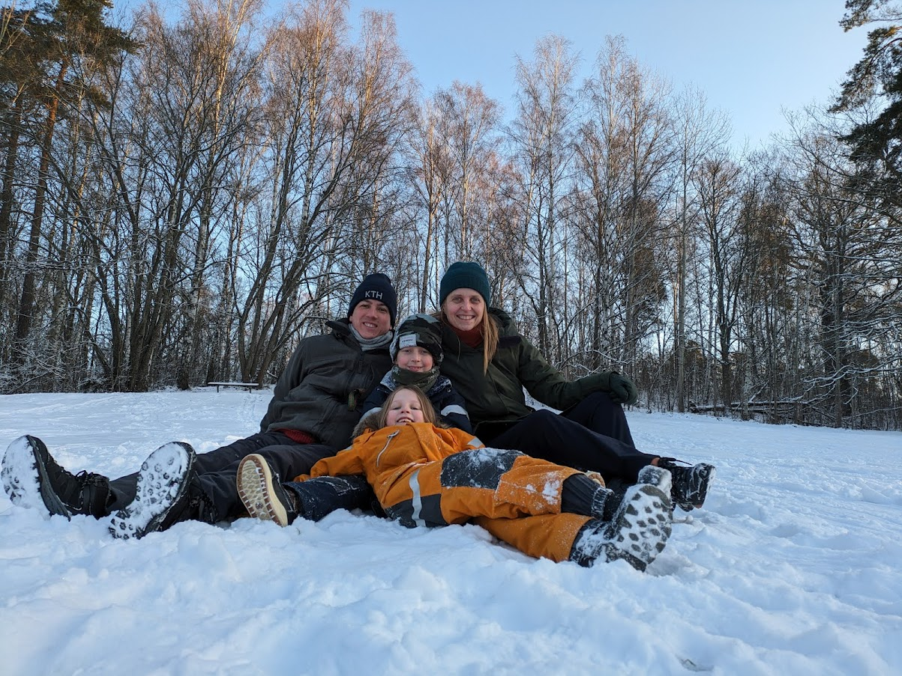

And then, two decades later… I went to Sweden for a Master’s Degree in Interactive Media Technology, at the Royal Institute of Technology.

Slide 17
When it comes to living abroad, even when things go wrong, it’s almost always still a great experience.

Slide 18
