Slide 1
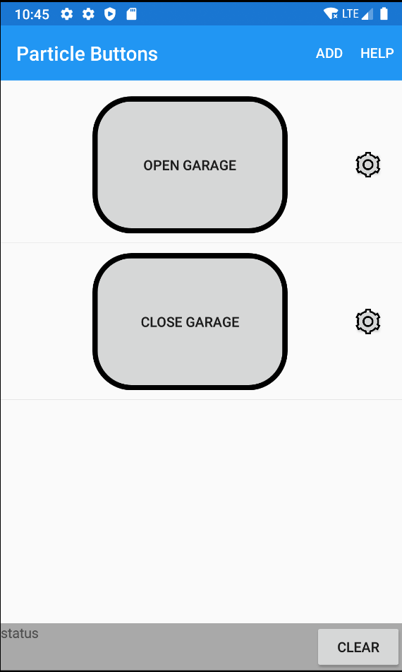
Go to help web page
Add a new button
Open the settings of the button
Execute the particle.io function
Log messages will show up here
Clear the status log

Slide 2
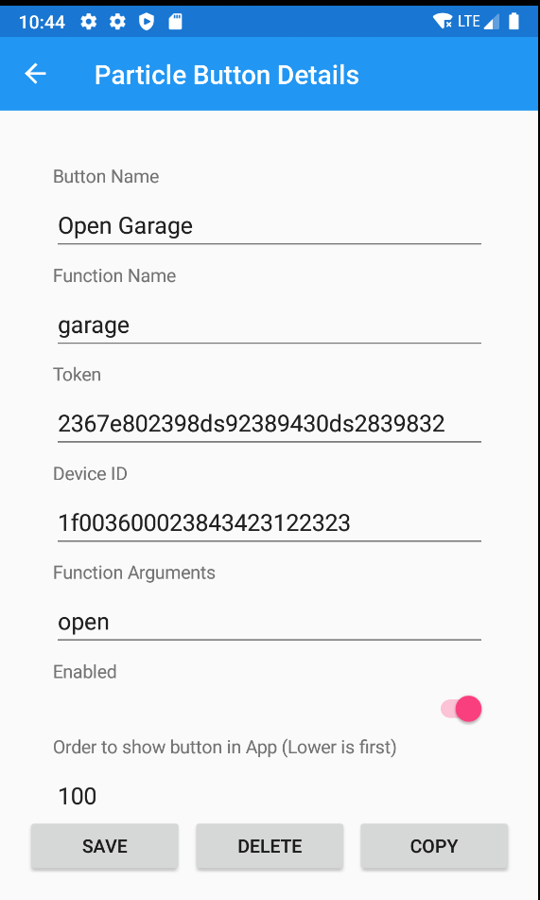
Go to help web page
Add a new button
Open the settings of the button
Execute the particle.io function
Log messages will show up here
Clear the status log

