Slide 1




Slide 2


Slide 3
pass

Slide 4
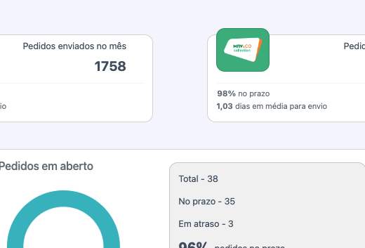

pass

