Slide 1

Data Thieves Project
Álvaro Grácio
Ricardo Mendes
Tiago Rebelo
Notes:
RICARDO
Major content creation companies use YouTube APIs to monitor their channels, improve their marketing strategy, adjust their content strategy and maximize their channel’s reach. That’s why this is a good use case for data analytics.

Slide 2

Dataset & Enrichment
Methods
Dataset: Trending YouTube Video Statistics (https://www.kaggle.com/datasets/datasnaek/youtube-new)
Enrichment:
Included data from the current day
Included data from the following (totally random) regions:
Portugal, Brazil, Spain, Kenya and Nepal
API requests:
Obtain category IDs per region (https://www.googleapis.com/youtube/v3/videoCategories)
Obtain data about trending videos per region (https://www.googleapis.com/youtube/v3/videos)
Notes:
RICARDO
The YouTube API provides a wide range of data: Video Metadata, Channel Metadata, Search Results (simulate a search), Video Comments, Channel Analytics, Playlists, Live Streaming, Subscriptions
Due to problem with the encoding of greek letters, we were not able to add Greece as a region

Slide 3
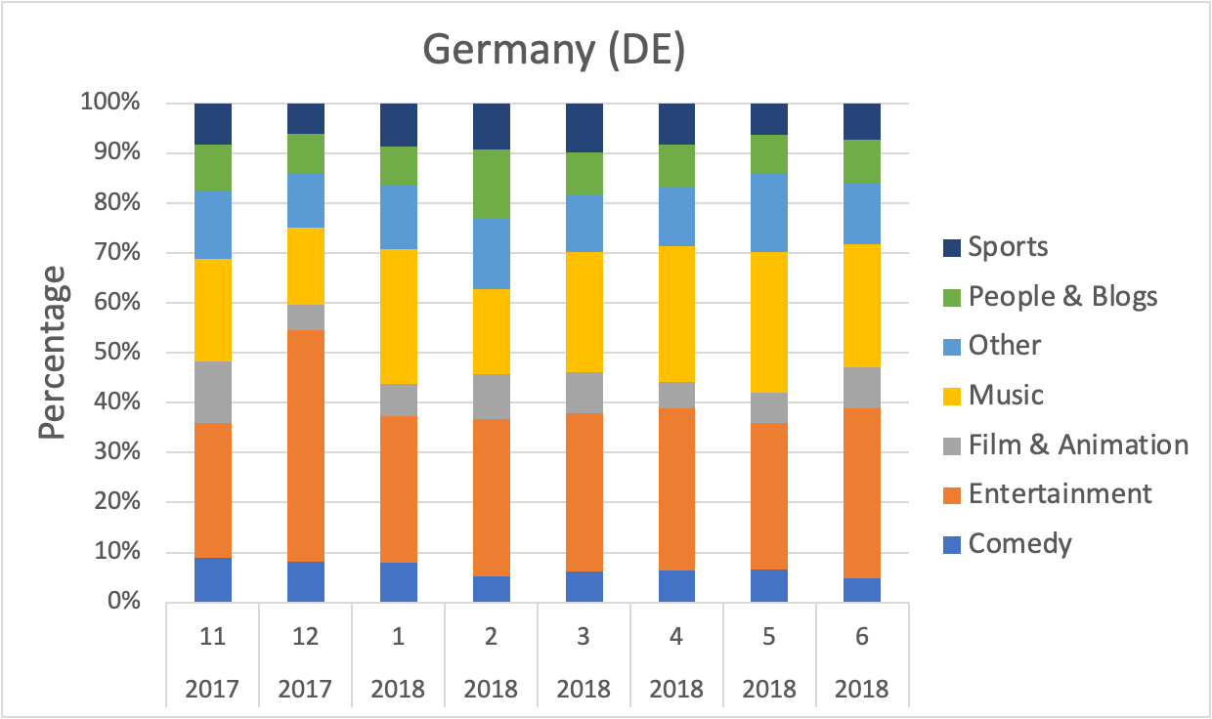
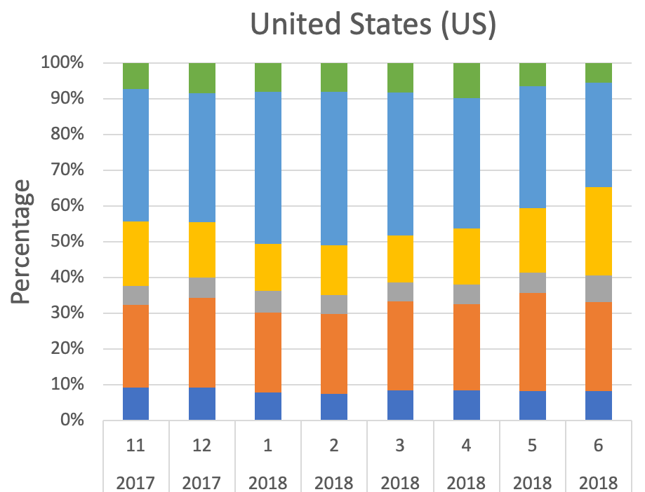
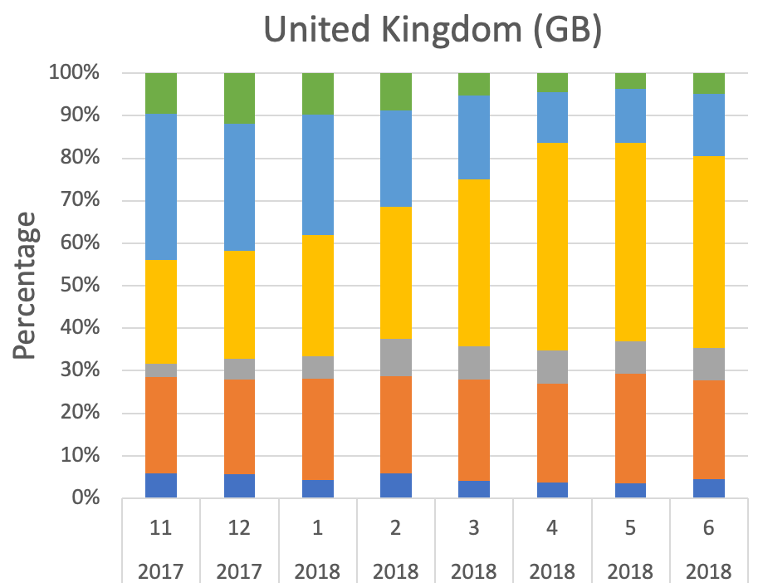
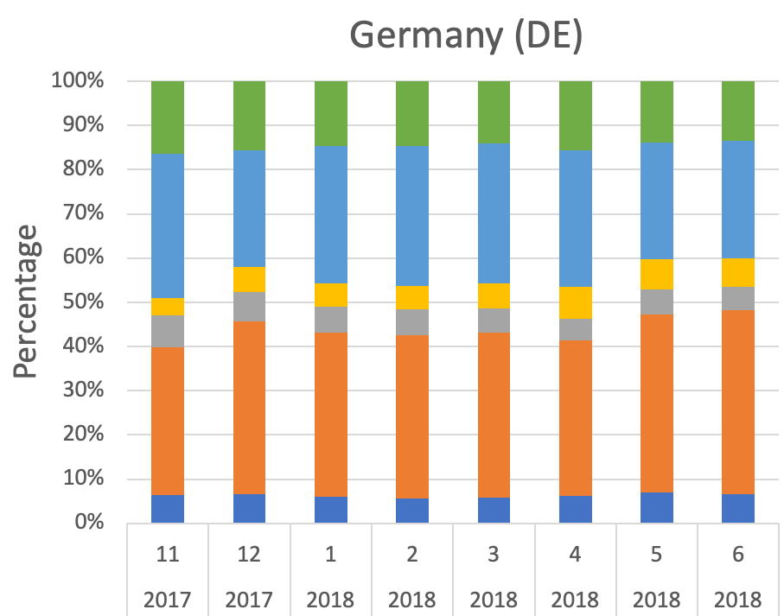
Trending categories over time
US, GB, DE regions
US: Other categories are the majority
UK: Music is the majority (increased over time)
DE: Entertainment is the majority
Notes:
TIAGO
From Nov 2017 to Jun 2018

Slide 4
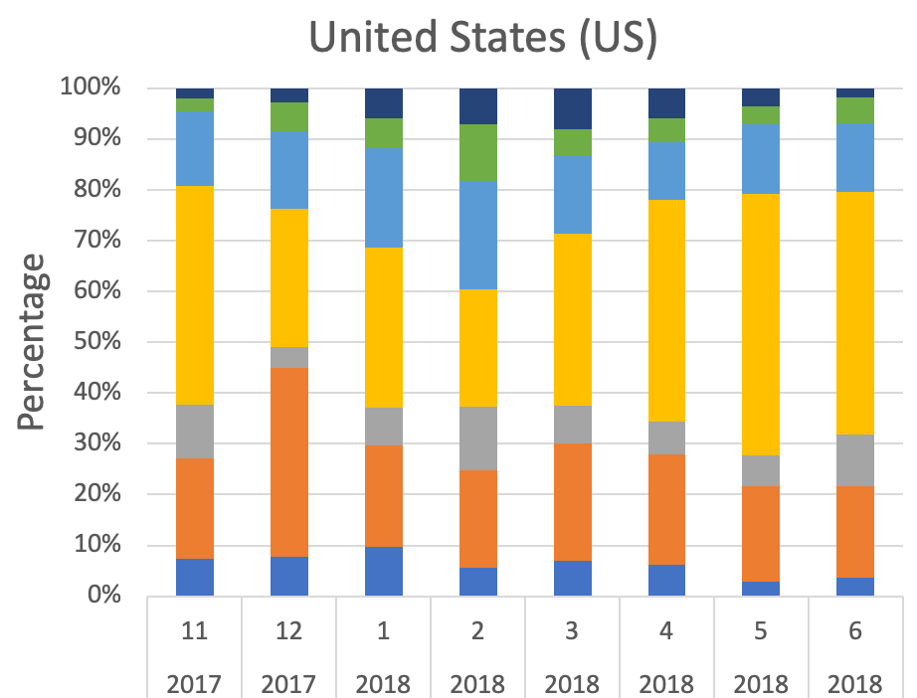
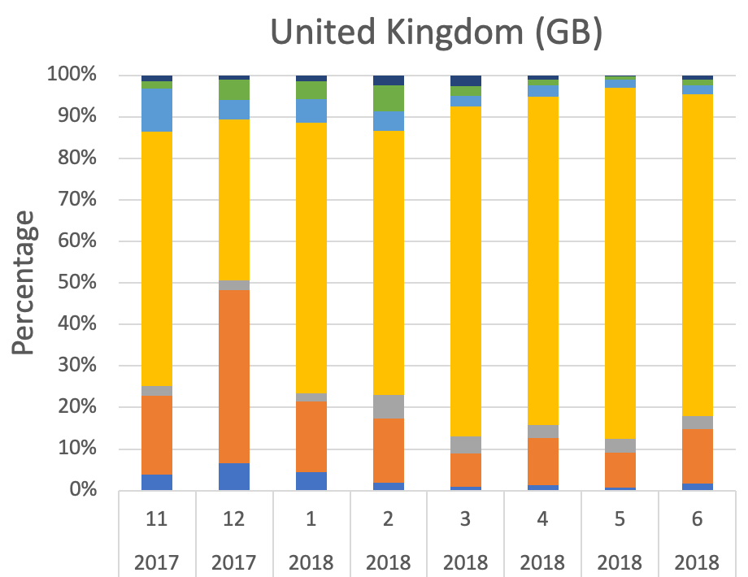
Views over time, per category
US, GB, DE regions
Music videos have a higher percentage of views
Sports videos make a (minor) appearance
Other categories, even though trending, have less views
Notes:
TIAGO

Slide 5
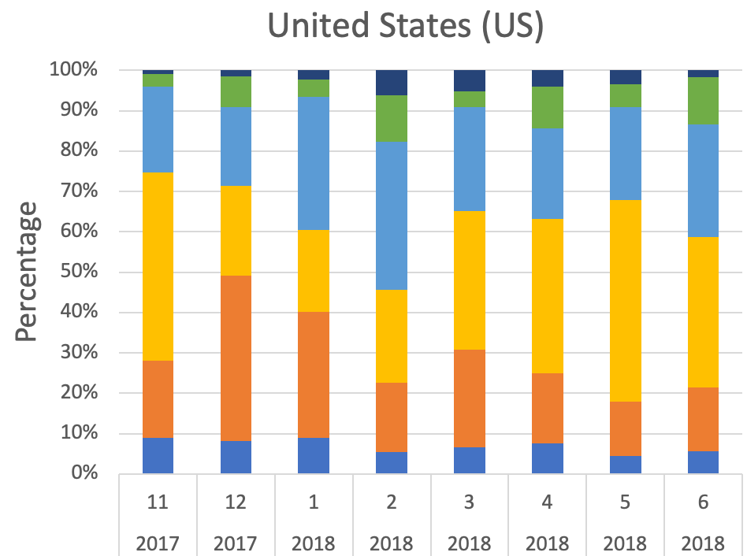
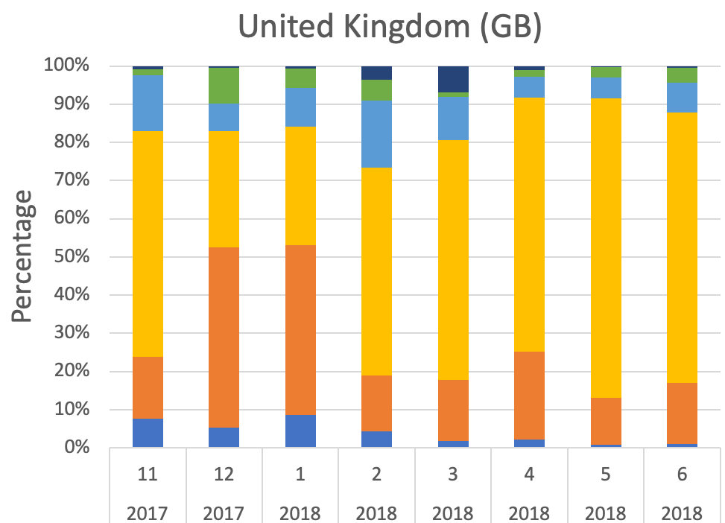
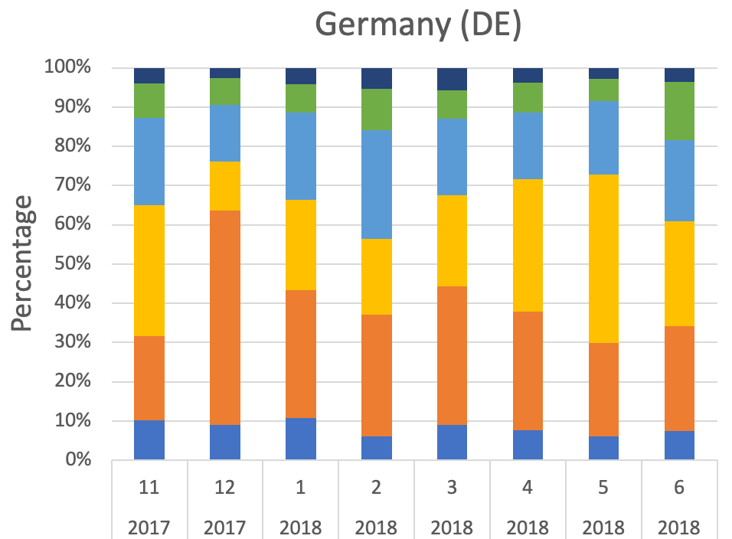
Comments over time, per category
US, GB, DE regions
Similar to views over time, per category
Film & Animation category disappears
Notes:
TIAGO
Comments show engagement

Slide 6
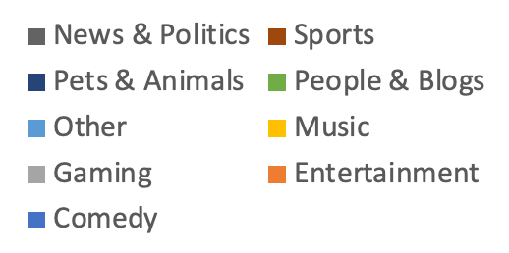
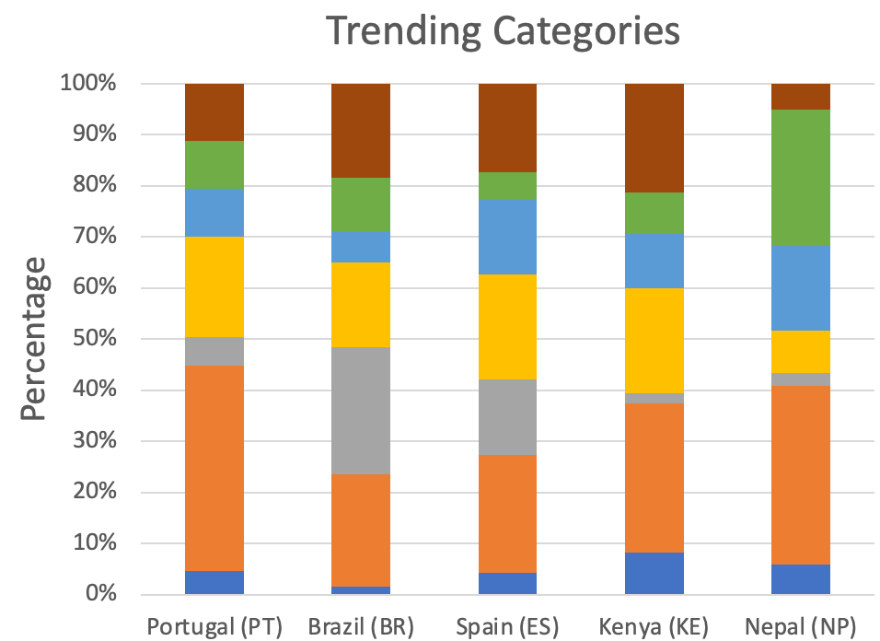
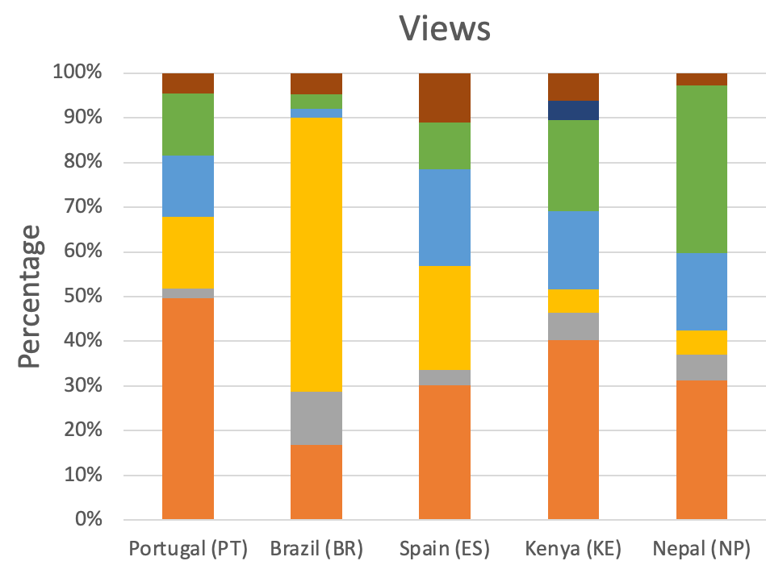
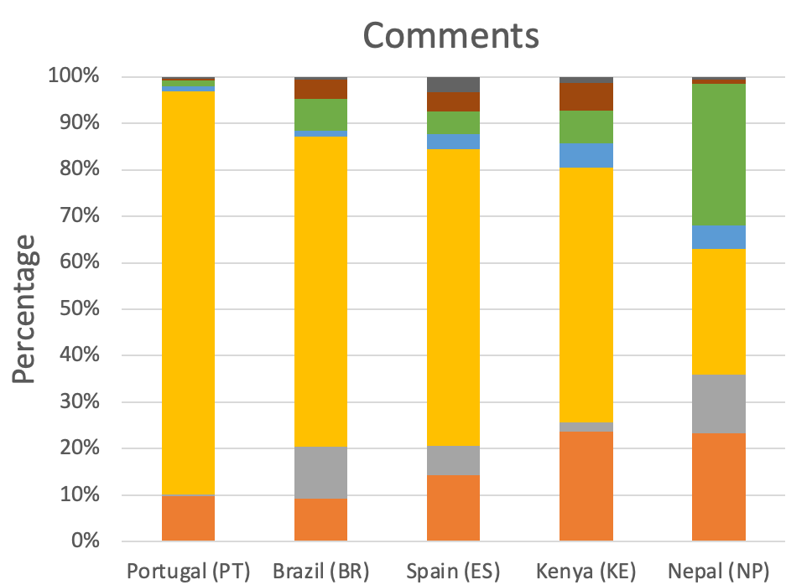
Daily analysis of trending videos
Categories, views and comments
Categories: Gaming in Brazil, People & Blogs in Nepal
Views: Music in Brazil, Pets & Animals in Kenya
Comments: Music in every region, News & Politics appears
Notes:
ÁLVARO
Categories: Entertainment everywhere, gaming in Brazil, Sport and Entertainment in Kenya, People & Blogs in Nepal, PT similar to Spain
Views: Music in Brazil, Comedy disappeared, Pets & Animals in Kenya
Comments: Music everywhere, News & Politics has a minor appearance
We would need more days to draw a conclusion

Slide 7
Applicability and Future Perspectives
Gain valuable insights into user behaviour, content trends and engagement
Optimize a YouTube channel or create more effective video content
Examples: AHREFS and TubeBuddy
For the future:
Analysis over time (extract data daily)
Further analysis of the obtained data (e.g. sentiment analysis of comments)
In depth exploration of the API to expand our analysis (extract more parameters)
Notes:
ÁLVARO
There are companies that manage, optimize and grow our channel through this data
Dislike button!
Trending for how many days?
Are viewers subscribed?
Are the videos in playlists?

