Slide 1
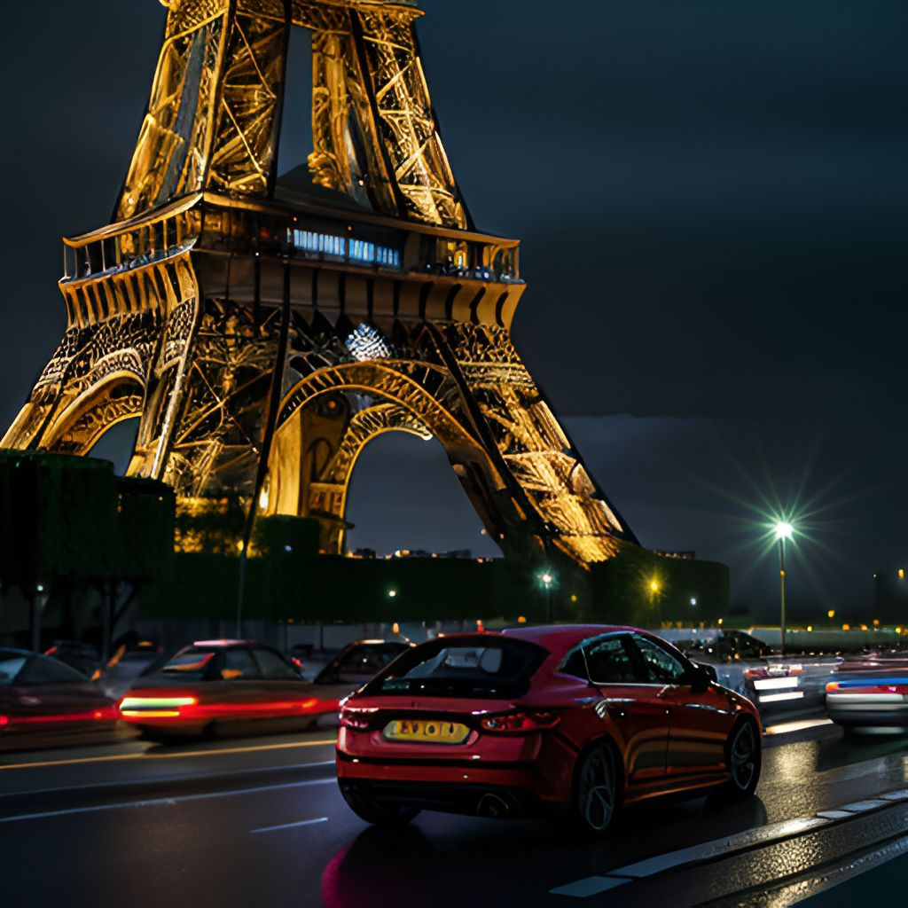
Car Accidents in France A Data Science Project of Tiago Russomanno Tobias Schulze Johanna Starkl
Here is where your presentation begins

Slide 2
ABOUT THE PROJECT
01
DATA
02
TABLE OF CONTENTS
DATA PROCESSING
03
MODELLING
04
CRITICAL VIEW & PERSPECTIVES
05
Problem & Stakes
Description & DataViz
From Raw Data to Prepared Data
Summary

Slide 3
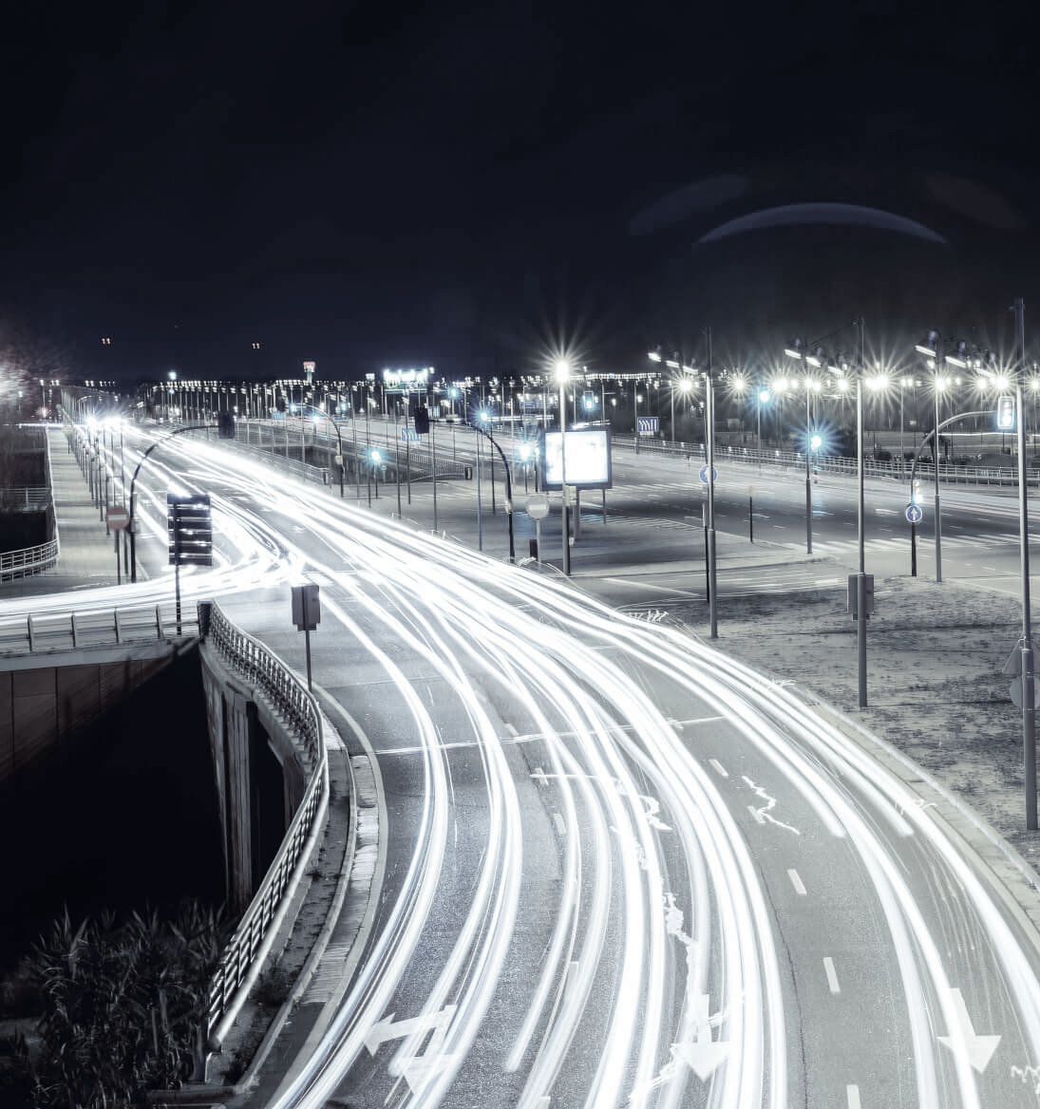
ABOUT THE PROJECT
PROBLEM AND STAKES

Slide 4
VEHICLES
USERS
DATA
CHARACTERTISTICS
PLACES
1121571 x 15
WHICH type of vehicle & engine
2509620 x 15
WHO was involved
WHAT happened WHERE
WHICH security equipment
1121571 x 15
WHEN does it happen
WHERE and under
WHICH conditions does it happen
1121571 x 18
ROAD Types & Conditions

Slide 5
DATA EXPLORATION & DataViz
IN STREAMLIT

Slide 6
DATA PROCESSING
STAGE 2
STAGE 4
Pre-Processing &
Feature Engineering
DataViz
MODELLING
STAGE 1
STAGE 3
STAGE 5
Import of Raw Data
Fix data issues
Merge Data
Correlation Analysis
First Run of XGBoost and Random Forest with grav

Slide 7
OUR MODELS
IN STREAMLIT

Slide 8

THANKS
Merry Christmas and a Happy New Year

