Slide 1
Ion Markers searching using Machine Learning

Slide 2
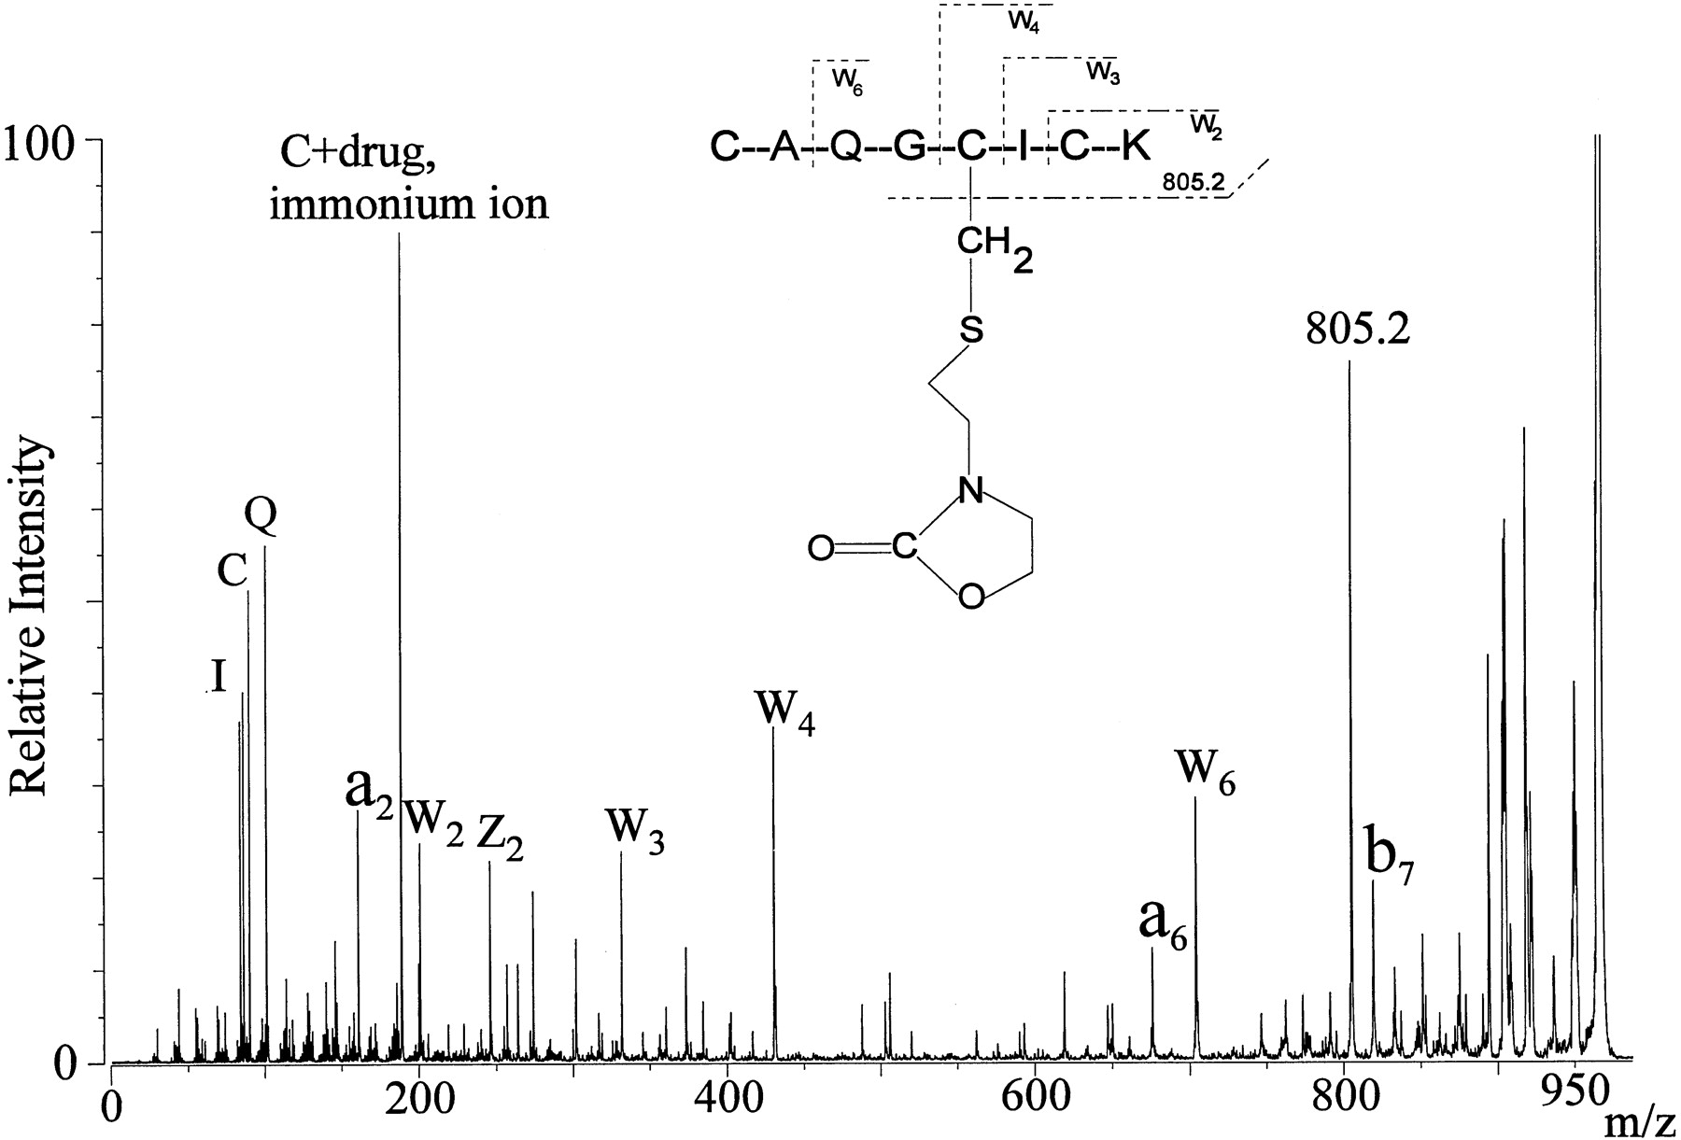
Immonium ion
Immonium ions are small, single amino acid structures that result from peptide fragmentation in tandem mass spectrometry.
They are internal product ions resulting from two-bond cleavages that retain a single amino acid side-chain.
Covalent Sequestration of Phosphoramide Mustard by Metallothionein - An In Vitro Study. Drug Metabolism and Disposition July 1999

Slide 3
DBIA ion marker
“Accelerating multiplexed profiling of protein-ligand interactions: High-throughput plate-based reactive cysteine profiling with minimal input.” Ka Yang et al. 2023 Cell Chemical Biology
HEK293T cell
MaxQuant search to identify the DBIA ms/ms scans
CYS – DBIA (mass shift 239.1628)

Slide 4
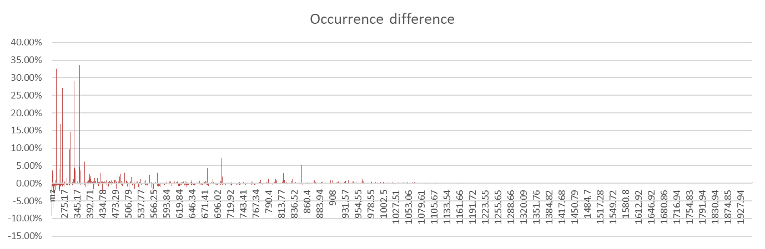
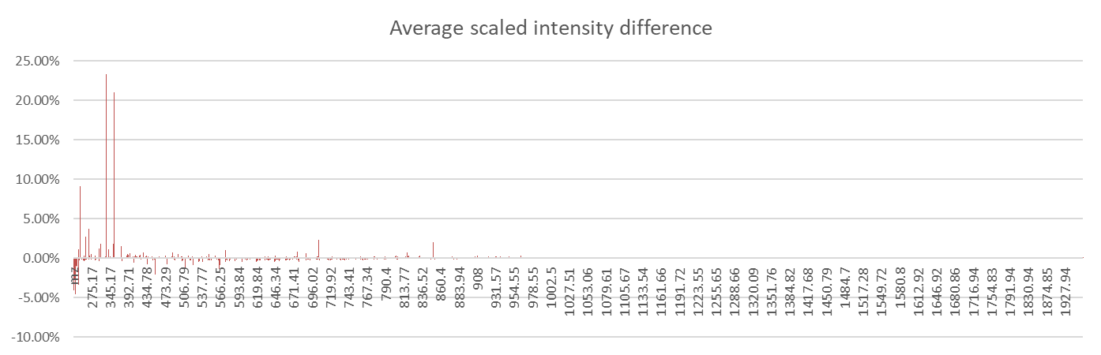
DBIA versus not DBIA ms/ms ions
m/z | Occurrence Difference | Intensity Difference
331.18 | 29% | 23%
355.18 | 34% | 21%

Slide 5
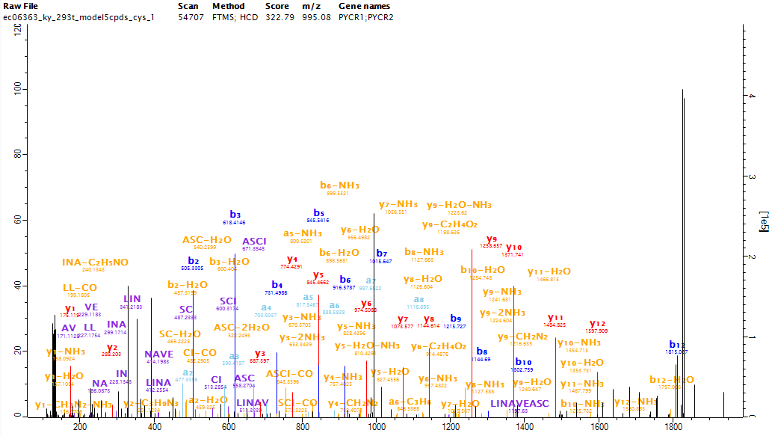


Slide 6
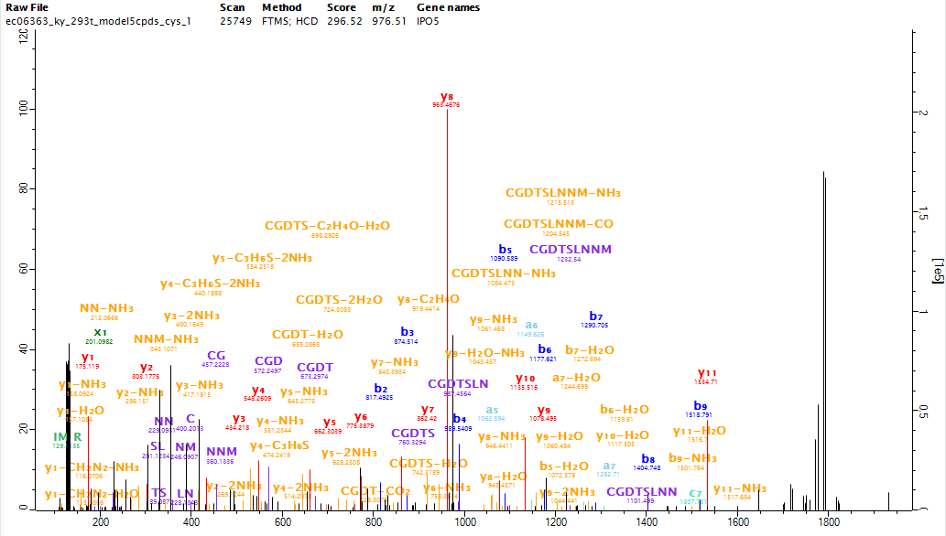


Slide 7
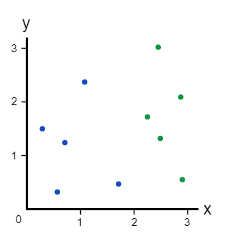

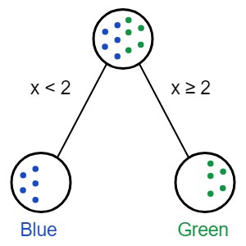
Machine Learning - Random Forest
m/z: 280.2
Green: ABPP
Blue: Not ABPP
https://victorzhou.com/blog/intro-to-random-forests/

Slide 8
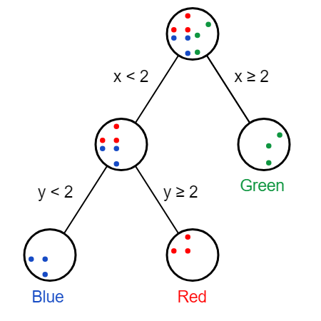
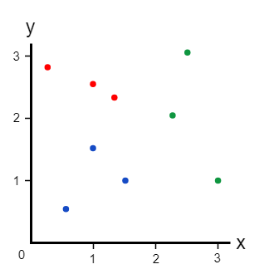
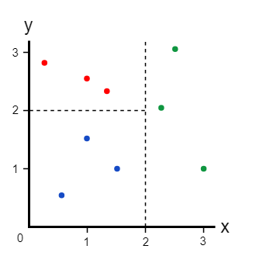
Random Forest
X: 280.2 m/z
Y: 197.12 m/z
Green and Red: ABPP
Blue: Not ABPP
ABPP
ABPP
Not ABPP
https://victorzhou.com/blog/intro-to-random-forests/

Slide 9
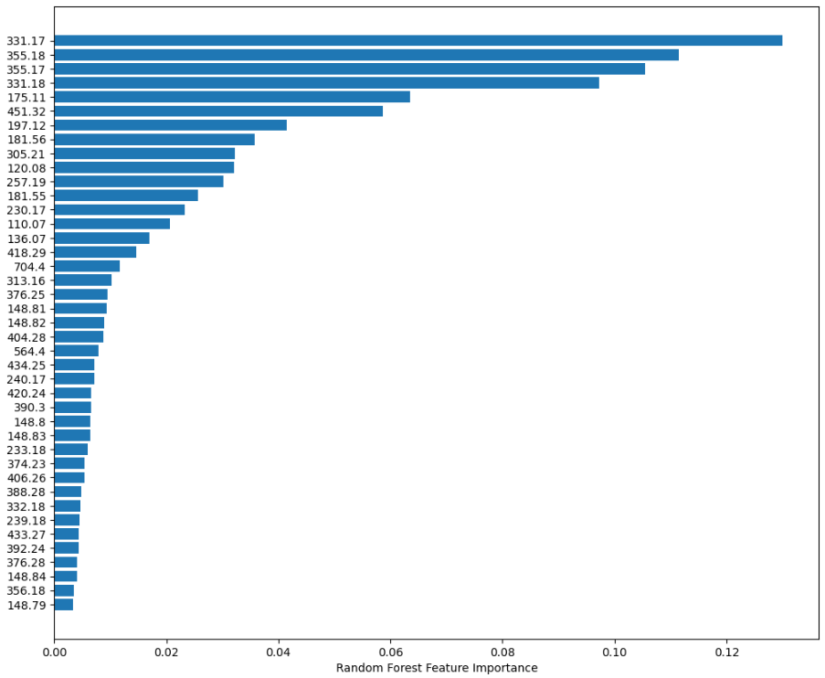
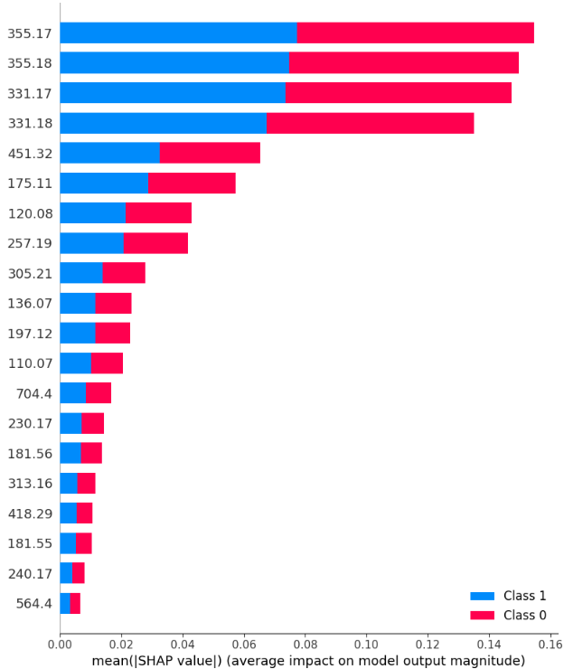
Best Ions
Class 1: ABPP
Class 0: Not ABPP
Random Forest Classifier
ACCURACY OF THE MODEL: 0.9390

Slide 10
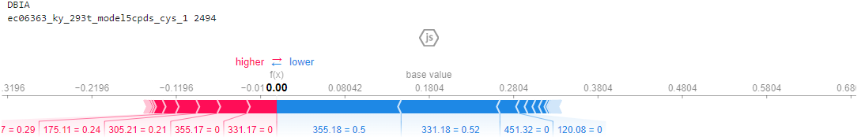
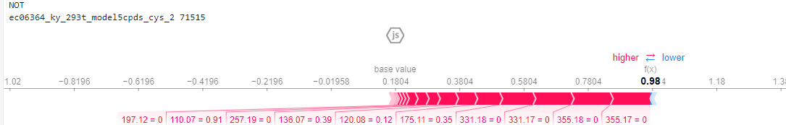
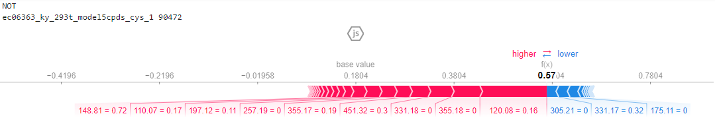
Classification examples
Class 0: DBIA
Class 1: Not DBIA

Slide 11
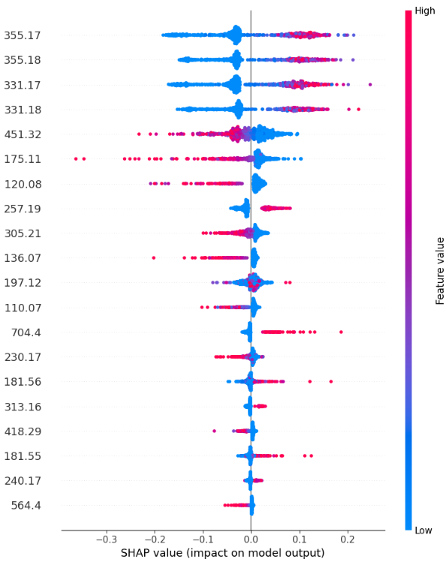
DBIA ions classification

Slide 12
Summary
Validation of the ABPP scans
Identification of compound interaction/reaction
Site localization
Quantification

