Slide 1

Information Theory
MAP-Tele
Carnegie Mellon University Accredited Course
José Vieira
IEETA
Departamento de Electrónica, Telecomunicações e Informática
Universidade de Aveiro
jnvieira@ua.pt
José Vieira
Information Theory 2010

Slide 2
Part III
Advanced Coding Techniques
Carnegie Mellon University Accredited Course
José Vieira
IEETA
Departamento de Electrónica, Telecomunicações e Informática
Universidade de Aveiro
jnvieira@ua.pt
José Vieira
Information Theory 2010

Slide 3
Objectives
To introduce the concept of rateless codes for erasure channels and the concept of digital fountains
To give an introduction to the first rateless codes and their design
Illustrative applications
  Network coding
  Distributed storage
José Vieira
Information Theory 2010

Slide 4
Part III – Outline
The Binary Erasure Channel (BEC)
Codes for the BEC
Fountain codes
  Rateless codes
  The LT code
  Design a rateless code
  The rank of random binary matrices
Applications of Fountain codes
  Network coding
  Distributed storage
José Vieira
Information Theory 2010

Slide 5
The Binary Erasure Channel
Introduced by Elias in 1955 and regarded as a theoretical model
Internet changed this notion 40 years later
On the internet, due to router congestion and CRC errors, sent packets may not reach the destination
This packet losses can be regarded as erasures
José Vieira
Information Theory 2010

Slide 6
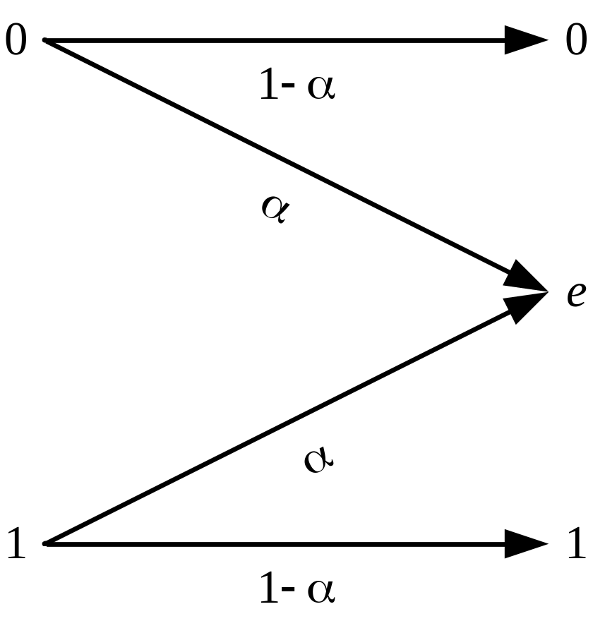
The Binary Erasure Channel
e – erasure
α – erasure probability
Erasure channel Capacity: C= 1-α
Intuitive interpretation: since a proportion α of the bits are lost in the channel, we can recover (at most) a proportion (1-α) of the bits.
José Vieira
Information Theory 2010

Slide 7
Classical solutions
When a packet did not reach the destination the receiver sends back a requests for retransmission
Alternatively, the receiver can send back acknowledgement messages for each successfully received packet. The sender keeps track of the missing packets and retransmits them until all have been acknowledged
José Vieira
Information Theory 2010

Slide 8
Classical solutions
Both solutions guarantees the correct delivery of all the packets regardless of the rate of packet losses
However, if the rate of packet losses is high, both of these schemes are very inefficient
The full capacity of the channel is not reached
According to Shannon theory, the feedback channel is not necessary
José Vieira
Information Theory 2010

Slide 9
Broadcast channel with erasures
On a broadcast channel with erasures, the repetition schemes are very inefficient, and can lead to network congestion
An appropriate Forward Error Correction (FEC) Code should achieve the theoretic channel capacity without feedback channel
With classical codes the design of the fixed rate R=K/N, should be performed to worst case conditions
This restriction makes this coding inefficient also
José Vieira
Information Theory 2010

Slide 10
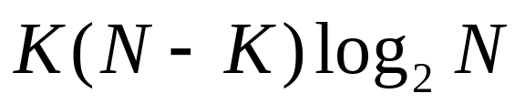
Reed-Solomon codes for broadcast channels with erasures
An (N,K) Reed-Solomon code correctly decode the K symbols of the message from K codeword symbols
However, Reed-Solomon codes are only pratical for small values of N and K
The coding / decoding cost is of order
José Vieira
Information Theory 2010

Slide 11
Variable rate codes
If the error probability of a BEC varies, the ideal code should allow on the fly variable encoding rate R=K/N
With Reed-Solomon codes it is not possible to change R on the fly
Michael Luby (2002) invented a rateless code with this propriety
José Vieira
Information Theory 2010

Slide 12
Fountain Codes
This code can generate a potentially infinite number of codewords
Fountain codes are near optimal for every erasure channel, despite the probability of erasure α
The message m with K symbols can be decoded from K´ received codewords, with K´ a little larger than K
José Vieira
Information Theory 2010

Slide 13
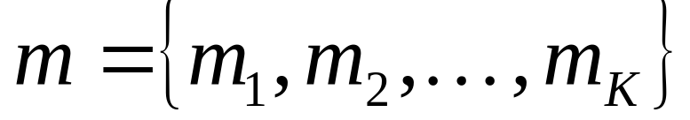
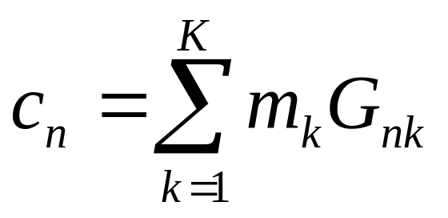
Fountain Codes
Consider a message m with K symbols
To generate the n^{th} codeword symbol the encoder chooses the number d of symbols to combine from a degree distribution ρ
Then the encoder chooses d symbols at random from m and perform the xor sum
José Vieira
Information Theory 2010

Slide 14
Fountain Codes
The growing encoding matrix G is formed on the fly, a row at a time
The rows of G should be transmitted to the receiver as side information
It is possible to use a seed for a random number generator to generate the same encoding rows of G at the receiver
José Vieira
Information Theory 2010

Slide 15
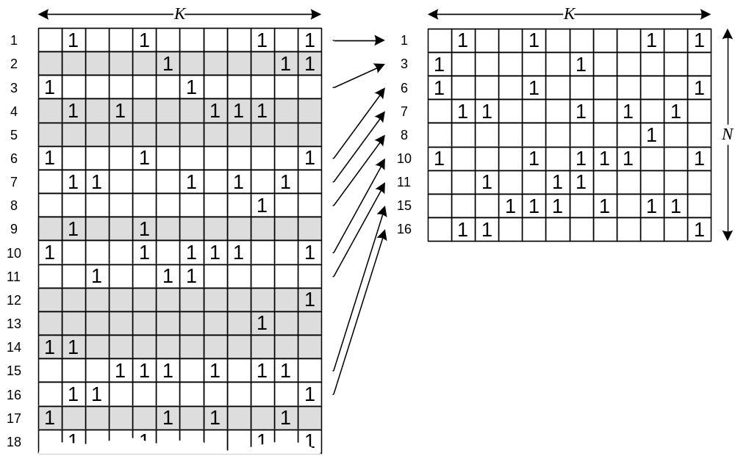
Fountain Codes
G(J)
The transmitted G and the received G(J) generator matrix with J={1,3,6,7,8,10,11,15,16}
G
José Vieira
Information Theory 2010

Slide 16
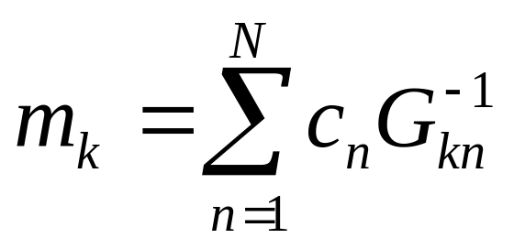
Fountain Codes
If N<K the decoder does not have enough codeword symbols to recover the original information
If N≥K and G has an K×K submatrix with inverse, then the receiver can recover the original information. It is possible to use Gaussian elimination and recover the message
José Vieira
Information Theory 2010

Slide 17
Fountain Codes
If it is possible to find an invertible K×K submatrix in the received N×K matrix, then the solution is unique
As the matrix is generated at random and we can not predict the columns that we are going to received, the question is:
What is the probability of a K×K random binary matrix being invertible?
José Vieira
Information Theory 2010

Slide 18
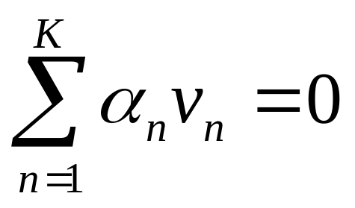
Random matrices
Linear independency
A set of K vectors v_{n} in some vector space of dim K is linearly independent if
only with all the α_{n}=0
José Vieira
Information Theory 2010

Slide 19


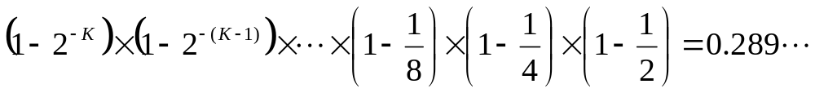
Probability of a K×K random binary matrix G being invertible
If we have only one vector the probability of being linear independent is the probability of being different from zero
With two vectors we have the probability of the second vector being different from zero and different from the first one
For K vectors the probability of all vectors being linear independent
José Vieira
Information Theory 2010
Notes:
Posso acrescentar aqui um acetato com a analogia dos dardos que acertam nos vectores possíveis com K elementos binários.

Slide 20
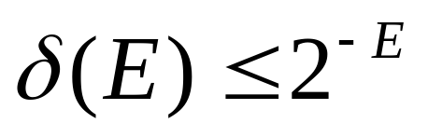
Probability of a random binary matrix G being invertible
If the number N of vectors is greater than K, with E=N-K (excess), what is the probability (1-δ) that there is an invertible K × K submatrix in G?
Where δ is probability of failure and E is the number of redundant packets
José Vieira
Information Theory 2010

Slide 21
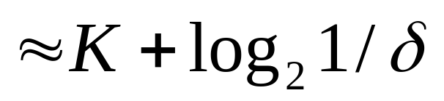
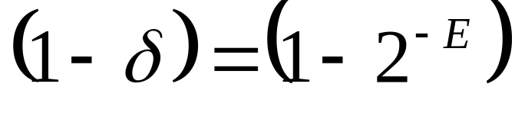
Probability of a random binary matrix G being invertible
The number of packets N=K+E in order to have (on average) a guarantee of decoding of (1-δ) is
So, an excess of E packets increases the probability of success to at least
José Vieira
Information Theory 2010

Slide 22
Computational cost
The encoding cost is K/2 symbol operations by codeword
The decoding cost has two components
  The matrix inversion with K³ operations by Gaussian elimination
  The application of matrix inverse to the received symbols which costs K²/2
When the value of K increases, random linear fountain codes approximate to the Shannon limit
Problem to solve: find a coding and decoding technique with lower cost, preferably linear
José Vieira
Information Theory 2010

Slide 23
Sparse random matrices
The coding and decoding computational cost can be reduced if the coding matrix G is sparse
Even for matrices with a small average number of ones per row is possible to find an invertible coding matrix
José Vieira
Information Theory 2010
Notes:
Colocar aqui as referência para o livro de Volchin

Slide 24
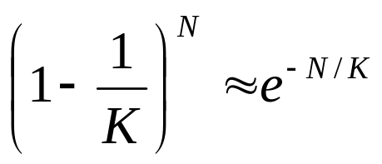
Balls and Bins
Suppose that we throw N balls to K bins at random
Question: After throwing N=K balls what fraction of the bins is empty?
Answer: The probability that a ball hits one of the K bins is 1/K. The complement is (1-1/K), and the probability that a bin is empty after N balls is
For N=K the probability of a certain bin is empty is 1/e and the fraction of empty bins would be 1/e also
José Vieira
Information Theory 2010

Slide 25
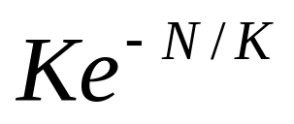
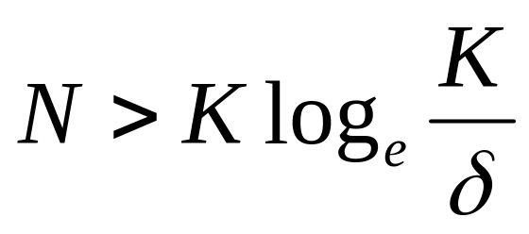
Balls and Bins
After throwing N balls the expected number of empty bins is
This expected number δ of empty bins is small for large N. So we can say that the probability of all bins have a ball is given by (1-δ) only if
José Vieira
Information Theory 2010

Slide 26

The LT code
Encoder
Consider a message m with K elements
  Choose at random the degree d_{n} of the codeword from a degree distribution ρ(d).
  Choose at random and uniformly, d_{n} distinct input symbols and sum them using the XOR operation.
This encoding defines a sparse and irregular encoding matrix
José Vieira
Information Theory 2010

Slide 27
The LT code
Decoder
The decoder must recover m form c=Gm supposing G known
If some of the codeword symbols are equal to one of the message symbols, then it is possible to decode by the following algorithm
  Find a codeword c_{n} with degree one. If it is not possible to find one halt and report fail
  Set m_{i}=c_{n}
  Add m_{i} (with XOR) to all codewords c_{n} that are connected to m_{i}
  Remove all the edges connected to m_{i}
  Repeat 1 to 4 until all m_{i} are decoded
José Vieira
Information Theory 2010

Slide 28
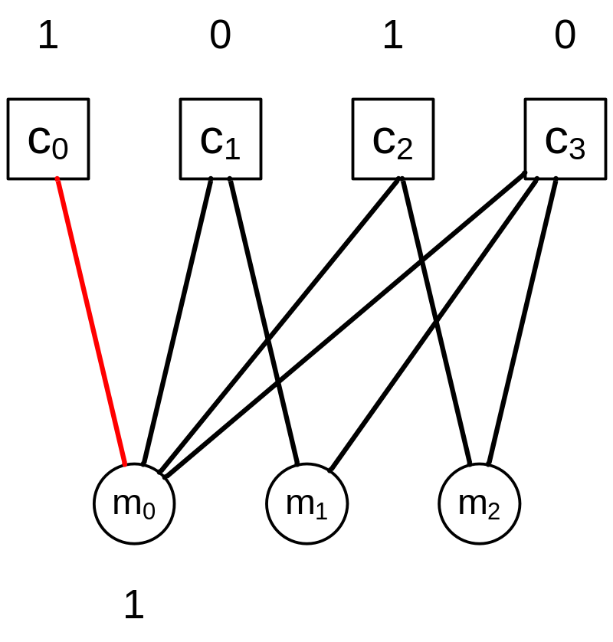
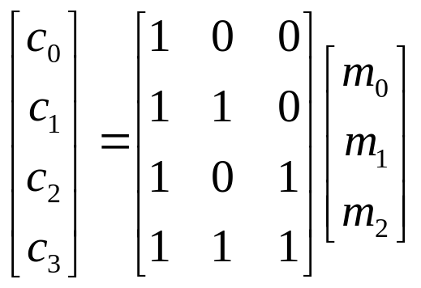
Decoding example – 1
José Vieira
Information Theory 2010

Slide 29
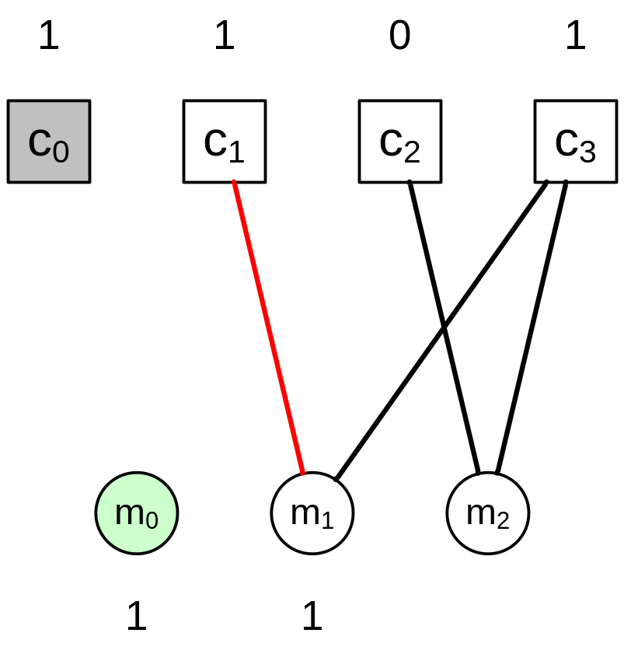
Decoding example – 2
José Vieira
Information Theory 2010

Slide 30
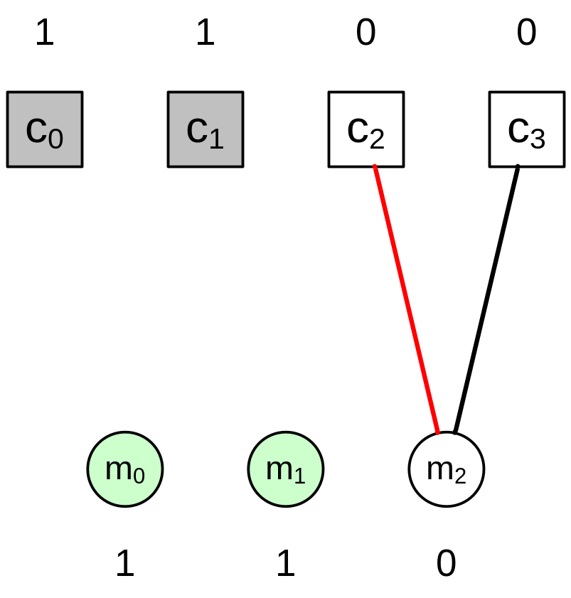
Decoding example – 3
José Vieira
Information Theory 2010

Slide 31
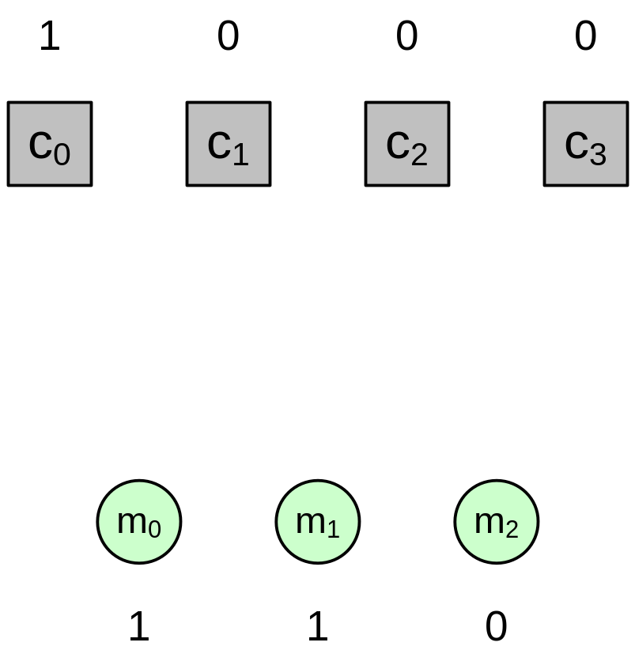
Decoding example – 4
José Vieira
Information Theory 2010

Slide 32
The Degree Distribution
Each codeword is a linear combination of d symbols from the message m
The degree d is chosen at random from a degree distribution ρ(d)
There are two design conflicts:
  The degree of some codewords should be high to guarantee that all the message symbols are covered
  The degree of some codewords should be low in order to start the decoding process and keep going
José Vieira
Information Theory 2010

Slide 33
Soliton distribution
Can we design a degree distribution that guarantees the optimal Shannon limit of decoding the K symbols of the message after K received codewords?
We want a distribution that on average guarantees that just one message symbol is uncovered at each iteration
Such a distribution is the Soliton
José Vieira
Information Theory 2010

Slide 34
Soliton distribution
Step 0
  The expected number of codeword symbols of degree one at step zero should be 1
Step 1
  One of the message symbols is decoded and it lower the degree of some of the codeword symbols.
  At the end of step 1, at most one degree 2 codeword should be connected to the decoded message symbol in order to decrease its degree to one and the process continues
Step n
  Continue the process checking at each step that one of the codeword symbols has degree one
José Vieira
Information Theory 2010

Slide 35
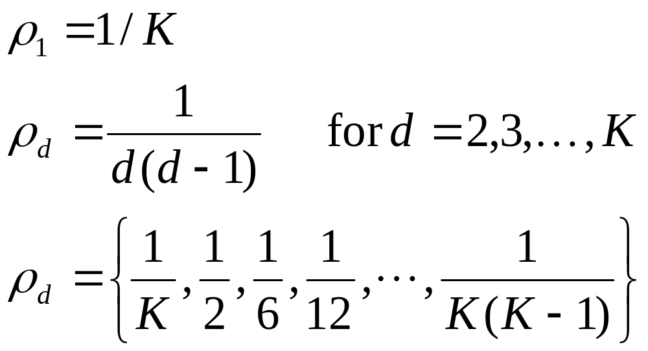
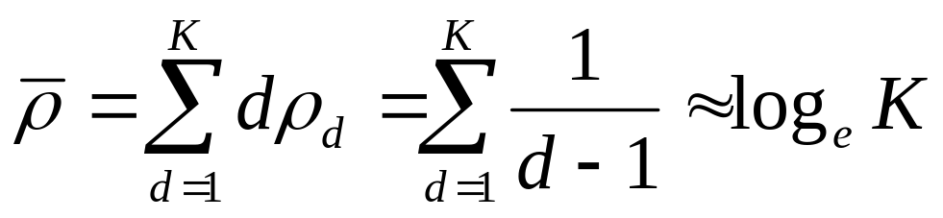
Soliton distribution
The mean degree of this distribution is
José Vieira
Information Theory 2010

Slide 36
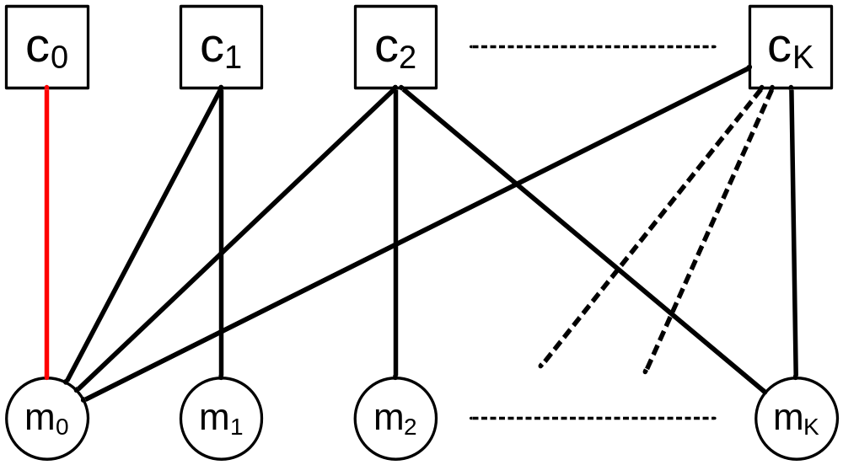
Soliton distribution
codewords
Message symbols
With the Soliton distribution the expected number of edges from each message symbol will be log_{e}K
José Vieira
Information Theory 2010

Slide 37
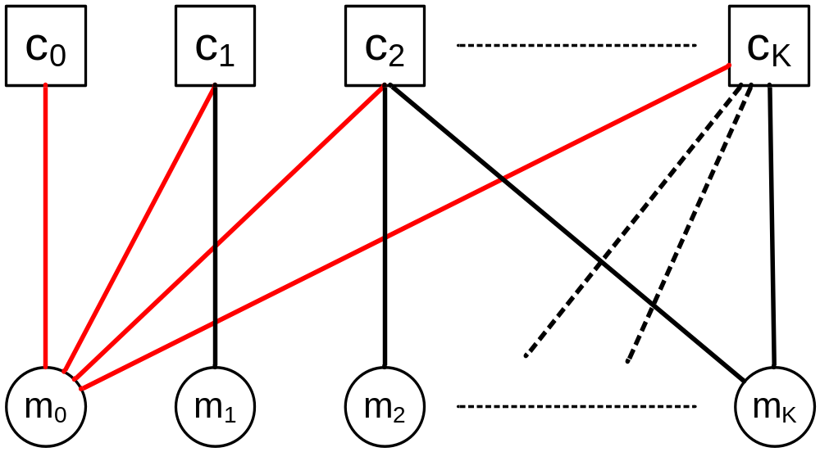
Soliton distribution
codewords
Message symbols
The decoding of m₀ from c₀ causes the degree of the connected codewords to decrease by 1
José Vieira
Information Theory 2010

Slide 38

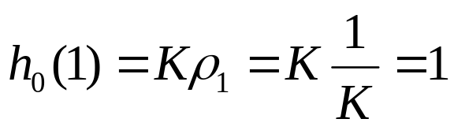
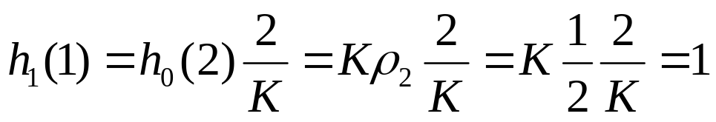
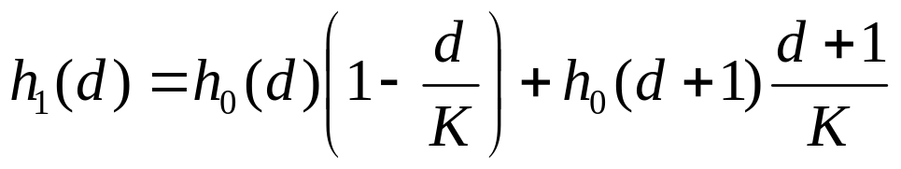
Soliton distribution
Let h_{t}(d) be the expected number of codewords of degree d after the t^{th} iteration of the algorithm
Step 0
Step 1
Probability of a degree d codeword had an edge to a message symbol
Expected number of codewords with degree d+1 that reduced their degree after step 0
Expected number of codewords with degree d that maintained their degree after step 0
José Vieira
Information Theory 2010

Slide 39
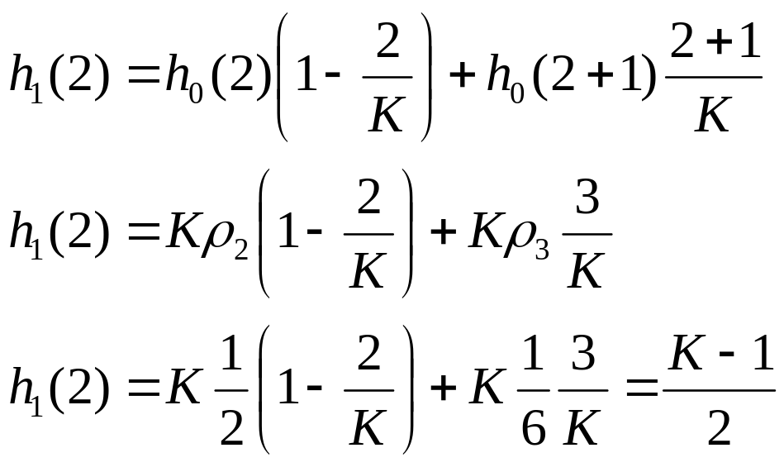
Soliton distribution
Step 1 (cont.)
José Vieira
Information Theory 2010

Slide 40
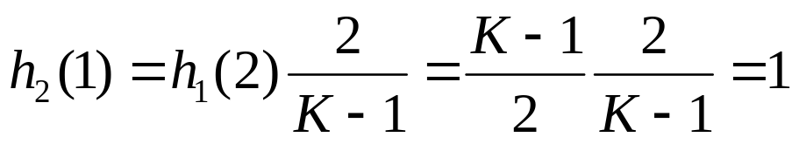
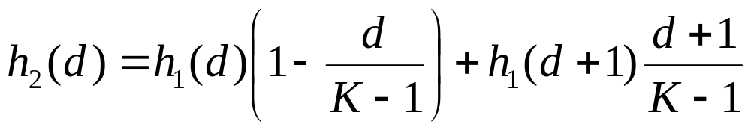
Soliton distribution
Step 2
We have showed (for the first 3 steps) that the expected number of degree 1 codeword symbols at each step will be 1 if we use the Soliton distribution.
José Vieira
Information Theory 2010

Slide 41

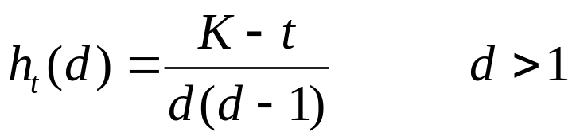
Soliton distribution
Theorem: Suppose that the expected degree distribution holds after t-1 iterations, for all t. Then, h_{t}(d) satisfies the two conditions
José Vieira
Information Theory 2010

Slide 42
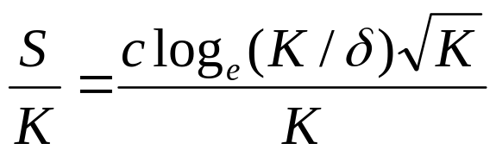
Robust Soliton
Due to the random fluctuations around the mean behaviour, the Soliton distribution behaves poorly in practice. If in one of the steps, there is not a degree one codeword, the decoding process stops
The Robust Soliton distribution tries to solve this problem by introducing two new parameters, c and δ, to obtain a expected number of degree one codeword symbols at each step of
instead of 1/K
José Vieira
Information Theory 2010

Slide 43
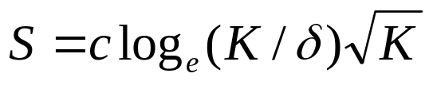

Robust Soliton
Luby proved that there exists a value of c and δ, given N received codeword symbols the algorithm recover the K message symbols with probability (1-δ)
José Vieira
Information Theory 2010

Slide 44
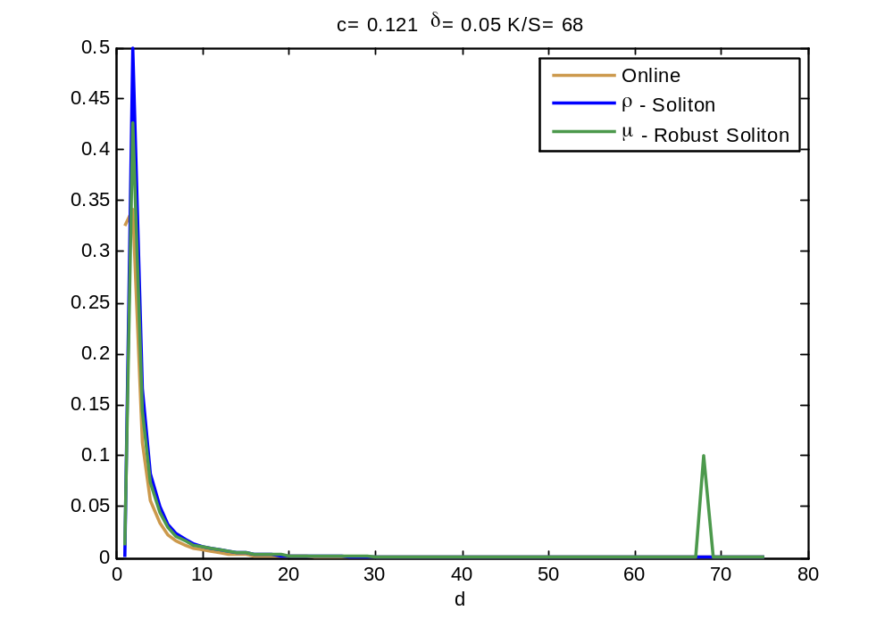
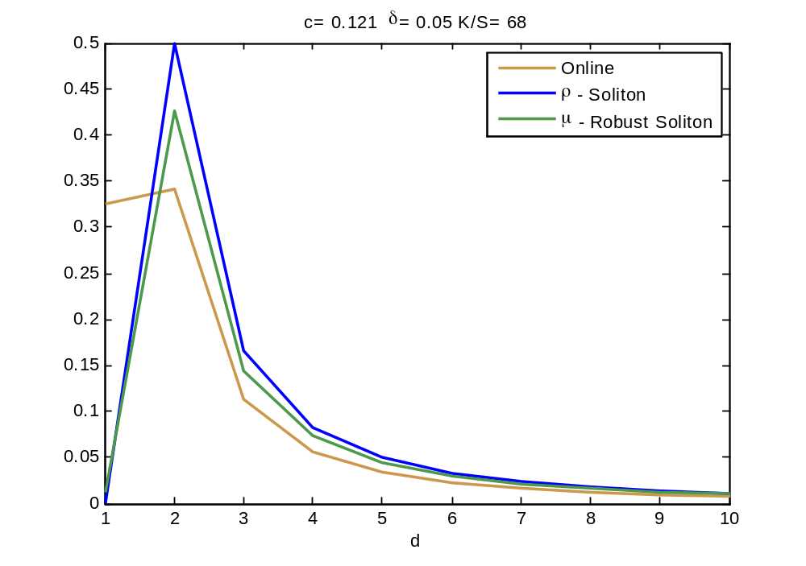
Comparing the distributions
The Robust Soliton does not have codewords of degree larger than K/S
José Vieira
Information Theory 2010

Slide 45
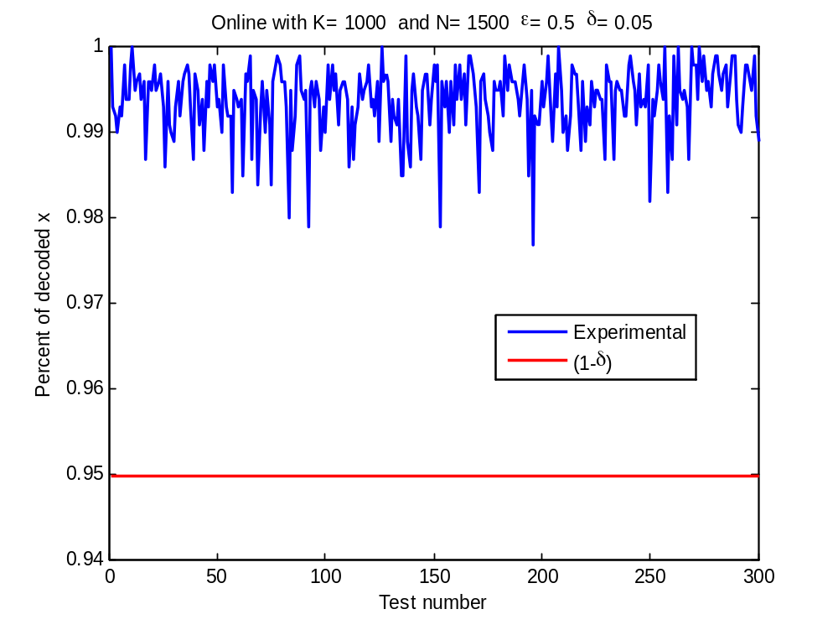
Performance of Fountain Codes – Online Code distibution from Maymounkov
José Vieira
Information Theory 2010

Slide 46
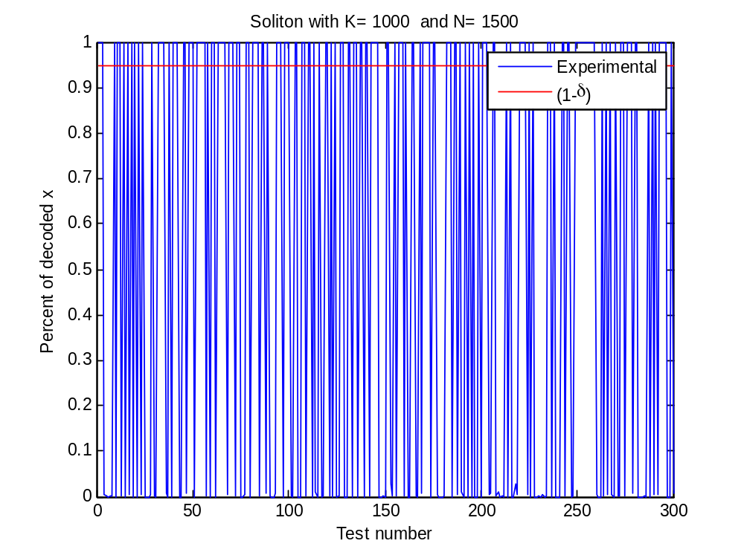
Performance of Fountain Codes – Soliton distribution
José Vieira
Information Theory 2010

Slide 47
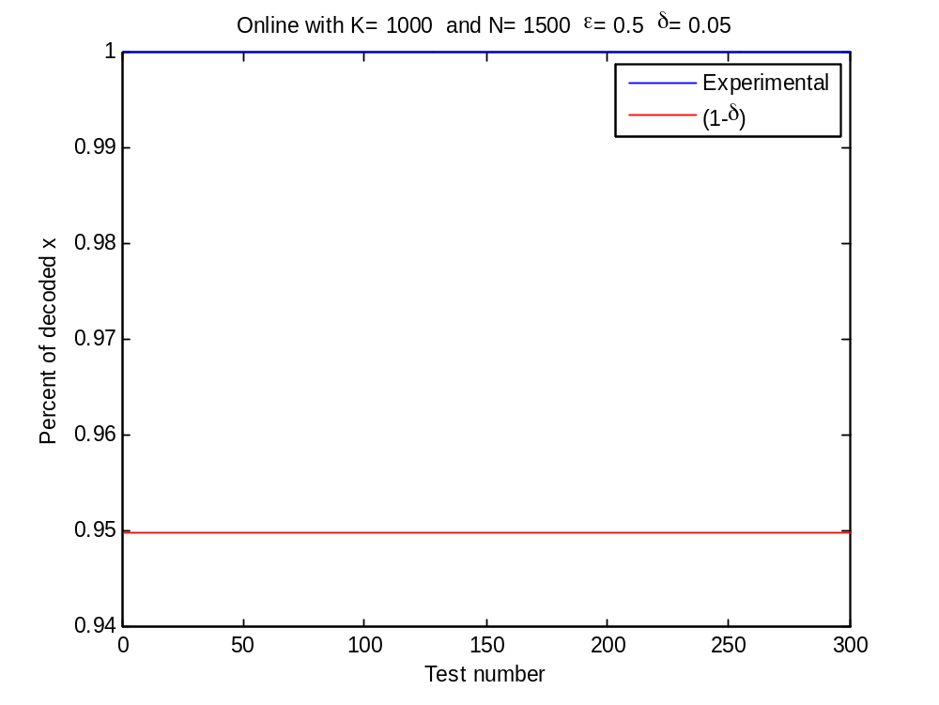
Performance of Fountain Codes – Robust Soliton distribution
José Vieira
Information Theory 2010

Slide 48
Applications
The same algorithms and coding techniques can be adapted to other applications such as
  Network coding
  Distributed storage
José Vieira
Information Theory 2010

Slide 49
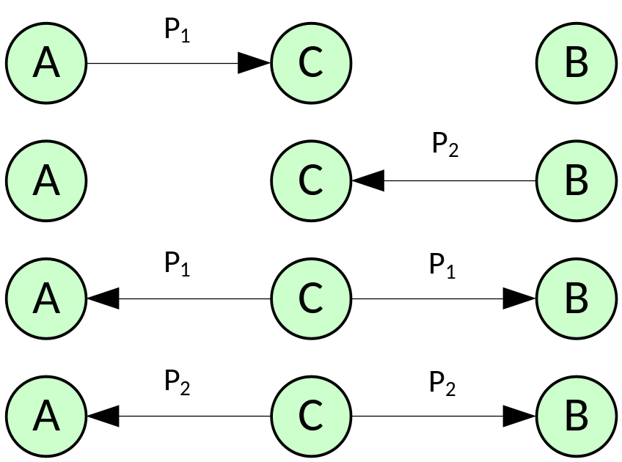
Network Coding
On traditional networks each peace of information is transmitted by using time sharing
In the figure at right, the wireless station C received the packets P₁ and P₂ almost simultaneously
Then he sends the two packets using different slots of time
José Vieira
Information Theory 2010

Slide 50
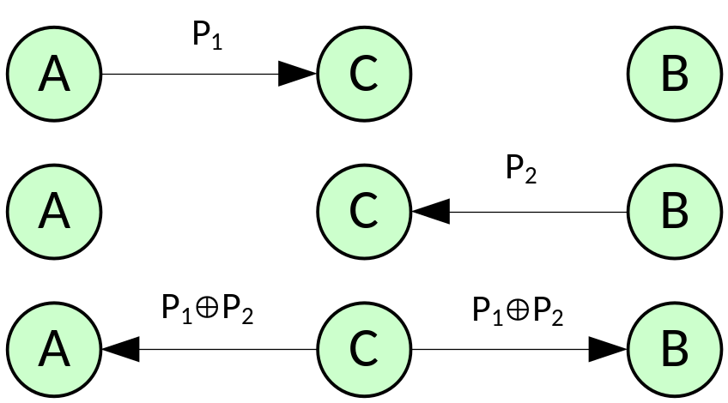
Network Coding
With network coding, the wireless station C sends the sum of the two packets
As each of the nodes A and B already have half of the information, each of them can recover P₁ and P₂
José Vieira
Information Theory 2010

Slide 51
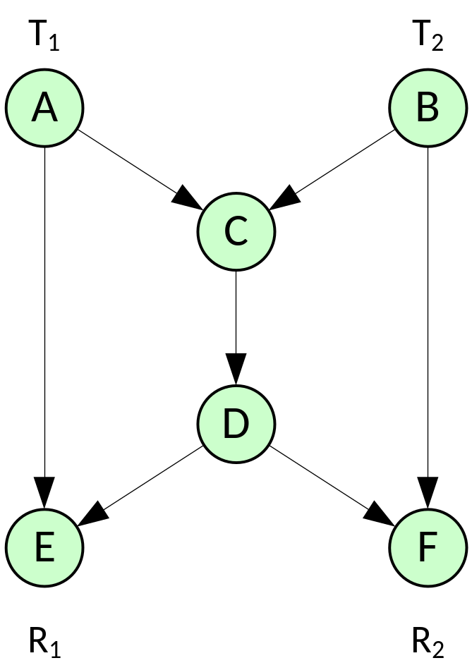
Network Coding – multicast
Consider the following network with 6 nodes
The nodes C and D are just routers
Suppose that the transmitters T1 and T2 need to send a packet to the two receivers at nodes E and F
José Vieira
Information Theory 2010

Slide 52
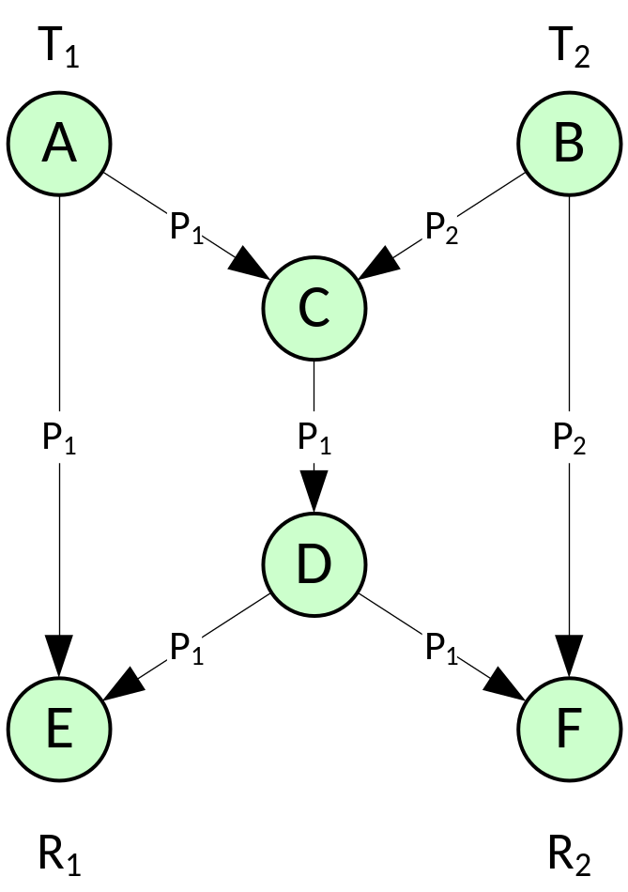
Network Coding – multicast
The router C is not able to transmit both packets at the same time and drops packet 2
The receiver R1 did not received the packet P₂
José Vieira
Information Theory 2010

Slide 53
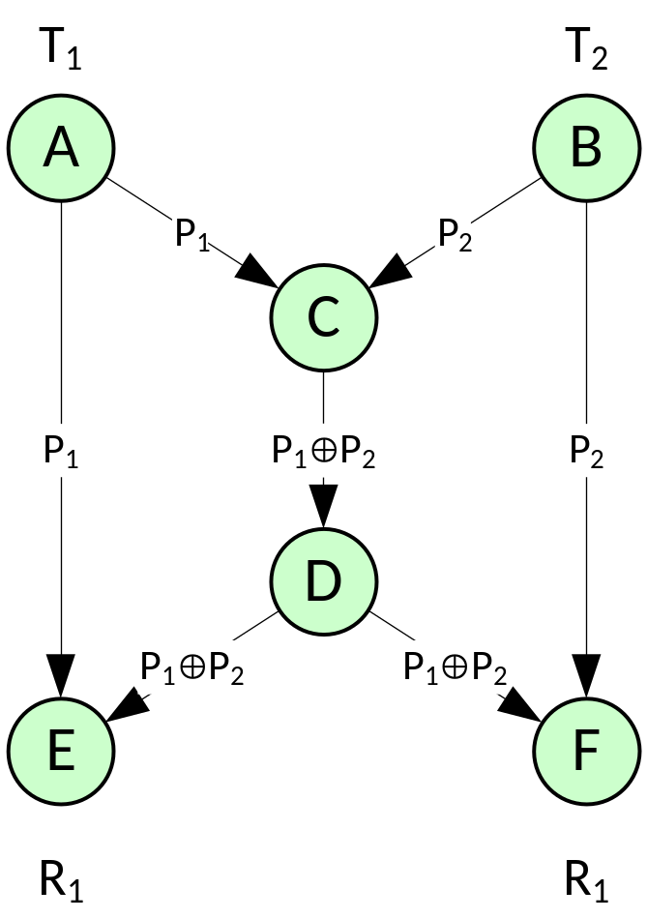
Network Coding – multicast
With network coding, the two packets are added at node C using the XOR operator
Now both receivers had enough information to recover both packets P₁ and P₂
José Vieira
Information Theory 2010

Slide 54
Network Coding
Theorem (from Fragouli 2006)
Assume that the source rate are such that, without network coding, the network can support each receiver in isolation (i.e. each receiver can decode all sources when it is the only receiver at the network). With an appropriate choice of linear coding coefficients, the network can support all receivers simultaneously.
José Vieira
Information Theory 2010

Slide 55

Distributed Storage
Consider a data file m with K symbols
Perform N linear combinations c_{n} with the symbols of m
Store the data symbols c_{n} on several servers
To recover the data file we have to receive a little more than K data symbols c_{n} from the servers to recover the original data
José Vieira
Information Theory 2010

Slide 56
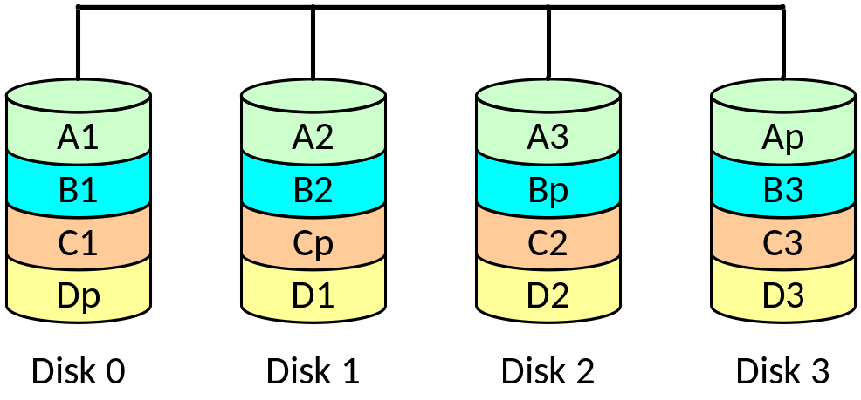
Problem
Consider a RAID 5 storage system with 4 disks as shown in the figure below
Compare this Raid 5 system with a four disks storage system using a Digital Fountain Code
José Vieira
Information Theory 2010

