Slide 1
Scalable Coding Solutions for Wireless Sensor Networks
IT Workshop
June 1st 2010, Porto, Portugal
Gerhard Maierbacher
Universidade do Porto, Portugal

Slide 2

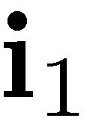
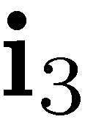
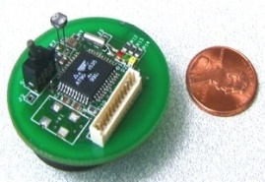
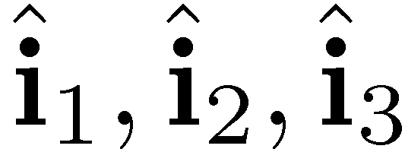
Motivation – Wireless Sensor Network Scenario
Source Coding Problem
Task: Collect and Transmit Data about Physical Process
Properties:
Correlated Sources
Several Sinks
Communication Network
Communication/ Network Aspect
Complexity Issue
Constraints:
Energy
Processing Power
Memory, etc.

Slide 3
Source Coding Problem
Part I: Low-Complexity Distributed Source Coding
Complexity Issue

Slide 4

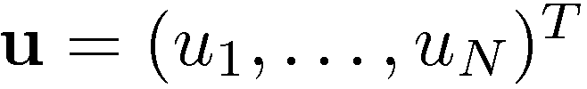
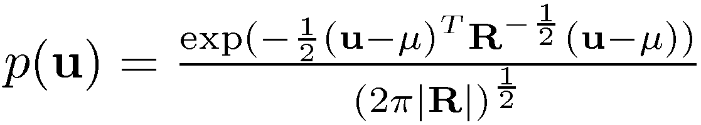

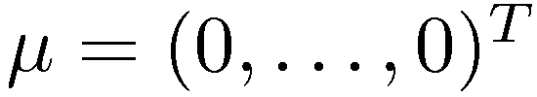
System Model – Source
correlated Gaussian sources
Vector of the source observations (samples)
Joint probability distribution is given by with known Covariance matrix and the vector of mean values
Two correlated Gaussian Sources:

Slide 5









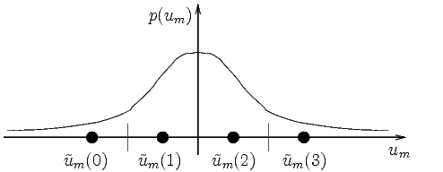

System Model – Quantizer
Encoder :
Scalar quantizer (block ) maps the continuous-valued source samples onto discrete-valued indices
Optimized for the statistics of the observation Simple and low delay
Quantizer:

Slide 6









System Model – Mapping
Encoder :
Encoder :
Simple surjective mapping (block ) from quantization indices onto codewords
Number of codewords smaller than number of indices
Reduced data rate from [bit/sample] to [bit/sample] Increased distortion
Mapping function:

Slide 7
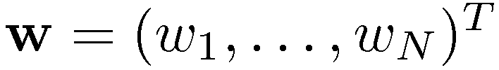

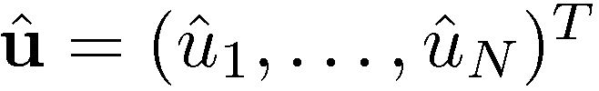
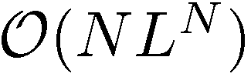
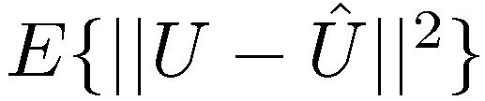

System Model – Decoder
Decoder uses the vector of received codewords and the source statistics to form estimates of the source samples
Fidelity criterion is the mean squared error
Optimal decoder given by conditional mean estimator
Complexity of optimal decoding is of

Slide 8
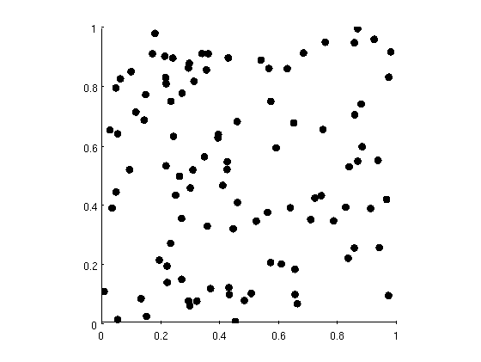

Considered Problem Setup – Large Scale Sensor Network
sensors uniformly distributed in a unit square
Correlation of sensors measurements decreases exponentially with Euclidean distance
Example:

Slide 9
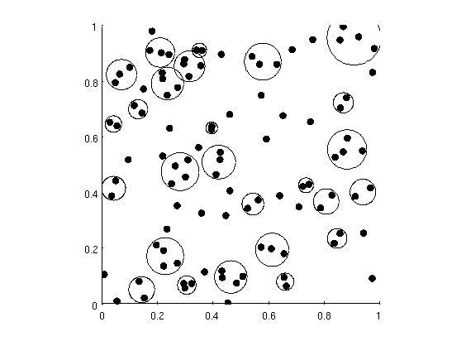





Source Optimized Clustering
Motivation:
Code design not feasible for large number of sources
Distributed data compression works (well) with strong correlations
Goal:
Find clusters with small number of encoders and strong correlations, where
Approach:
Use hierarchical clustering algorithm such that and are as similar as possible, i.e. minimize KLD
Maximum Clustersize :

Slide 10
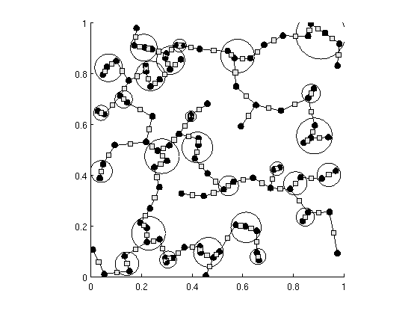



Source Model for Efficient Decoding
Motivation:
Optimal decoder that uses exact source statistics is not feasible
Suboptimal decoder can be tailored for approximated source statistics (factor graph + sum-product algorithm)
Find factorization such that similarity between and is maximized, i.e. minimize KLD
Account for cluster statistics
Goal:
Approach:
Directed spanning tree algorithm can be used to do that
PhD Seminar, December 2nd 2009

Slide 11
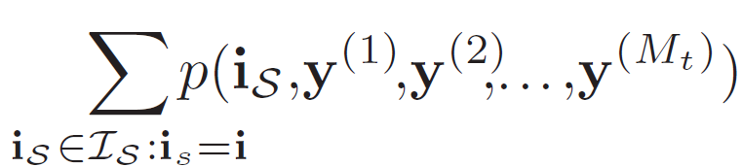
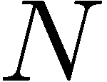
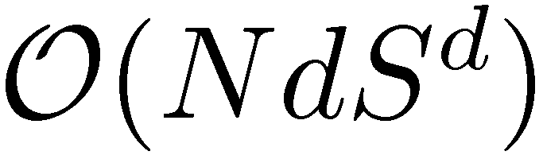
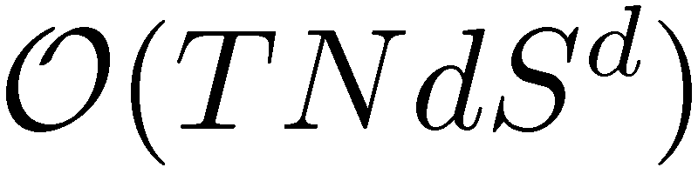


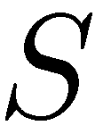
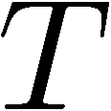
An Iterative Decoding Approach...
Optimal decoding requires marginalization
Marginalization can be performed efficiently using the sum-product algorithm
Sum-product algorithm runs on factor-graph describing the factorization of
Idea: Perform global marginalization via local ones Low complexity
... and its Complexity
Only linear dependency on number of nodes
Decoding Complexity
No cycles:
Cycles:
Exponential dependency on node degree
number of nodes
degree of function nodes
maximum alphabet size
iteration constant

Slide 12
Source Coding Problem
Part II: Diophantine Index Assignments for Distributed Source Coding

Slide 13
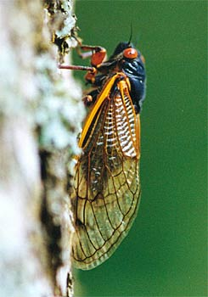




Intuition/ Key Idea
Periodical cicadas
Plant feeding insect
Spend most of their live below ground
Emerge synchronized to breed
Live cycle is periodic and a prime number of years (species with 5, 7,13,17 years)
Species compete for the same food and want to avoid each other
Example 1:
Example 2:
Different properties!
Diophantine equation
Equation for solutions:
PhD Seminar, December 2nd 2009

Slide 14






Diophantine Index-Assignments
Distributed source coding based on Diophantine index-assignments
Properties:
Characterized by parameter
Goal: Jointly find to minimize decoding errors (distortion)
Example:
Let be the number of codewords , then all indices are mapped onto the same codeword i.e. .

Slide 15
And it actually works...

Slide 16
Part III:
Joint Source-Network Coding
Communication/ Network Aspect

Slide 17
Joint Source-Network Coding
Goal:
Given the statistical representation of the system components, construct a statistical model for decoding
Decoding model contains both source and network components
Factor graph representation for iterative decoding
Example:
2 Step approach

Slide 18
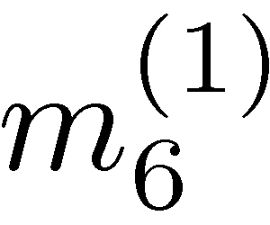
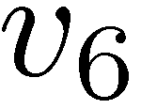
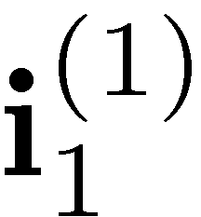
Decoding Model (Step 1) - Modelling the Packet’s Path
Decoding model at node after receiving message
Model of packet path (full model)
Constructed Decoding Model
Packet path

Slide 19
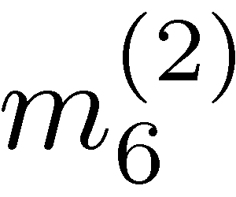
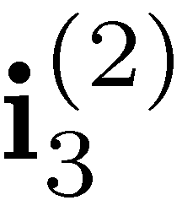
Decoding Model (Step 1) - Modelling the Packet’s Path
Decoding model at node after receiving message ,
Model of packet path (full model)
Constructed Decoding Model
Packet path

Slide 20
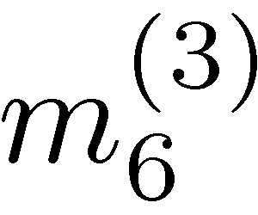
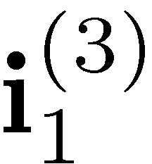
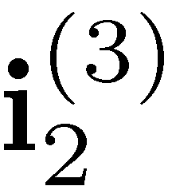
Decoding Model (Step 1) - Modelling the Packet’s Path
Decoding model at node after receiving message , ,
Model of packet path (full model)
Constructed Decoding Model
Packet path

Slide 21
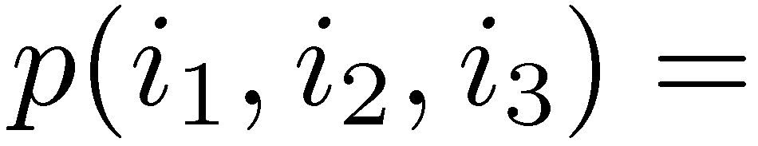
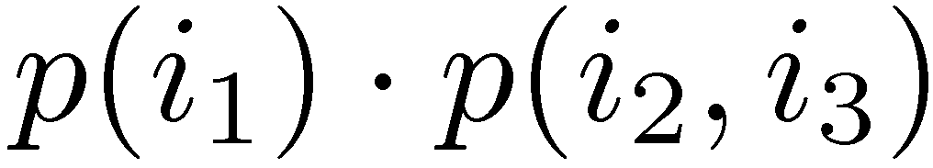
Decoding Model (Step 2) – Adding the Source Model
Combined packet models for , ,
Source model
Full decoding model
Decoding Complexity still
No cycles:
Cycles:

Slide 22
Future Work
Compare low-complexity distributed source coding approach with other work (DISCUS, etc.)
Conduct large-scale experiments with large number of sources for the network coding case
Consider quantization with memory (TCQ)
Incorporate mappings with memory (e.g. trellis based approaches)
Thank you!

