Slide 1
(Network) Coding in Uncertain Networks
Daniel E. Lucani

Slide 2
Sources of Uncertainty
Rate uncertainty
user rate
changes with time,
user, other users
Channel
Delay
packets
are
lost
cannot
react
quickly
Interference
collisions

Slide 3
Motivations for Research
Rate uncertainty
How much to talk before stopping to listen?
Capacity improvement through simple, distributed algorithms?
Which transmissions have greatest impact?
Channel
Delay
Uncoded rate without additional cost?
Interference
How to perform efficient rateless transmission?

Slide 4
Network Coding
A new means of conveying information
  Throughput gains, robustness against failures and erasures
  Routing/traditional network: data can only be forwarded or replicated
  Network coding: data is an algebraic entity
In wireless networks
  Broadcast advantage
  Packet erasures (losses)
Routing
Network Coding
A
A
B
B
A
A+B
A+B
B

Slide 5


Network Coding
In wireless networks
  Broadcast advantage
  Packet erasures (losses)
p₁+ p₂ + p₃
p₂
p₃
p₁
p₁
p₂
p₁+ p₂ + p₃
p₃
p₃
p₁
p₂
p₁+ p₂ + p₃

Slide 6
On Coding for Delay
Rate uncertainty
How much to talk before stopping to listen?
Channel
Delay
Interference
Joint work with:
Muriel Médard
Milica Stojanovic
David Karger

Slide 7
Application: dissemination of information
Time-Division Duplexing or ‘Half-Duplex’ channels
  How much should we talk before stopping to listen?
Large latency channels
  Satellite and deep space communications
    Very long distances (~10,000 km and up)
  Underwater acoustic communications
    Low propagation speed (~1500 m/s)
    Long distances (~km)
Previous work for link/broadcast scenarios
  ARQ schemes
  FEC schemes: block-based (no feedback) or rateless
  Hybrid schemes

Slide 8
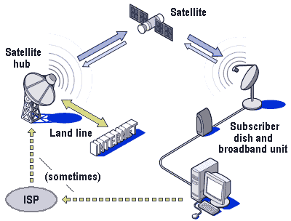
Cases
Link
Rx
Tx
  Mean completion time: close to full duplex (gold standard)
  Mean completion energy: close to optimal
Tx with M packets
Rx N
1-to-all Broadcast
…
Rx 2
Rx 1
  Mean completion time: can be better than scheduling schemes with full duplex capabilities
  Optimization: Hard, but have good heuristics

Slide 9
Cases
Node N
M_{N} packets
Node 1
M₁ packets
all-to-all Broadcast
…
Node 3
M₃ packets
Node 2
M₂ packets
  Mean completion time: can be better than scheduling schemes with full duplex capabilities
  Optimization: hard, but have algorithm+heuristics

Slide 10
Description of Scheme: Link
Goal: reliable transmission of a block of data packets
Tx
Rx
Erasure Channel
ACK i
Generates N
random linear coded packets
Header
Coded Data
C₁
…
C_{M}
M
Received k coded packets,
only M-i independent
linear combinations
i
h bits
n bits
g bits
M data
packets
.
ACK degrees of freedom
required to decode (dofs req’d):
Not particular data packet
.
.
.
.
.
Degrees of freedom
needed by Rx:
Degrees of freedom
needed to decode:
M
i
M
i
Note: Choice of N_{i,} ∀i determines performance of scheme
[ITA’09, Infocom’09, ICC’09]

Slide 11


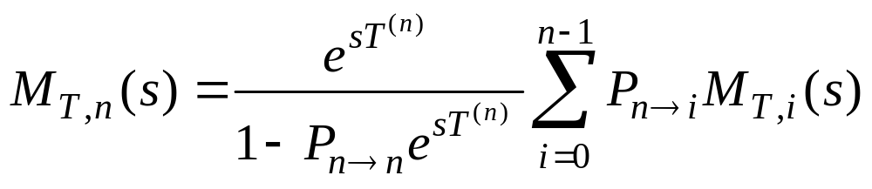
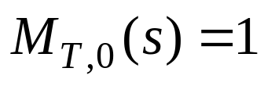
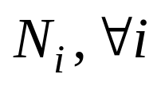

Description of Scheme: Link
Scheme can be modeled as a Markov chain
  States: degrees of freedom (dof) required to decode
  Transition time ( ) depends on starting state
We determined moment generating function of completion time [ITA’09]
Optimizing to minimize completion time:
  No closed-form expressions
  are integer-valued: hard
  Exploit recursion, performed off-line

Slide 12
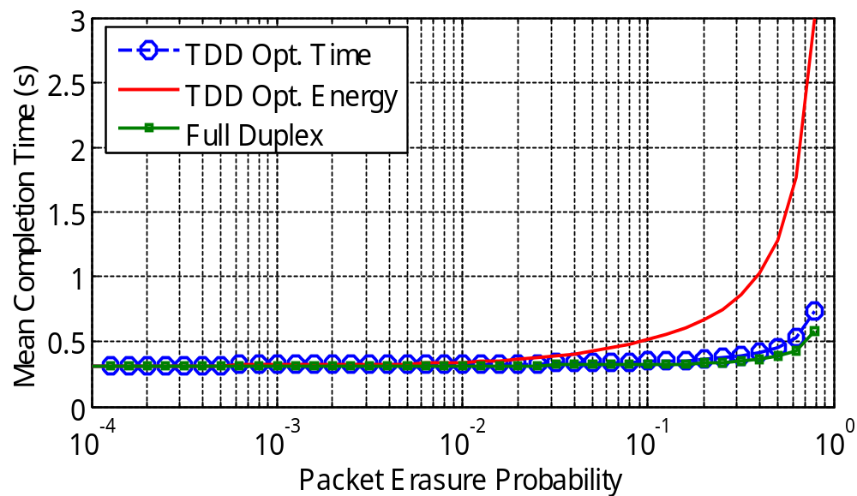
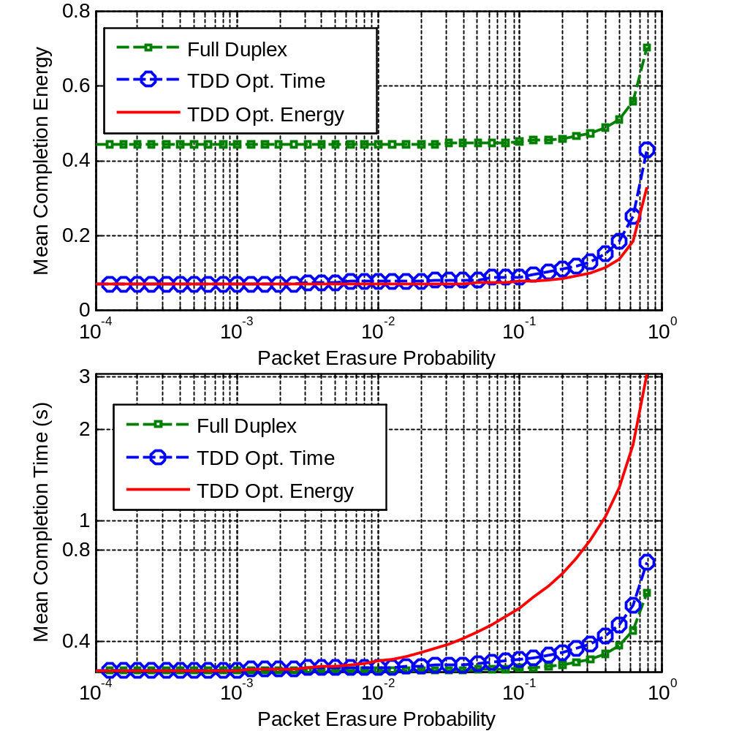
Minimizing Completion Time or Energy
Full Duplex Network Coding:
TDD constraint
Ni, ∀i chosen to minimize
  Mean completion time [ITA’09 Infocom’09]
  Mean completion energy [ICC’09]
Tx
Rx
Channel
ACK
ACK
Time
Energy
Pe = 0.8
1.15dB
Pe = 0.8
1.1dB
e.g: M = 10, round trip time = 250 ms, Rate = 1.5 Mbps

Slide 13
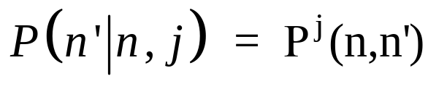
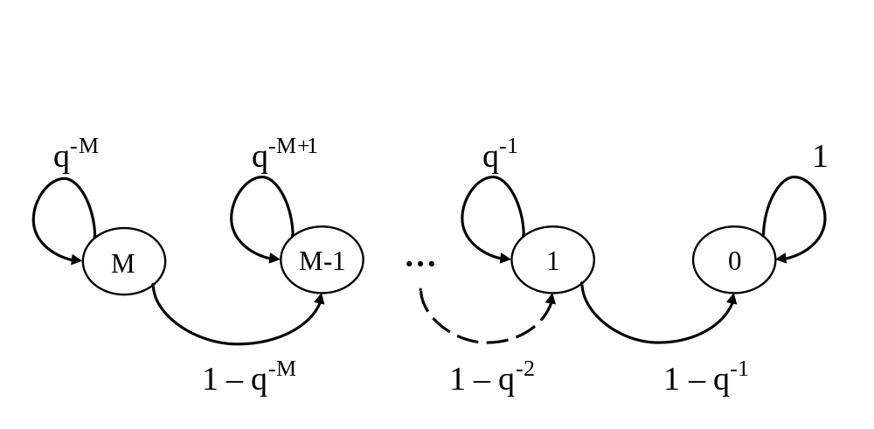

Effect of Field Size
[GLOBECOM’09]
Tx
Rx 1
Channel / Network
(Packet Losses)
  n ind. linear
  combinations
  needed
  Inputs random linear
  network coded packets
  (M original packets)
  j coded packets arrive
  We are interested in
  Modeled as a Markov chain
  with transition
  probability matrix
  Shown that each receiver requires in average less than M + 2
  coded packets to decode regardless of field size (q)

Slide 14
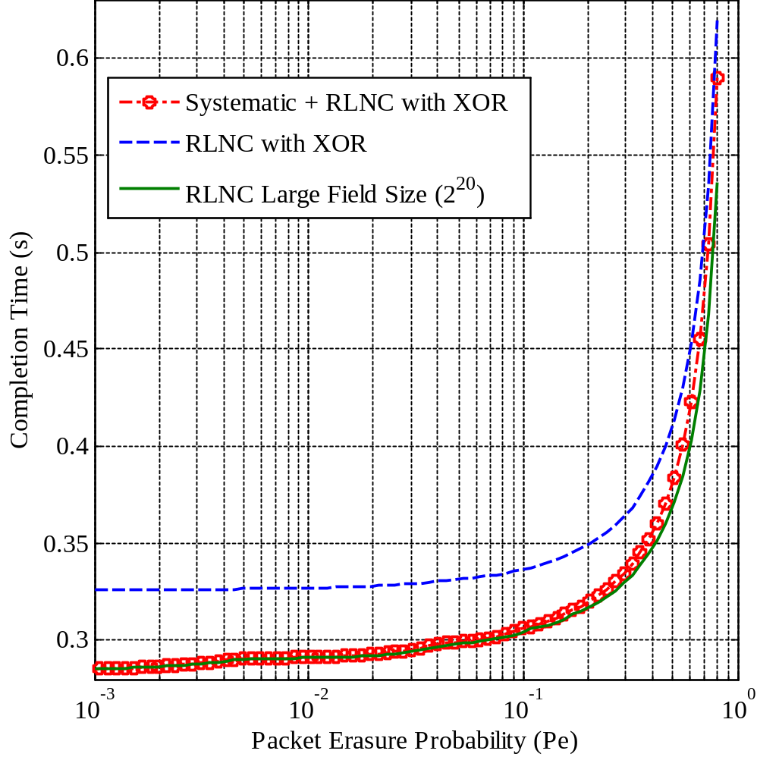
Systematic coding: a free lunch?
Can we use smaller field size (simpler operations) and still perform close to large field size?
  Ans. Yes + reduction in decoding complexity
Systematic network coding:
  First M transmissions are the original packets
  All other transmissions: random linear combinations
Decoding complexity down from O(M³) to O(Pe³M³)
  Pe = 0.1 → 1000 times less operations in average

Slide 15
Inter-Layer Coding for Multicast
Rate uncertainty
Channel
Delay
Capacity improvement through simple, distributed algorithms?
Interference
Joint work with:
Muriel Médard
MinJi Kim
Fang Zhao
Shirley Shi

Slide 16

Layered Multicast with Network Coding
Directed acyclic graph, unit capacity links
r₁
X₁
Multicast Network
r₂
X₁
s
Base Layer
X₁ , X₂ , X₃
X₁, X₂ , X₃
r₃
Refinement layers
n-layer multicast:
  If n = 2, multicast all layers to all but one receiver: achieves min-cut with linear codes [Koetter et al ‘03]
  Otherwise: min-cut not achievable with linear codes in general
Previous work, e.g. [Wu et. al, ‘08], [Sundaram et. al ‘05]
  “Intra-layer” coding and no “inter-layer” coding
  Centralized, LP
Notes:
Single source
Multicast
Multi-resolution: layers

Slide 17
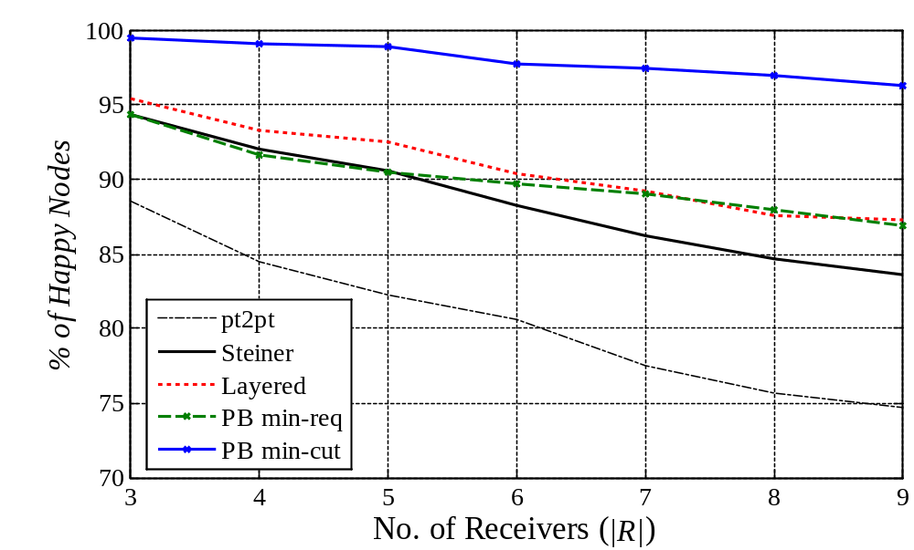
Pushback Algorithm
[Infocom’10]
Distributed, random linear network coding
Message passing: two stages
Guarantees decodability of base layer
q(v)
q(v)
c(m₁)
c(m₂)
v
q(u)
c(m₃)
c(m₄)
u

Slide 18
Conclusions
Sources of uncertainty are not restricted to channel limitations/constraints, but also include network topologies and interactions between network nodes
On Coding for Delay:
  Tailoring feedback and coding can reduce mean delay for successful in-order transmission of packets
  Coding is designed to minimize delay
  Have looked at queueing analysis
  Currently using these intuitions to improve satellite networks
Inter-layer coding multicast:
  Simple, distributed algorithm to determine liner network codes
  Benefits in coding (when done appropriately)
  Extension: use a modified version to determine uncoded rate that can be guaranteed to users

Slide 19
Extra Slides

Slide 20
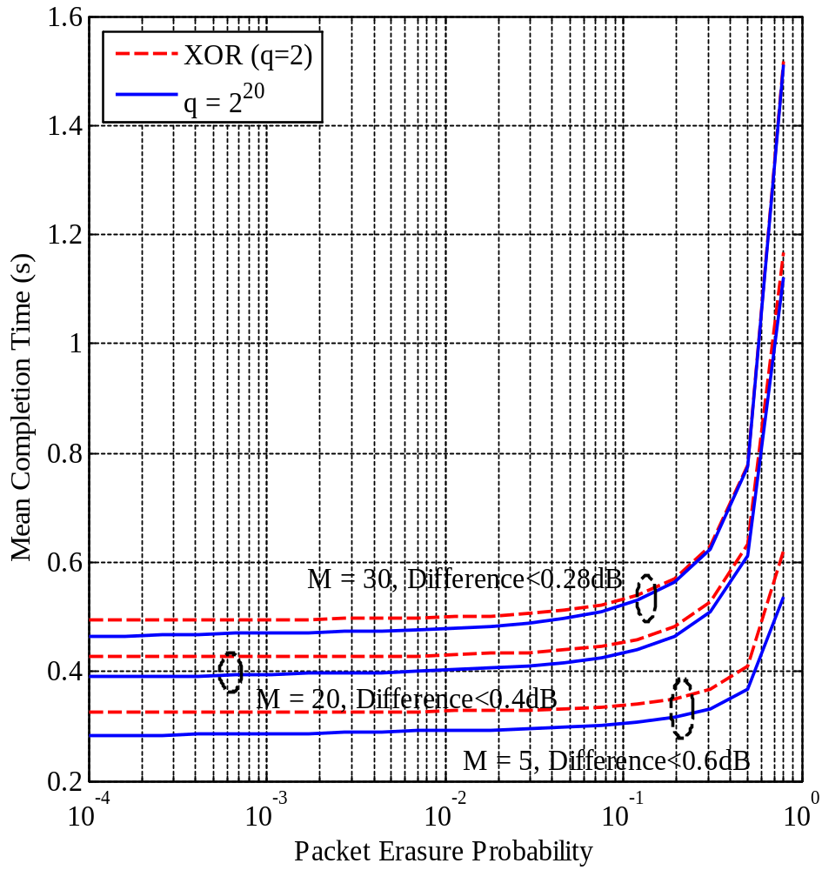
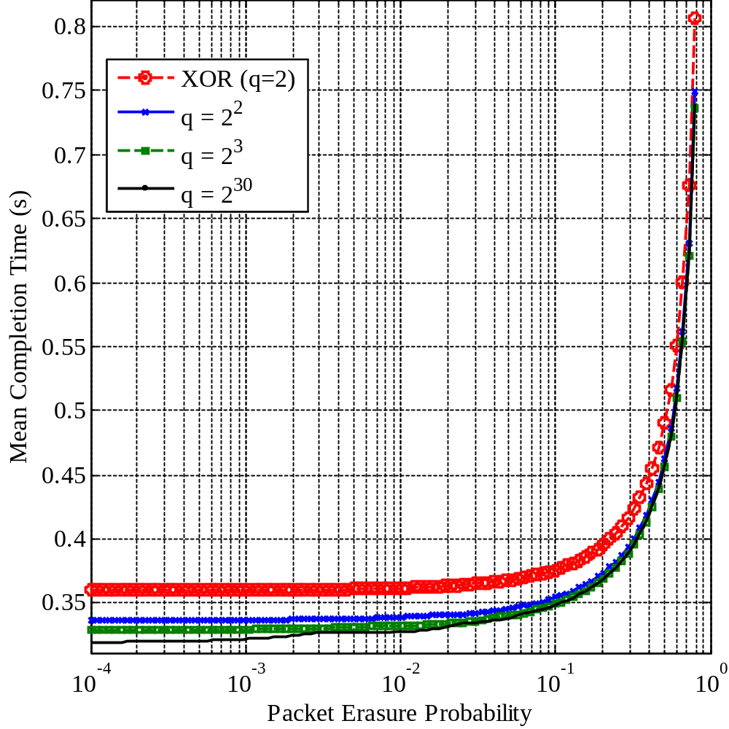
Effect of field size
[GLOBECOM’09]
Computation: Smaller field size, simpler operations
How much do we loose in performance?
  Shown that each receiver requires in average less than M + 2 coded packets to decode regardless of field size (q)
    If q large, roughly M
  If M is large, not much performance degradation

Slide 21
Motivations for Research
Rate uncertainty
How much to talk before stopping to listen?
Capacity improvement through simple, distributed algorithms?
Which transmissions have greatest impact?
Channel
Delay
Interference
How to perform efficient rateless transmission?

Slide 22
Future work: Midterm goals
Simple distributed MAC layer data dissemination protocol
Online network coding in large latency half-duplex channels
Improvement of pushback algorithm: can we send uncoded packets while maintaining rate?
Scaling laws for underwater networks → scale frequency

Slide 23
Future work: Long term goals
General wireless networks that are challenged by high packet losses and large latency
  Special interest in underwater and satellite
Trade-off between cost and rate of sending uncoded packets in network coding
Data dissemination in wireless networks
  Theoretical bounds for half-duplex systems
  MAC level schemes for fast and efficient dissemination
Voice and video transmission in networks and how to best incorporate network coding and feedback in the network

Slide 24
Other Research Topics
Queuing analysis for large latency half-duplex scheme [ISIT’09]
Underwater acoustic networks
Channel models [Oceans’08, JSAC’08]
Fundamental limits [JSAC’08, Asilomar’08, Submitted to IT Trans.]
Joint work with:
Muriel Médard
Milica Stojanovic

Slide 25
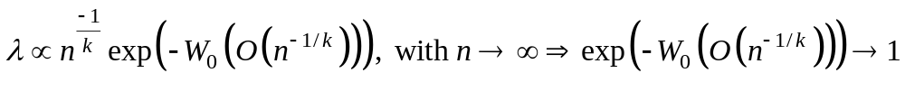
Results
Proposed first simple tractable model relating transmission power, band, capacity [Oceans’08, JSAC’08]
Proposed approximate channel models for transmission power [Oceans’08, JSAC’08]
  Convex for practical purposes [ISITA’08, JSAC’08]
Lower bound to transmission power for multicast [ISITA’08, JSAC’08]
  Based on network coding subgraph selection problem
  Use (approximate) channel models as cost function
Capacity scaling [Asilomar’08, Submitted to IT Trans.]
  Proposed upper bounds for transport capacity for the underwater networks for different setups

Slide 26
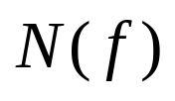
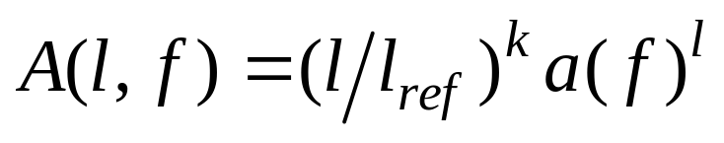
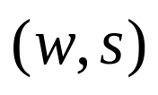

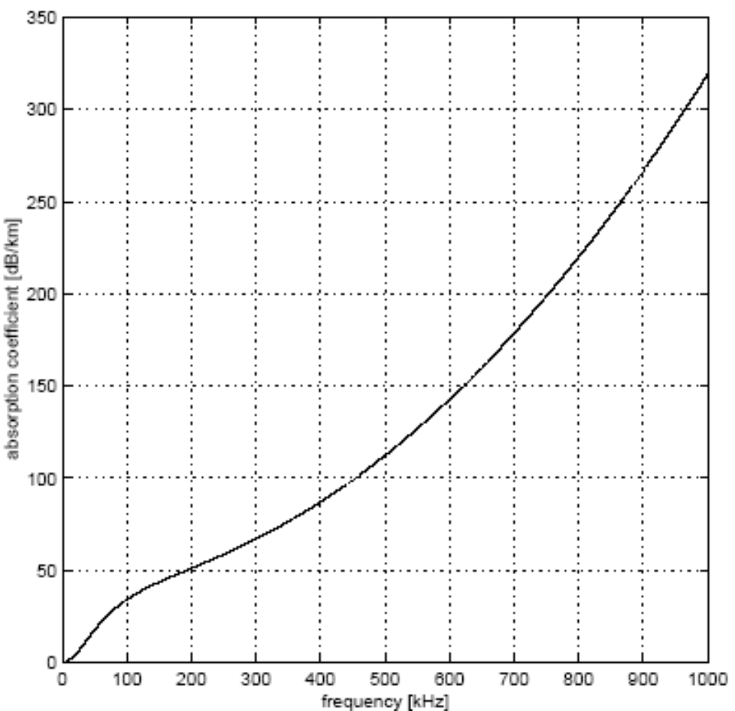
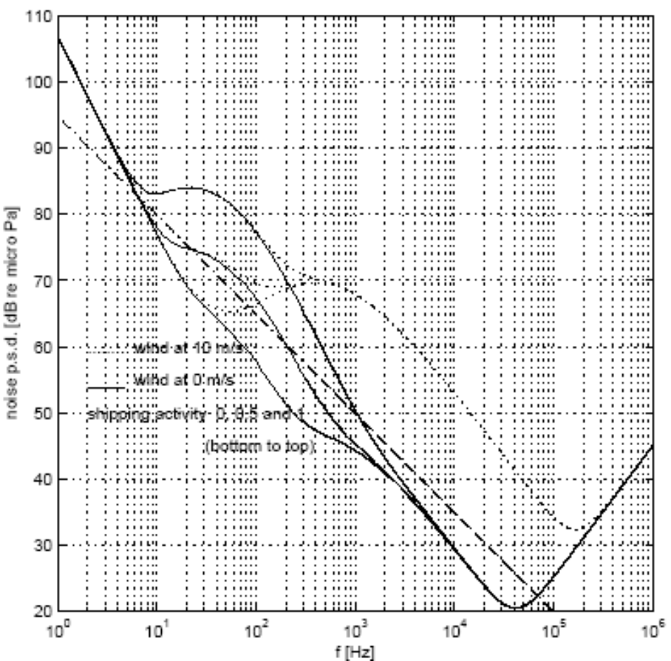
Underwater Acoustic Channel
Path loss:
Noise :
Parameters
Spherical geometry k = 2
A(l,f)N(f)
l
Cylindrical geometry k = 1
f
l

Slide 27
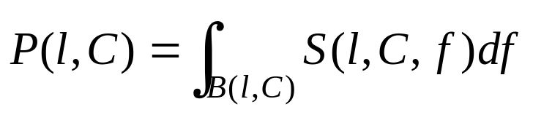
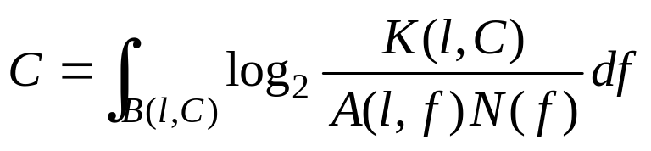



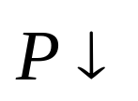
Underwater Acoustic Channel
Power:
where
Capacity (water filling principle):
where optimum band, constant
f_{c}(l)
100 km
A(l,f)N(f)
A(l,f)N(f)
A(l,f)N(f)
K(l,C)
B(l,C’)
50 km
10 km
K(l,C’)
f_{c}(l)
f
5 km
f_{c}(l)
l
f
l<<1 km
f

Slide 28
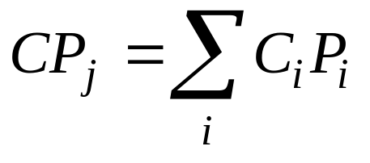


Random Linear Network Coding
Generating a random linear network coded packet (CP)
Operations over finite field of size q = 2^{g}.
e.g. g = 8 bits, q = 256
D
A
T
A
1
x
x
x
x
x
n bits
g bits
C₁
C₁
C₁
C₁
C₁
+
+
+
+
+
D
A
T
A
2
x
x
x
x
x
C₂
C₂
C₂
C₂
C₂
Coded Data
C₂
Header
Coded Data
C₁
h bits
n bits
g bits

Slide 29
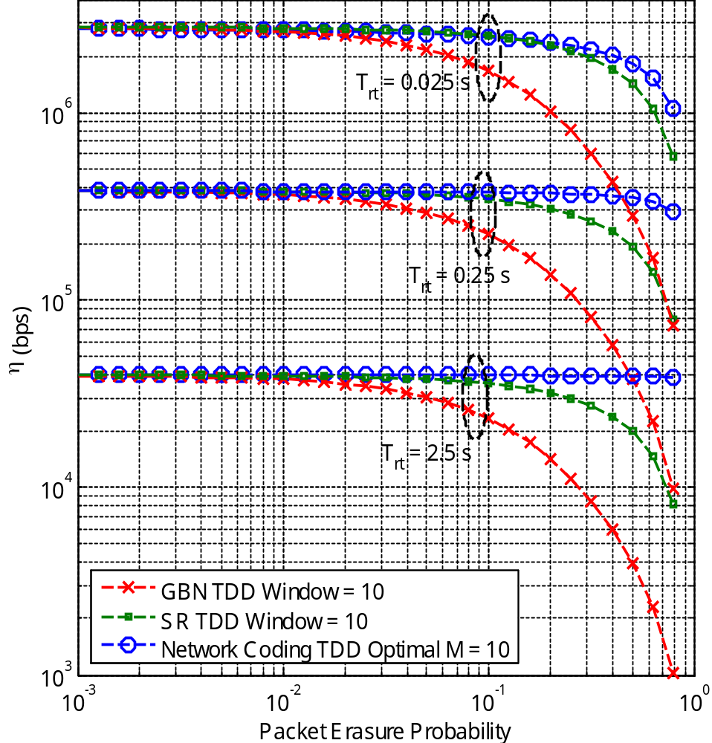
Throughput
Ni, ∀i chosen to minimize mean completion time for channel conditions
e.g: M = 10, Rate = 10 Mbps
Throughput Metric
η = #bits / E[Time]
Increasing latency, favors
network coding TDD scheme
Better performance than
Go-back-N (GBN) and Selective
Repeat (SR) for TDD

Slide 30
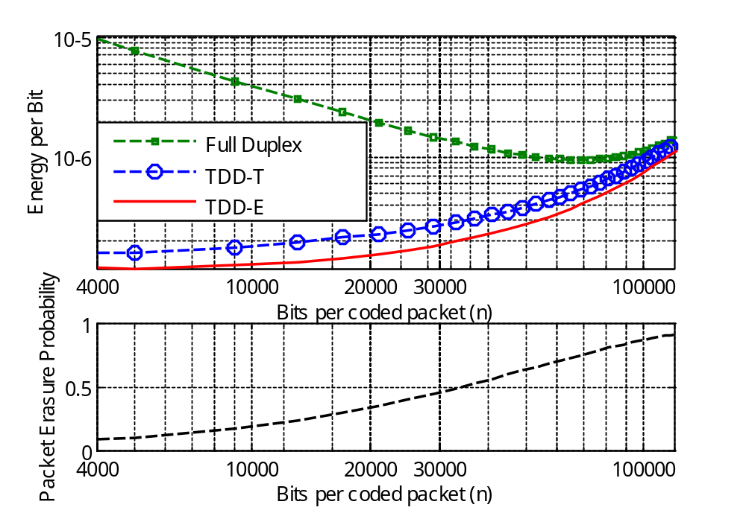
Energy Per Bit
n = # of data bits per packet
Fixed bit error probability: n ⁭ , packet erasure prob. ⁭
Fixed transmission power
<1.4dB
Optimizing for time or energy: similar performance in energy

Slide 31
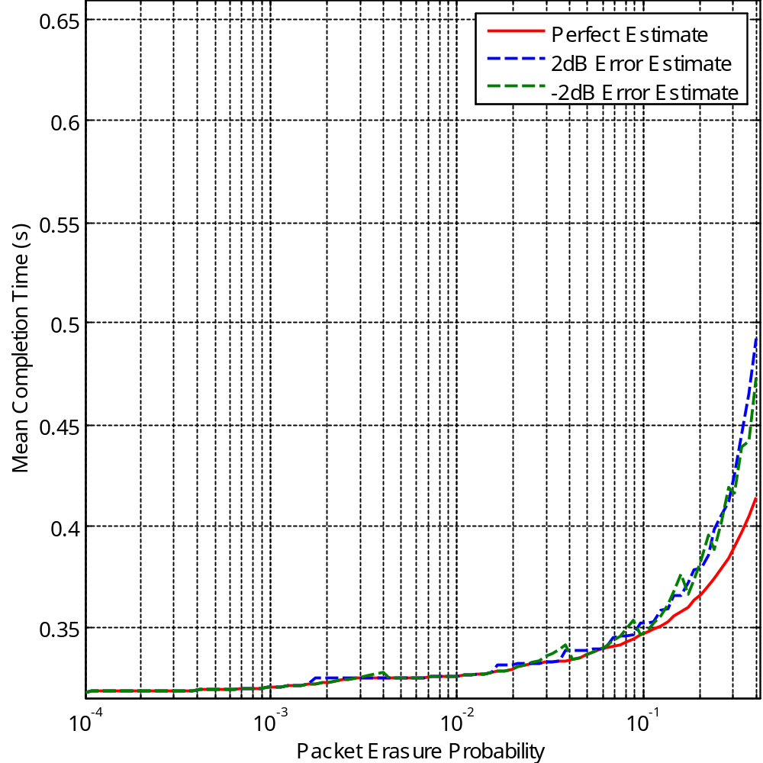
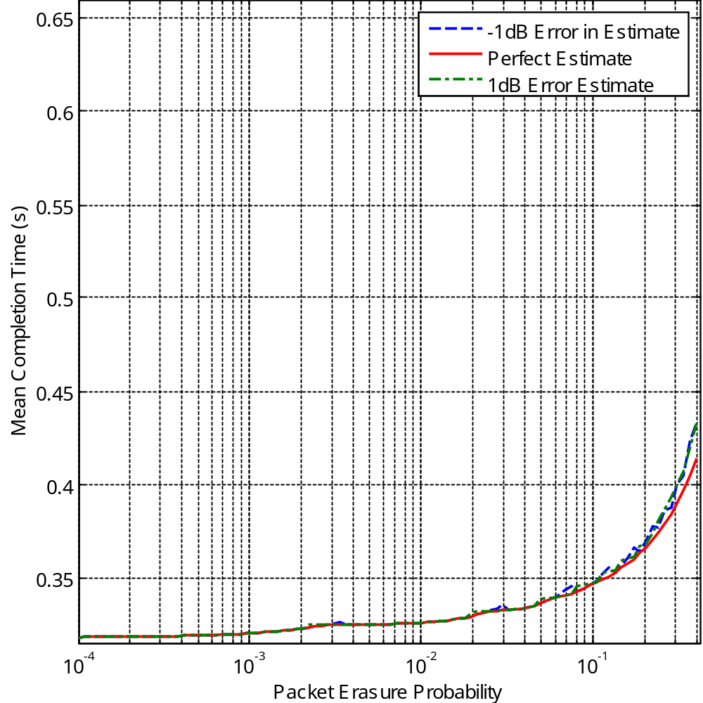
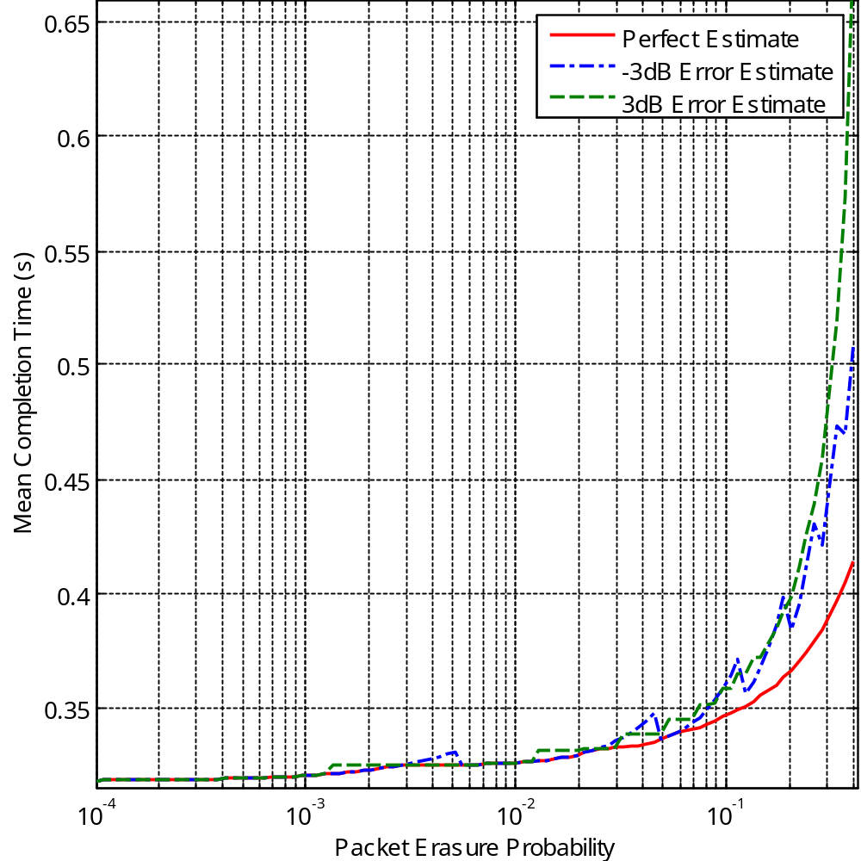
Sensitivity
Errors in estimate of
probability of erasure
Over /Underestimate
of P_{e} : similar results
at low P_{e}
±1dB
±2dB
±3dB
Underestimate of P_{e} :
Better performance
at high P_{e}
<2dB
<0.2dB
<0.84dB
<0.67dB

Slide 32
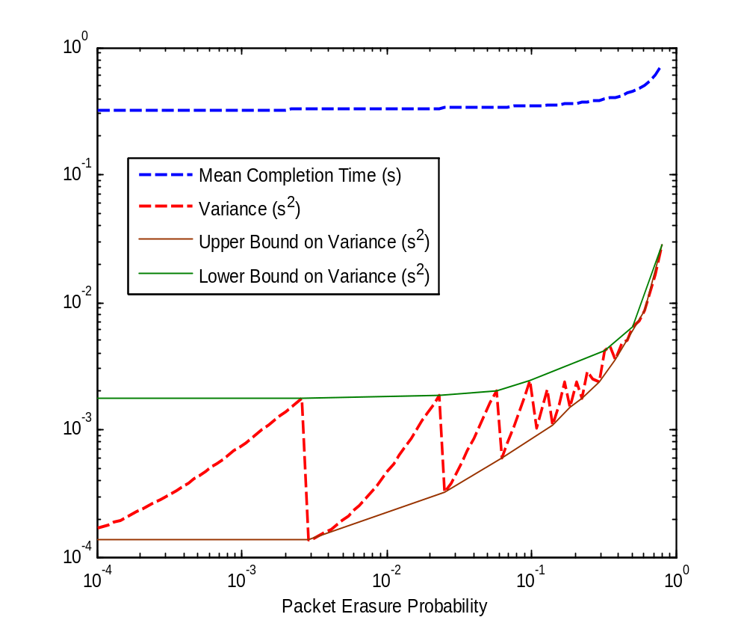
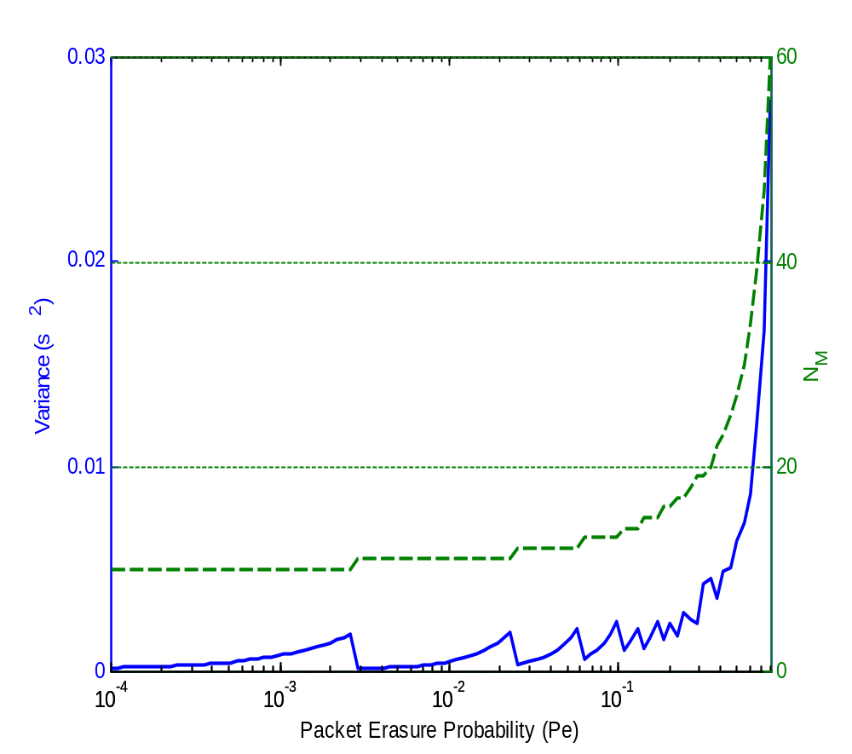
Variance of Completion Time
Variance is not continuous
w.r.t packet erasure prob.
Why?
Change in N_{M}
Change in N_{M}
Change in N_{M}
As packet erasure prob.
increases, number of coded
packets sent N_{i} increases

Slide 33
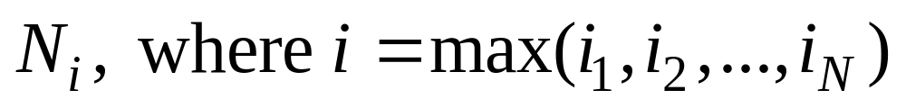
Broadcast: viable scheme
Number of variables:
Reduce to M variables
Optimization:
# of operations depends on # of states, i.e. ~(M+1)^{N}
Develop heuristics to
reduce computation
  Worst Link
  Combined Erasures
M = 3
max dof = 3
3,3
3,2
3,1
3,0
2,3
2,2
2,1
2,0
1,3
1,2
1,1
1,0
0,3
0,2
0,1
0,0

Slide 34
Description of scheme: two nodes
Node 1
Node 2
Erasure Channel
ACK M₂
ACK i₁
ACK i₁
Generates N( , , )
random linear coded packets
Generates N( , , )
random linear coded packets
M₁
i₁
i₁
M₂
0
i₂
M₂
1
Header
Coded Data
C₁
…
C_{M}
h bits
n bits
g bits
M₁ data
packets
.
.
M₂ data
packets
.
.
.
.
.
.
.
.
.
.
Degrees of freedom
needed by Node 2:
Degrees of freedom
needed to decode:
Degrees of freedom
needed by Node 1:
Degrees of freedom
needed to decode:
M₁
i₁
M₂
M₁
M₂
i₁
i₂
Note: Choice of N(i,j,t), ∀I,j,t determines performance of scheme

Slide 35
Description of the scheme
Modeled as Markov chain
  # states N (M₁+1)^{N−1}(M₂ + 1)^{N−1}...(M_{N} + 1)^{N−1}
  N absorbing states
# of variables: large, even for two nodes
Structure:
  Round robin assignment of Tx: Periodicity
  Node “sees” the system as a broadcast problem [Netcod’09] with round trip time variable, depends on initial state
2,2,1
2,1,1
2,0,1
2,2,0
2,1,0
2,0,0
1,2,1
1,1,1
1,0,1
1,2,0
1,1,0
1,0,0
0,2,1
0,1,1
0,0,1
0,2,0
0,1,0
0,0,0
Absorbing
States

Slide 36
Algorithm
Step1: Initialize N(i,j,0) = i, N(i,j,1) = j
Step 2: ∀j’ , fix j’ compute N(i,j’,0) ∀i
Step 3: ∀i’ , fix i’ compute N(i’,j,1) ∀j
Step 4: Converges, then STOP
Node 1
Node 2
N(i,j’,0)
Trt + E[ N(i’,j’,1) P_{(i,j’,0) -> (i’,j’,1)} ] Tp
Dofs needed
i
i’
Fixed value
Node 1
N(i’,j,1)
Node 2
Trt + E[ N(i’,j’,0) P_{(i’,j,1) -> (i’,j’,0)} ] Tp
j’
Dofs needed
j
Fixed, computed in step 2

Slide 37
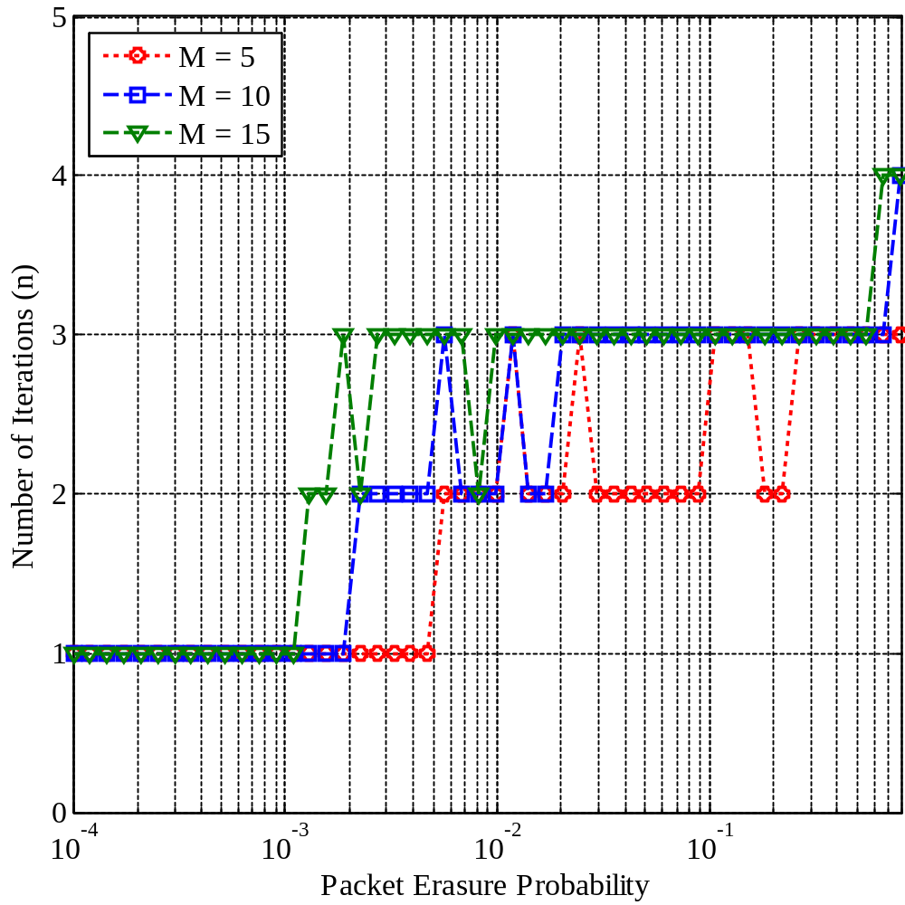
Number of Iterations of Algorithm
M₁ = M₂ = M
Small number of iterations needed
before converging to a solution
For Pe < 10⁻³: algorithm converges to initialization values

Slide 38
Comparison Schemes: Two node case
TDD using Round Robin:
Node 1
1
2
3
…
M₁
Channel
Node 2
1
3
M₁
M₂
2
M₂
…
2
1
Full Duplex using Round Robin:
Node 1
Channel
Node 2
1
2
3
…
M₁
1
2
3
1
3
M₁
1
M₂
2
2
1
M₂
…
2
1
Full Duplex using Network Coding:
Node 1
Channel
Node 2

Slide 39
Greedy algorithm
coding horizon for device i
coding horizon for device 1
100%
75%
50%
25%
backward healing
device i
forward dissemination
device j

Slide 40
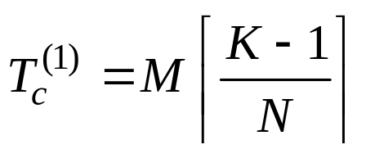
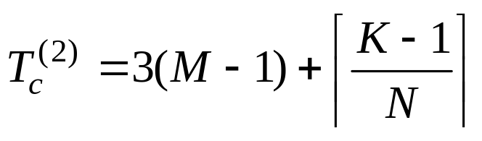
Breaking ties
Break tie: node with the most knowledge
M Data Packets, K nodes, transmit to N nodes downstream
Break tie: schedule that benefits nodes with less data
M Data Packets, K nodes, transmit to N nodes downstream

Slide 41

Objective: minimize dissemination time, arbitrary wireless networks
Assumptions:
  Slotted time
  Network modeled as hypergraph
Optimal scheme
  Involves choosing the sequence of transmissions
  Hard problem
Proposed a greedy algorithm
  Chooses hyperarcs that maximize impact at each slot
    Impact: Avg. # of nodes that benefit from transmission
  Breaks ties in favor of transmissions that disseminate information to nodes with small # degrees of freedom
2
l_{1{2}}
l_{1{2,3,4}}
l_{1{2,3}}
4
1
3

Slide 42
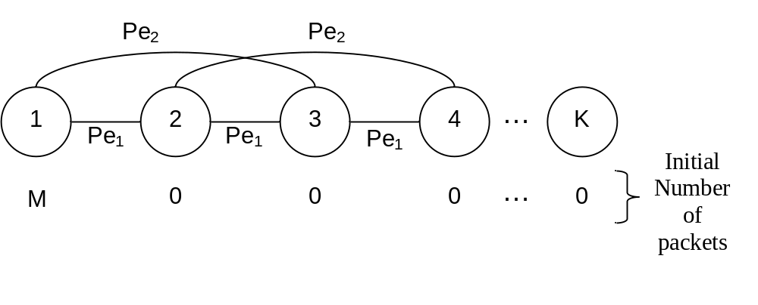
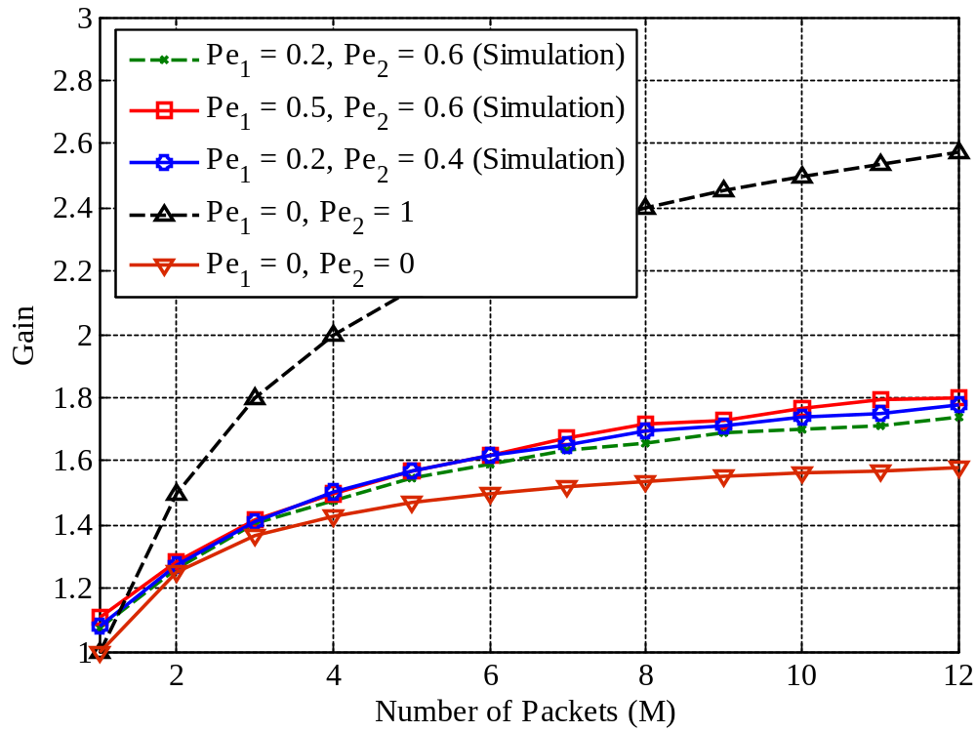
Dissemination time gains: losses
Fixed number of nodes
Overhearing reduces gain,
but reduces completion time
Gain increases in presence
of erasures

Slide 43
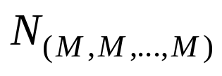

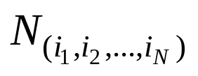




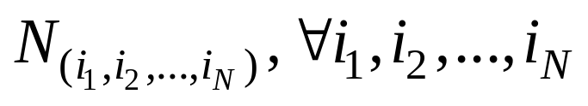

Broadcast
Tx
dofs to decode:
M
Rx N
M packets
…
dofs to decode:
M
Rx 2
Rx 1
dofs to decode:
M
Challenges:
  Optimal scheme: (M+1)^{N}-1 variables to optimize
Viable scheme: Reduce to M variables
Developed heuristics to determine
[NetCod’09, GLOBECOM’09]

Slide 44
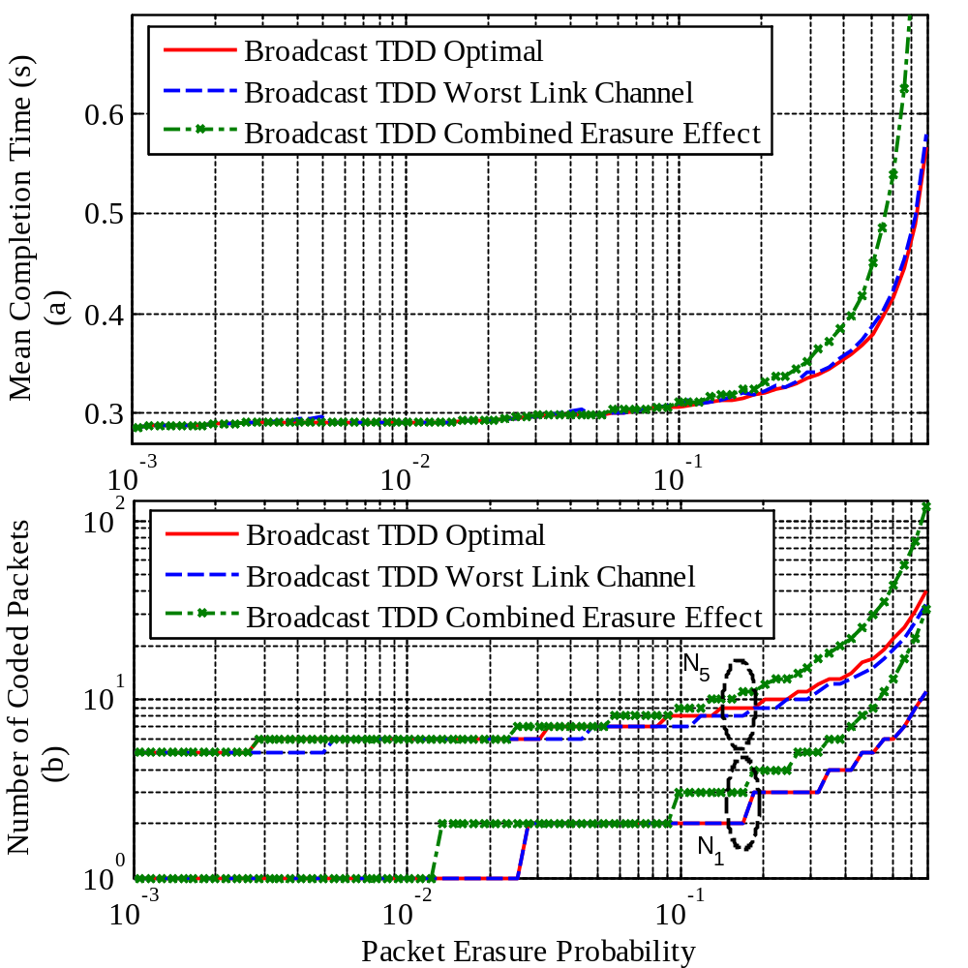
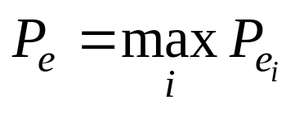
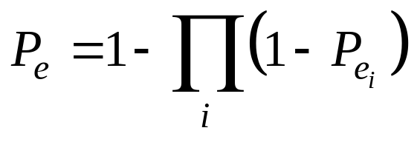
Completion Time: Broadcast
Worst Link Heuristic:
Compute N_{i}’s for link
Combined Erasure:
Compute N_{i}’s for link
Worst Link Heuristic:
Performs close to
optimal

Slide 45
Comparison Schemes: Broadcast
Full Duplex Broadcast using Round Robin:
Tx
i-th
Channel
Rx_{i}
1
2
3
…
M
1
2
3
1
3
M
3
ACK
TDD Broadcast using Round Robin:
Tx
i-th
Channel
Rx_{i}
1
2
3
9
M
ACK

Slide 46
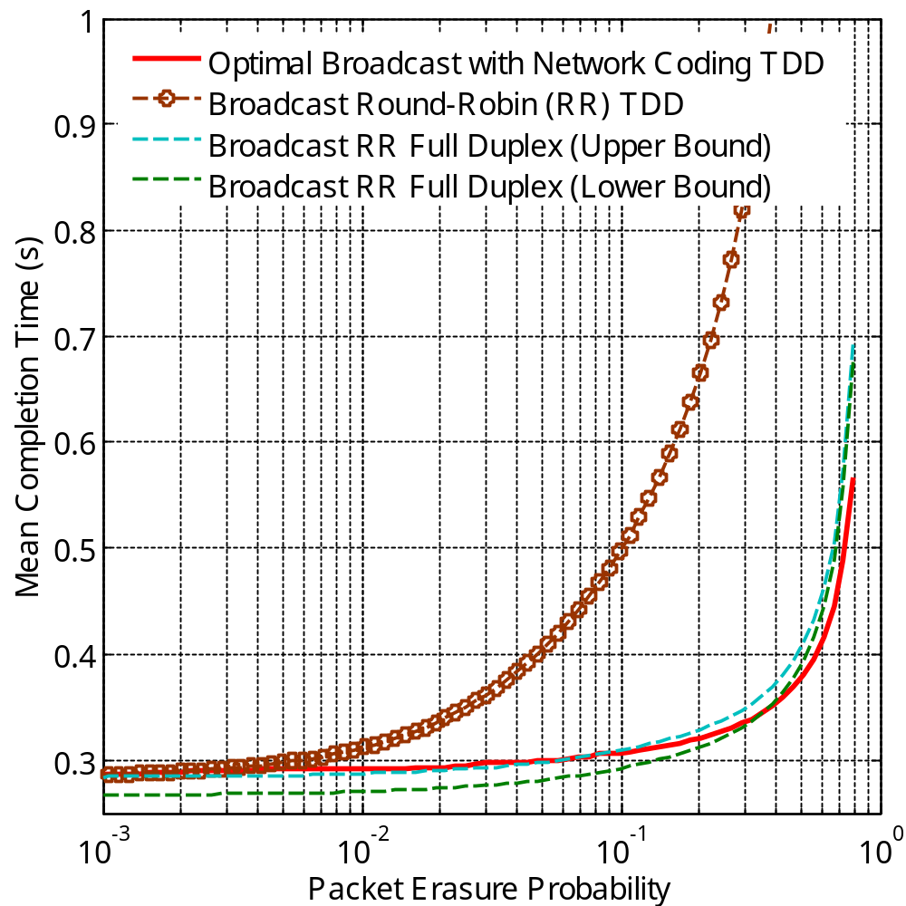
Completion Time: Broadcast
Outperforms TDD
constrained Round
Robin broadcast scheme
(optimal, no coding)
0.8dB @ Pe = 0.8
For high erasure
probability:
Outperforms
full duplex
Round Robin broadcast
Pe > 0.3
better than
RR full duplex

Slide 47
Sharing information in TDD: all-to-all broadcast
[Allerton’09]
Node N
M_{N} packets
Node 1
M₁ packets
…
Node 3
M₃ packets
Node 2
M₂ packets
Setup:
  Broadcast assumption
  Round robin assignment of channel
  Completion time: M_{i} original packets of each node i are successfully transmitted to all N-1 nodes and receive ACK

Slide 48
Description of the scheme
# of variables: large
Structure:
  Round robin assignment of Tx: Periodicity
  Node “sees” the system as a broadcast problem with round trip time variable, depends on initial state
Algorithm exploits this structure:
  Computes #of coded packets to transmit for broadcast (using heuristics) from each node
  Couples the effect of other nodes through the average round trip time
  Converges in a small number of iterations

Slide 49
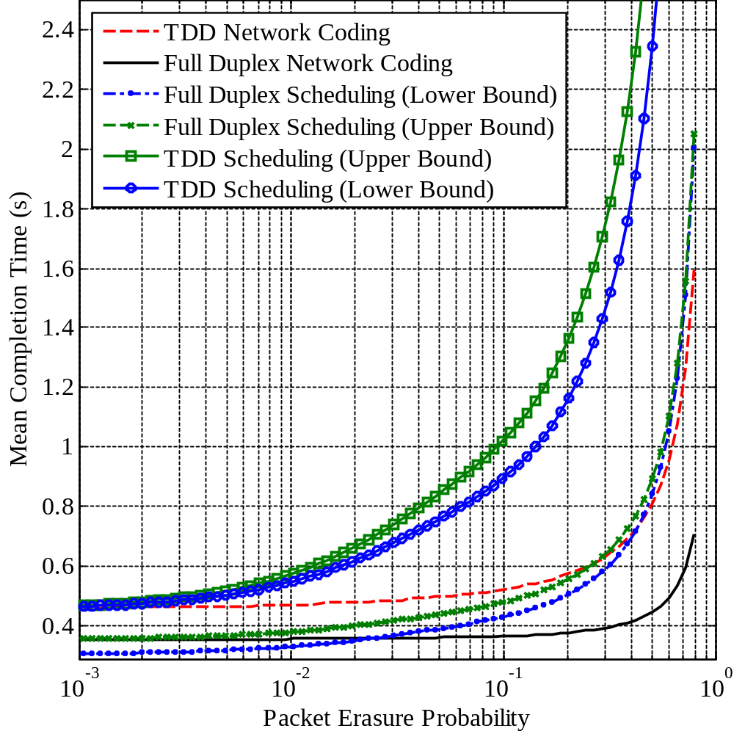
Mean Completion Time
M₁ = M₂ = M
At high Pe:
  better than no coding with a full duplex channel
  ~3dB more than network coding full duplex
At moderate Pe: 1dB away from full duplex
TDD Scheduling
Full Duplex
Scheduling

Slide 50
Underwater Rateless Transmission
Rate uncertainty
How to perform efficient rateless transmission?
Channel
Delay
Interference
Joint work with:
Muriel Médard
Milica Stojanovic

Slide 51
Underwater Rateless Transmission
Underwater constraints
  Large propagation delay, e.g. 1.5 km → 1 s
  High packet losses
  Transmission band
    Very limited, typically from ~0Hz to 100 kHz
    Bandwidth decreases as distance increases
System design
  MAC model: hard to coordinate or perform power control
    ALOHA
  Use implicit ACK in network coding
    Gain information from state of nodes based on their own coded packet transmissions
    Reduce power consumption of purely rateless scheme

Slide 52
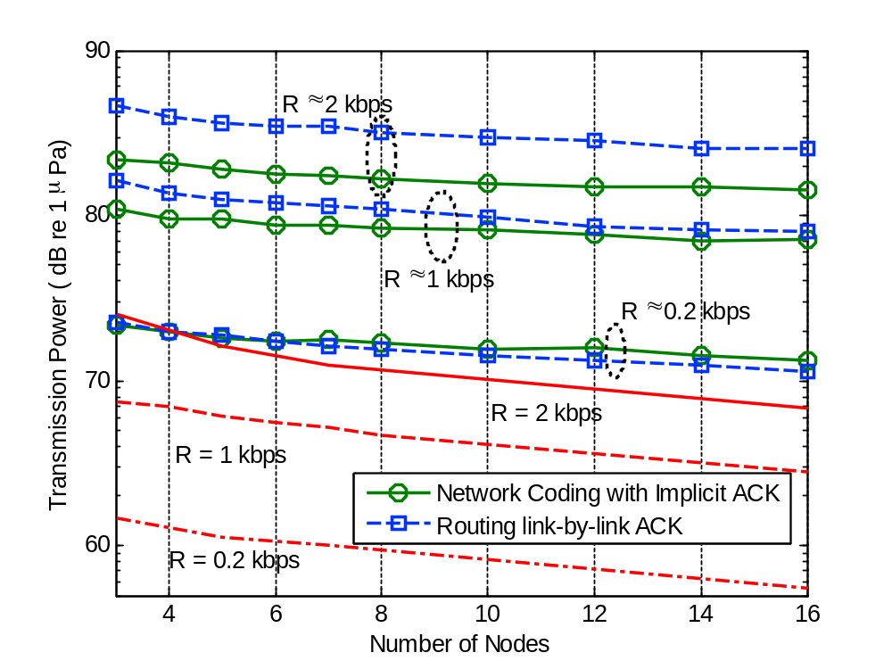
Numerical Results
Node deployed in a square of 1x1 km²
Schemes transmit power to reach receiver with some SNR
Gaussian signaling
~3 dB
[WUWNET’07,
ISITA’08,
JSAC’08]
~11 dB

Slide 53
Coding for Data Dissemination
Rate uncertainty
Which transmissions have greatest impact?
Channel
Delay
Interference
Joint work with:
Muriel Médard
Milica Stojanovic
Frank H. P. Fitzek

Slide 54
Sharing information in Half-Duplex Channels
[RAWNET’09]
Setup:
  Optimal scheme
    Involves choosing the sequence of transmissions
    Hard problem
  Proposed a greedy algorithm
    Chooses hyperarcs that maximize impact at each slot
      Impact: Avg. # of nodes that benefit from transmission
    Breaks ties in favor of transmissions that disseminate information to nodes with small # degrees of
    freedom

Slide 55
Toy example
Progressive Base Station:
Slots
5M/2
2M
M
0
3M/2
M Data Packets
Greater Impact (Vanilla):
backward healing
forward dissemination
2M
3M/2
M/2
0
M
M Data Packets

Slide 56
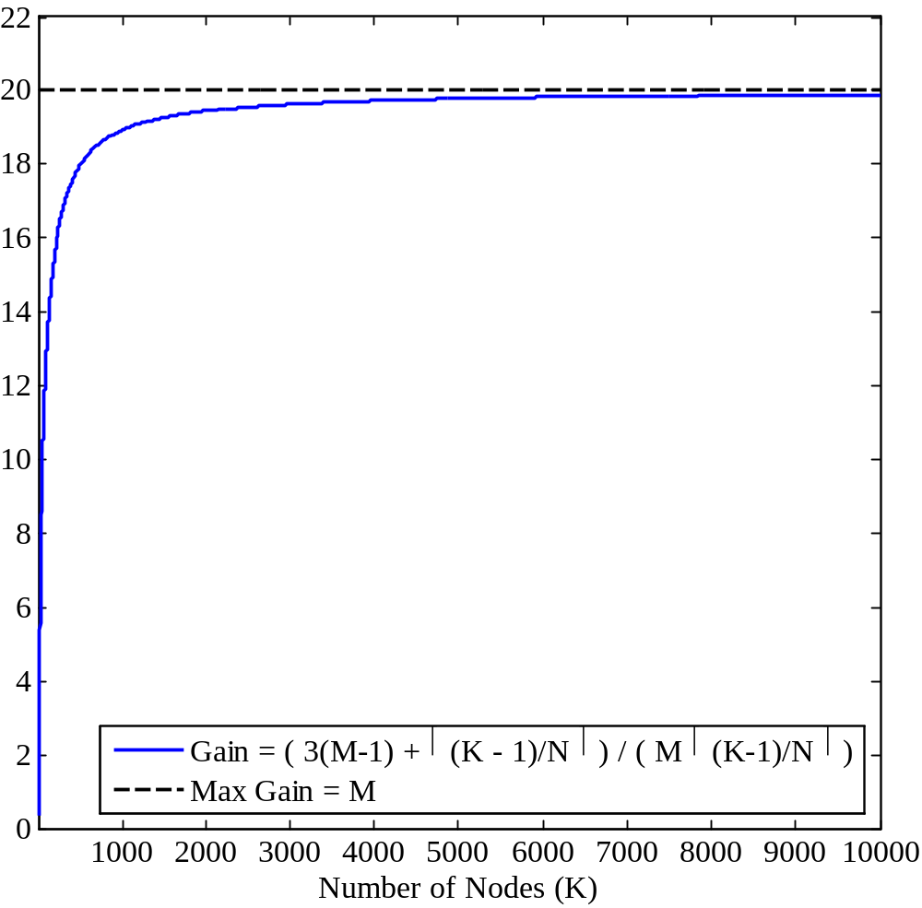
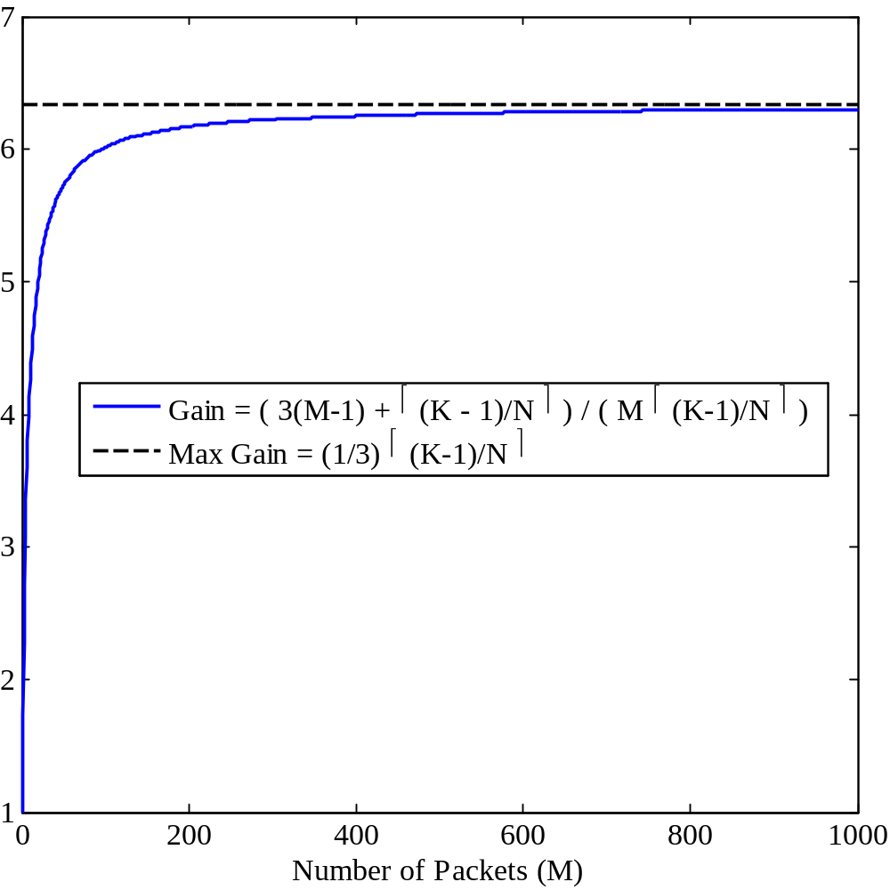
Dissemination time gains: no losses
Overhearing
of N = 2
20 packets
20 nodes

