Slide 1
Friendly Jamming for Wireless Secrecy
IT Workshop
June 1st
João P. Vilela‡, Matthieu Bloch†, João Barros‡, Steven W. McLaughlin†
‡ Instituto de Telecomunicações
University of Porto, Portugal
†Georgia Institute of Technology

Slide 2
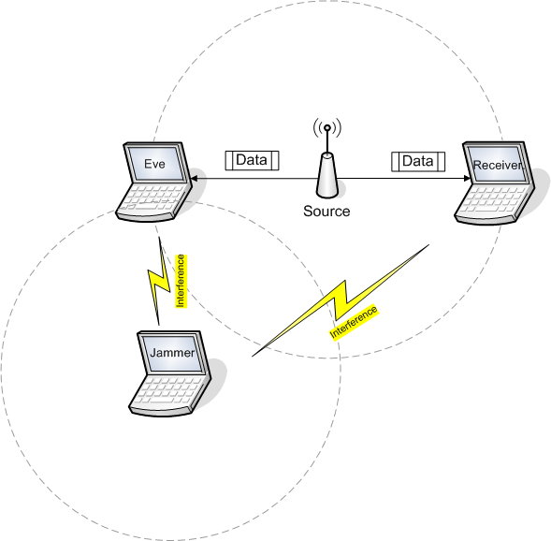
Scenario
Friendly Jamming for Wireless Secrecy
IT Workshop
Notes:
We consider a scenario where a source wants to communicate to a receiver (e.g. an AP to a laptop).
There is an eavesdropper who whishes to overhear the communication.
Jamming is traditionally viewed as a means to corrupt communications. In this case we have a friendly jammer, i.e. a node that can be used to cause interference to the eavesdropper. This may be, for example, a node that does not have information to transmit, or a node waiting for a time slot in a time division system.
Our goal is to evaluate how this jammer can be used to increase the secrecy of wireless networks by adding controlled interference on the communication.
Maximum transmission rate at which the eavesdropper is unable to acquire any information.

Slide 3
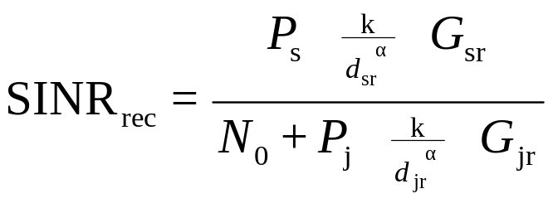

Secrecy Capacity
Two ways to increase the secrecy capacity:
Increase the SINR of the legitimate receiver
Reduce the SINR of the eavesdropper
Design parameters:
  Tx Power of Jammer
  Location of the Jammer
  CSI (channel state information)
Distance/Path loss
Tx Power of Jammer
Rayleigh Fading Gain
Friendly Jamming for Wireless Secrecy
IT Workshop
Notes:
For a channel without fading, Cs represents the maximum transmission rate at which the eavesdropper is unable to acquire any information.
Increasing the SNR of the legitimate receiver: shortenning the distance to the source.
Reducing the SNR of the eavesdropper: adding controlled interference.
If we focus on the jammer, we have the following design parameters:
Tx Power
Location
Cs:
maximum transmission rate at which the eavesdropper is unable to acquire any information (for AWGN channels?
security metric for the case of non fading channels (the SNR does not have fading neither interference from jammers)
Simplified path loss model (common for microcellular systems – from Rappaport Wireless Communications Principles and Practice):
Path loss exponent = 4
Normalization constant k = free-space path gain for 2.4GHz transmission at the reference distance of 1 meter
Microcellular systems: something in between a regular AP and a cellular base station.
Rayleigh fading: standard statistical model for multipath propagation. Captures the essence of the reception of an individual multipath component. Gain is exponential.

Slide 4
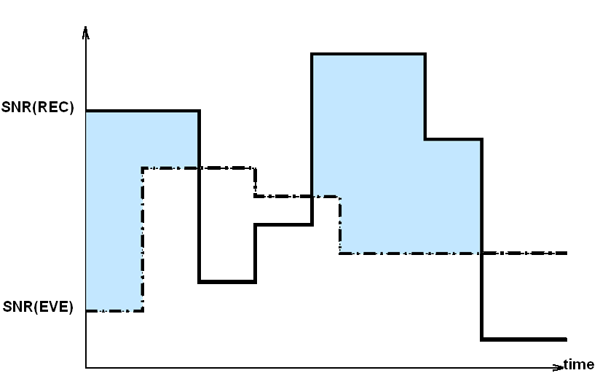
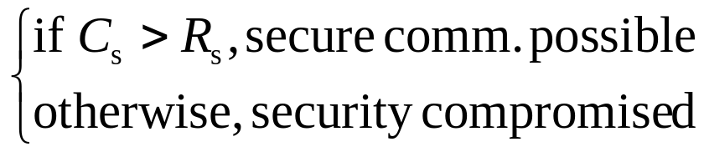
Secrecy Outage Probability
[Barros, Rodrigues, ISIT’06]
The capacity varies with the instantaneous SNRs
Users agree on a target secrecy rate Rs:
Secrecy Outage Probability:
Friendly Jamming for Wireless Secrecy
IT Workshop
Notes:
Due to fading, the SNR varies with time and the capacity can assume a range of values depending on the instantaneous SNRs.
There is always a non-zero probability that any specified secrecy rate is not achievable
The way this SNRs vary is unpredictable
Therefore, the best the users can do is agree on a target secrecy rate and transmit.
- If the capacity of the channel (Cs) is higher than the secrecy rate (Rs) secure communication is possible.
- Otherwise security is compromised and an outage is reported.
And so, the probability of outage is described as Pout(Rs) = P{Cs < Rs}
This was proposed by Barros and Rodrigues as a metric for the secrecy of wireless networks.
Mention slow fading channels?
It is an average measure of security that tells you the expected number of secrecy outages.

Slide 5
Previous Work
Cooperative Jamming [Tekin, Yener, 2008]
Artificial Noise [Goel, Negi, 2008]
Fading channels
Closed-form expressions for the secrecy outage probability
Jamming strategies with different CSI requirements
Our Contribution
Friendly Jamming for Wireless Secrecy
IT Workshop
Notes:
Tekin, Yener:
Gaussian channels: Gaussian Multiple Access and Gaussian Two-Way Wiretap
power allocations maximizing secrecy sum rate
cooperative jamming increases secrecy sum rate
Goel, Negi:
Fading
CSI publicly available

Slide 6
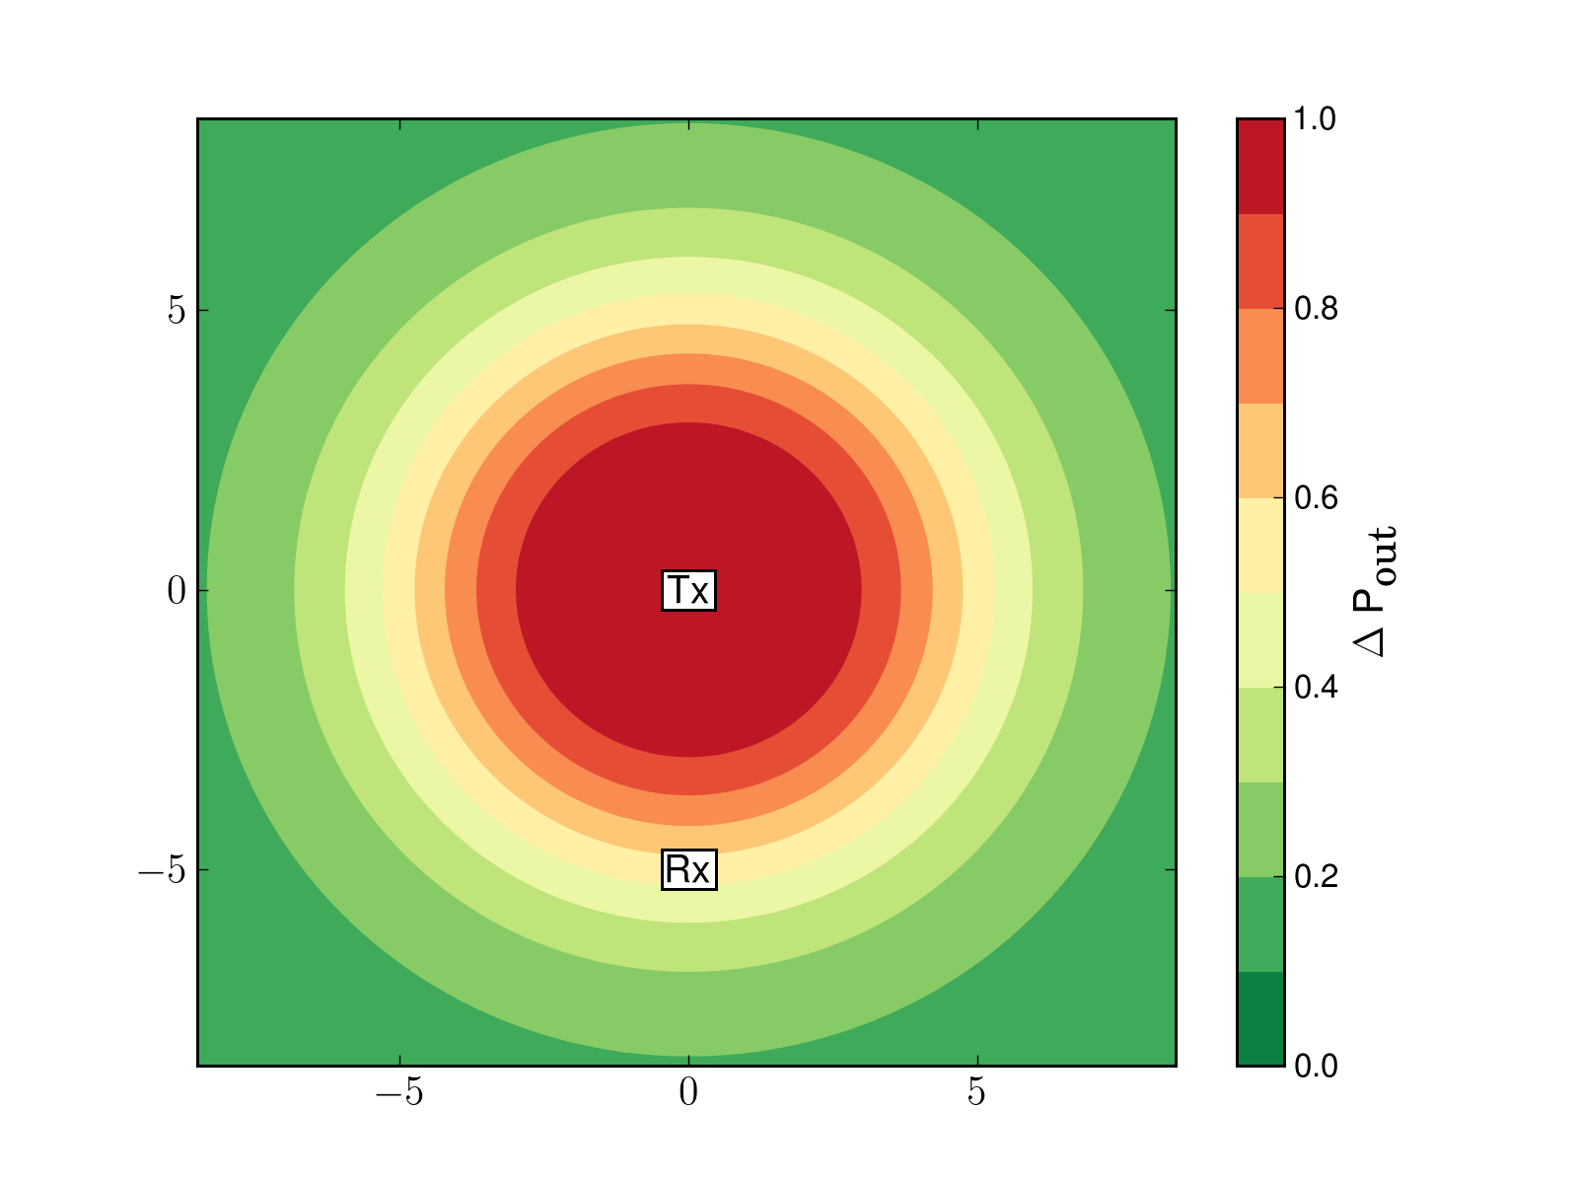
Secrecy Outage Probability – Illustration
Friendly Jamming for Wireless Secrecy
IT Workshop
Notes:
For each location in this map, it represents the probability of outage we get if the eavesdropper is there.
Motivation with cell planning example? If there is time

Slide 7
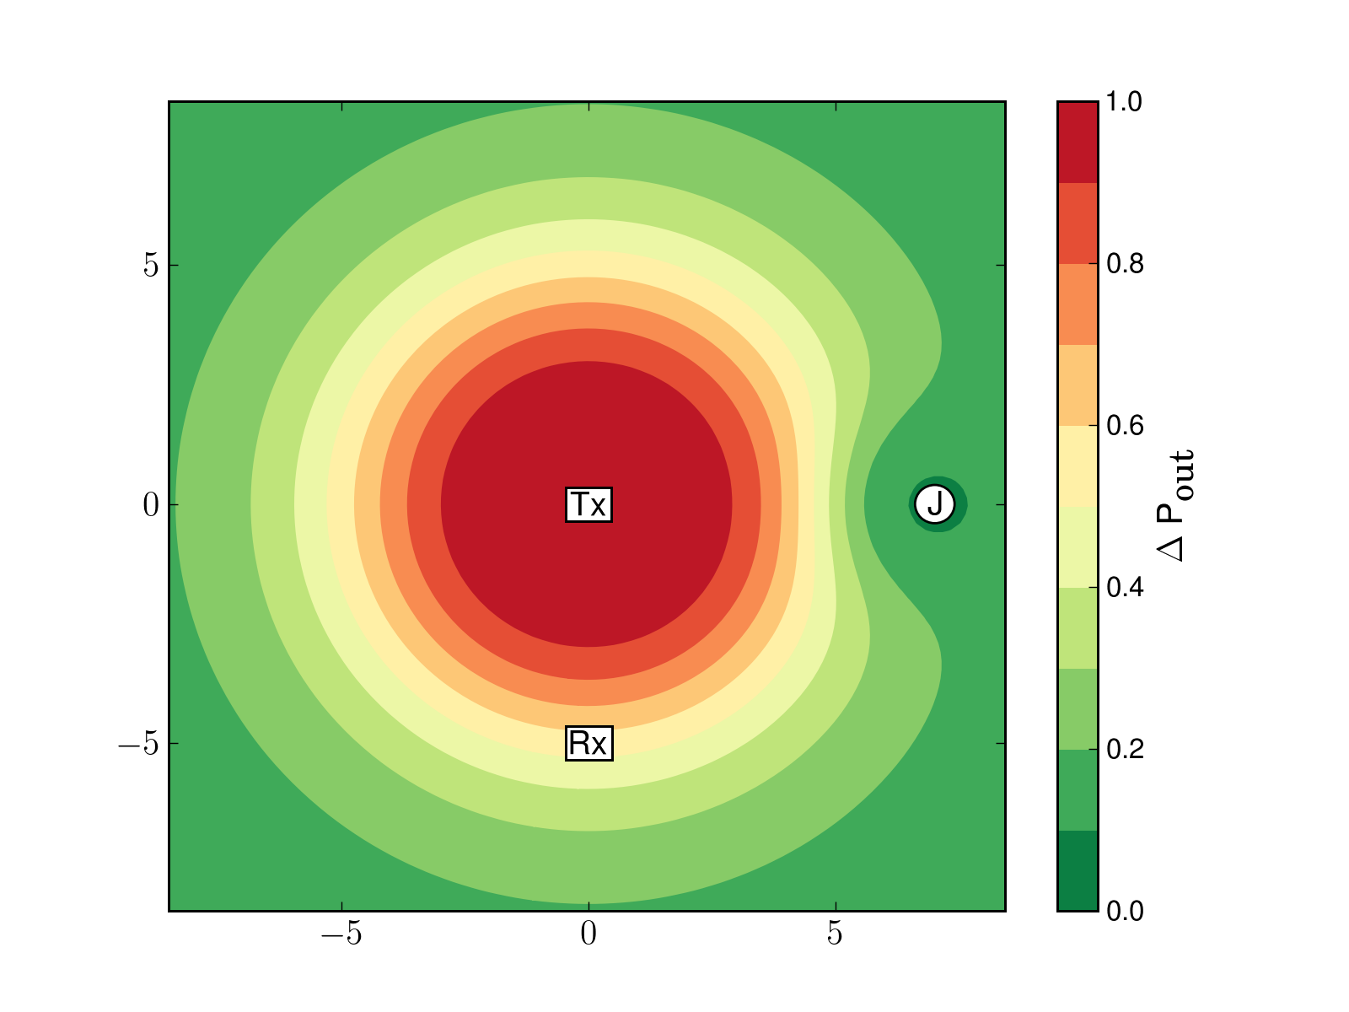
Secrecy Outage Probability with Jamming
Friendly Jamming for Wireless Secrecy
IT Workshop

Slide 8

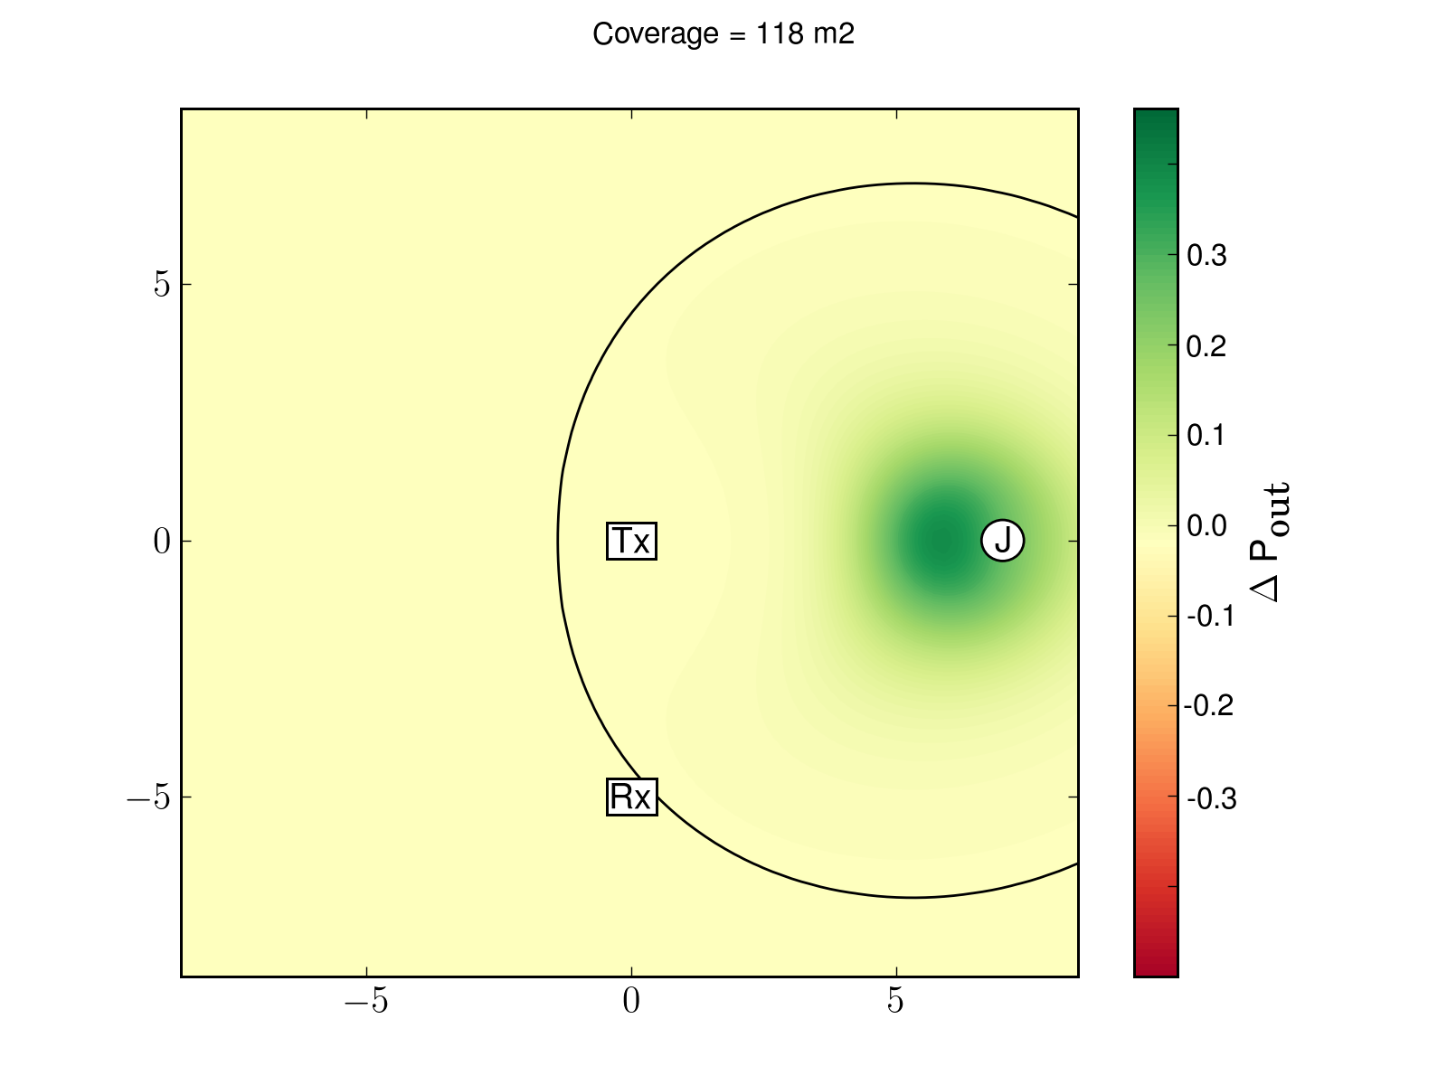
Focusing on the impact of the Jammer
Variation of Secrecy Outage Probability:
Friendly Jamming for Wireless Secrecy
IT Workshop

Slide 9


Metrics
Security impact of jamming in a confined area:
Jamming coverage: area of region where
Jamming efficiency: average over whole region
Ultimate security goal:
Achieve the largest coverage
while assuring the highest efficiency.
Friendly Jamming for Wireless Secrecy
IT Workshop
Notes:
We assume that the location of the eavesdropper is not known. These security metrics capture that effect.
Large coverage configurations guarantee that the reduction of the secrecy outage occurs over a large region;
The jamming efficiency favors large reductions on the secrecy outage probability

Slide 10
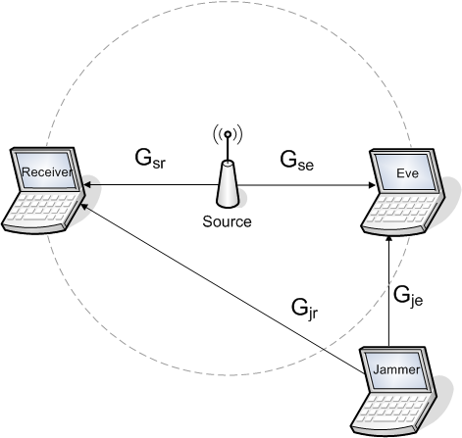

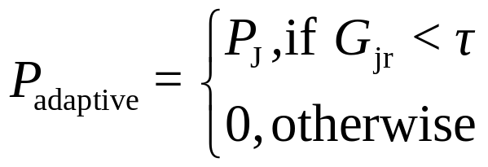
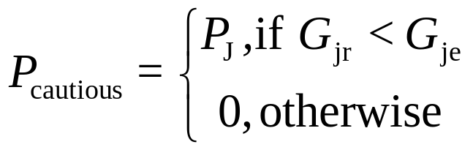
Jamming Strategies
Channel State Information (CSI) may be available:
No CSI: Blunt Jamming
CSI of Receiver only: Adaptive Jamming
CSI of Receiver and Eve: Cautious Jamming
Friendly Jamming for Wireless Secrecy
IT Workshop
Notes:
Several jamming strategies have been investigated (survey on “Cooperative Jamming: the tale of friendly interference for secrecy”, He & Yener), such as based on:
Gaussian noise
Gaussian codebooks
structured codebooks
Our goal is to analyze how the availability of CSI affects the secrecy benefits of jamming, so we restrict ourselves to the simplest case: jamming with Gaussian noise. The different jamming strategies differ only in terms of the CSI they require.
We derived closed-form expressions for the secrecy outage probability for each of the strategies:
Averaged over the fading coefficients
instead of adapting the jamming power, the fading coefficients distribution changes for each strategy

Slide 11
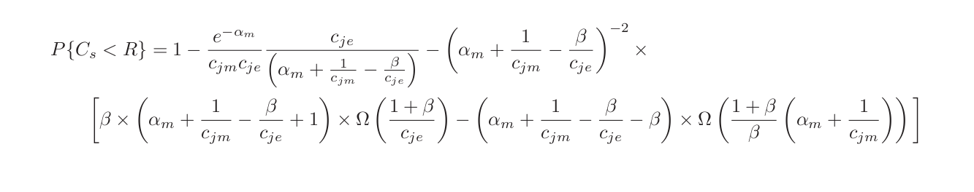
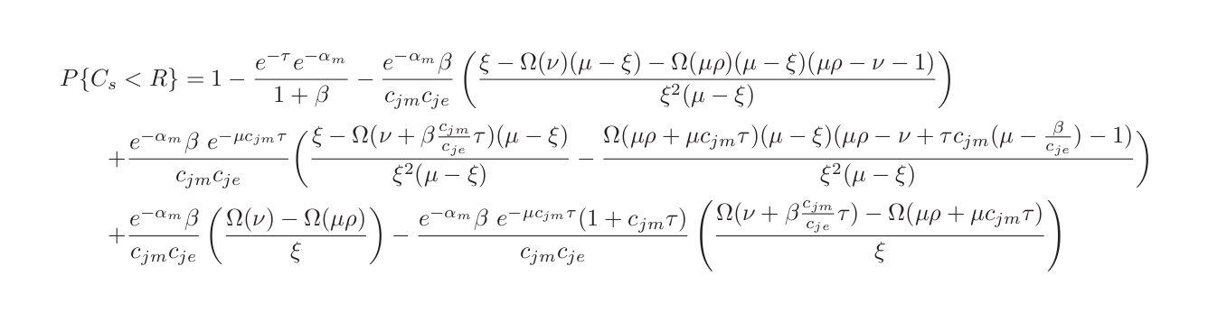
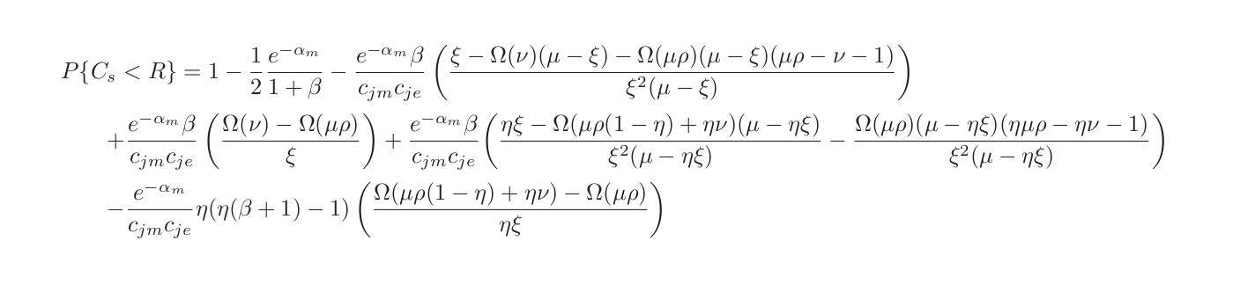
Secrecy Outage Probability with Jamming
Blunt Jamming:
Adaptive Jamming:
Cautious Jamming:
Friendly Jamming for Wireless Secrecy
IT Workshop
Notes:
Remove formula?

Slide 12


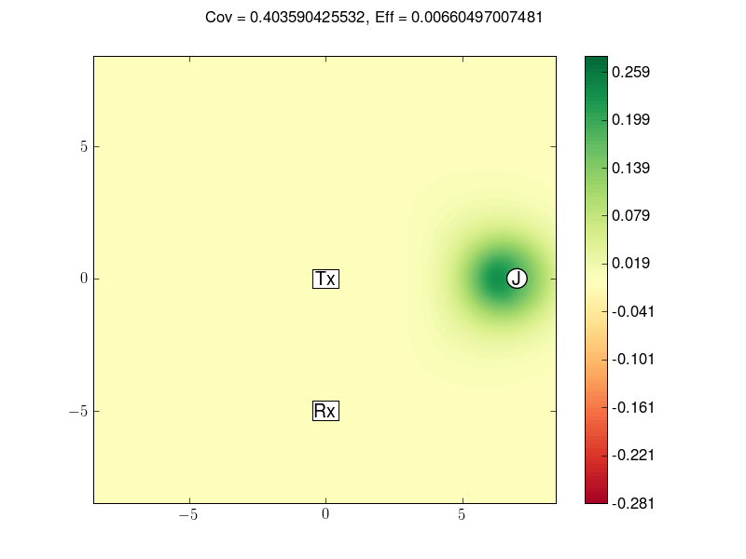
Results – Methodology
Source and receiver with fixed location and power
Desired secure communication rate:
Jammer transmit power:
Sampling of location of jammer
Friendly Jamming for Wireless Secrecy
IT Workshop
Notes:
Rs is 10% of the capacity of the channel without fading. The capacity of the channel with fading is already lower than the one without fading. Yet, by considering a low relative secrecy, we implicitly assume that there is a penalty in terms of communication rate to achieve security.
Sampling of location and transmit power of the jammer: gives us an approximation of the best location.
30 transmit powers between 10^-2 W and 10 W
1156 locations sampled
results in a total of nearly 35K setups being tested

Slide 13
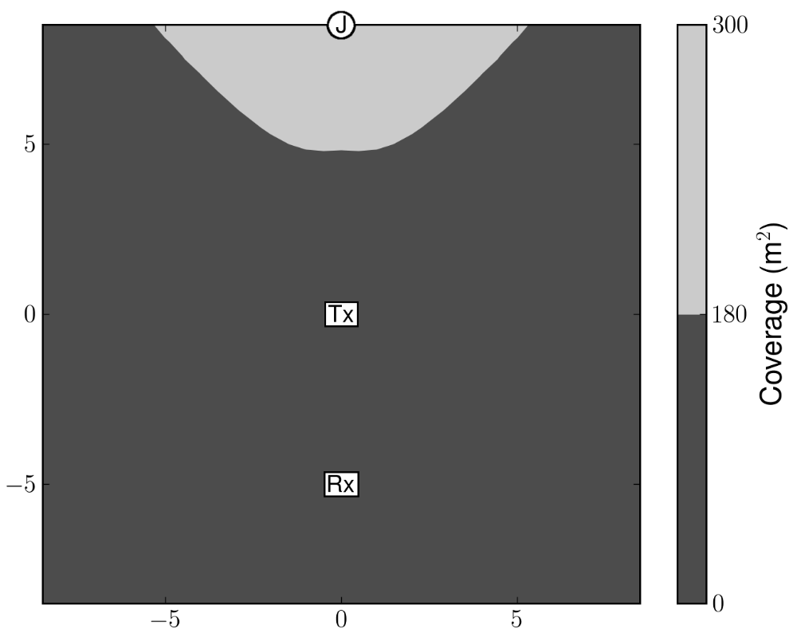
Optimal Coverage Results – Blunt Jamming
Characteristics:
Locations far from receiver
Low transmit power by the jammer (10⁻²W)
Friendly Jamming for Wireless Secrecy
IT Workshop
Notes:
Configurations where the jammer is able to provide largest coverage.
Although this results are specific for blunt jamming, the characteristics we present here hold for other strategies as well.
Locations far from receiver: because interference on the main receiver is harmful.
Low transmit power by the jammer: because higher transmit power causes more interference on the legitimate receiver

Slide 14
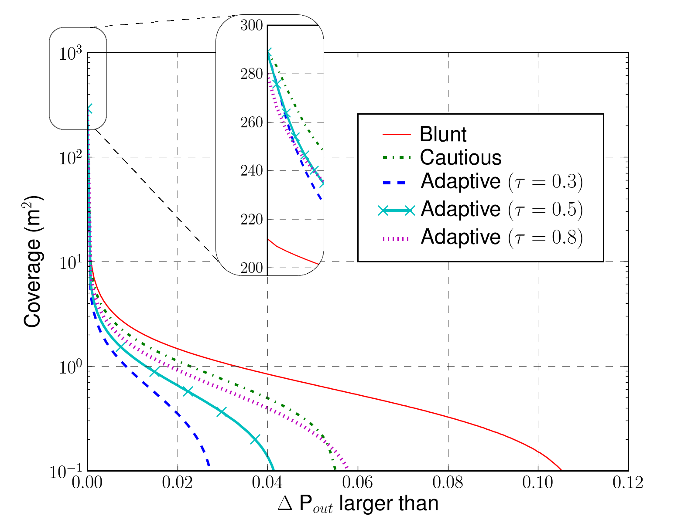
Optimal Coverage Results – Comparison of Strategies
Highlights:
Negligible gains in terms of
Coverage-efficiency tradeoff
Friendly Jamming for Wireless Secrecy
IT Workshop
Notes:
Blunt jamming: delta Pout > 0.03 (3% improve) over an area of 1m^2.
Cautious jamming is able to achieve a variation on the secrecy outage (delta Pout) above 0.02 over an area of 1m^2 (negligible).
Why does blunt jamming (which doesn’t use any CSI) surpass the others? Because the others use CSI with respect to the impact of the jammer only, which causes them to miss favorable opportunities to jam. To achieve that they would have to use CSI with respect to all channels.

Slide 15
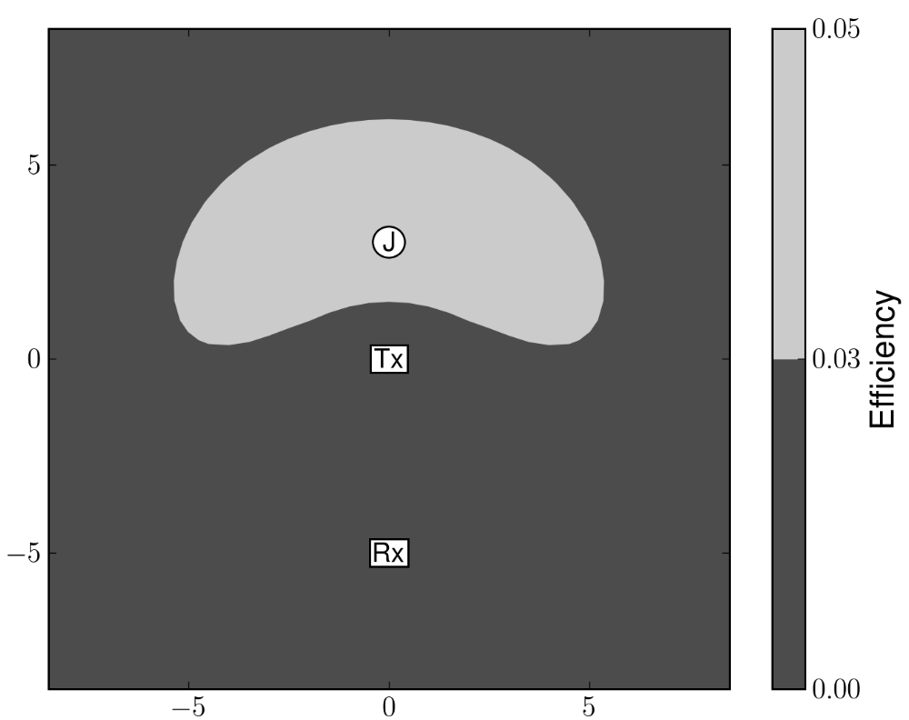
Optimal Efficiency Results – Blunt Jamming
Characteristics:
Locations closer to the source
Higher transmit power by the jammer (10W)
Friendly Jamming for Wireless Secrecy
IT Workshop
Notes:
Configurations where the jammer is able to provide largest efficiency.
Although this results are specific for blunt jamming, the characteristics we present here hold for other strategies as well.
Need for controlled interference: higher transmit power is OK, if controlled. If it is increased on and on, it ends up causing more harm than good.
Locations closer to the source: because it is close to the source that the secrecy outage is higher and the jammer is most useful. Still tending away from the receiver, since interference on the receiver is harmful.

Slide 16
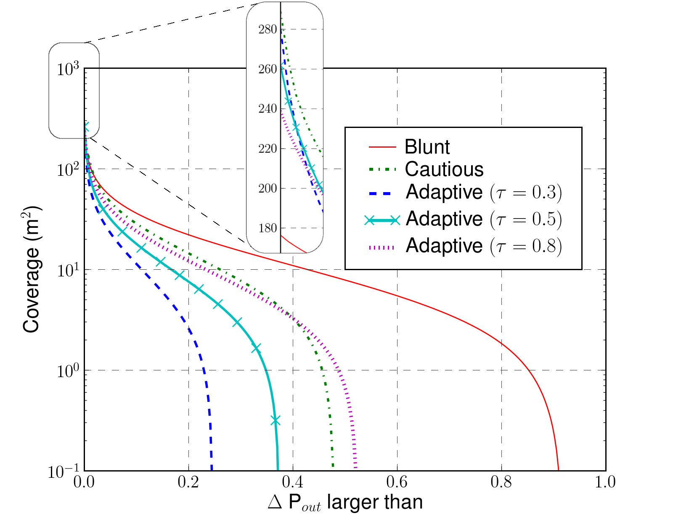
Optimal Efficiency Results – Comparison of Strategies
Highlights:
Relevant gains in terms of
Still shows the coverage-efficiency tradeoff
Friendly Jamming for Wireless Secrecy
IT Workshop
Notes:
Blunt jamming: delta Pout > 0.73 over an area of 1m^2.
Why does blunt jamming (which doesn’t use any CSI) surpass the others? Because the others use CSI with respect to the impact of the jammer only, which causes them to miss favorable opportunities to jam. To achieve that they would have to use CSI with respect to all channels.
There is a need to protect locations close to the receiver as well, specially if it is close to the source. Notice that, although the other strategies use high transmit power as well, they still manage to achieve a large coverage (close to the maximum). This shows that CSI is useful to protect locations close to the receiver.

Slide 17
Final Remarks
Our work:
Secrecy outage with jamming metrics: coverage and efficiency
Jamming strategies based on different levels of channel state information
Conclusions:
Low transmit power yields negligible security gains
High transmit power brings security benefits if harmful interference is kept under control.
Jammer close to receiver: channel state information is required
Coverage-efficiency tradeoff: none of the analyzed strategies is able to provide both coverage and efficiency, therefore more jammers are needed.
Friendly Jamming for Wireless Secrecy
IT Workshop
Notes:
Low transmit power yields negligible security gains (as seen from the optimal coverage configurations).
High transmit power can become harmful, yet a proper selection of higher power can improve results
Channel State Information useful to provide security close to the receiver => suggest hybrid scheme with different types of jammers according to their location?

Slide 18
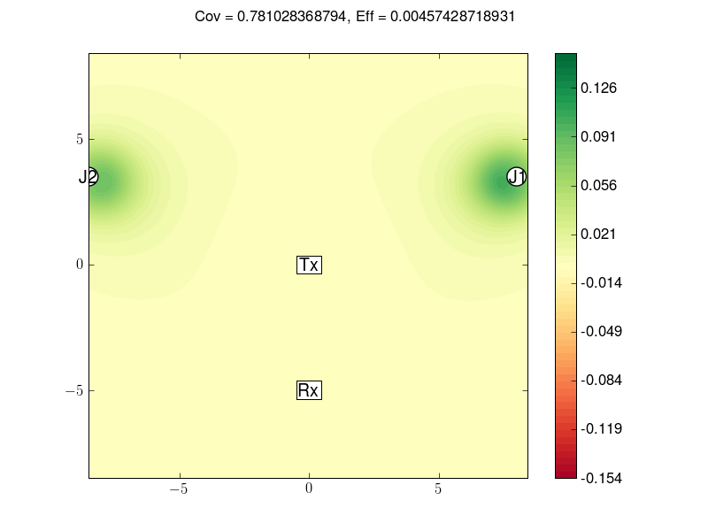
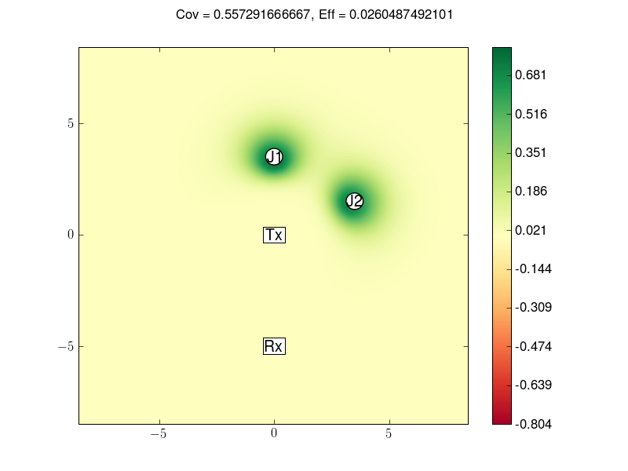
Multiple Jammers
Friendly Jamming for Wireless Secrecy
IT Workshop

