Slide 1
Filter Design with Secrecy Constraints
Hugo Reboredo
Instituto de Telecomunicações
Departamento de Ciências de Computadores
Faculdade de Ciências da Universidade do Porto
Joint work with Miguel Rodrigues, Munnunjahan Ara,
Vinay Prabhu and João Xavier

Slide 2
Outline
Motivation
Problem Statement
Optimal Receive Filter
Optimal Transmit Filter
Algorithm
Numerical Results
Final Remarks

Slide 3


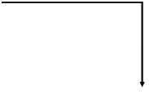

Why?
Some security notions…
X
X
k-bit message M
Alice
Bob
X
k-bit decoded message M^{b}
key K
key K
Eve
Information-Theoretic Security
  strictest notion of security, no computability assumption
    H(M|X)=H(M) or I(X;M)=0
  e.g. One-time pad
  Shannon, 1949: H(K)≥H(M)
  Suggests a physical-layer approach to security
Computational Security
  Alice sends a k-bit message M to Bob using an encryption scheme;
  Security schemes are based on assumptions of intractability of certain functions;
  Typically done at upper layers of the protocol stack

Slide 4





Why?
Wiretap Channel
message M
mesg. estimate M_{b}
X^{n}
Y^{n}
Alice
p(y|x)
Bob
equivocation rate
p(z|y)
mesg. estimate M_{e}
Z^{n}
Eve
H(M)
D
RELIABILITY CRITERION:
Transmission rate
Pr(M=M_{b})→1
C_{S}
C_{M}
SECURITY CRITERION:
H(M|Z^{n})→H(M)
[Wyner’75]

Slide 5





Why?
Gaussian Wiretap Channel
N_{M}
X
Y
Alice
Bob
N_{W}
Z
Eve
Secrecy Capacity: C_{s}=C_{M}-C_{W}=log₂(1+P/N_{M})−log₂(1+P/N_{W})
Positive Secrecy Capacity -> degraded scenario
[Leung and Hellman’78]

Slide 6
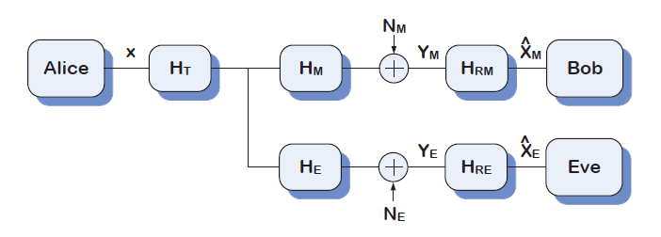




Filter design with secrecy constraints
s.t.
Notes:
Assuming a degraded scenario – Hm’Hm > He’He

Slide 7
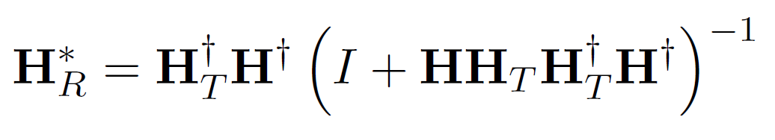
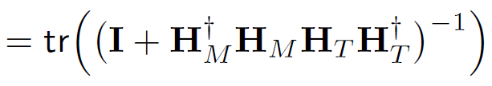



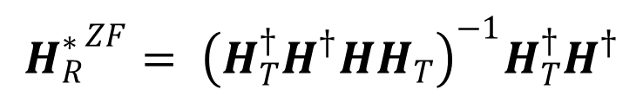
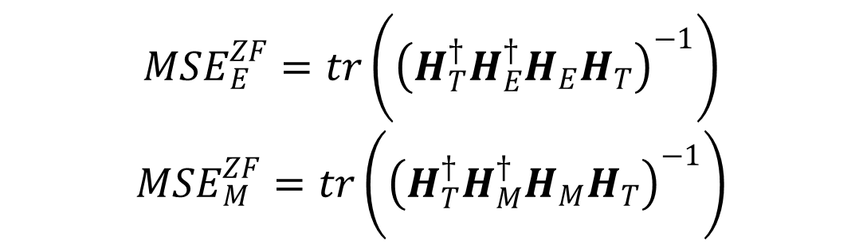
Optimal Receive Filter
Wiener Filter
Zero Forcing Filter

Slide 8







Optimal Transmit Filter
Weiner filters
N_{M}
X
Y_{M}
Bob
Alice
H_{T}
H_{M}
H_{RM}
Y_{E}
Eve
H_{E}
H_{RE}
s.t.
s.t.

Slide 9






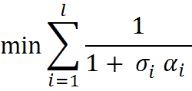
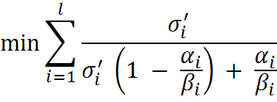
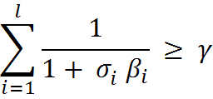
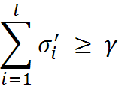


Optimal Transmit Filter
Weiner filters
GEVD
s.t.
s.t.

Slide 10
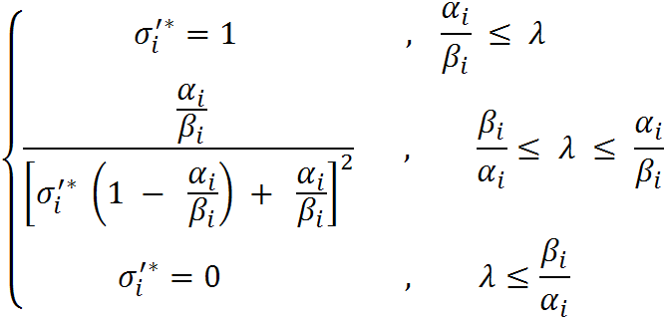
Optimal Transmit Filter
Weiner filters
N_{M}
X
Y_{M}
Bob
Alice
H_{T}
H_{M}
H_{RM}
Y_{E}
Eve
H_{E}
H_{RE}

Slide 11




Optimal Transmit Filter
ZF filters
N_{M}
X
Y_{M}
Bob
Alice
H_{T}
H_{M}
H_{RM}
Y_{E}
Eve
H_{E}
H_{RE}
s.t.
s.t.

Slide 12






Optimal Transmit Filter
ZF filters
N_{M}
X
Y_{M}
Bob
Alice
H_{T}
H_{M}
H_{RM}
Y_{E}
Eve
H_{E}
H_{RE}

Slide 13
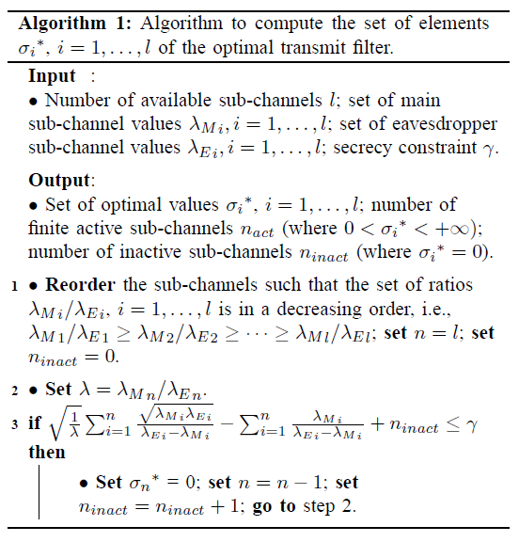
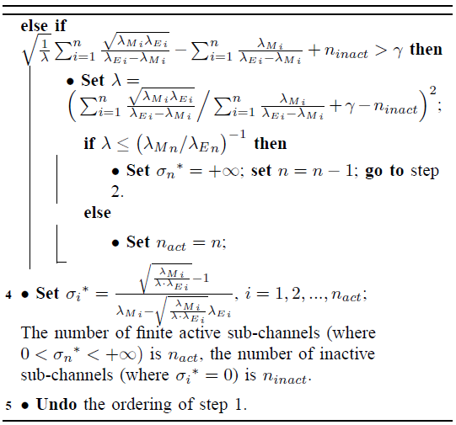
Algorithm
Wiener Filters
:

Slide 14
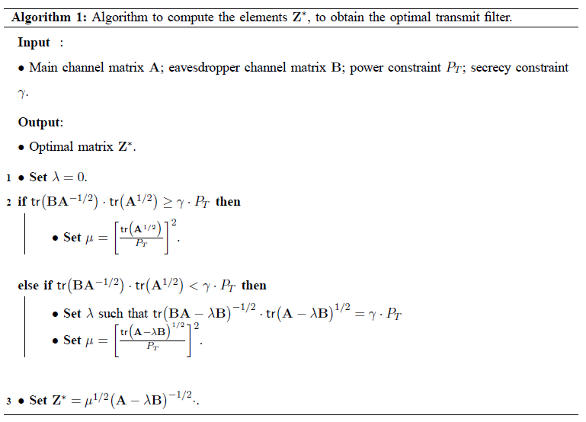
Algorithm
ZF Filters
:

Slide 15
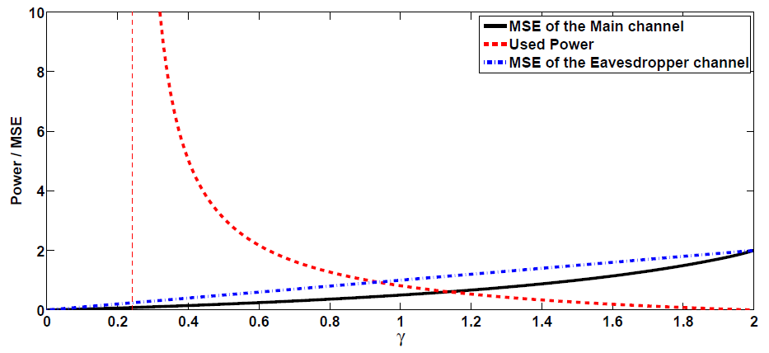
Numerical Results
Wiener Filters
Gaussian MIMO 2x2 channel

Slide 16
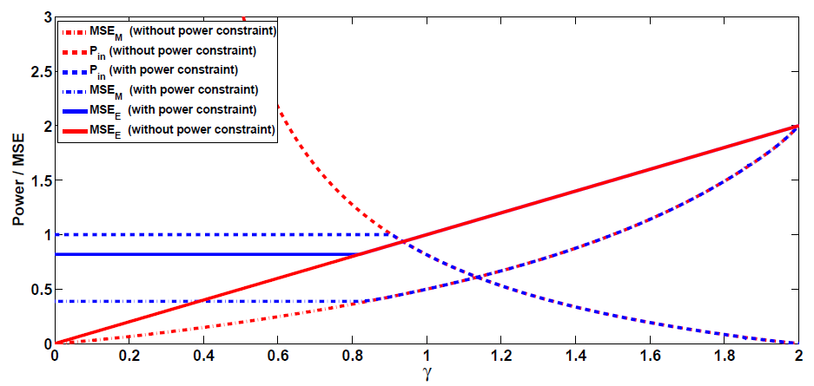
Numerical Results
Wiener Filters
Gaussian MIMO 2x2 channel

Slide 17
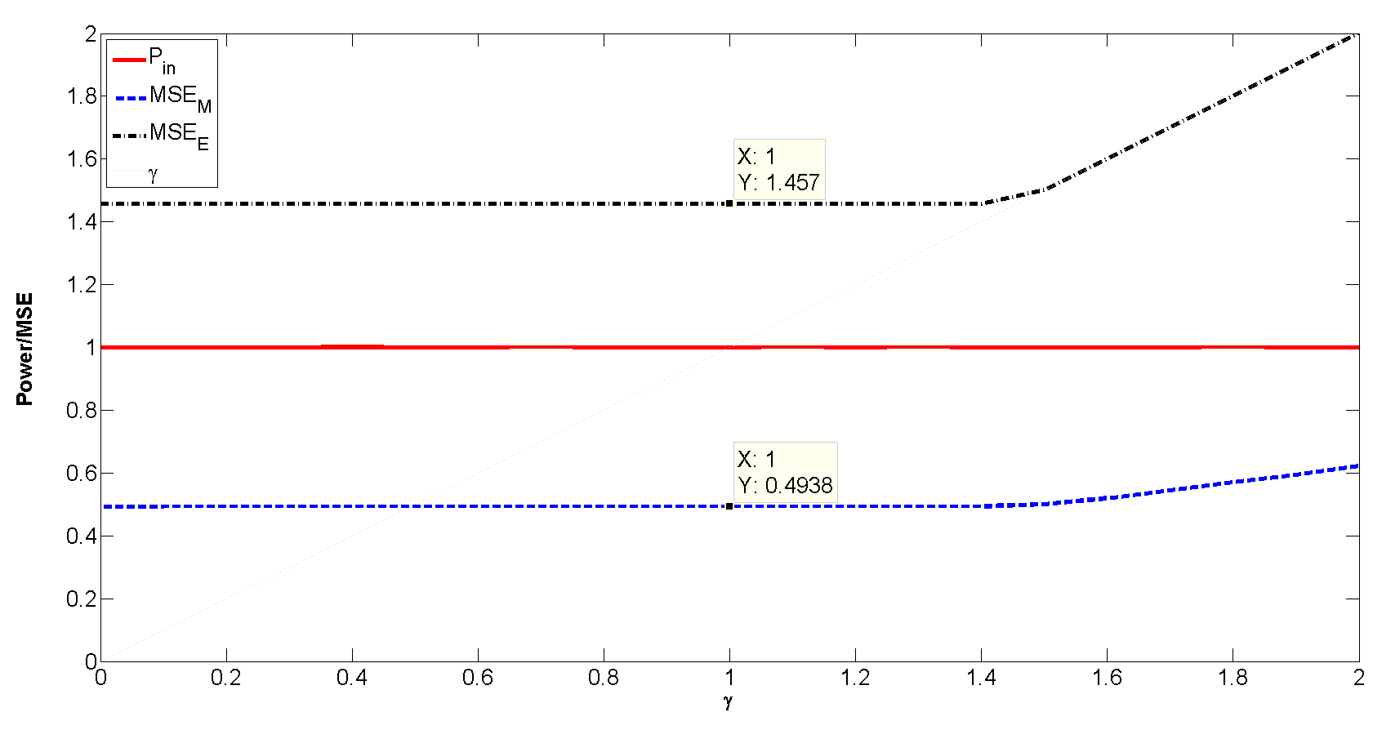
Numerical Results
ZF Filters
Main and eavesdropper MSE vs. secrecy constraint gamma and
input power vs. secrecy constraint – Degraded Scenario
Gaussian MIMO 2x2 channel

Slide 18
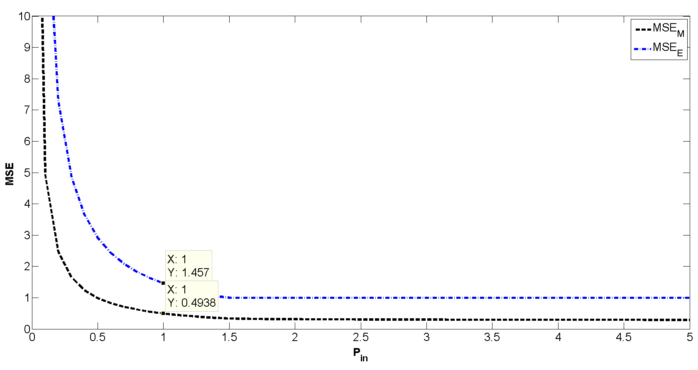
Numerical Results
ZF Filters
Main and eavesdropper MSE vs. input power – gamma = 1
Degraded Scenario
Gaussian MIMO 2x2 channel

Slide 19
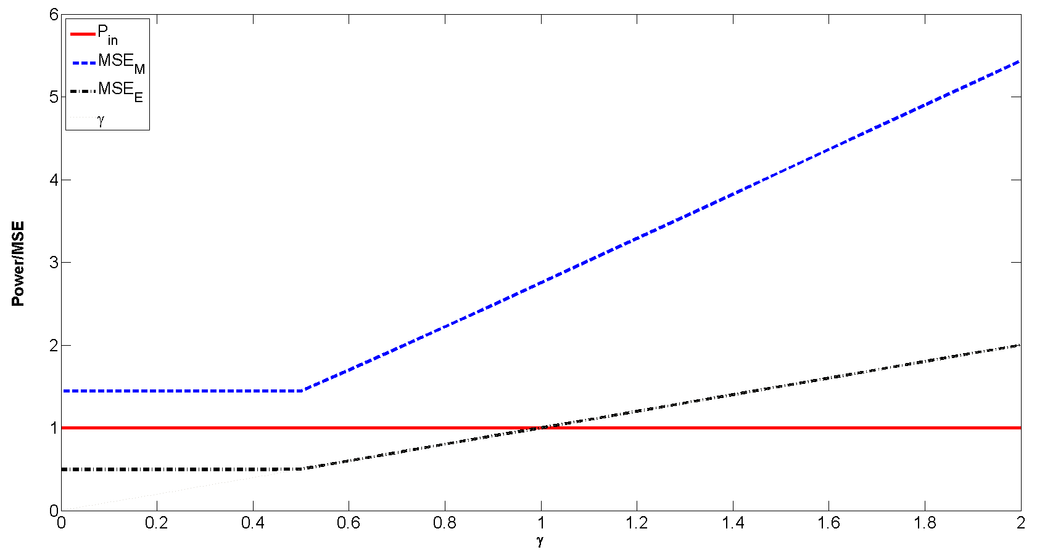
Numerical Results
ZF Filters
Main and eavesdropper MSE vs. secrecy constraint gamma and
input power vs. secrecy constraint – Non-degraded Scenario
Gaussian MIMO 2x2 channel

Slide 20

Final Remarks
Wiener Filters at the receiver:
Optimization Problem
Optimal Receive Filter
Optimal Transmit Filter
GEVD does not affect power
Suitable Algorithm
Minimum gamma for finite power

Slide 21
Final Remarks
ZF Filters at the receivers:
Address a more general case
  Non-degraded scenario
Introducing a power constraint
Optimal Transmit Filter
Suitable Algorithm
  Straightforward Algorithm
  Need to solve a nonlinear equation

Slide 22
Filter Design with Secrecy Constraints
Thank You
Hugo Reboredo
hugoreboredo@dcc.fc.up.pt

