Slide 1
Debian packaging
tutorial for newcomers
FLOSS Day
Vanier College 2024
Tiago Bortoletto Vaz

Slide 2
What is Debian?

Slide 3


Slide 4
Over 1,000 volunteers
package maintainers
bug reporters
wiki editors
translators
designers
package sponsors / mentors / reviewers
press contributors
sysadmins
outreaching
quality assurance
list moderators
debconf attendees
debconf speakers
local gathering organizers
testers
… and so on

Slide 5
What is a Debian package?

Slide 6
“A very powerful and convenient way to distribute software to users”

Slide 7
Concerns when installing (or removing) a software:
security
dependencies / conflicts
licensing
stability
compatibility
upgradability

Slide 8
How Debian address them:
Debian Policy
Debian Free Software Guidelines
Files System Hierarchy Standard
Clear distinction between “unstable”, “testing” and “stable”
Auto testing / QA (debCI, autopkgtest, lintian, piuparts, etc)
Rigorous New Maintainer process
Web of trust and extensive checks of signatures
12 architecture ports
User-friendly tools
...

Slide 9
Why learn how to package for Debian

Slide 10
Be part of an amazing community of volunteers.
Acquire a culture of technical excellence (and fun)
…and bring it to your daily life!
Learn a lot about Debian in general when packaging
…which can help you later performing other Debian work.

Slide 11
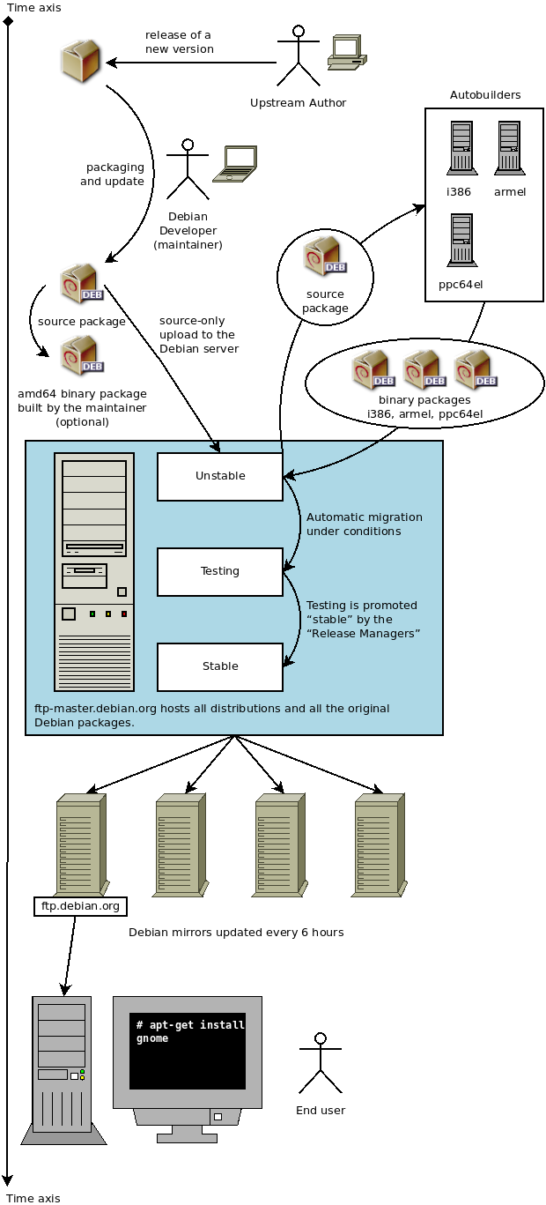
General packaging workflow
from “https://debian-handbook.info”
by Raphaël Hertzog and Roland Mas

Slide 12
Anatomy of a Debian package
Source
Binary
.
└── hello-flossday
├── debian
│ ├── changelog
│ ├── compat
│ ├── control
│ └── rules
└── hello.py
→
.
├── DEBIAN
│ └── control
└── usr
└── bin
└── hello-flossday

Slide 13
Hands on – part 1
Building a simple package
git clone https://github.com/tiagovaz/vanier-flossday-2024.git
(demo + explanation)

Slide 14
Hands on – part 2
Building a (less) simple package
(demo + explanation)

Slide 15
Hands on – part 3
Modifying an existant Debian package
(demo + explanation)

Slide 16
Resources
https://www.debian.org/doc/manuals/debmake-doc/
https://wiki.debian.org/Packaging
https://feeding.cloud.geek.nz/posts/whats-in-a-debian-directory/
https://wiki.debian.org/BuildingTutorial
https://wiki.abrahamraji.in/simple-packaging-tutorial.html
https://wiki.debian.org/SimplePackagingTutorial
https://wiki.debian.org/HowToPackageForDebian
https://github.com/FooBarWidget/debian-packaging-for-the-modern-developer
https://www.debian.org/doc/manuals/packaging-tutorial/packaging-tutorial

Slide 17
_______________________
< Questions? >
-----------------------
\ ^__^
\ (Oo)\_________
(__)\ )\/\
||----w |
|| ||

