Slide 1
Autism/RHT Mooney face experiment
Experiment design
Aaron Schurger

Slide 2
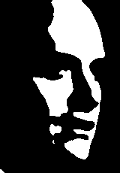
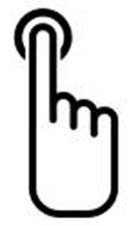
+
Press <J> key with right index finger = “perceived a face”
Press <K> key with right middle finger = “did not perceive a face”
+
If you can use a button box instead of the keyboard, that is better. But still use index and middle finger of right hand for responses. Go ahead and counter-balance (across subjects) which finger goes with which response.
Pre-stim interval
1.0 – 1.5 sec
uniform random
+
Mooney face
250 ms
Random size:
1.5°, 3°, 6°, 12°, 24° in height
time
+
Await response…
max 2 sec
Inter-trial interval
2 sec
. . .
If no response before 2 sec, then screen turns red for 4 sec.

Slide 3
details
Total duration of the experiment should be about 40 minutes max.
LouAnne and Deanna will help decide how many blocks and how long each block.
To start with, I would suggest 6 x 5-minute blocks with a 2-minute break in between each, with 50 trials per block.
Each block should have an equal number of trials per condition, fully randomized. Since there are 5 different conditions (i.e. sizes), then you should have 10 trials per condition per block.
Be sure to fully randomize the trial order within each block, even if sometimes you get 3 or more in a row of the same condition.

Slide 4
More details
Be sure that data can be exported to Matlab somehow.
For each session we want to record the subject’s age, gender, and handedness, as well as the time of day the session was run.
For each trial we want to record the condition (image size), the response (“I perceived a face” or “I did not perceive a face”), and the response time (in ms). The response can be coded with a 1 or 0.
Did you figure out how to measure the number of pixels per degree for a given viewing distance, screen size, and screen resolution? If not then let me know. I can explain.

