Slide 1
Software Tools Training
IHI Co. Confidential
Matt Schoen
Sr. Manager – Release Management and Operations
IHI Energy Storage

Slide 2
Overview
GIT
JIRA
GIT/JIRA Integration
IHI Agile Process

Slide 3
GIT
Version control technology
Distribured Version Control System (DVCS)
Entire repositories are mirrored to clients
If server dies, client can be copied back to server to restore
Developed by Linus Torvalds
Goals include:
Speed
Simple design
Non-linear development (thousands of branches worked on in parallel)
Able to handle large projects

Slide 4
GIT Cont…
Other source control technologies track changes made to files over time
This is not how git works
Git thinks of it’s data as a set of snapshots of a file system
Every time changes are committed git takes a snapshot of your entire project
Git is efficient so if file doesn’t change then it creates a reference to the previous file that is stored
Essentially git creates a mini filesystem with tools on top
Nearly every operation is local
Entire history of repository is local to your copy
Makes operations very fast
You can work on local snapshot without an internet connection (or VPN connection)
Very difficult to do something that you can’t undo
As long as you are frequently saving to server

Slide 5
Commit Hash
A git save is referred to as a commit
Everything is checksumed before it is stored and then referred to by that checksum
Impossible to change a file or contents of directory without git knowing
GIT uses SHA-1 hash
40 character string (0-9 and a-f)
Example commit hash:

Slide 6
Repositories URLs
Git has its own URL syntax
This syntax is used on remote git operations
SSH protocol
Need to establish credentials (either username/password or ssh public/private keys)
GIT protocol
Protocol unique to git.
Similar to ssh however no authentication
HTTP protocol
Git can be configured to communicate over HTTP
Supports http and https

Slide 7
git clone
Modern git systems have server(s) that store code changes remotely
Extra resiliency is built into the server to make them highly available and fault tolerant
This allows multiple users to collaborate and work on common code
The ‘clone’ command is provided to create a snapshot of the code on local computer
Example usage: git clone <repository url>
Creates snapshot based on master branch
Example usage: get clone -b <branch name> <respository url>
Creates a snapshot based on a preexisting branch in the specified repo url
Example usage: get clone -b <tag> <repository url>
Creates a snapshot based on a preexisting tag in the specified repo url

Slide 8
Three States
Three main states that your files can reside in
Modified
Developer has made updates to a file since last commit
Staged
File has been marked a modified file in its current version to go into the next commit snapshot
Committed
File is safely stored in the local database and version is associated with unique commit Hash
All three of these state are local operations
Committed files don’t mean they are backed up on remote git server
Git push copies local changes to remote server
Covered in later slide

Slide 9
git add
Once a file enters the modified state it can be staged
The `git add` command stages the file
Adds the content of the file to the current index
The current index holds the content for the next snapshot
If a file has been added to the index and then is modified then it must be added again
Git add is performed on a single file
Will fail if adding “ignored” files
Adding an ignored file with –f (forced) option will stage an ignored file.
New files are considered “Untracked files”
Git add will stage a new file
Once a file is added it is considered to be in the staged state.

Slide 10
git rm
There are times where you want to remove a file from source control
Performing an OS level delete is not enough for git
This only removes the file from the working tree
File still exists in the index
Example Usage: git rm <file>
Removes the file from the index, or from the working tree and the index
Example Usage: git rm –r <directory>
Recursively removes directory, sub-directories, and files from working tree and index
Example Usage: git rm –files>
Removes the files from the index, or from the working tree and the index

Slide 11
git commit
Git commit records the changes to the repository
Example Usage: git commit
Create new commit based on the current contents of the index
All files that were previously added using `git add` or removed using `git rm` will be committed
Example Usage: git -a commit
Automatically adds all known files to index
Automatically rm all files that have been removed from working tree
Will NOT automatically add new files
Once all files have been added an removed then commit is performed
The commit results in a new snapshot of the repository
The new snapshot has a corresponding uniquie SHA-1 hash
The new commit is only available on the local computer
Making commit available to other users is done by ”pushing” the commit
Git push is covered in later slide

Slide 12
git stash
When you want to record current state but want to go back to last recorded commit
You have made changes that aren’t ready to be committed and don’t want to lose them.
`git stash` will record contents of working directory and the index
Equivalent to `git stash push`
Git stash list – gives details on the contents of the stash
If/when you want to restore a stash:
git stash pop – applies stash (potentially on top of different commits) and removes the stash
git stash apply – applies stash (potentially on top of different commits) and keeps the stash
Latest stash is stored in refs/stash
Older stashes will be stored in reflog
`git stash list` lists the stashes that you currently have
`git stash branch <branch_name>` checkouts a new branch with contents of stash

Slide 13
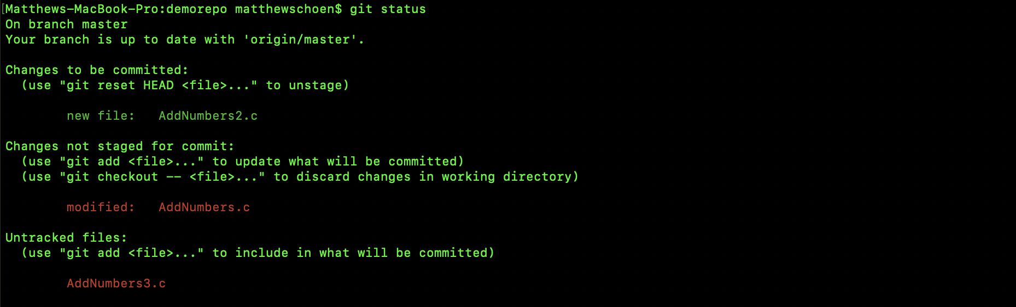
git status
Example Output:
Gives details on new files (untracked)
Modified files (not staged)
Staged Files (changes to be committed)

Slide 14
git push
Git push is used to upload local repository to remote repository
Transfers commits performed locally to remote repository
Example Usage: git push
When the default remote branch is set
Example Usage: git push origin <branch>
When the local branch is new and remote server doesn’t know about it
Example Usage: git push <repository> --delete <branch name>
Deletes the branch on the remote server in the specified repository
This doesn’t delete the branch locally (git branch –d <branch name>)

Slide 15
git pull
What happens if changes are made available upstream?
Example, there are two developers collaborating on a piece of functionality.
Developer 1 pushes change
Developer 2 wants to use new changes
Git pull will update local snapshot with any updates from the remote repository
Performs the following:
git fetch – updates all branches and tags locally
git merge – merge the retrieved branch HEAD into the current branch
Can run with --rebase if you want a rebase to be used in place of a merge
Merge/Rebase covered in a later slide

Slide 16
git log
Displays the commit logs
Simplest form is `git log`
This will display commits in sequential (time based) order
Contains the following details
Commit hash
Author of the changes
Date/time of the commit
Commit comment
`git log` has powerful filtering options
List commits after a specific date “—since=<date>”
List commits with a specific commit comment pattern “—grep=<pattern>”
Reverse ordering performed with `git log –reverse`

Slide 17
.gitignore
There are certain that are intentionally untracked files
Executables
Libraries
Autogenerated source code
The git ignore file is in the root of the repository directory structure
It is named .gitignore
Each line in the file specifies a pattern
Blank lines don’t match anything so feel free to use them
Comments being with #
Sample Patterns:
hello.* - any file that begins with hello.
dir/ - Will match a directory named dir and directories underneath it. Will not match a file named dir.
**/foo – matches a file or a directory named foo anywhere
abc/** - matches all files in directory abc (relative to .gitignore)

Slide 18
git diff
Shows changes between commits or commit and working tree
Example Usage: git diff <file name>
Changes between current working tree and the latest commit
Example Usage: git diff <commit hash 1> <commit hash 2>
Changes between two different commits
Example Usage: git diff <path/filename1> <path/filename2>
Changes between two working trees
Example Usage: git diff <commit hash> <path/filename>
Changes between working tree and a commit hash

Slide 19
Mergetool
Merge conflicts are often encountered when merging branches
When this occurs the merge fails and you need to resolve conflicts
git mergetool will use the configured merge tool to resolve merge conflicts
git mergetool –tool-help will provide a list of supported merge tools
When mergetool encounters a conflict it can’t resolve then user will resolve graphically
I use kdiff3: http://kdiff3.sourceforge.net/
Configuring kdiff3:
Download kdiff3
git config --global merge.tool kdiff3
git config --global mergetool.kdiff3.path /Applications/kdiff3.app/Contents/MacOS/kdiff3 (on OSX)

Slide 20
Introduction to merging in GIT
Merge
Rebase
Interactive rebase

Slide 21
Merge
Incorporates changes from two different branches since their histories diverged
When source branch is merged into target all changes are replayed on top of target branch
Merge result is recorded in a new commit that represents the merge
Example Usage: git merge origin/master (above)
Merging remote source branch into local branch
Unresolved merge conflicts will result in merge command to fail
Need to resolve manually or use configured git mergetool
Once conflicts are resolved then run git merge again
Git merge –abort can only be ran if merge resulted in conflicts
Will attempt to get back to state when merge was initiated
Always safe to commit all changes before merge
branch1
E
F
G
H
master
A
B
C
D

Slide 22
Rebase
Git rebase reapplies commits on top of another branch
Copies commits that aren’t in the upstream to a temporary location
Example Usage: git rebase
Assuming master is the upstream commits from branch 1 will be placed on top of most recent commit in master
branch1
E
F
G
master
A
B
C
D
branch1
E
F
G
master
A
B
C
D

Slide 23
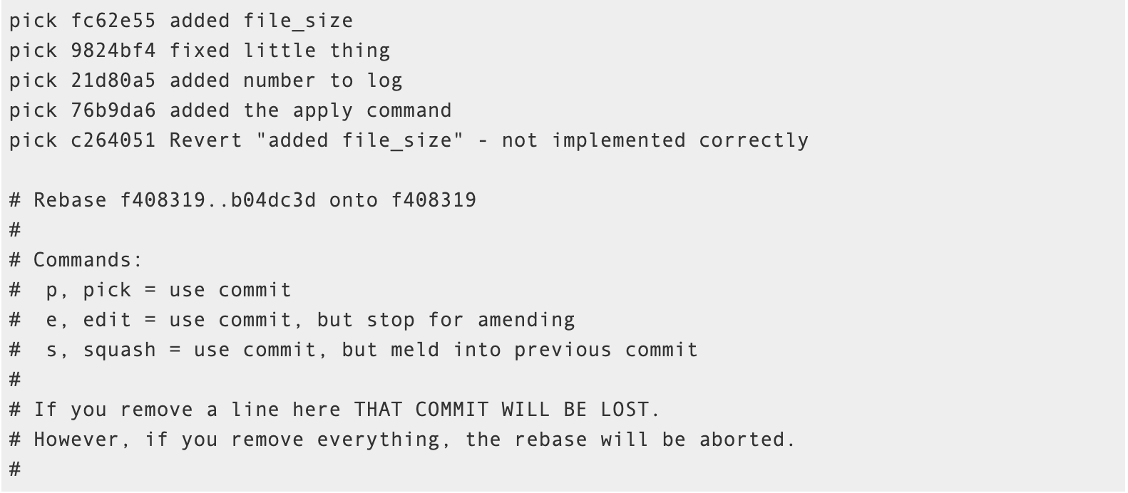
Interactive Rebase
There are certain cases where merge and rebase won’t work by themselves
Need a combination of the two methods
Interactive rebase gives the user complete control over the rebase/merge process
Gives the ability to modify commit(s) from source or target branch
Example Usage: git rebase -i
Indicates that there were 5 commits since you last pushed and one per line
(action) (partial-sha) (short commit message)
You can then pick, squash, or edit each commit (or even remove commits)

Slide 24
cherry-pick
Enables arbitrary commits to be picked by commit hash and applied to current working HEAD.
If merge would work then don’t use cherry-pick
Cherry-pick is useful for the following scenarios
Bug hotfixes
Restoring lost commits
Team collaboration – sharing consolidated pieces of code
Example Usage: git cherry-pick `F`
branch1
E
F
G
A
B
C
D
master
branch1
E
F
G
master
A
B
C
D
F

Slide 25
What is a Branch?
An isolated version of code
Types of branches
Development branch – Unverified changes
Bug Fix branch – Unverified changes for defect fix
Feature branch – In flight features that are not complete
Staging branch – Pre-mainline release branch
Master branch – Verified customer releasable code

Slide 26
Protected Branch
By default anyone can make changes to a branch
Protected branch – restricts who can edit
Branch Type | Merge Target | Branch Restrictions
master | N/A | Only release manager
staging | master | Only engineering managers
feature | staging | Only engineering managers and feature leads
development | feature | Up to developer
bugfix | feature or staging | Up to developer

Slide 27
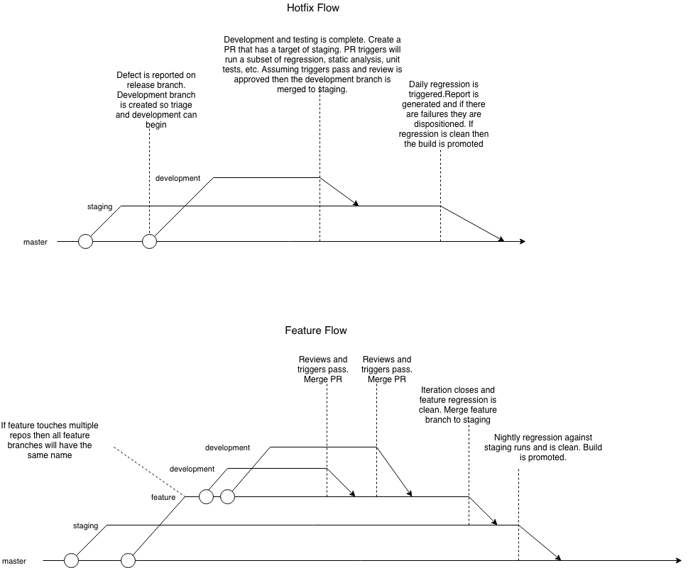
IHIES Branching Strategy

Slide 28
Pull Request
Developer creates pull request when code is ready to merge
Merge checks are quality checks that can prevent code from merging
Merge Check | Type
One Review Approval | Review
All PR Issues Resolved | Review
Changes Reset Approvals | Review
Sonar Scan | Static Analysis
Code Coverage | Testing
Run Unit Tests | Testing
End User Tests | Testing

Slide 29
Tagging
Used to indicate a version of “importance”
Most commonly used to indicate a release or point release
Example Usage: git tag –a <tag name>
Lauches editor so a tag message can be provided
Adds the specified tag to the latest commit
Example Usage: git tag -a <tag name> <commit hash>
Lauches editor so a tag message can be provided
Adds the specified tag to the provided commit hash
Publishing new tag is same as pushing a new branch: git push origin <tag name>
Delete local tag: git tag -d <tag name>
Delete tag on remote server: git push <remote> :refs/tags/<tag name>

Slide 30
GIT Best Practices
Frequent pushes
2 (at most) admins
Keep repositories under 1 GB
Learn git commands
Pick a graphical tool but don’t rely on it
Merges should be done via Pull Requests
Squash defects and story work
Don’t allow development branches to get too far behind upstream branch

Slide 31
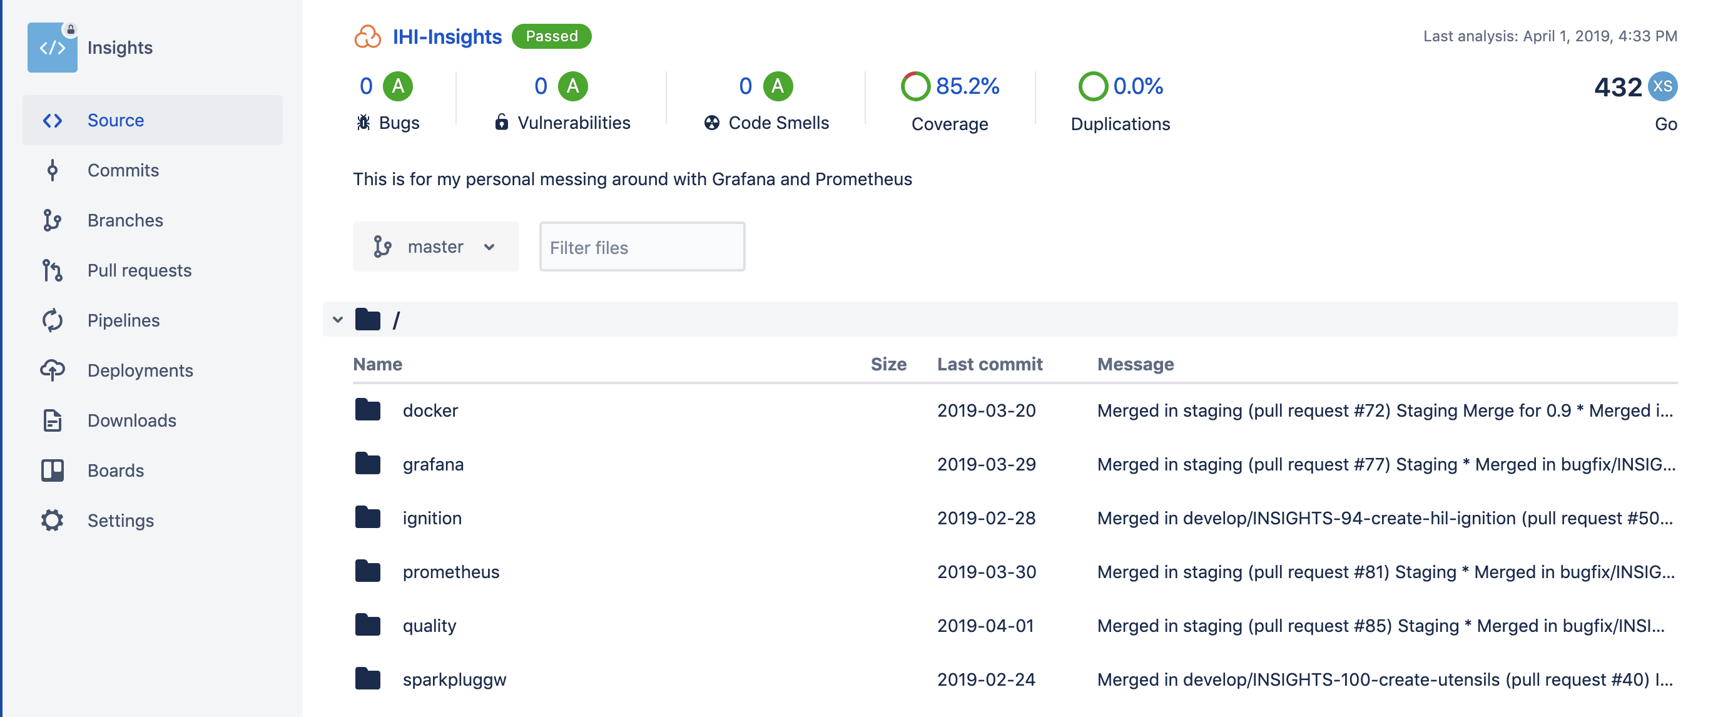
Sonar Static Analysis
Sonar is our static analysis tool
Static Analysis: Examining code before running it
Integrates with code repositories including a quality dashboard
Code coverage: Percentage of new code that is being tested
Integrates with our nightly build

Slide 32
IHI Agile Process
Jira is the software tool that is used to capture, manage, and execute all software activities
Every software request is one of the following:
Software feature or part of a feature
A defect in released software
Jira Ticket Type | Description
Epic | A unique capability of the product has value to a customer
Story | System requirements. Must fit in a 2 week Sprint.
Bug | An issue with the software. Could be requirements, code, test, etc.

Slide 33
IHI Agile Process – Ticket Hierarchy
Release
Epic 1
Epic 2
……………….….
Epic n
Story 1
Story 2
………….
Story n
Story 1
Story 2
……….
Story n
Story 1
Story 2
…………
Story n

Slide 34
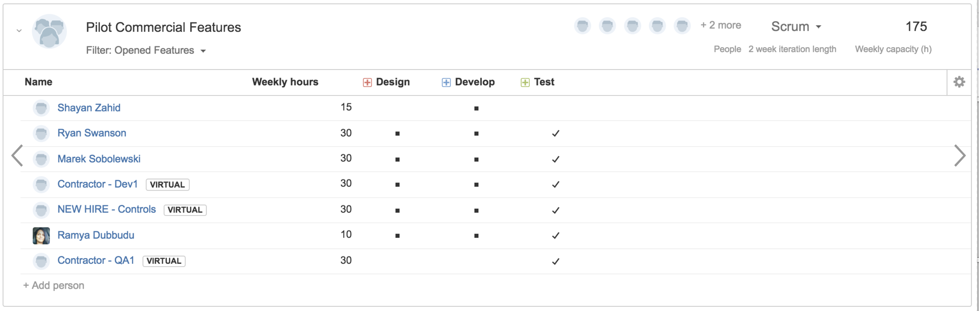
IHI Agile Process – The Who
When features are planned they are allocated to scrum teams
Scrum is the type of Agile process that we follow at IHI
This team is a collection of people with the appropriate skill set for the feature
We don’t form new teams each feature.
We move entire teams to features as they are ready for planning and development

Slide 35
IHI Agile Process – The When
Features are allocated to releases then assigned a scrum team
Work is then investigated and documented in Jira tickets
Tickets (stories) are then reviewed and estimated
Work is then allocated to two week chunks of time (called a Sprint)
At this point we have a sprint plan and whenthe feature will be complete

Slide 36
IHI Agile Process – Scrum Ceremonies
Ceremony | Description
Scrum | Daily checkin: What you did yesterday and today and impediments
Story Grooming | Review story details and estimate work
Sprint Planning | Schedule work for the team. Ensure commitment from team that they comfortable with commitment.
Sprint Review (Demo) | Demonstrate new functionality to team or outside people
Sprint Retrospective | What is working, what isn’t working, and new changes

