Slide 1
COSC3380: Database ER design, Normalization and Web App An Airline Database System

Slide 2
What is web application?
Most important: figure out how to process each request and return the right response

Slide 3
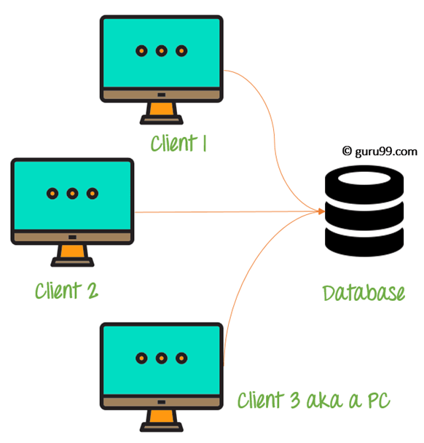
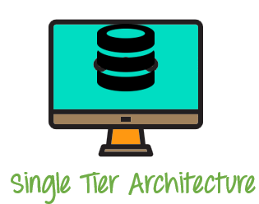
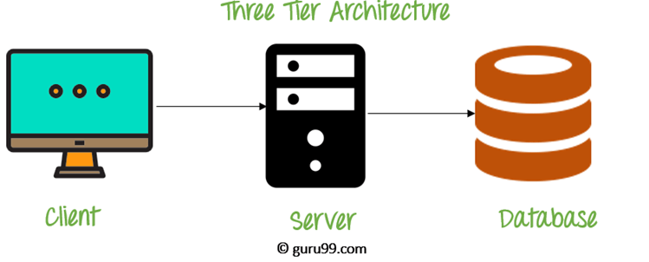
What is Web application?
Web application architecture

Slide 4
Three tier architecture
High performance, lightweight persistent objects
Scalability – Each tier can scale horizontally
Performance – Because the Presentation tier can cache requests, network utilization is minimized, and the load is reduced on the Application and Data tiers.
High degree of flexibility in deployment platform and configuration
Better Re-use
Improve Data Integrity
Improved Security – Client is not direct access to database.
Easy to maintain and modification is bit easy, won’t affect other modules
In three tier architecture application performance is good.

Slide 5
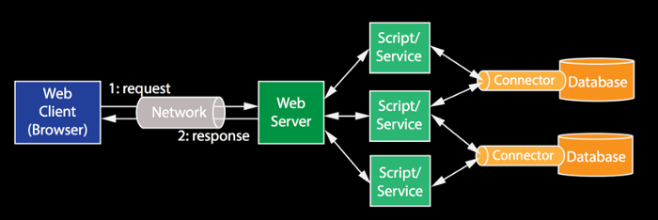
Web application architecture
More details (Three-Tier Architecture)

Slide 6
Web application architecture
Three layer
Front-End Layer (Blue): This layer is where technologies such as HTML, CSS and JavaScript create the look and feel of our application. The closest layer to the end users, and requires a lot of design and creativity
Application Layer (Green): This is the middle layer where computation and presentation logic work together to deliver the response back to the users
Database Storage Layer. Postgres Database

Slide 7
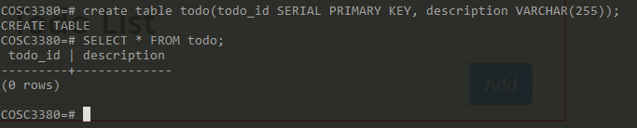
An example Web application
A table in Postgres:
CREATE TABLE todo(
todo_id SERIAL PRIMARY KEY,
description VARCHAR(255)
);
only two attributes in the table: todo_id and description
What I want to do?
type a value of ‘description’ in the client interface and insert into the table todo

Slide 8
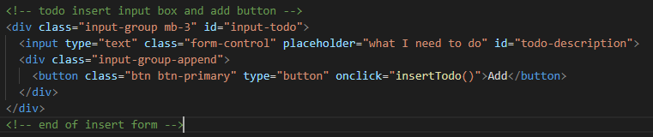
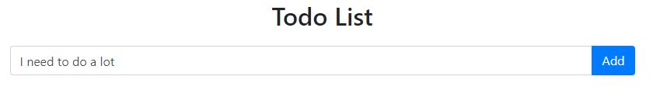
Web client
How to do the “request”?

Slide 9
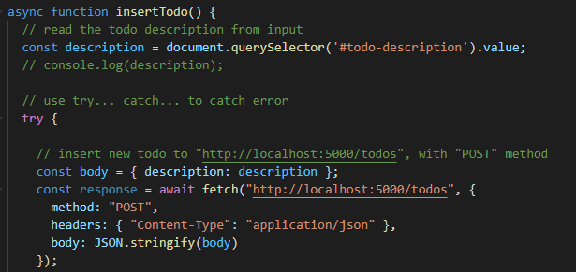
Request

Slide 10

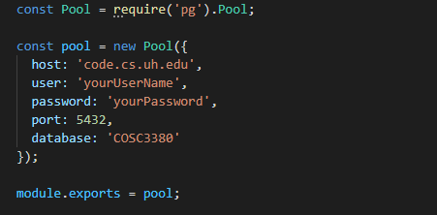
Web server

Slide 11
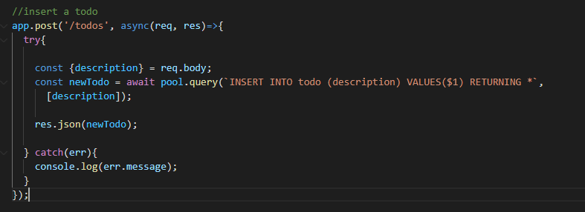
Web Server
Send query to database

Slide 12
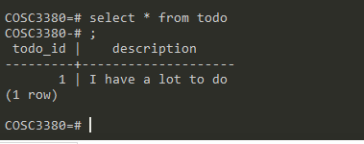
Database
The value is added in the database

Slide 13
Other queries
In my example code, I also have examples of update, select and delete.
You can follow my example

