Slide 1
WinDbg

Slide 2
3 ways to get Debugging Tools for Windows
As part of the WDKInstall Microsoft Visual Studio and then install the Windows Driver Kit (WDK). Debugging Tools for Windows is included in the WDK. You can get the integrated environment here.
As part of the Windows SDKInstall the Windows Software Development Kit (SDK). Debugging Tools for Windows is included in the Windows SDK. You can get the Windows SDK here.
As a standalone tool setIf you want to download only Debugging Tools for Windows, install the Windows SDK, and, during the installation, select the Debugging Tools for Windows box and clear all the other boxes.

Slide 3
当前操作系统版本信息
Cmd > msinfo32
操作系统：Windows 8.1 专业版
硬件抽象层 – 版本 = “6.3.9600.17196”

Slide 4
SOS in Visual Studio
Son of Strike (SOS): SOS是作为.net framework的一部分安装的(SOS.dll)，位于%windir%/Microsoft.NET/Framework/v*.*.****(版本号)/目录下。在使用SOS(加载SOS.dll)进行调试的步骤。

Slide 5
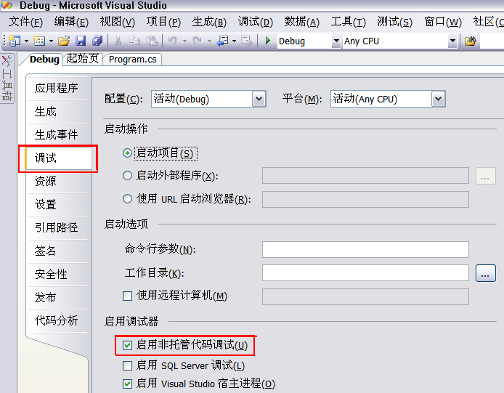
Step 1. 设置项目属性，以便启动托管调试
菜单->项目(Project)->Project属性->调试->启用非托管代码调试
Notes:
http://www.xuebuyuan.com/1222574.html

Slide 6
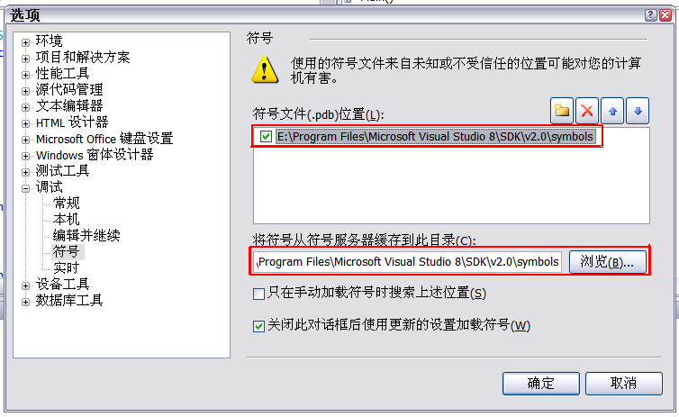
Step 2设置Symbol目录
菜单->工具->选项->调试->符号

Slide 7
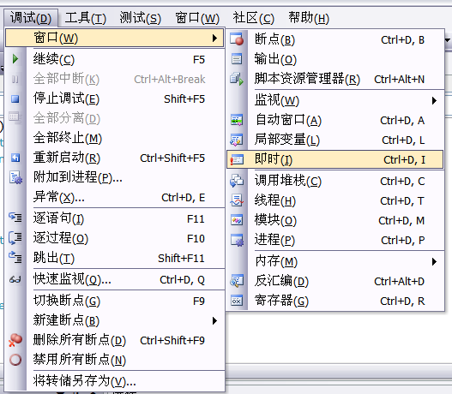
Step 3 加载SOS
菜单->调试->窗口->即时

Slide 8
Step 4. 执行SOS命令
!help <command>
.load sos

