Slide 1
Find the optimal location to start a restaurant in Toronto
Coursera Capstone Project
By Ye Tian
08/30/209

Slide 2
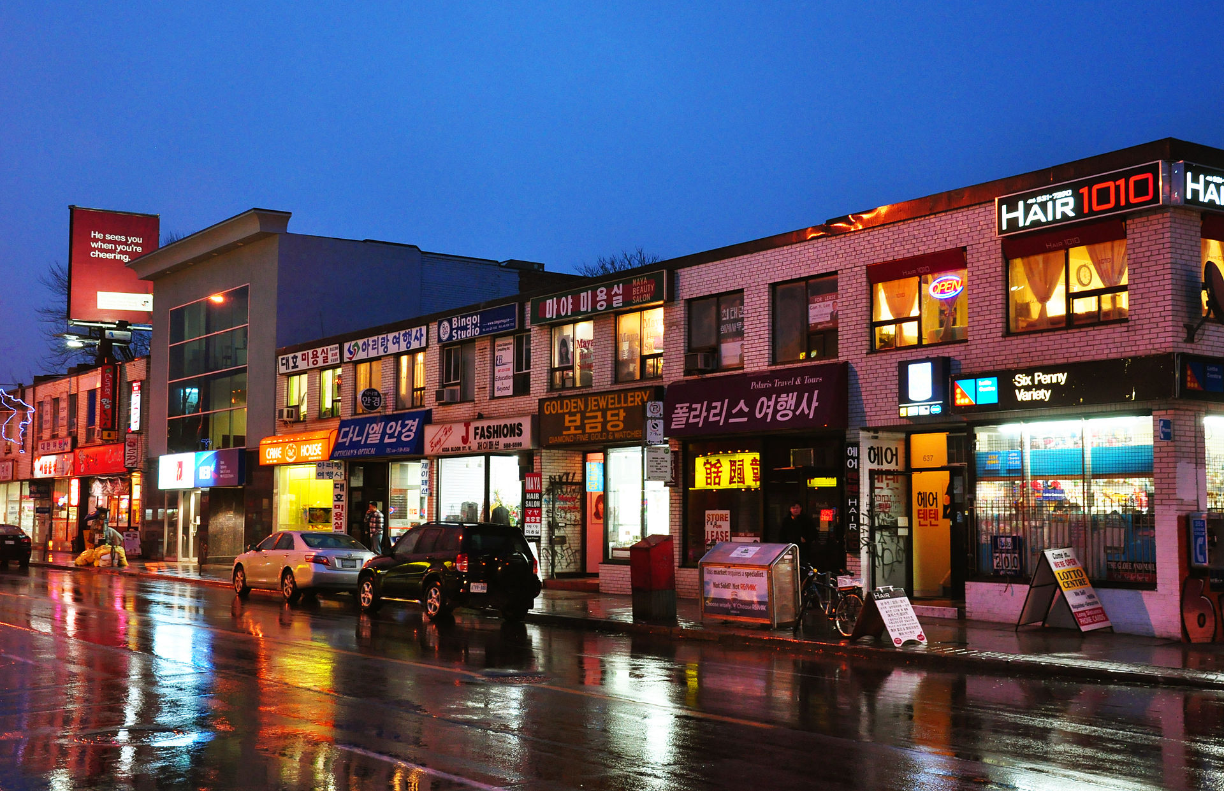
Introduction
Dong-jun is a new immigrant from Korea to the Toronto city, and he would like to start a Korean restaurant.
According to South Korea's Ministry of Foreign Affairs and Trade, there were 240,942 ethnic Koreans or people of Korean descent in Canada as of 2017, around 60,000 of them live in Toronto.
We would like to find the optimal location for Dong-jun
Wikipedia: Korean businesses and restaurants in Toronto

Slide 3
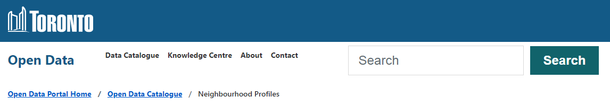
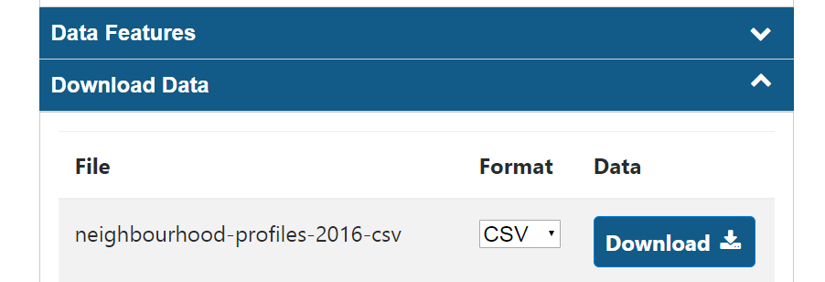
Data collection
First, we need to obtain the neighborhood and its geospatial data of Toronto from a publicly available database e.g., https://open.toronto.ca/dataset/neighbourhood-profiles/. We download the CSV file and uploaded to IBM cloud.

Slide 4
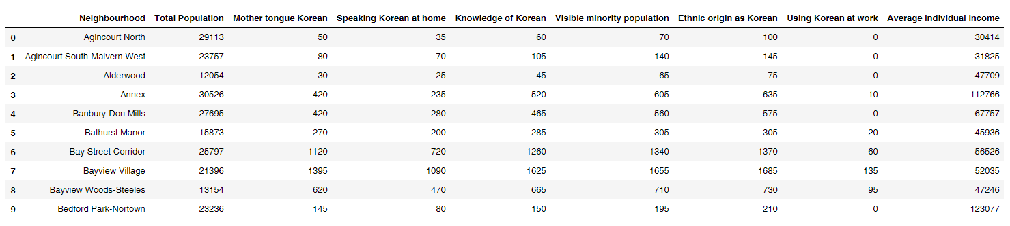
Data processing
We would like to know our potential customers for Dongjun’s business. Hence, we would focus on residents with Korean origin (who can speak Korean, or who characterized themselves of Korean ancestry) in a neighborhood.
Average individual income is also important.

Slide 5
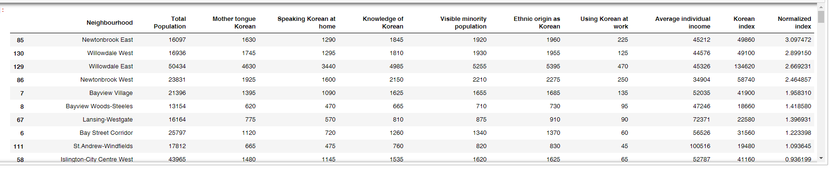
Data processing
We the normalize the index with total population and sort it by descending order
We found several neighbourhoods with very high index, say 'Newtonbrook East', korean is the 3rd most speaking language, after English and Chinese in Newtonbrook East.

Slide 6
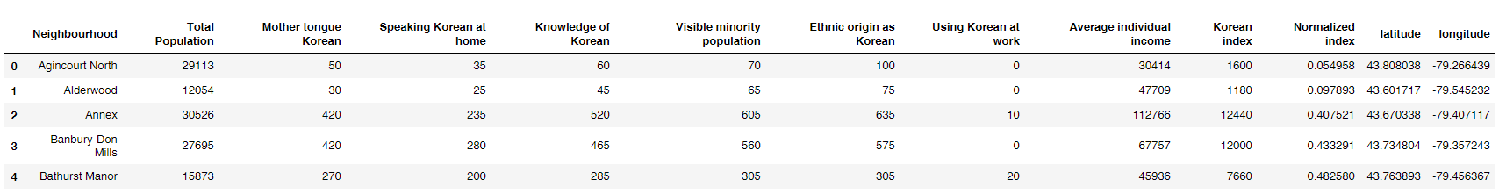
Nominatim API
Like other geocoder, Nominatim API can return the coordinate with input name, say Agincourt North, Its return latitude and longitude are 43.808038, -79.266439.
But as a free API, we only obtain coordinate for 105 out of 140 neighbors in Toronto. (Google keeps returning None in my case.)

Slide 7
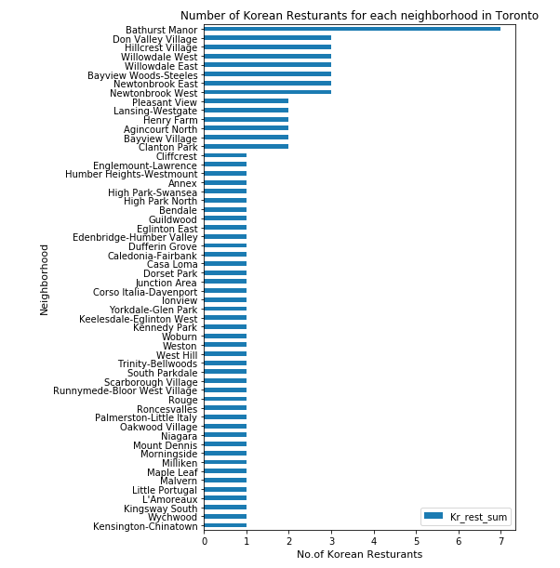
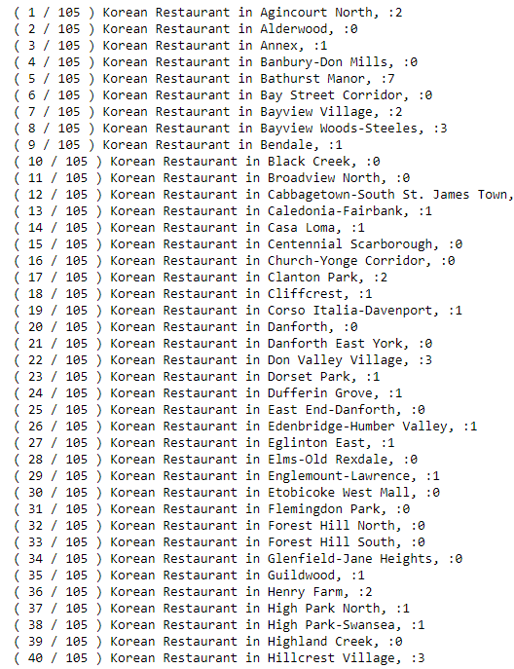
Foursquare API
We then use the Foursquare API to obtain detailed information on existing Korean restaurants in each neighborhood with known coordinates and find its competitors in 105 neighborhoods.

Slide 8
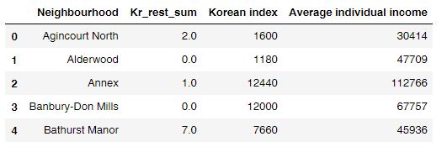
Combine the data
Lastly, we will combine data from foursquare with demographic data to find a solution to Dongjun’s question.
We join it with previous demographic dataframe 'toronto_kr’ obtained from City of Toronto by column “Neighbourhood".
We can then visualize the data.

Slide 9
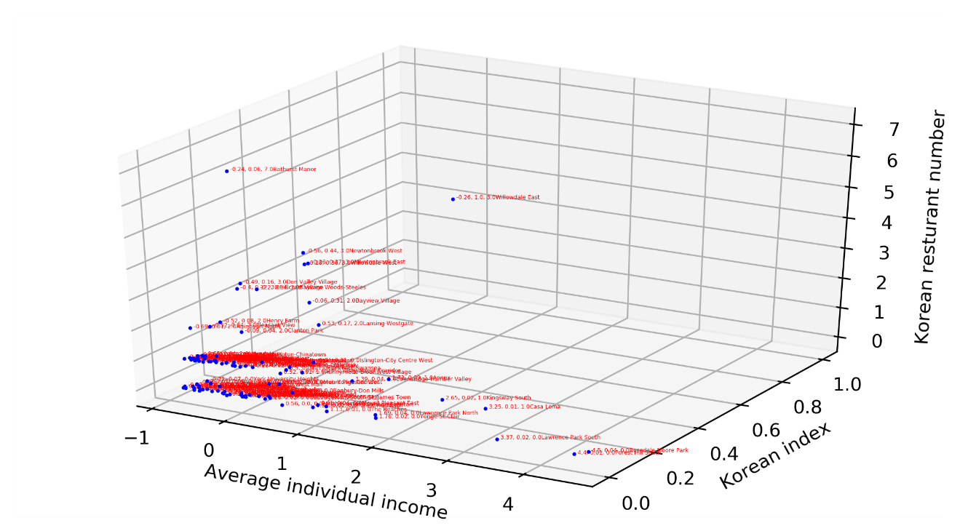
Data visualization with scatter plot
Ideally, we want to find a neighborhood with high Korean_index, high income, but low Kr_rest_sum. But also, can accept a neighborhood with high Korean_index, high income, also high Kr_rest_sum.
We would like to avoid a neighbourhood with low Korean_index, low income, also low Kr_rest_sum. Hence, we can plot all the neighborhood with these three values as coordinates in the 3D space.
Outlier!
Here we found an outlier, Willowdale East, which has very high Korean index, relatively good average income

Slide 10
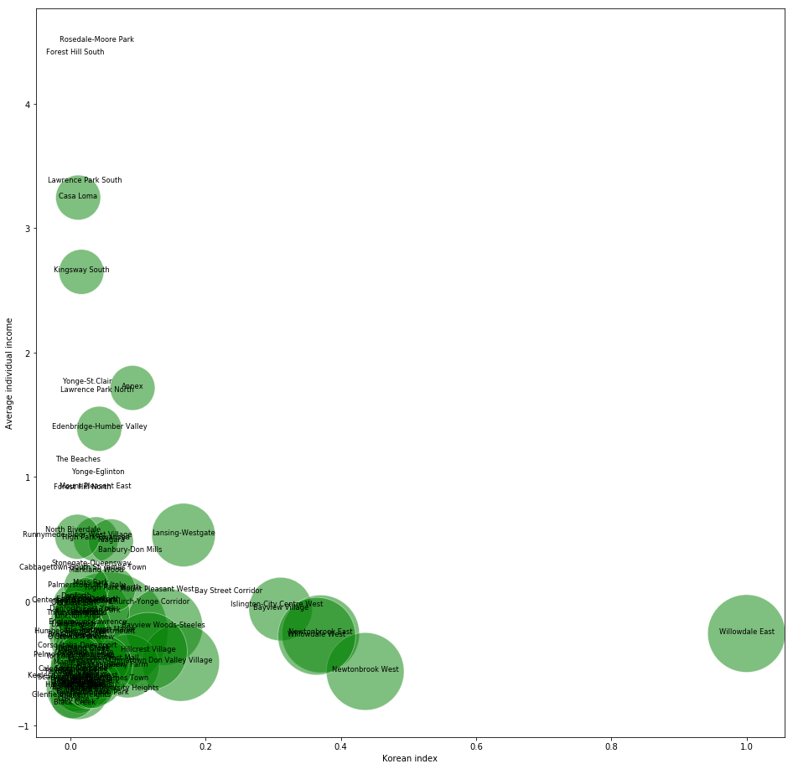
Data visualization
Again, Willowdale East will still stand out, Hence, we would suggest Dongjun to start his restaurant there.
Newtonbrook West, Newtonbrook East, and Willowdale West could be his second group choice, who also has a slight less Korean index, but similar level of average income.
2nd choice
1st choice

Slide 11
Conclusions
We first used publicly available data, and processed the data using Pandas. We then create a so called “Korean Index” to quantify the level of Korean-related of resident in each neighborhood. Besides, we also obtain the average individual income of each neighborhood.
We then combine Nominatim and Foursquare API to summarize the number of Korean restaurants in each neighborhood of Toronto.
Finally, we obtain the data we need and visualize them in both bubble and scatter plot.
The first choice is Willowdale East, which has a few high Korean index and relatively good average individual income, the number of other Korean restaurants is 3 which is smaller than 7 in Bathurst Manor. And second-best group of location are Newtonbrook West, Newtonbrook East, and Willowdale West. who also have a slightly less Korean index, but similar level of average income and few competitors as 3.

