Slide 1
论文分享：Eyeriss V2
周依源 2021.06.01

Slide 2
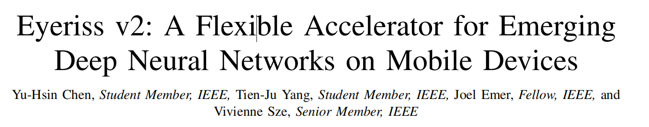
JETCAS 2019
(IEEE Journal on Emerging and Selected Topics in Circuits and Systems)
Eyeriss V1: ISCA 2016

Slide 3
Contents
Introduction
Architecture Overview
Flexible Hierarchical Mesh On-Chip Network
Sparse Processing with SIMD Support
Experiment
Summary

Slide 4
Contents
Introduction
Architecture Overview
Flexible Hierarchical Mesh On-Chip Network
Sparse Processing with SIMD Support
Experiment
Summary

Slide 5
Introduction
There has been an increasing effort to reduce the computational complexity of DNNs, particularly for those targeted at mobile devices:
reduced precision of weights and activation
Envision, Thinker, UNPU, Loom, Stripes
compact network architectures (this work)
Depth-wise Convolution (MobileNet)
increasing sparsity in the filter weights (this work)

Slide 6
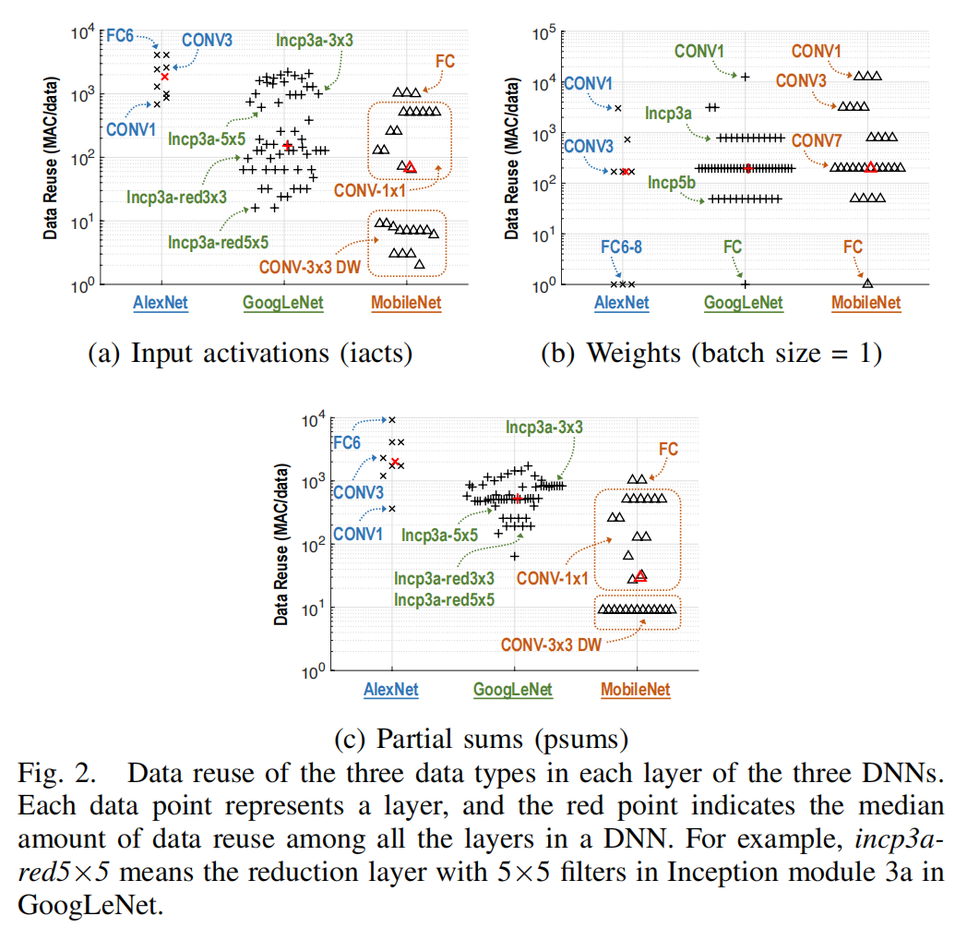
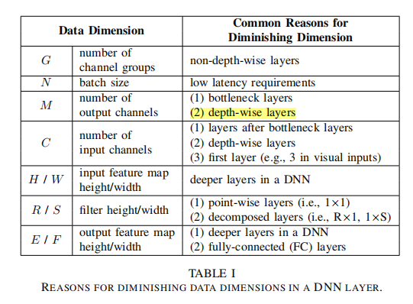
Challenges for Compact DNNs
reuse: variation increases, amount decreases
The trend for compact networks is evident in how the iconic DNNs have evolved over time.
Widely varying DNN layer shapes results in changes in a key property of DNNs: data reuse.

Slide 7
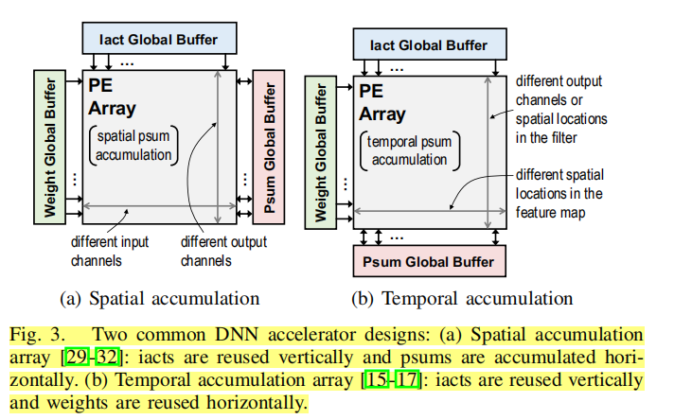
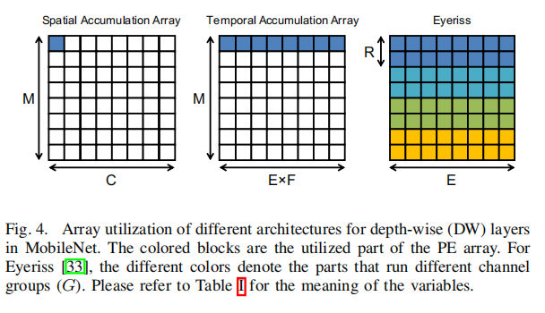
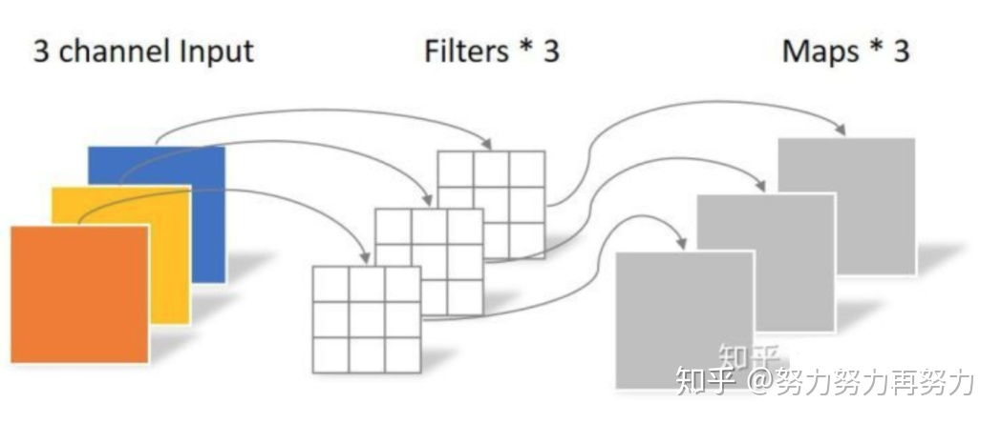
Challenges for Compact DNNs
Challenge 1: Array Utilization
Many existing DNN accelerators rely on a set of pre-selected data dimensions to exploit both high parallelism across an array of processing elements (PEs) for high performance and data reuse for high energy efficiency.
When the set of pre-selected data dimensions diminish due to a change in DNN shapes and sizes, efficiency decreases.
filter height
output channels
input channels
output width x height
output height
Depth-wise Convolution
(input channels = output channels = 1)

Slide 8
Challenges for Compact DNNs
Challenge 2: PE Utilization
A lower data reuse also implies that a higher data bandwidth is required to keep the PEs busy.
If the on-chip network (NoC) for data delivery to the PEs is designed for high spatial reuse scenarios, e.g., a broadcast network, the insufficient bandwidth can lead to reduced utilization of the PEs.
For instance, even though Eyeriss can better utilize the array, its broadcast NoC(which supports multicast) is not going to provide adequate bandwidth to support high throughput processing at high parallelism.
However, if the NoC is optimized for high bandwidth scenarios, e.g., many unicast networks, it may not be able to take advantage of data reuse when available.
NoC has to be able to provide high bandwidth when data reuse is low while still being able to exploit data reuse with high parallelism.

Slide 9
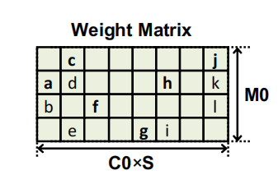
Challenges for Sparse DNNs
Irregular Accesses Patterns
It is complex to find the next non-zero value to read without wasting cycles reading zeros.
2) Workload Imbalance and PE Utilization
The amount of work to be performed at each PE depends on sparsity

Slide 10
Contribution
A novel NoC, called hierarchical mesh, that is designed to adapt to a wide range of bandwidth requirements.
A PE that exploits the sparsity in weights and activations to achieve improved throughput and energy efficiency across a variety of DNN layers.
A flexible accelerator, Eyeriss v2, that combines the above contributions to efficiently support both compact and sparse DNNs.

Slide 11
Contents
Introduction
Architecture Overview
Flexible Hierarchical Mesh On-Chip Network
Sparse Processing with SIMD Support
Experiment
Summary

Slide 12
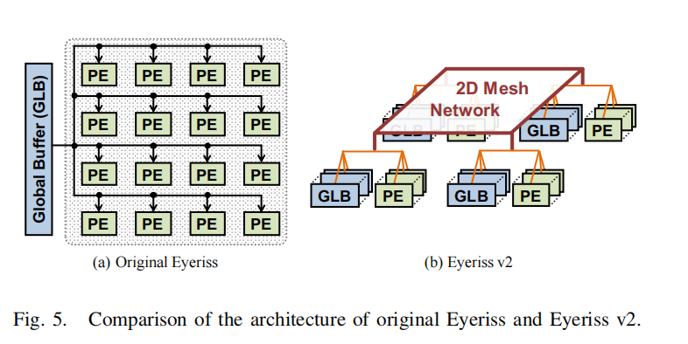
Architecture Overview
Eyeriss v2 uses a hierarchical structure, where the PEs and GLBs are grouped into clusters in order to support a flexible on-chip network (NoC) that connects the GLBs to the PEs at low cost.
In contrast, the original Eyeriss used a flat multicast NoC between the GLB and PEs.

Slide 13
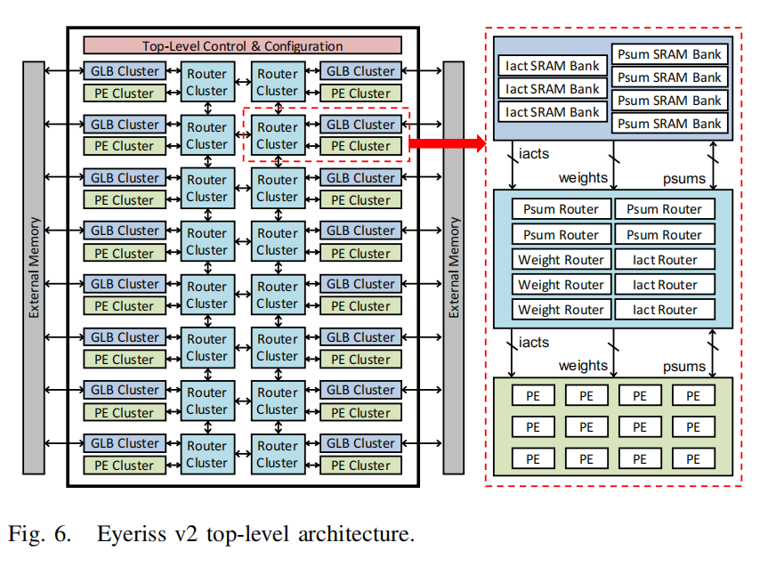
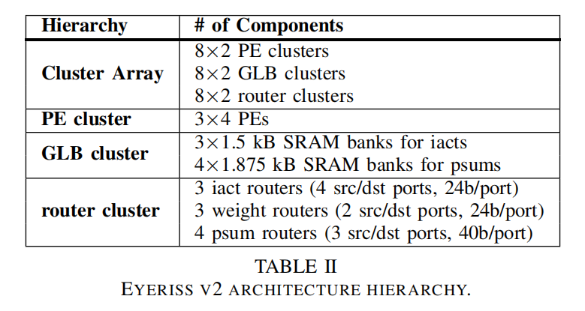
Architecture Overview

Slide 14
Data movement
iacts are read from off-chip into the GLB cluster, where they can be stored into the GLB memory or get passed directly to the router cluster depending on the configuration.
psums are always stored in the GLB memory once they get out of the PE cluster. The final output activations skip the GLB cluster and go directly off-chip.
weights are not stored in GLB and get passed to the router clusters and eventually stored in the SPads in each PE directly.
为什么weights存储在Spads中，而iacts和psums存储在GLB中？

Slide 15
Contents
Introduction
Architecture Overview
Flexible Hierarchical Mesh On-Chip Network
Sparse Processing with SIMD Support
Experiment
Summary

Slide 16
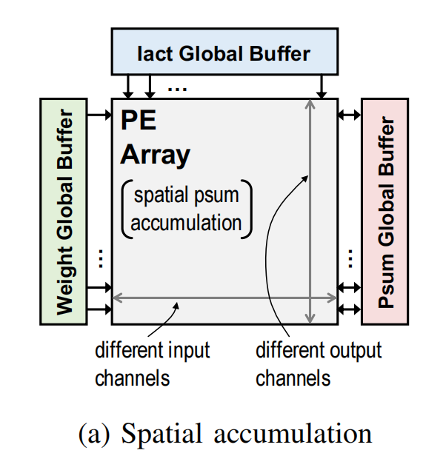
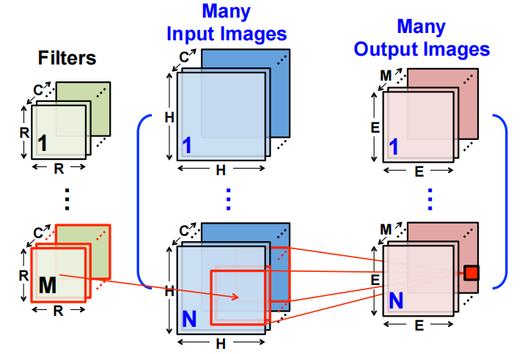
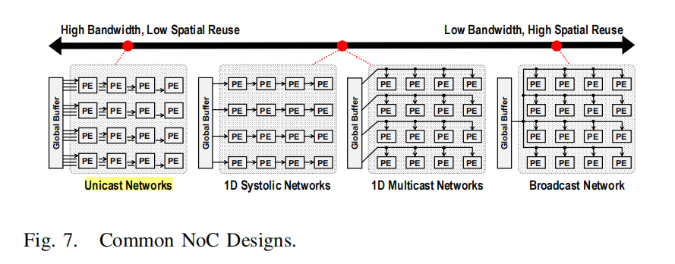
Motivation
Weights/iact/psum require different NoC,
e.g. output-stationary dataflow:
1D horizontal multicast network to reuse the same weight in the same row
1D vertical multicast network to reuse the same iact across PEs in the same column
unicast network that gathers the unique output activations from each PE
The lack of input or output channels made it difficult to efficiently utilize this example due to its rigid NoC design.
depth-wise layers of MobileNet
bottleneck layers of ResNet and GoogLeNet
fully-connected layers with small batch size

Slide 17
Motivation
The broadcast network can exploit the most data reuse, but its low source bandwidth can limit the throughput when data reuse is low.
The unicast network can provide the most source bandwidth but misses out on the data reuse opportunity when available.
An all-to-all network that connects any data sources to any destinations can adapt to the varying amount of data reuse and bandwidth requirements.
However, the cost of its design increases quadratically with the number of nodes and therefore is difficult to scale up.

Slide 18
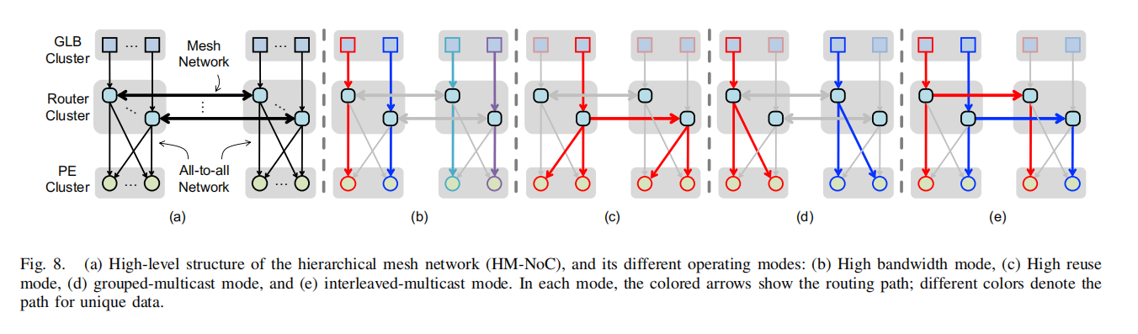
High-Level Concept
At the lower level, the all-to-all network is limited within the scope of a cluster.
Each cluster has 12 PEs and the cost is acceptable
At the top level, the clusters are further connected with a mesh network.
The implementation cost increases linearly instead of quadratically

Slide 19
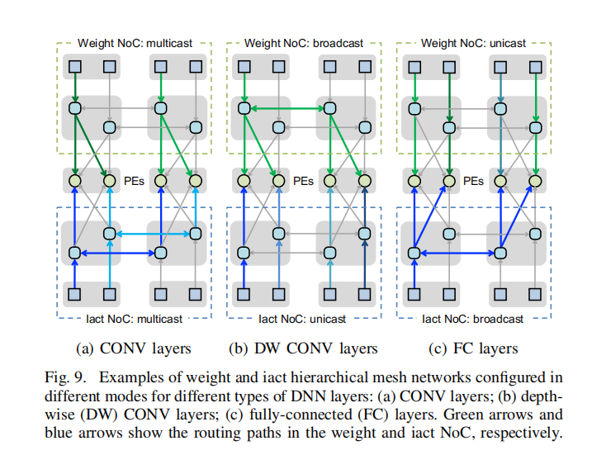
Use Case
CONV: either the HM-NoC for iact or weight has to be configured into the grouped-multicast mode, while the other one configured into the interleaved-multicast mode.
Depth-wise CONV: only exploit the reuse of weights by broadcasting the weights to all PEs while fetching unique iacts for each PE.
FC with small batch: the weights are now unicast to the PEs while the iacts are broadcast to all PEs.

Slide 20
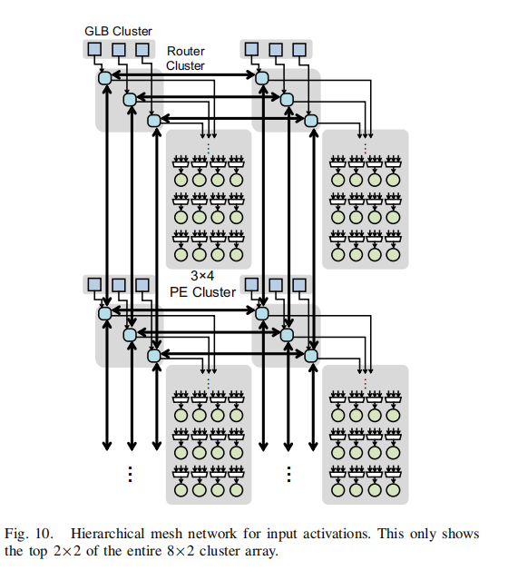
Implementation Details
1) HM-NoC for input activations
There are three iact routers per router cluster, one for each iact SRAM bank in the GLB cluster.
Each router for iact has four source ports (to receive data) and four destination ports (to transmit data).
Three of the source and destination ports are used to receive and transmit data from the other clusters in the mesh.
The fourth source port connects to the GLB cluster to receive data either from the memory bank or off-chip, and the fourth destination port connects to all the 3×4 PEs in the cluster.

Slide 21
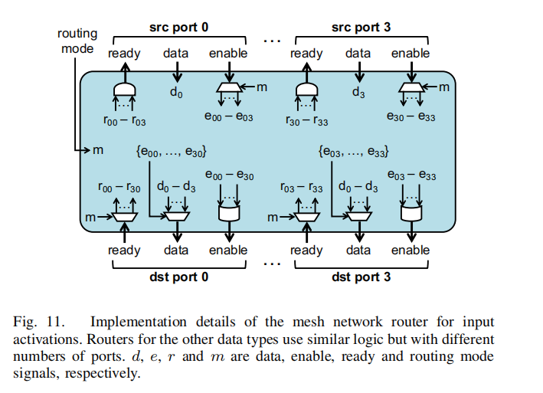
Implementation Details

Slide 22
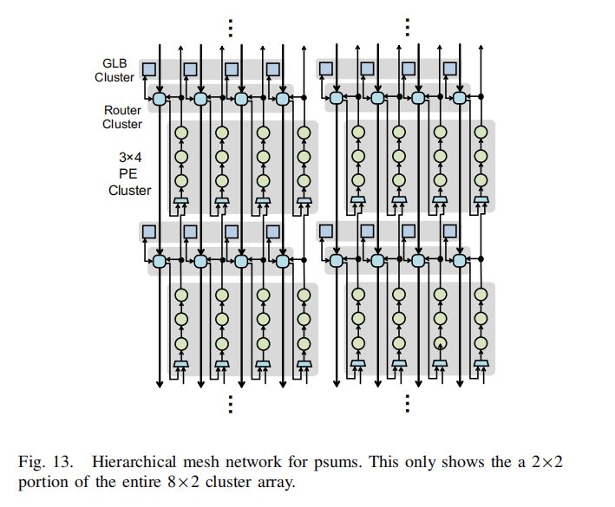
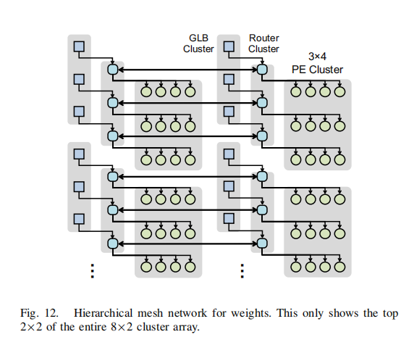
Implementation Details
2) HM-NoC for weights
3) HM-NoC for psums

Slide 23
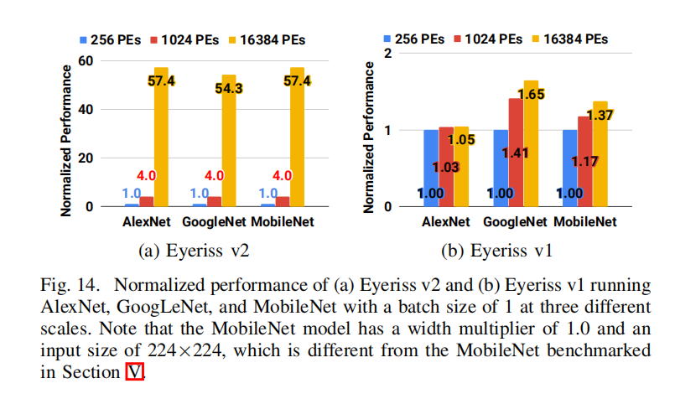
Scalability
A key design focus of the HM-NoC is to enable strong scaling for Eyeriss v2
For all three DNNs, the performance of Eyeriss v2 scales linearly from 256 to 1024 PEs, and achieves more than 85% of the linearly scaled performance at 16384 PEs.

Slide 24
Contents
Introduction
Architecture Overview
Flexible Hierarchical Mesh On-Chip Network
Sparse Processing with SIMD Support
Experiment
Summary

Slide 25
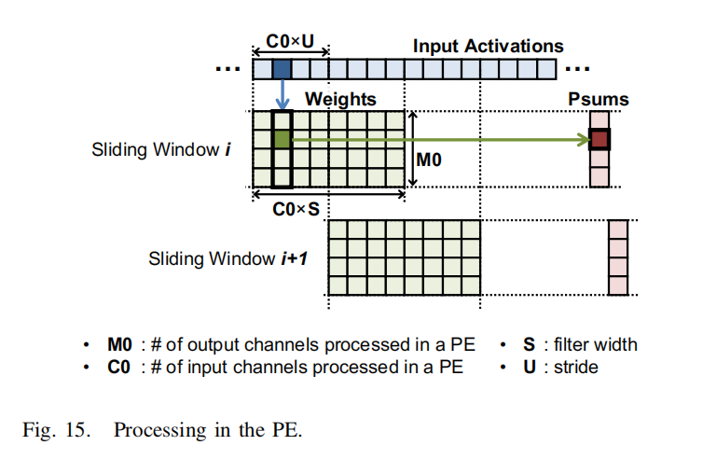
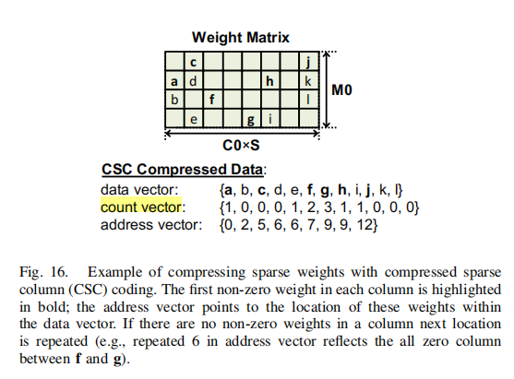
Sparse PE Architecture
uncompressed original Eyeriss

Slide 26
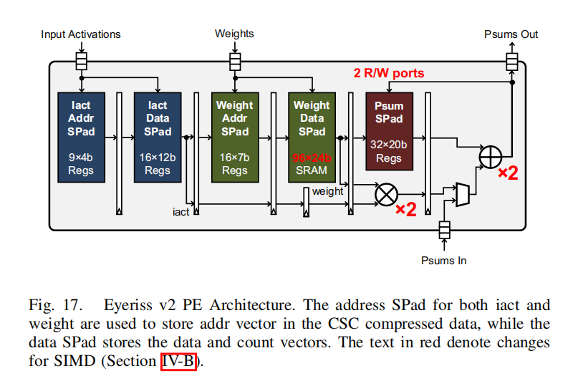
Sparse PE Architecture
The PE is implemented using seven pipeline stages and five SPads.
The first two pipeline stages are responsible for fetching non-zero iacts from the SPads.
The next three pipeline stages read the corresponding weights.
The final two stages in the pipeline perform the MAC computation on the fetched non-zero iact and weight, and then send the updated psum either back to the psum SPad or out of the PE.

Slide 27
Contents
Introduction
Architecture Overview
Flexible Hierarchical Mesh On-Chip Network
Sparse Processing with SIMD Support
Experiment
Summary

Slide 28
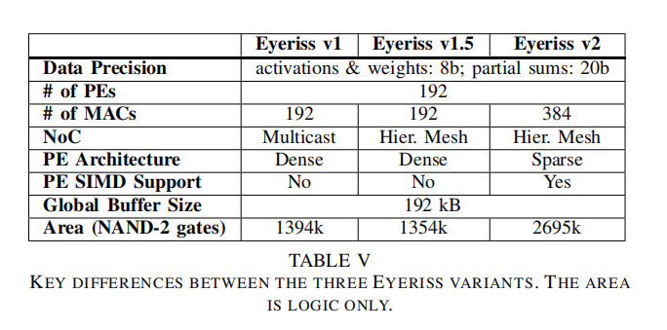
Experiment

Slide 29
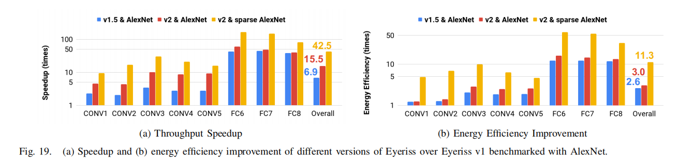
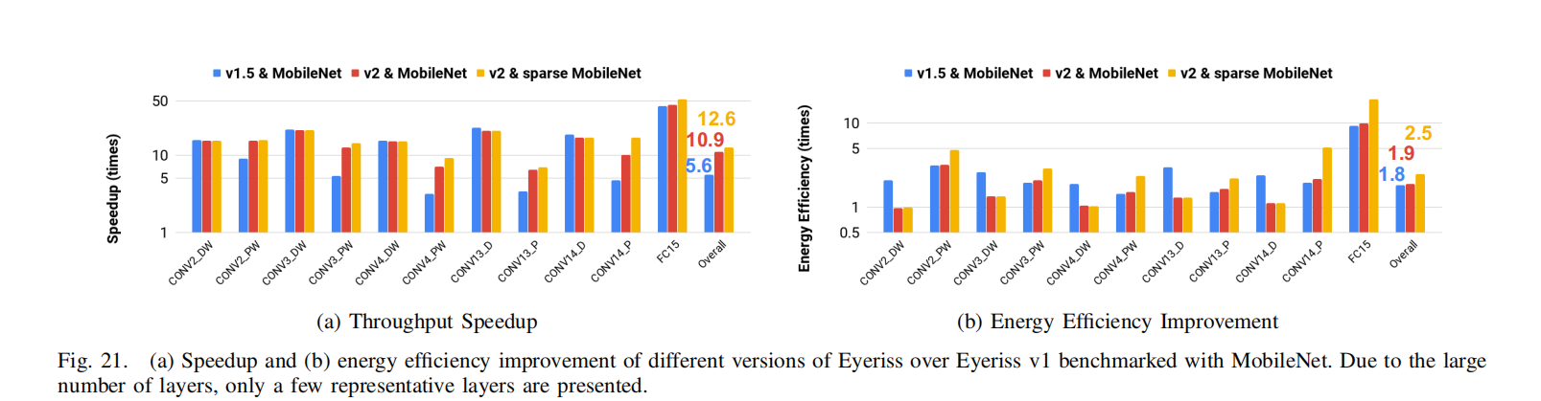
Experiments

Slide 30
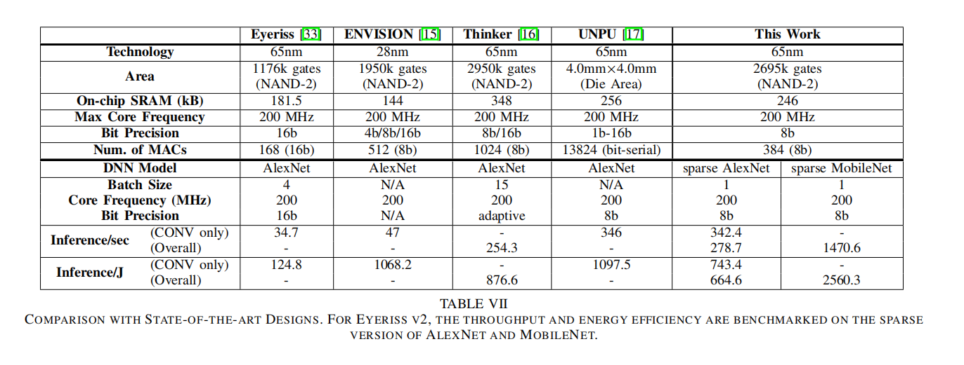
Experiments

Slide 31
Contents
Introduction
Architecture Overview
Flexible Hierarchical Mesh On-Chip Network
Sparse Processing with SIMD Support
Experiment
Summary

Slide 32
Summary
Problem 1
The varying layer shapes makes the on-chip network (NoC) the performance bottleneck since conventional NoC design poses strong assumptions on the amount of data reuse and required data bandwidth for each data type, which is too rigid to adapt.
Solution
Introduce HM-NoC (hierarchical mesh network), which can be configured into different modes that can deliver from high bandwidth to high data reuse.
固定的spatial mapping依赖于某些dimension
当某一dimension小于PE array的size时，通过tiling用其他dimension来填充
不同的dimension填充会带来不同的data reuse，对NoC的bandwidth的要求不同
Trade-off between reuse and bandwidth
设计hierarchy mesh NoC来适应不同shape的workload

Slide 33
Summary
Problem 2
Sparse weights and input activations
Solution
Incorporates a new PE architecture that support processing sparse weights and input activations directly in compressed domain to improve not only energy efficiency but also throughput. It also adds SIMD support so that each PE can process 2 MACs per cycles.
Results
Overall, Eyeriss v2 achieves 42.5× and 11.3× improvement in throughput and energy efficiency, respectively, with sparse AlexNet compared to Eyeriss v1 running AlexNet.
It also achieves 12.6× and 2.5× improvement in throughput and energy efficiency, respectively, with sparse MobileNet compared to Eyeriss v1 running MobileNet.

Slide 34
Comments
优点
分层的NoC，PE clusters内部采用all-to-all network，clusters间采用mesh network，兼顾了flexibility和scalability
分析了不同情况下（CONV, Depth-wise CONV, FC）data reuse的情况和适宜的NoC，并设计了可配置的NoC来实现各种情况
缺点
Challenges for Compact DNN讲的不是很清楚，很难看懂。

