Slide 1
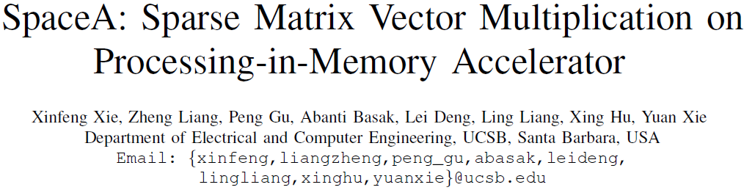
HPCA’2021

Slide 2
motivation
1. Intrinsic memory-bound characteristics
2. Limited bandwidth between processors and memory
3. PIM, 3D stacking, ultra-high bandwidth

Slide 3
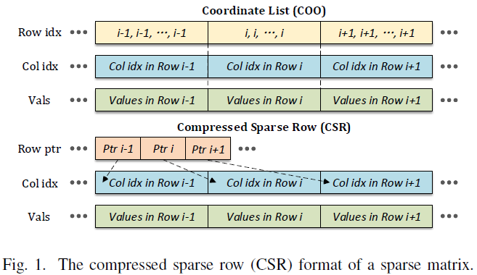
Background
SpMV Workloads
Y=Y+AX X: input vector; A: input matrix; Y: output vector
For a sparse matrix, mul is skipped if Aij=0
COO: 2*nnz
CSR: N+1+nnz

Slide 4
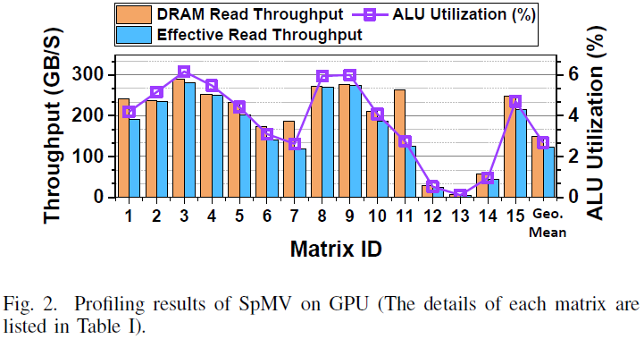
Background
SpMV on GPU
Profile SpMV using csrmv() from cuSPARSE
Dataset: UF sparse matrix collection: 15 real-world matrices
DRAM Read Throughput: nvprof
Effective Read Throughput: nnz*size/execution time
ALU Utilization: achieved GFLOPS/maximum GFLOPs
Titan Xp: max DRAM BW 547.7GB/s
Average BW utilization: 27.08%/43.39%
(excluding 12,13,14)
ALU Utilization: 2.68%
Small ALU utilization compared to much larger DRAM BW utilization -> memory-bound PIM
Effective is close to actual BW Utilization -> hardware innovation

Slide 5
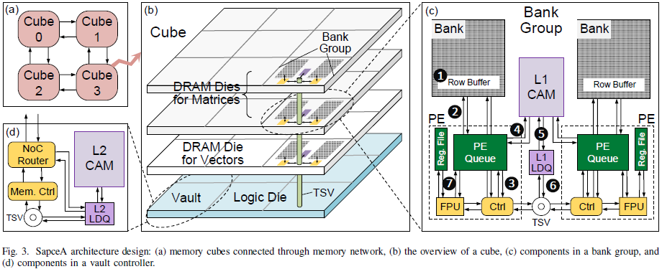
architecture
3D stacking
PIM PE design
Data & Control Flow

Slide 6
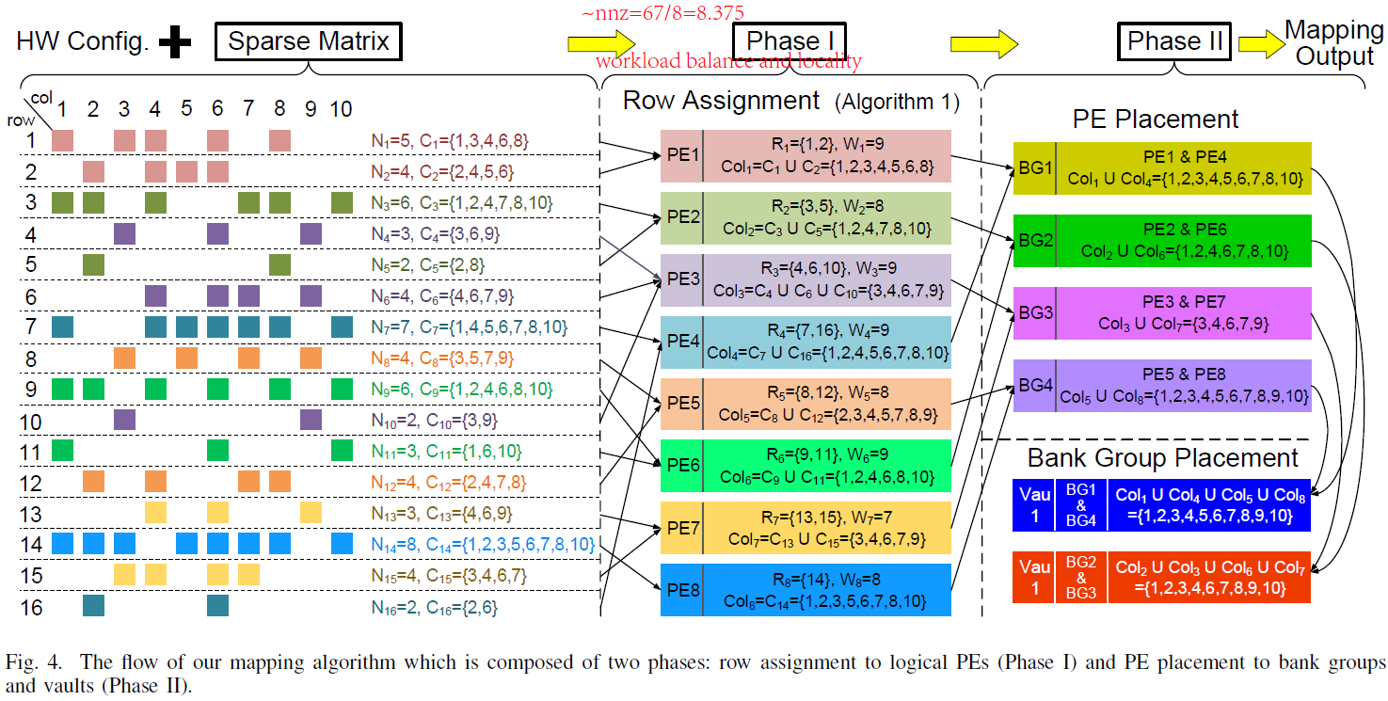
Mapping method
Workload balance and locality
Assign rows of non-zero elements with similar column index pattern to the same PE
Cluster PE workloads with similar sets of column index from the non-zero elements; Minimize the maximal number of unique column indexes across bank groups and vaults.

Slide 7
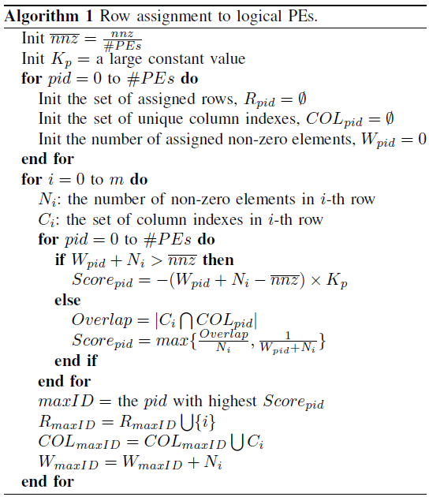
Mapping method
Workload balance
Initialization
每一行
每个PE
Assign row i to the PE with the highest score
Update PE

Slide 8
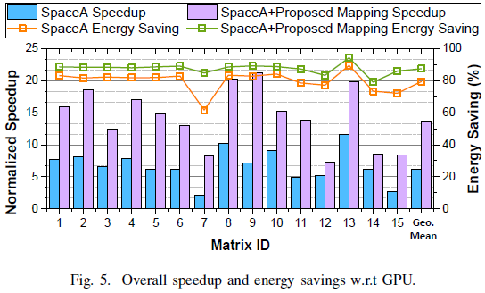
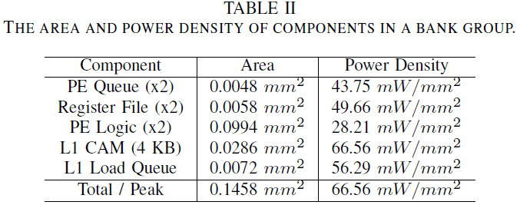
Results
4.86% of the area of a bank group
Without mapping method:
6.22x speedup
Energy reduction 4.89x (79.55% energy saving)
With mapping method:
13.54x speedup
Energy reduction 7.99x (87.49% energy saving)

Slide 9
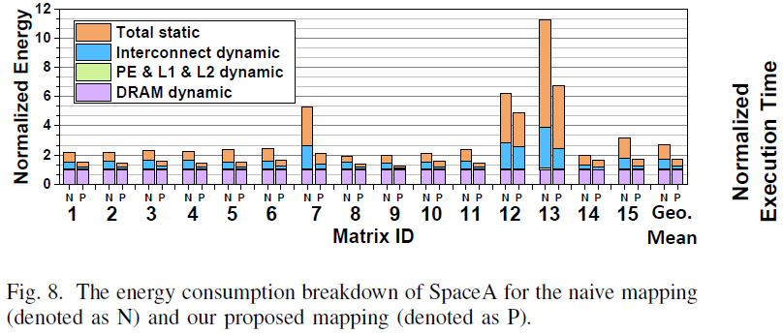
Results
Dynamic power of hardware components added by SpaceA design is negligible (PE & L1 & L2 dynamic)
65.55% on average of the dynamic power of interconnect is saved (the result of a reduced traffic amount on TSV and NOC)
54.05% energy consumption of the static power part

