Slide 1
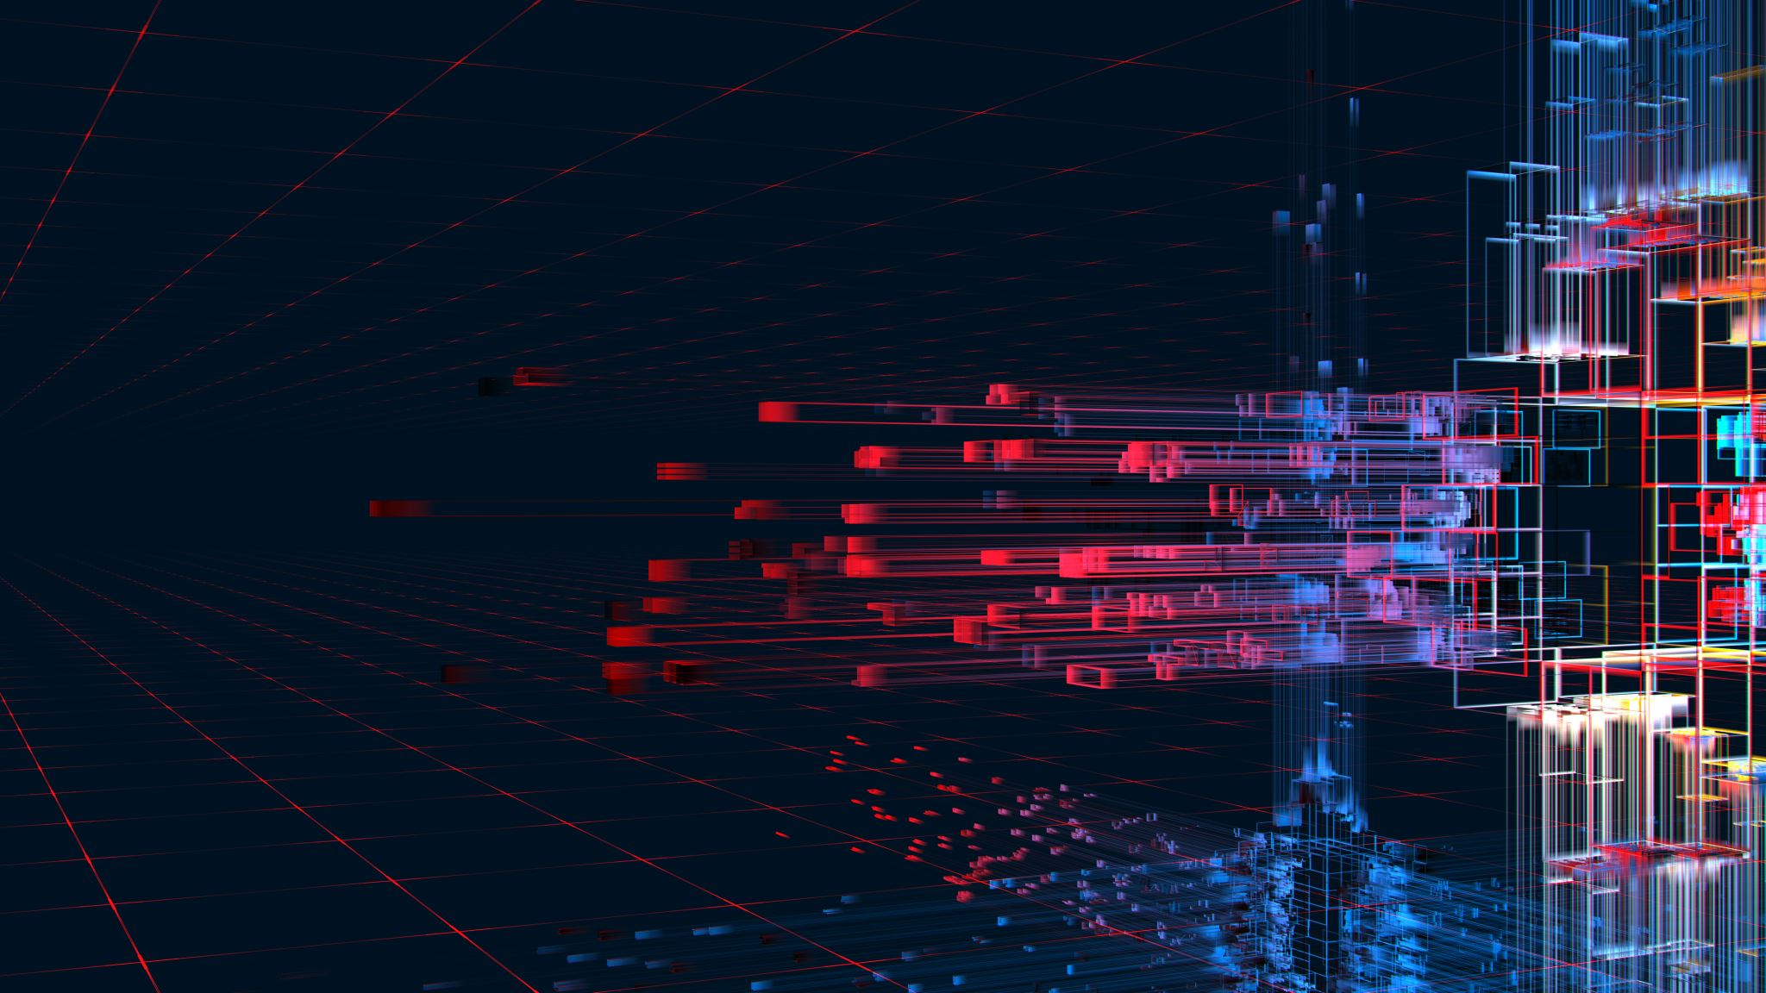
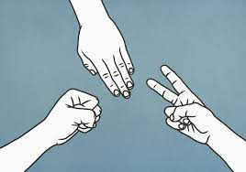
Rock, paper, scissors By: Tiana Murphy
This program implements the classic game of rock, paper, scissors.

