Slide 1
AI in Modern Healthcare
By Tiana Pfeifer

Slide 2
Table of Contents
The Role of AI in Modern Healthcare 2
Introduction 2
What Benefits does AI offer? 2
Concerns about AI in Healthcare 3
References 4

Slide 3
Introduction
There are many new advancements concerning AI in healthcare, beneficial to both patients and doctors alike. This article will explore the benefits and problems that AI faces. I will address the myriad of healthcare solution that Ai can offer, from diagnostic, to process automation. Also, we will look at the Ethics surrounding AI.

Slide 4
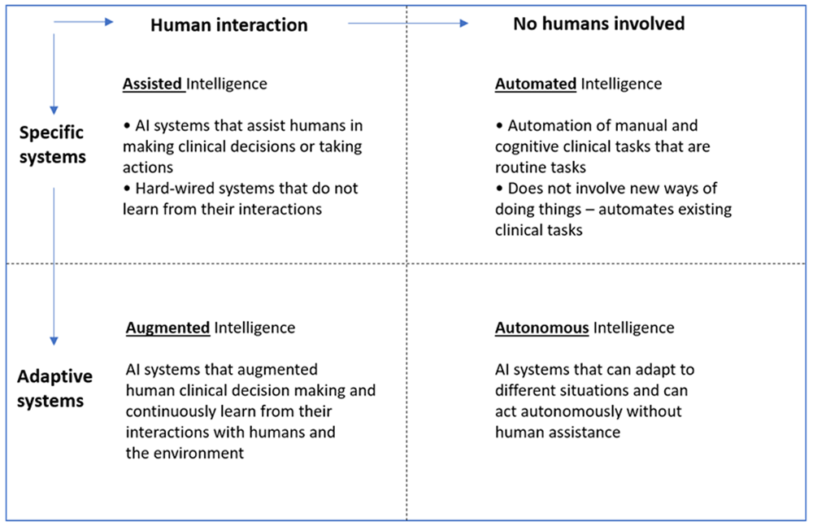
What Benefits does AI offer?

Slide 5
Concerns for AI in Healthcare
So now that we have review some benefits of AI in Healthcare, let’s take a look at some Concerns. Data Privacy and Security are incredibly important aspects that will constantly need to be monitored for the benefit of all parties. Policymakers must develop guidelines and standards for the ethical deployment of AI technologies in healthcare settings. (Esmaeilzadeh, 2020)

Slide 6
Conclusion
There are so many arguments for and against AI in Healthcare, and here I have barely touched the surface. I hope that whomever is responsible for the future of AI in healthcare considers all the factors and ethics involved in their ventures and that these advances in technology can continue to benefit people.

