Slide 1
PDC
tbt23@mails.tsinghua.edu.cn

Slide 2
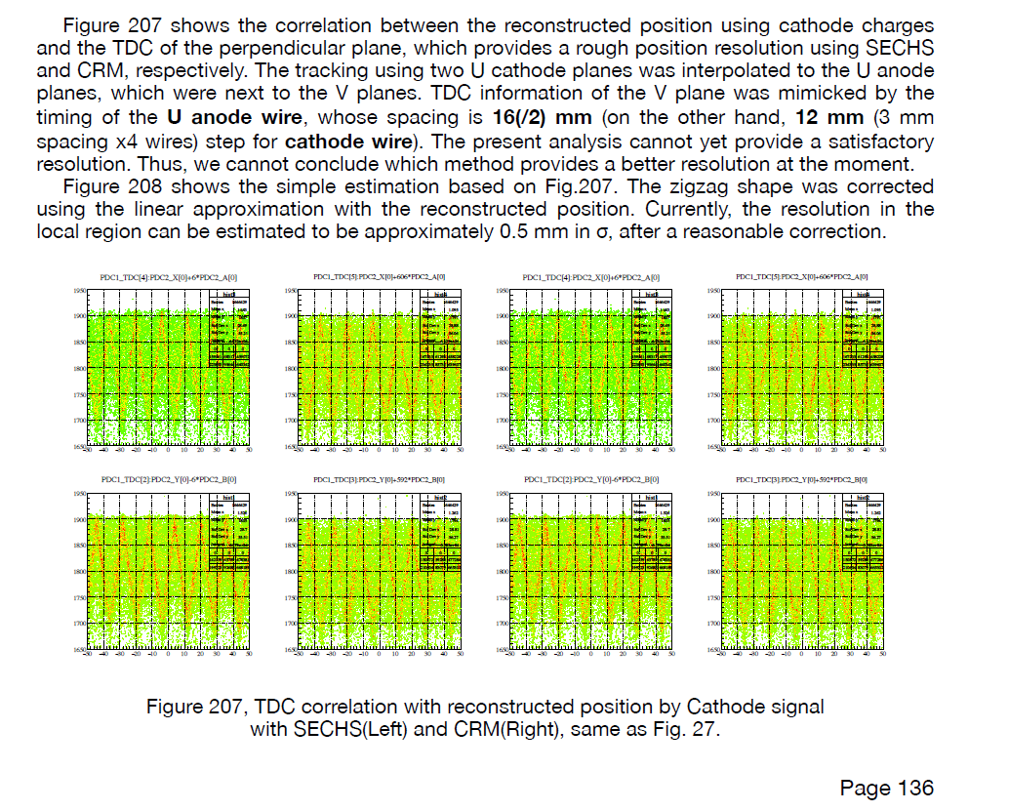
·what’s the TDC in fig 207 ?
The text mentions that "TDC information of the V plane was mimicked by the timing of the U anode wire". Could you please elaborate on this?
If I want to know the resolution of U cathode planes, I think the x axis is the position reconstructed by the U cathode induced charge signal and y axis is the TDC. But how to get the TDC information? If the anode can be readout? For my understanding, It should measure the same direction position, so it can have the correlation. So the drift time should the the time drift to U anode.
I think there are 2 cases:
Anode can be readout. Y axis is the U anode drift time.
Only cathode can be readout. Y axis is the getTDC() of V cathode. As the configuration is cathode(U)-Anode(V)-cathode(X)-anode(U)-cathode(V). cathode(V) can give the drift time of anode(U).

Slide 3
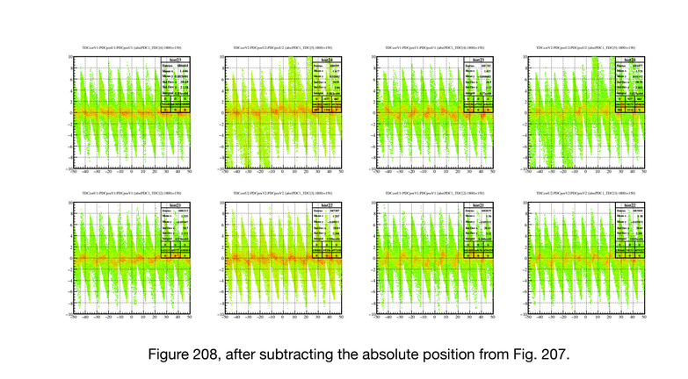
About the resolution:
So , now the resolution is about 0.35-2 mm for U & V layer?
Is that value obtained from something like Figure 208? However, I think Figure 208 just shows the magnitude of the relative error between the two methods: the one using drift time and the one using induced charge reconstruction. How can one determine which of these two errors is relatively larger and which is smaller?

Slide 4
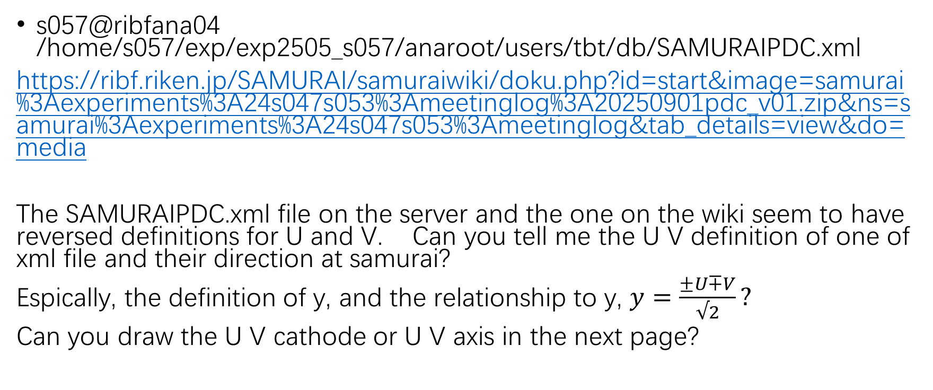
What’s the U V definition.
s057@ribfana04 /home/s057/exp/exp2505_s057/anaroot/users/tbt/db/SAMURAIPDC.xml
https://ribf.riken.jp/SAMURAI/samuraiwiki/doku.php?id=start&image=samurai%3Aexperiments%3A24s047s053%3Ameetinglog%3A20250901pdc_v01.zip&ns=samurai%3Aexperiments%3A24s047s053%3Ameetinglog&tab_details=view&do=media
The SAMURAIPDC.xml file on the server and the one on the wiki seem to have reversed definitions for U and V. Can you tell me the U V definition of one of xml file and their direction at samurai?
Espically, the definition of y, and the relationship to y, $y=\frac{±U∓V}{√2}?$
Can you draw the U V cathode or U V axis in the next page?

Slide 5
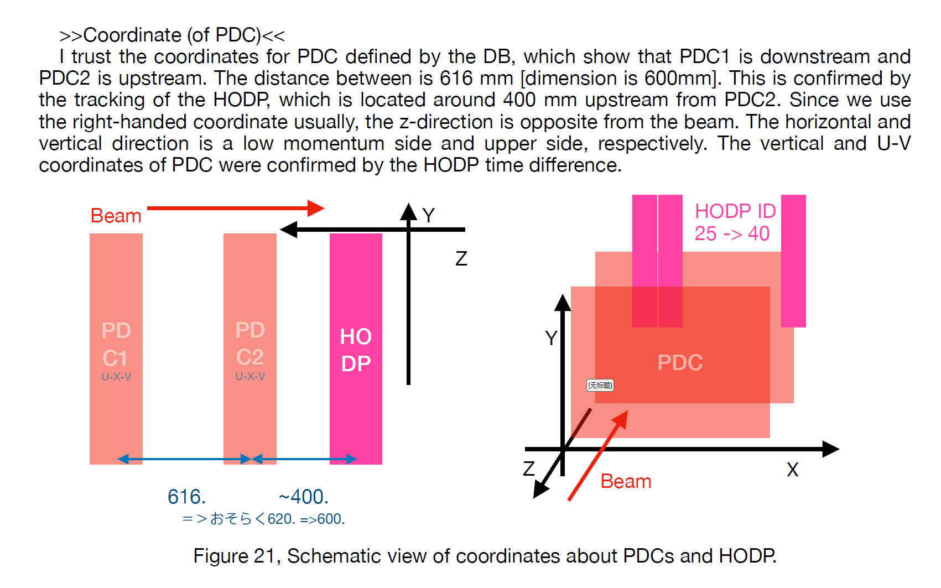
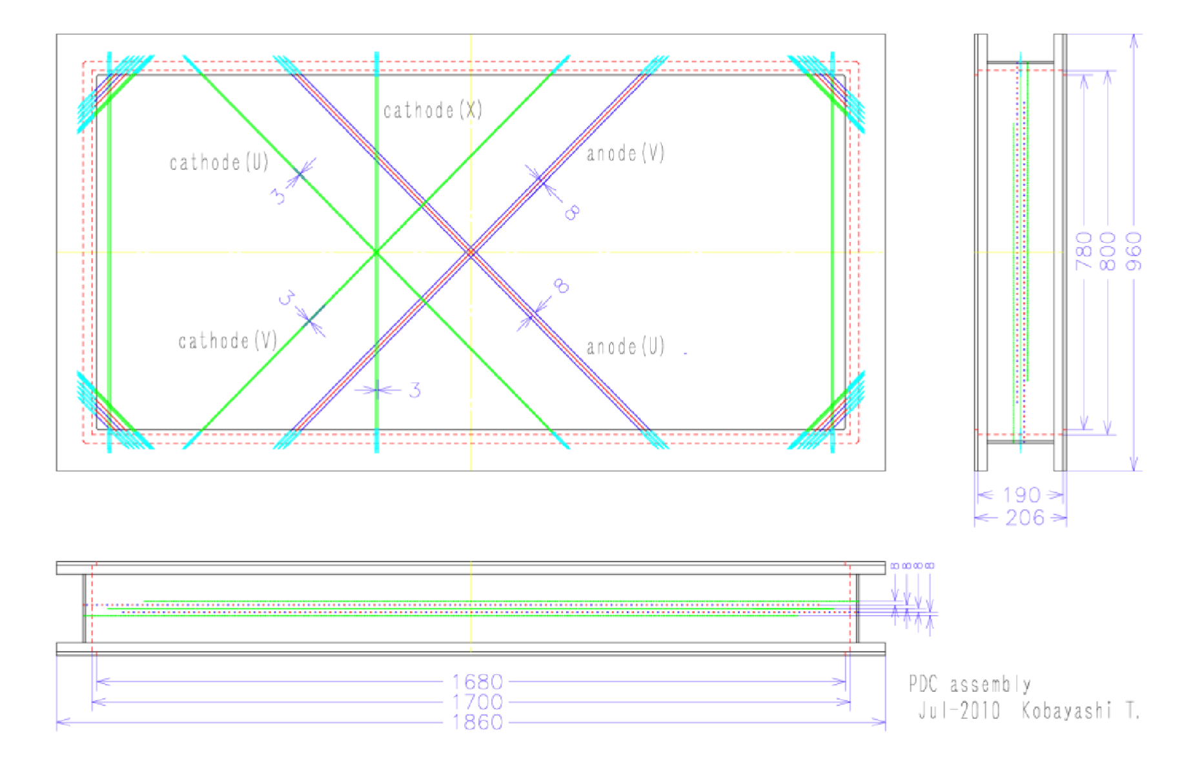
And in order to make self-consistency of cathode (x), which means one cathode wire x has the same x position, different wire have different x position. U V is the position instead of direction.

