Slide 1
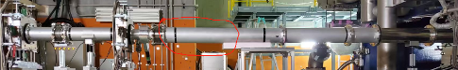
GateValve:
downstream: VF100
(1)VG100-VF150
converter
(2) VG150-VF150
flexible pipe
(3) VG150-VF150
duct
You should connect pipes to the gate value, which is the standard.
After that, you can arrange it as you want. I recommend you use the JIS standard flange.
Please refer to the next page.

Slide 2
