Slide 1
PearsonCorrelation

Slide 2
Refreshable
UserSimilarity
ItemSimilarity
AbstractItemSimilarity
AbstractSimilarity
PearsonCorrelationSimilarity

Slide 3
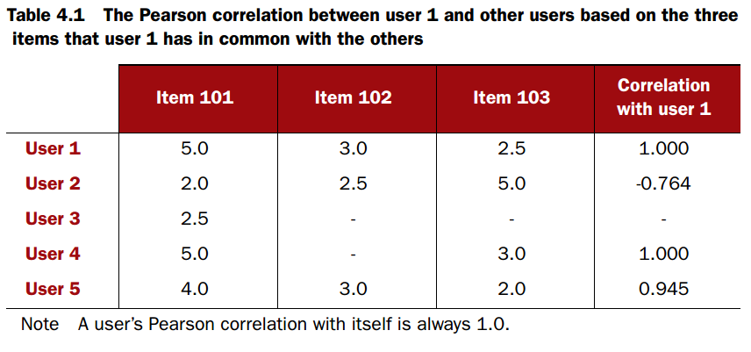

Slide 4
@Override
public double userSimilarity(long userID1, long userID2) throws TasteException {
DataModel dataModel = getDataModel();
PreferenceArray xPrefs = dataModel.getPreferencesFromUser(userID1);
PreferenceArray yPrefs = dataModel.getPreferencesFromUser(userID2);
int xLength = xPrefs.length();
int yLength = yPrefs.length();
if (xLength == 0 || yLength == 0) {
return Double.NaN;
}
long xIndex = xPrefs.getItemID(0);
long yIndex = yPrefs.getItemID(0);
int xPrefIndex = 0;
int yPrefIndex = 0;
double sumX = 0.0;
double sumX2 = 0.0;
double sumY = 0.0;
double sumY2 = 0.0;
double sumXY = 0.0;
double sumXYdiff2 = 0.0;
int count = 0;
boolean hasInferrer = inferrer != null;
boolean hasPrefTransform = prefTransform != null;

Slide 5
while (true) {
int compare = xIndex < yIndex ? -1 : xIndex > yIndex ? 1 : 0;
if (hasInferrer || compare == 0) {
double x;
double y;
if (xIndex == yIndex) {
// Both users expressed a preference for the item
if (hasPrefTransform) {
x = prefTransform.getTransformedValue(xPrefs.get(xPrefIndex));
y = prefTransform.getTransformedValue(yPrefs.get(yPrefIndex));
} else {
x = xPrefs.getValue(xPrefIndex);
y = yPrefs.getValue(yPrefIndex);
}
} else {
// Only one user expressed a preference, but infer the other one's preference and tally
// as if the other user expressed that preference
if (compare < 0) {
// X has a value; infer Y's
x = hasPrefTransform
? prefTransform.getTransformedValue(xPrefs.get(xPrefIndex))
: xPrefs.getValue(xPrefIndex);
y = inferrer.inferPreference(userID2, xIndex);
} else {
// compare > 0
// Y has a value; infer X's
x = inferrer.inferPreference(userID1, yIndex);
y = hasPrefTransform
? prefTransform.getTransformedValue(yPrefs.get(yPrefIndex))
: yPrefs.getValue(yPrefIndex);
}
}

Slide 6
sumXY += x * y;
sumX += x;
sumX2 += x * x;
sumY += y;
sumY2 += y * y;
double diff = x - y;
sumXYdiff2 += diff * diff;
count++;
}

Slide 7
if (compare <= 0) {
if (++xPrefIndex >= xLength) {
if (hasInferrer) {
// Must count other Ys; pretend next X is far away
if (yIndex == Long.MAX_VALUE) {
// ... but stop if both are done!
break;
}
xIndex = Long.MAX_VALUE;
} else {
break;
}
} else {
xIndex = xPrefs.getItemID(xPrefIndex);
}
}
if (compare >= 0) {
if (++yPrefIndex >= yLength) {
if (hasInferrer) {
// Must count other Xs; pretend next Y is far away
if (xIndex == Long.MAX_VALUE) {
// ... but stop if both are done!
break;
}
yIndex = Long.MAX_VALUE;
} else {
break;
}
} else {
yIndex = yPrefs.getItemID(yPrefIndex);
}
}
}

Slide 8
// "Center" the data. If my math is correct, this'll do it.
double result;
if (centerData) {
double meanX = sumX / count;
double meanY = sumY / count;
// double centeredSumXY = sumXY - meanY * sumX - meanX * sumY + n * meanX * meanY;
double centeredSumXY = sumXY - meanY * sumX;
// double centeredSumX2 = sumX2 - 2.0 * meanX * sumX + n * meanX * meanX;
double centeredSumX2 = sumX2 - meanX * sumX;
// double centeredSumY2 = sumY2 - 2.0 * meanY * sumY + n * meanY * meanY;
double centeredSumY2 = sumY2 - meanY * sumY;
result = computeResult(count, centeredSumXY, centeredSumX2, centeredSumY2, sumXYdiff2);
} else {
result = computeResult(count, sumXY, sumX2, sumY2, sumXYdiff2);
}
if (similarityTransform != null) {
result = similarityTransform.transformSimilarity(userID1, userID2, result);
}
if (!Double.isNaN(result)) {
result = normalizeWeightResult(result, count, cachedNumItems);
}
return result;
}

Slide 9
简化

Slide 10
PreferenceArray xPrefs = dataModel.getPreferencesFromUser(userID1);
PreferenceArray yPrefs = dataModel.getPreferencesFromUser(userID2);
int xLength = xPrefs.length();
int yLength = yPrefs.length();
if (xLength == 0 || yLength == 0) {
return Double.NaN;
}
long xIndex = xPrefs.getItemID(0);
long yIndex = yPrefs.getItemID(0);
int xPrefIndex = 0;
int yPrefIndex = 0;
double sumX = 0.0;
double sumX2 = 0.0;
double sumY = 0.0;
double sumY2 = 0.0;
double sumXY = 0.0;
double sumXYdiff2 = 0.0;
int count = 0;
boolean hasInferrer = inferrer != null;
boolean hasPrefTransform = prefTransform != null;
xPrefs=userID:1,{101=5.0,102=3.0,103=2.5}
yPrefs=[userID:2,{101=2.0,102=2.5,103=5.0,104=2.0}]
xIndex = 101,yIndex=101

Slide 11
while (true) {
int compare = xIndex < yIndex ? -1 : xIndex > yIndex ? 1 : 0;
if (hasInferrer || compare == 0) {
double x;
double y;
if (xIndex == yIndex) {
if (hasPrefTransform) {
…
} else {
x = xPrefs.getValue(xPrefIndex);
y = yPrefs.getValue(yPrefIndex);
}
} else {
…
}
sumXY += x * y;
sumX += x;
sumX2 += x * x;
sumY += y;
sumY2 += y * y;
double diff = x - y;
sumXYdiff2 += diff * diff;
count++;
x | 5
y | 2
sumXY | 10
sumX | 5
sumX2 | 25
sumY | 2
sumY2 | 4
diff | 3
sumXYdiff2 | 9

Slide 12
if (compare <= 0) {
if (++xPrefIndex >= xLength) {
if (hasInferrer) {
// Must count other Ys; pretend next X is far away
if (yIndex == Long.MAX_VALUE) {
// ... but stop if both are done!
break;
}
xIndex = Long.MAX_VALUE;
} else {
break;
}
} else {
xIndex = xPrefs.getItemID(xPrefIndex);//
}
}
获取x下一个item的index

Slide 13
if (compare >= 0) {
if (++yPrefIndex >= yLength) {
if (hasInferrer) {
// Must count other Xs; pretend next Y is far away
if (xIndex == Long.MAX_VALUE) {
// ... but stop if both are done!
break;
}
yIndex = Long.MAX_VALUE;
} else {
break;
}
} else {
yIndex = yPrefs.getItemID(yPrefIndex);
}
}
}
获取y下一个item的index

Slide 14
item=101
item=102
x | 5
y | 2
sumXY | 10
sumX | 5
sumX2 | 25
sumY | 2
sumY2 | 4
diff | 3
sumXYdiff2 | 9
x | 3
y | 2.5
sumXY | 17.5
sumX | 8
sumX2 | 34
sumY | 4.5
sumY2 | 10.25
diff | 0.5
sumXYdiff2 | 9.25

Slide 15
item=102
item=103
x | 3
y | 2.5
sumXY | 17.5
sumX | 8
sumX2 | 34
sumY | 4.5
sumY2 | 10.25
diff | 0.5
sumXYdiff2 | 9.25
x | 2.5
y | 5
sumXY | 30
sumX | 10.5
sumX2 | 40.25
sumY | 9.5
sumY2 | 35.25
diff | -2.5
sumXYdiff2 | 15.5

Slide 16
double result;
if (centerData) {
double meanX = sumX / count;
double meanY = sumY / count;
// double centeredSumXY = sumXY - meanY * sumX - meanX * sumY + n * meanX * meanY;
double centeredSumXY = sumXY - meanY * sumX;
// double centeredSumX2 = sumX2 - 2.0 * meanX * sumX + n * meanX * meanX;
double centeredSumX2 = sumX2 - meanX * sumX;
// double centeredSumY2 = sumY2 - 2.0 * meanY * sumY + n * meanY * meanY;
double centeredSumY2 = sumY2 - meanY * sumY;
result = computeResult(count, centeredSumXY, centeredSumX2, centeredSumY2, sumXYdiff2);
} else {
result = computeResult(count, sumXY, sumX2, sumY2, sumXYdiff2);
}

Slide 17
@Override
double computeResult(int n, double sumXY, double sumX2, double sumY2, double sumXYdiff2) {
if (n == 0) {
return Double.NaN;
}
// Note that sum of X and sum of Y don't appear here since they are assumed to be 0;
// the data is assumed to be centered.
double denominator = Math.sqrt(sumX2) * Math.sqrt(sumY2);
if (denominator == 0.0) {
// One or both parties has -all- the same ratings;
// can't really say much similarity under this measure
return Double.NaN;
}
return sumXY / denominator;
}

Slide 18
sumX | 10.5
sumY | 9.5
count | 3
centeredSumXY | -3.25
centeredSumX2 | 3.5
centeredSumY2 | 5.166666666666668
result | -0.7642652566278799

