Slide 1
Highly-optimized Logistic Regression for Spark Model Training Systems
Tianbing XU
Quan Wang
Infra Group

Slide 2
Baidu’s Challenges:
Scalability
Large scale problems at Baidu, 10-100 Terabytes training
Huge dimension feature space, 10 - 100 Billions
Performance
Daily model training, within 10 hours
Accurate model prediction, e.g. 0.85-0.88 AUC

Slide 3
Why we not choose MLLib
MLLib SGD
Slow convergence rate, not able to achieve desirable high accuracy
MLLib LBFGS
not able to scale to large data, crash when training about 400G data

Slide 4
What we have done
Developed as fast and accurate as possible Logistic regression (LR) algorithms for Baidu’s scale
Build effective and easy to use model training systems

Slide 5
Major results
Our model converges fast with high accuracy while maintain cheap computations and superior scalability
Train 1T – 10 T data in 50 – 150 machines cluster
10X – 20X speedup compared to MLLib SGD
Significant better Accuracy (AUC) than MLLib SGD, comparable to industrial systems

Slide 6
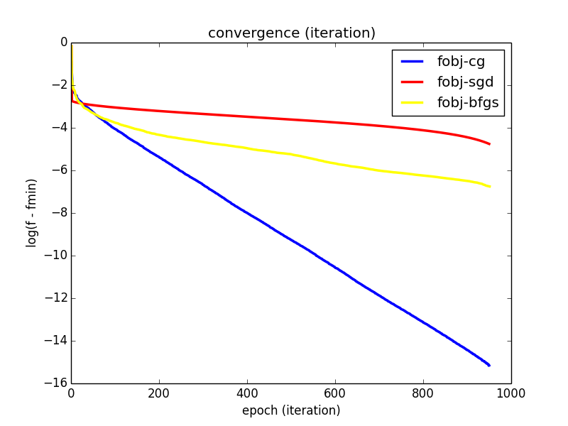
Convergence Rates Comparison (700 M training data, 1.2 K dim)

Slide 7
1 Terabytes train data (63 nodes, 500 cores, 20G memory per node)
Training Data | 1.2 Terabytes
Num Examples | 0.545 Billions
Feature dim | 350 K
Testing Data | 0.12 Terabytes
 | CG | MLLib SGD | Speedup
Training Time | 25.4 min | 438.1 min | 17.2
Test AUC | 0.894410465 | 0.530167961

Slide 8
10 Terabytes train data (147 nodes, 730 cores, 30G memory per node)
Training Data | 13 Terabytes
Test AUC | 0.8808
Num Examples | 5.7 Billions
Feature dim | 120 K
Training Time | 4.2 hours
Testing Data | 0.75 Terabytes

Slide 9
How we achieve it?
Optimization Algorithms
Computations optimization
Memory optimization
Mini-batch
Feature mapping

Slide 10
Algorithms
Conjugate gradient
Strong Global linear Convergence guarantee[1,3]
Local superliner or quadratic convergence rate
Cheap computational cost per iteration
Time complexity to achieve epsilon-accuracy
O(nd log(1/epsilon))

Slide 11
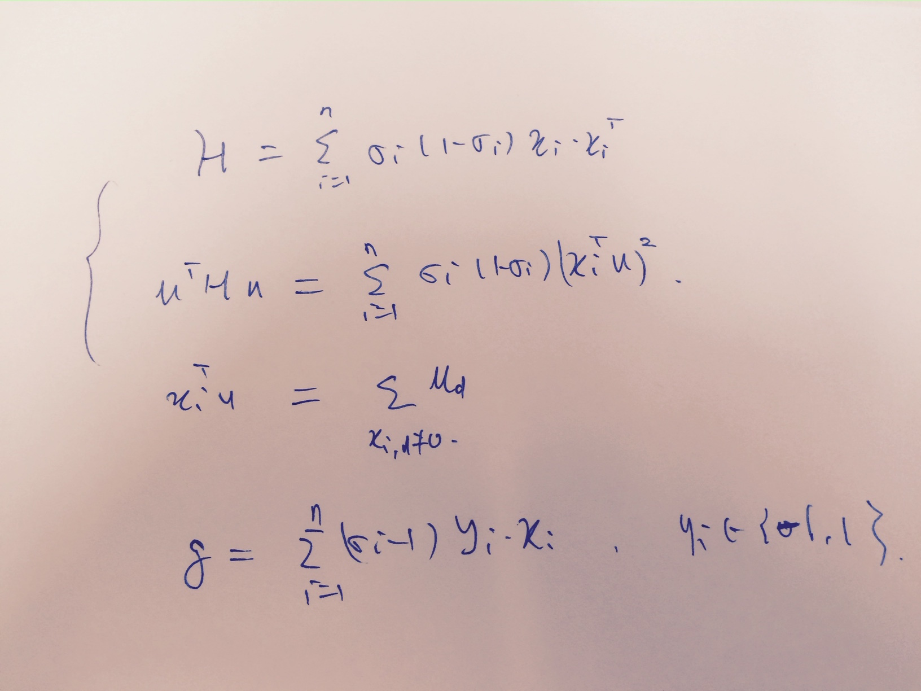
Computations optimization
Reduce from matrix-vector multiple to add

Slide 12
Memory optimization
Feature Representation Optimization
Tuning Garbage Collection (Thanks to Ning Qu’s discussion)
Model Representation Optimization

Slide 13
Mini-batch
Advantages
Reduce training time
Boost model prediction accuracy

Slide 14
Feature mapping
Feature dimension reduction
Reduced from 10B to about 100K – 10M dim
Tradeoff between computations/memory cost and prediction accuracy

Slide 15
Easy to use Training Systems
Data Loading
Model
Training
Model Prediction
Feature Mapping

Slide 16
Reference
1. Introductory Lectures on Convex Programming, Volume I: Basic course, Yu. Nesterov
2. On optimization methods for deep learning, Quoc V. Le , Jiquan Ngiam , Adam Coates , Abhik Lahiri , Bobby Prochnow , Andrew Y. Ng
3. A Nonlinear Conjugate Gradient Method with a Strong Global Convergence Property, Y. H. Dai and Y. Yuan

Slide 17

Thank you

