Slide 1
Level1
A:Play P:0.99
R:$20
End game
Level2
A:Quit P: 1.0 R:$0
A:Play P:0.95
R:$50
A:Quit P: 1.0 R:$0
Level3
A:Quit P: 1.0 R:$0
A:Play P:0.9
R:$100
Level4
A:Quit P: 1.0 R:$0
A:Quit P: 1.0 R:$0
A:Play P:0.85
R:$200
A:Play P:0.3
R:$10K
…
A:Quit P: 1.0 R:$0
P:0.05
R:$0
Level12
A:Quit P: 1.0 R:$0
P:0.15
R:$0
A:Play P:0.2
R:$20K
P:0.01
R:$0
P:0.7
R:$0
Level13
P:0.1
R:$0
A:Play P:0.1
R:$50K
Level14
P:0.8
R:$0
P:0.9
R:$0
A:Play P:0.05
R:$100K
Level15
P:0.95
R:$0
End game

Slide 2
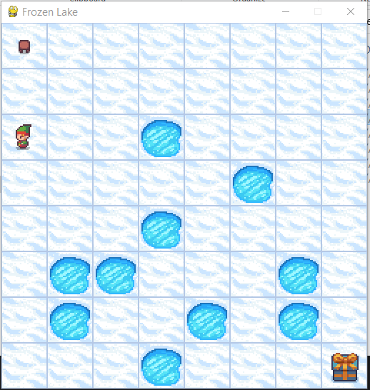
S
F
F
F
F
H
H
G

Slide 3
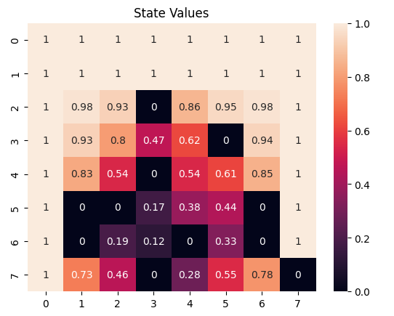

Slide 4
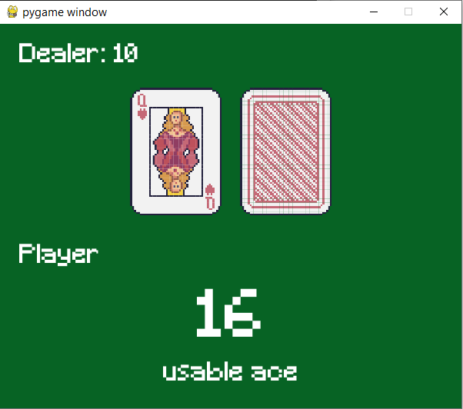
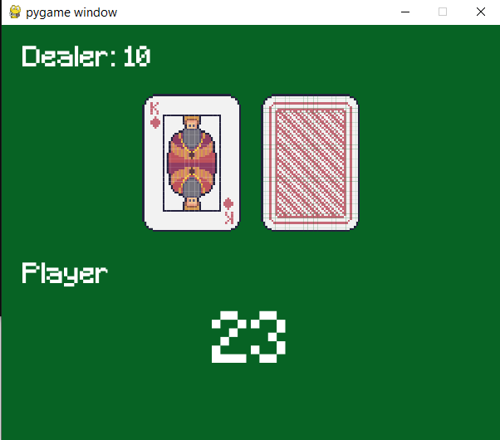
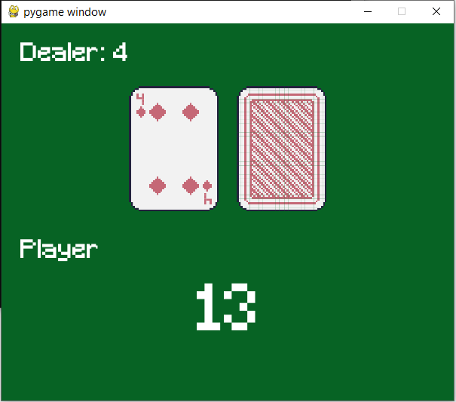

Slide 5
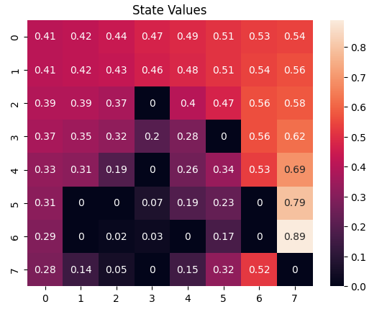
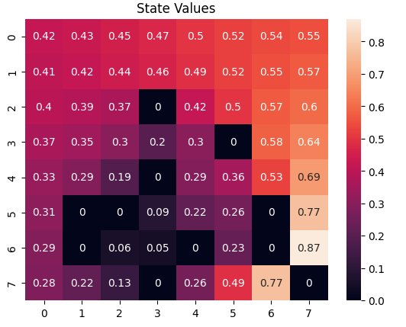
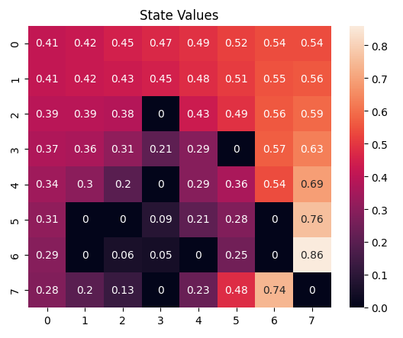

Q learning
50K iteration
100K iteration
VI & PI convergence
200K iteration
500K iteration

