Slide 1
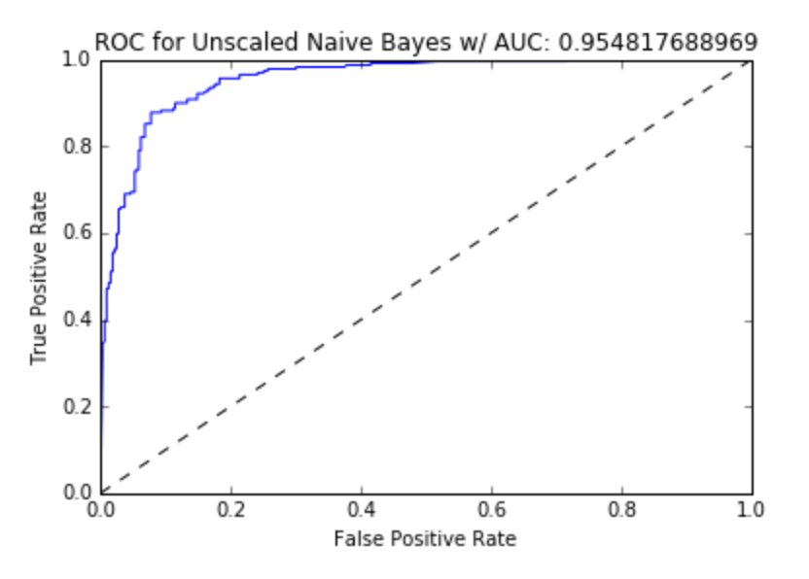
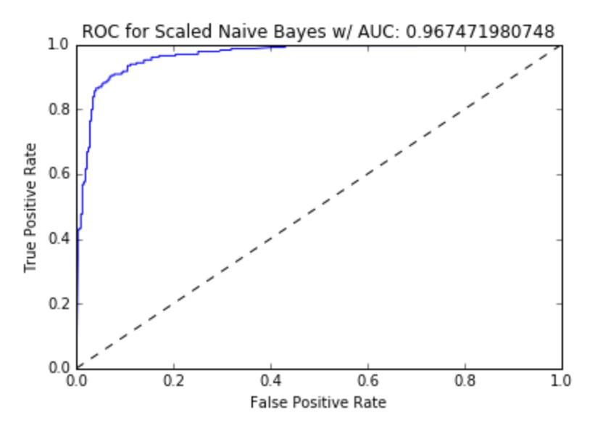
CMSC 422: Task 3
I first used the standared ones, but the result is not very good, then I used the preprocessing skills
1. Normal default SVM
I used this default method, the best I can get is 0.83, which is not very good
2. Preprocessing data
I used and tried different data and skills, and different random_state , change the c and the kenral, I tried both “linear” and “rbf”, But I think “rbf make more senes on it

Slide 2
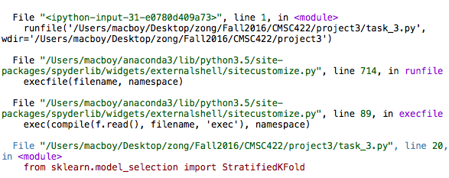
Some other problems
When I was doing this task I found I should not only preprosessing the preprocessing.scale(X_train), and also preprocessing.scale(X_val) in order to get the right accuracy
I tried the data sctructre to test ROC online, but they only return different errors like

Slide 3
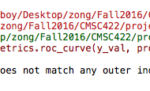
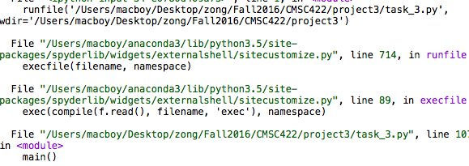
Other errors
I have this error: from sklearn.model_selection import StratifiedKFoldImportError: No module named 'sklearn.model_selection’ not sure

