Slide 1
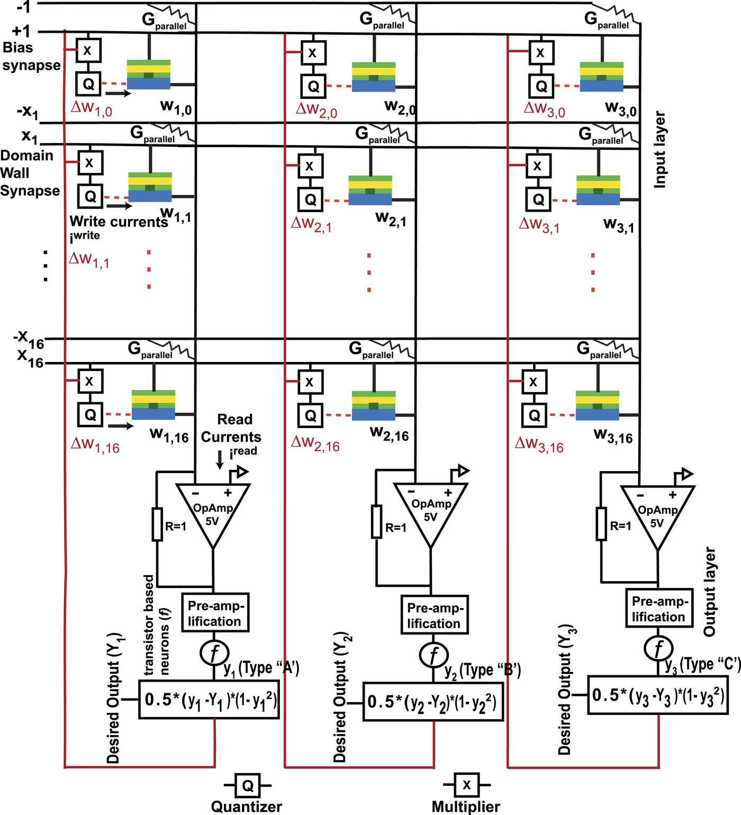
FIG. 5. Schematic of designed DW synapse based crossbar array along with analog peripheral circuits for on-chip learning.
Published in: Divya Kaushik; Utkarsh Singh; Upasana Sahu; Indu Sreedevi; Debanjan Bhowmik; AIP Advances 10, 025111 (2020)
DOI: 10.1063/1.5128344
Copyright © 2020 Author(s)

