Slide 1


Comparing domain wall synapse with other non volatile memory devices for on-chip learning in analog hardware neural network
(III. NETWORK LEVEL COMPARISON)
28
th
February 2020

Slide 2


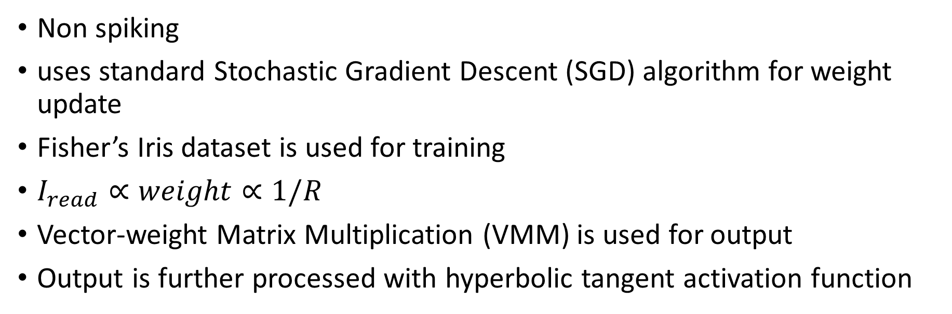
On-Chip Learning Architecture
Non spiking
uses standard Stochastic Gradient Descent (SGD) algorithm for weight update
Fisher’s Iris dataset is used for training
$I_{read}∝weight∝1/R$
Vector-weight Matrix Multiplication (VMM) is used for output
Output is further processed with hyperbolic tangent activation function

Slide 3
On-Chip Learning Architecture
Common part of weight update computed at each output node is next multiplied with the inputs using the multiplier circuit (x)
Conductance of the DW synapse takes only quantized values (updated by write current pulses of fixed magnitude (25 μA) only with quantizer circuit)

Slide 4
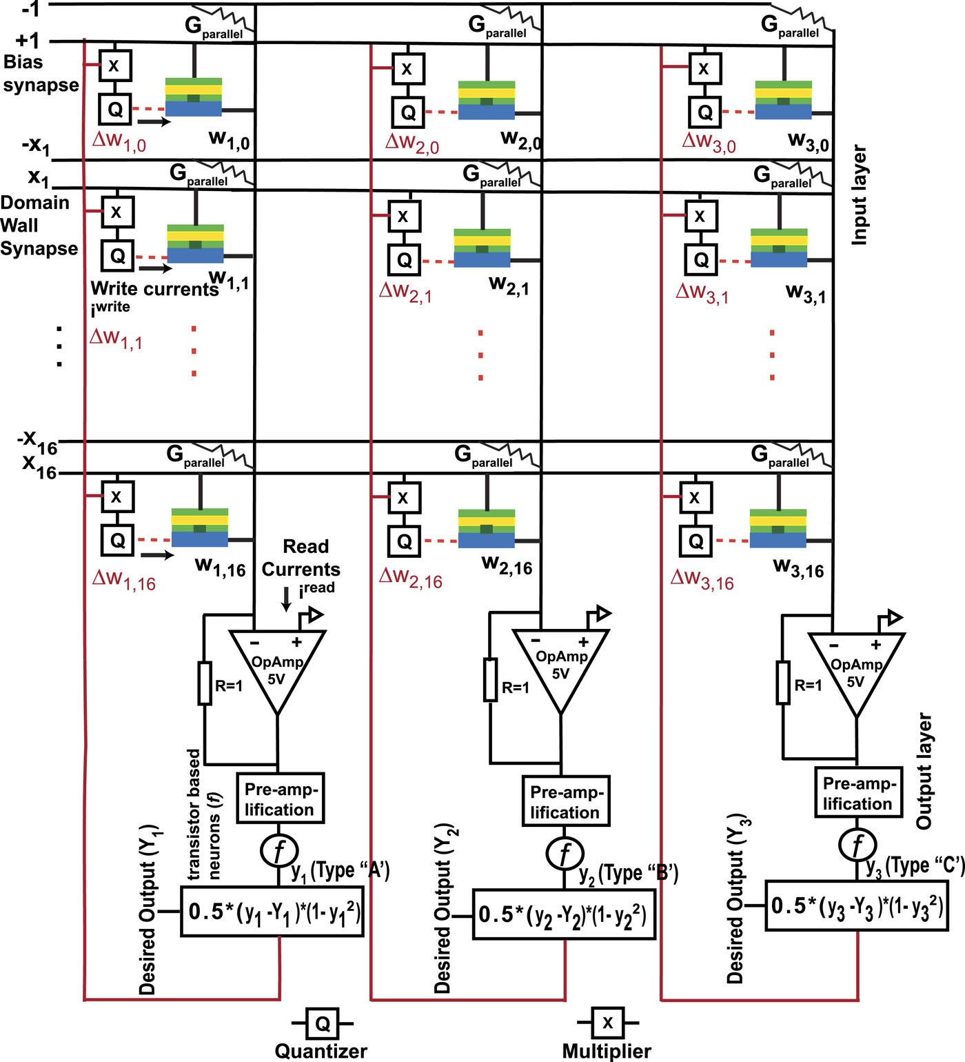
On-Chip Learning Architecture
FIG. 5. Schematic of designed DW synapse based crossbar array along with analog peripheral circuits for on-chip learning.

Slide 5
Test Result
89 % train accuracy
92 % test accuracy
Test accuracy > train accuracy due to smaller test dataset (50 test vs 100 train)

Slide 6
Performance of RRAM/PCM vs DW Synapse
Energy Consumption:
Net energy consumed is several orders of magnitude higher for RRAM/PCM (high energy for SET pulse and RESET pulse)
Training time:
training takes much longer for RRAM/PCM because of long duration RESET pulses (microseconds) vs (nanoseconds for DW)
Overall RESET time taken is as long as the longest time taken for 1 synapse.
No such problem for DW synapse

