Slide 1
ReserveHub
1552215 田甘迅

Slide 2
CONTENT
01
Background
02
Design
03
Evaluation

Slide 3
01
Background

Slide 4
01
Background
01
Problems：
The badminton courts in our campus are always busy, and there are often no free courts.
However, students don’t know if there is an available badminton court until they get to the gym.
Ineffcient!

Slide 5
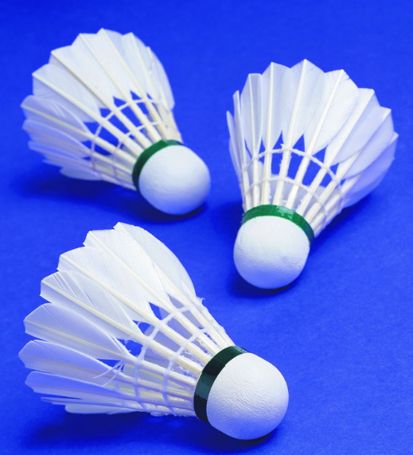
01
Background
01
Students wonder:
1. Is there an available court at the moment?
2. Does anyone want to play together?

Slide 6
01
Background
01
Cause of the problems:
—— Lack of information
Solution:
We want to provide a platform for information sharing, and users can interact with others on this platform.

Slide 7
01
Background
01
Easy Task
Register & Login & Show user information
Basic and essential functions
User friendly
View their own information

Slide 8
01
Background
01
Medium Task
Booking court
Booking the court in advance
Reduce the time cost
Reserve an unreserved venue

Slide 9
01
Background
01
Hard Task
Seek partners
Issuing invitations
Message discussion
Meet some like-minded friends

Slide 10
02
Design
2.1 Navigation Design
2.2 User Interface Design

Slide 11
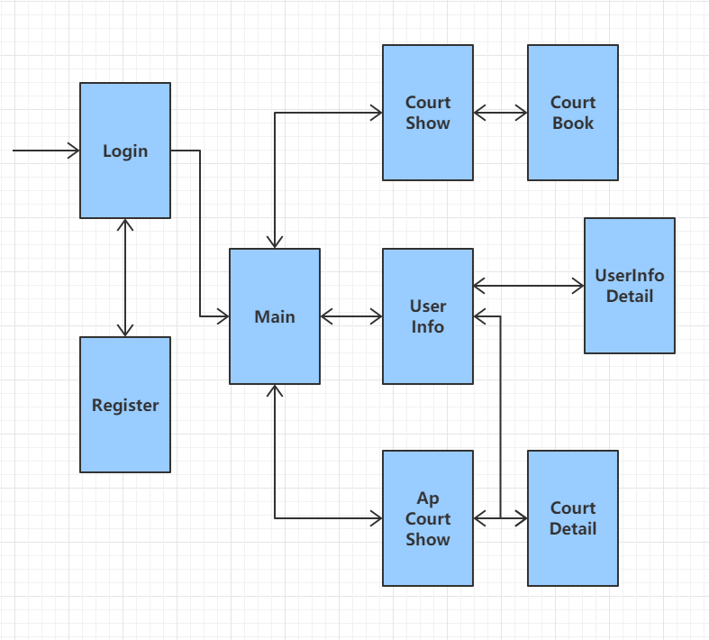
02
Design
01
2.1 Navigation Design —— the global structure
Initial conception:
A deep hierarchy may reduce the usability

Slide 12
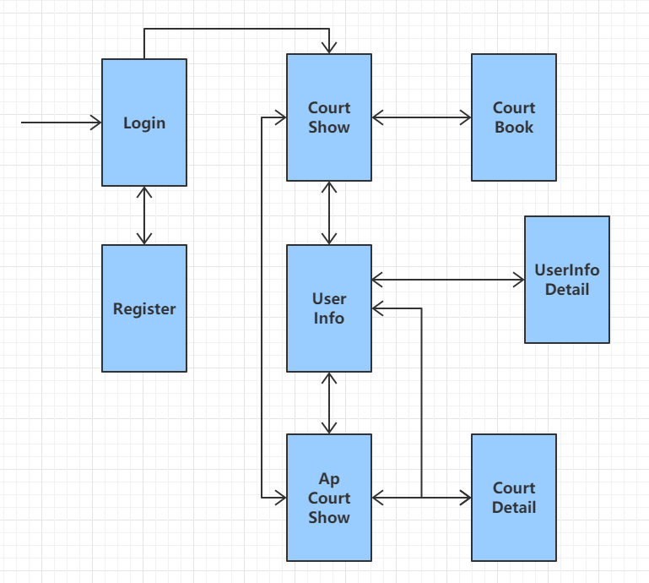
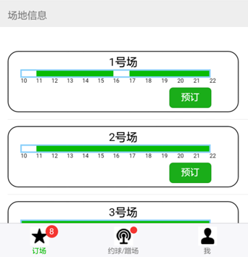
02
Design
01
2.1 Navigation Design —— the global structure
Improved version:
Alter the structure and remove the redundant page

Slide 13
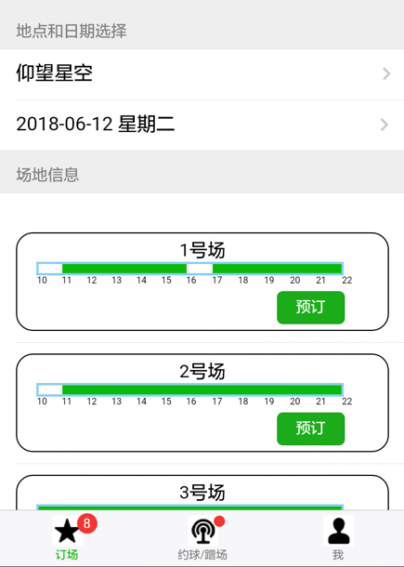
02
Design
01
2.2 User Interface Design
Operation Visibility:
to shown the availability of operations that can be performed next

Slide 14
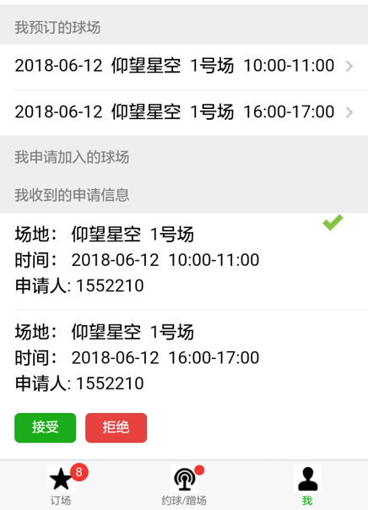
02
Design
01
2.2 User Interface Design
Operation Visibility:
to shown the availability of operations that can be performed next

Slide 15
02
Design
01
2.2 User Interface Design
Honesty:
to provide an observable and informative account of change

Slide 16
02
Design
01
2.2 User Interface Design
Honesty:
to provide an observable and informative account of change

Slide 17
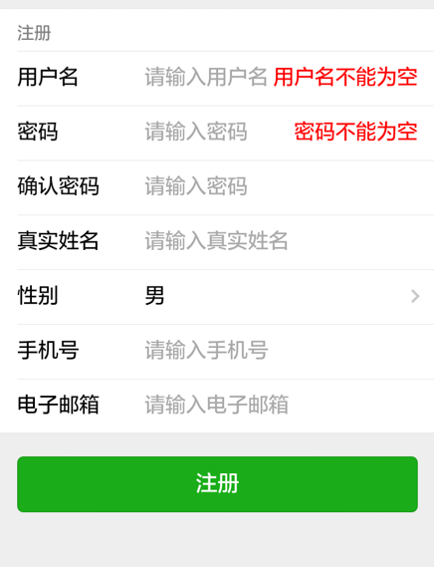
02
Design
01
2.2 User Interface Design
Recoverability:
users are offered clear instructions to enable them to recover once an error has been recognized

Slide 18
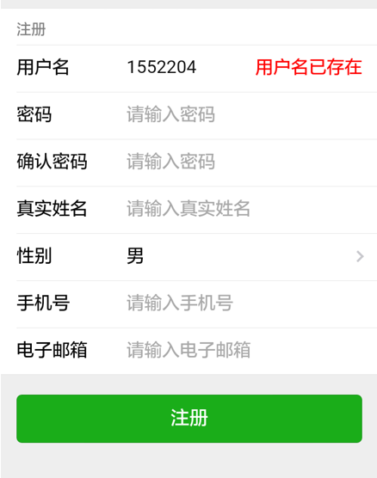
02
Design
01
2.2 User Interface Design
Recoverability:
users are offered clear instructions to enable them to recover once an error has been recognized

Slide 19
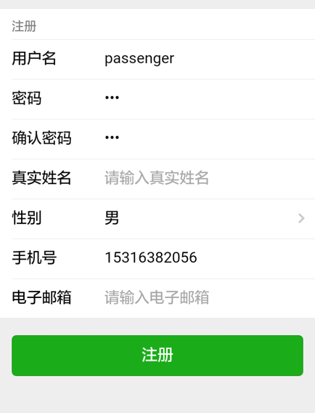
02
Design
01
2.2 User Interface Design
Alignment:
Align each part of the text to the left.
Use one visual starting point.

Slide 20
02
Design
01
2.2 User Interface Design
Color:
Functional website
Make the other color more prominent, to increase the navigability of the web site

Slide 21

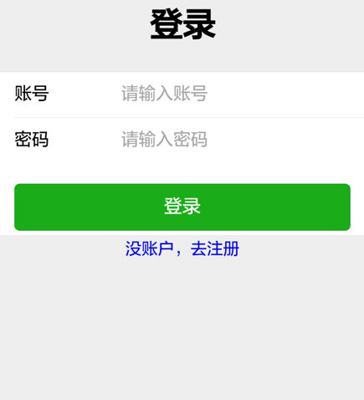
02
Design
01
2.2 User Interface Design
Color:
Wechat
Green bring us a distinct but not abrupt feeling ,and makes us feel relax.

Slide 22
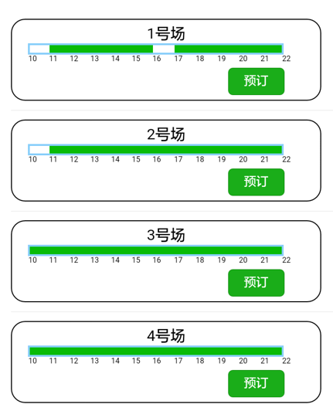
02
Design
01
2.2 User Interface Design
Color:
Red light stop and green light go---unimpeded
The answer key on the cell phone is green, while the hanging key is red.
Green means this site can be booked at this time.

Slide 23
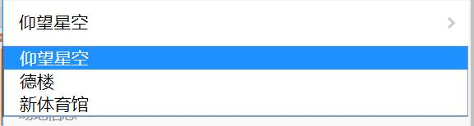
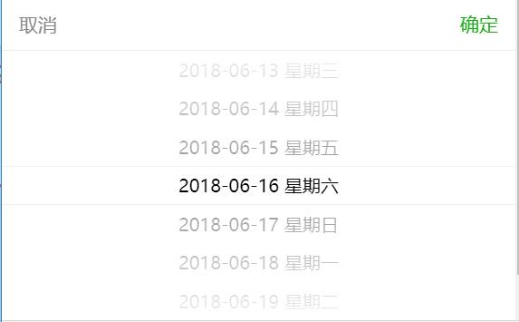
02
Design
01
2.2 User Interface Design
Selection bar:
Stadium : little selectable items and simple type for operation
Time: many electable items and for the cleanliness of the interface

Slide 24
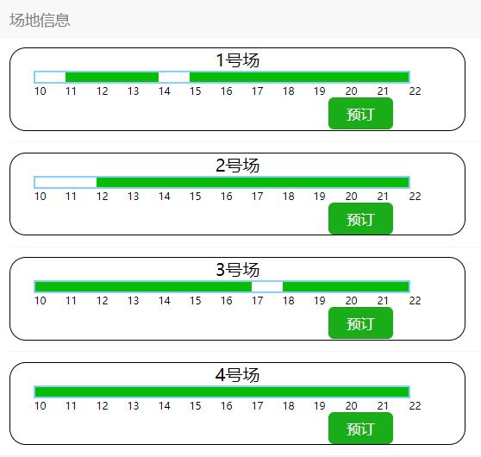
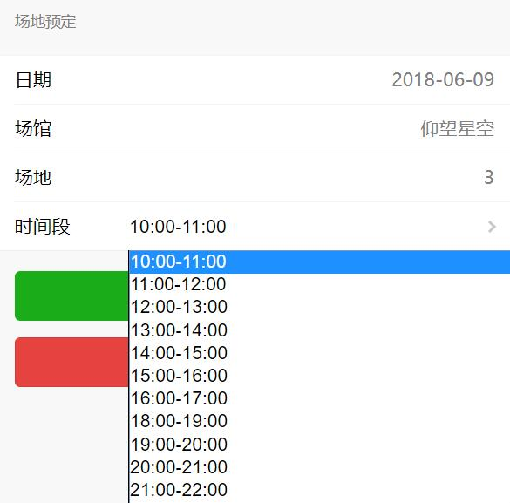
02
Design
01
2.2 User Interface Design
Usability:
Check the venue information before make a reservation

Slide 25
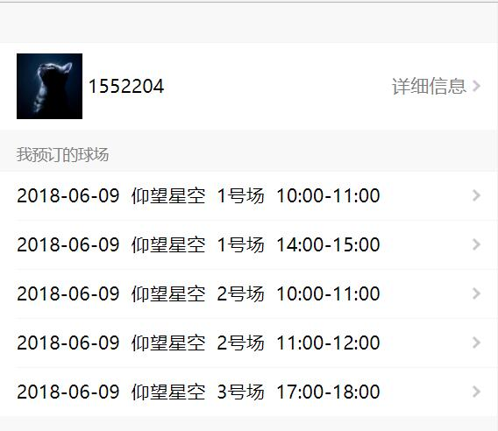
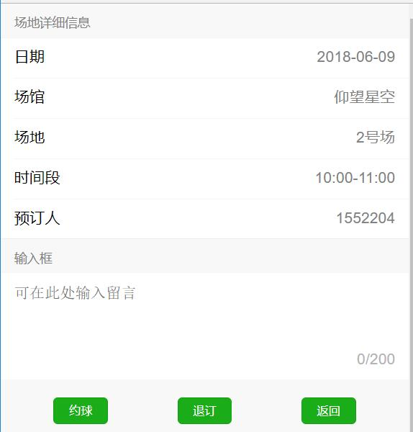
02
Design
01
2.2 User Interface Design
Usability:
Check the detailed information of the reserved venues
Look for a friend to play
Cancel reservation

Slide 26
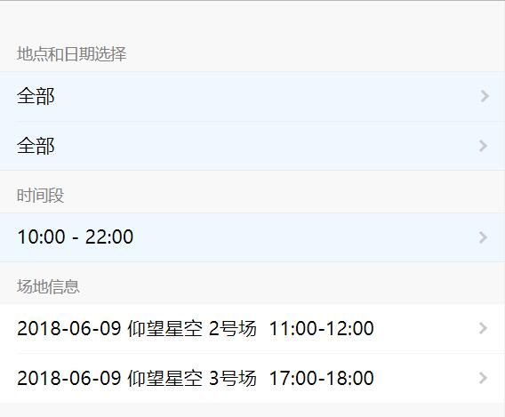
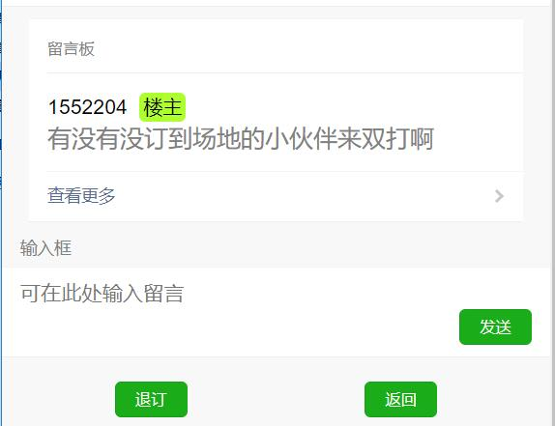
02
Design
01
2.2 User Interface Design
Usability:
Check who looking for a friend to play
Communicate with him in the message area

Slide 27
03
Evaluation

Slide 28
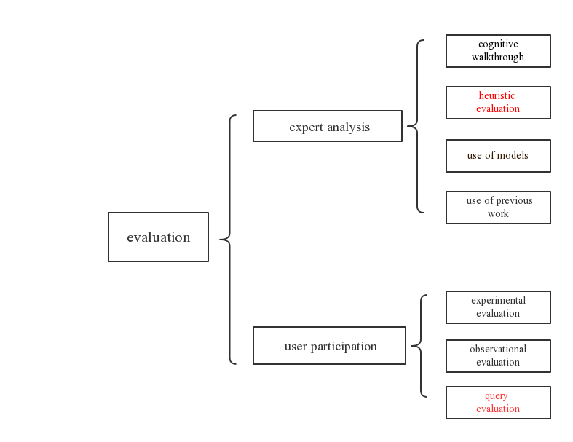
03
Evaluation
04

Slide 29
03
Evaluation
04
Heuristic evaluation
①Visibility of system status | ⑥Recognition rather than recall
②Match between system and the real world | ⑦Flexibility and efficiency of use
③User control and freedom | ⑧Aesthetic and minimalist design
④Consistency and standards | ⑨Help users recognize, diagnose and recover from errors
⑤Error prevention | ⑩Help and documentation

Slide 30
03
Evaluation
04
Heuristic evaluation
four factors
How COMMON is the problem?
How easy is it for the user to OVERCOME?
Will it be a ONE-OFF problem or a PERSISTENT one?
How SERIOUSLY will the problem be perceived?

Slide 31
03
Evaluation
04
Heuristic evaluation
an overall severity rating on a scale of 0-4:
0 = I don’t agree that this is a usability problem at all
1 = Cosmetic problem only: need not be fixed unless extra time is available on project
2 = Minor usability problem: fixing this should be given low priority one
3 = Major usability problem: important to fix, so should be given high priority
4 = Usability catastrophe: imperative to fix this before product can be released

Slide 32
03
Evaluation
04
Heuristic evaluation
Evaluator A:
 | Visibility of system status? | Follow real world? | User control and freedom? | Consistency and standards? | Error prevention?
Common? | Common | Rare | Rare | Rare | Rare
Overcome? | Easy | Hard | Easy | Hard | Hard
Persistent? | persistent | persistent | persistent | persistent | persistent
Seriously? | 1 | 3 | 0 | 3 | 3

Slide 33
03
Evaluation
04
Heuristic evaluation
Evaluator A:
 | Recognition rather than recall? | Flexibility and efficiency of use? | Aesthetic and minimalist design? | Help users recover from error? | Help and documentation?
Common? | Common | Rare | Rare | Rare | Common
Overcome? | Hard | Easy | Easy | Easy | Hard
Persistent? | persistent | persistent | persistent | persistent | persistent
Seriously? | 3 | 0 | 2 | 0 | 3

Slide 34
04
Evaluation
04
Heuristic evaluation
Evaluator B:
 | Recognition rather than recall? | Flexibility and efficiency of use? | Aesthetic and minimalist design? | Help users recover from error? | Help and documentation?
Common? | Common | Rare | Rare | Rare | Common
Overcome? | Hard | Easy | Hard | Easy | Hard
Persistent? | persistent | persistent | persistent | persistent | persistent
Seriously? | 3 | 4 | 2 | 0 | 3

Slide 35
03
Evaluation
04
Heuristic evaluation
Evaluator B:
 | Visibility of system status? | Follow real world? | User control and freedom? | Consistency and standards? | Error prevention?
Common? | Common | Rare | Rare | Rare | Rare
Overcome? | Easy | Easy | Easy | Hard | Hard
Persistent? | persistent | persistent | persistent | persistent | persistent
Seriously? | 1 | 3 | 2 | 4 | 3

Slide 36
03
Evaluation
04
Heuristic evaluation
Evaluator C:
 | Visibility of system status? | Follow real world? | User control and freedom? | Consistency and standards? | Error prevention?
Common? | Common | Common | Rare | Common | Rare
Overcome? | Easy | Hard | Easy | Easy | Hard
Persistent? | persistent | persistent | persistent | persistent | persistent
Seriously? | 1 | 3 | 0 | 3 | 3

Slide 37
03
Evaluation
04
Heuristic evaluation
Evaluator C:
 | Recognition rather than recall? | Flexibility and efficiency of use? | Aesthetic and minimalist design? | Help users recover from error? | Help and documentation?
Common? | Common | Rare | Rare | Rare | Common
Overcome? | Hard | Easy | Easy | Easy | Hard
Persistent? | persistent | persistent | persistent | persistent | persistent
Seriously? | 3 | 0 | 2 | 0 | 3

Slide 38
03
Evaluation
04
Heuristic evaluation
Flexibility and efficiency of use

Slide 39
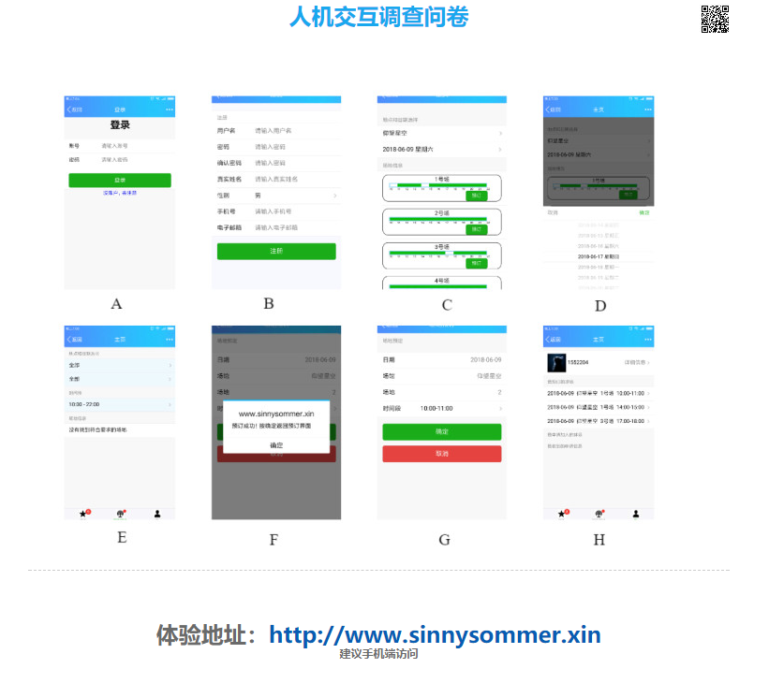
03
Evaluation
04
Query evaluation

Slide 40
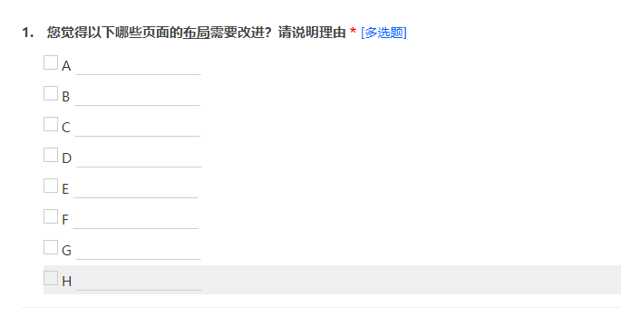
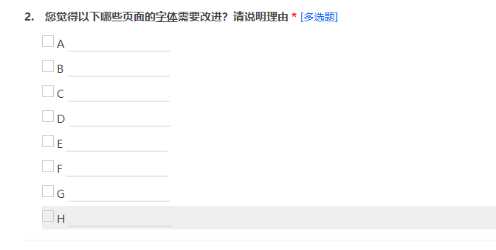
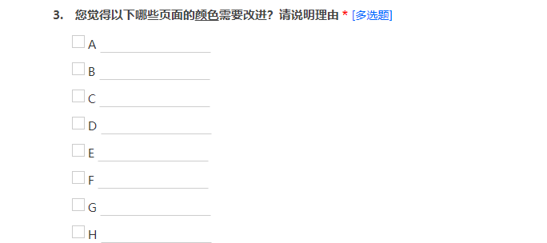
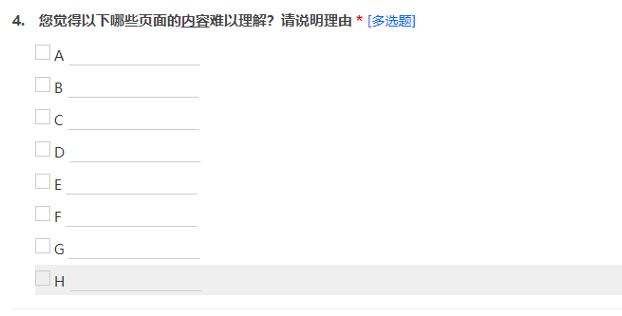
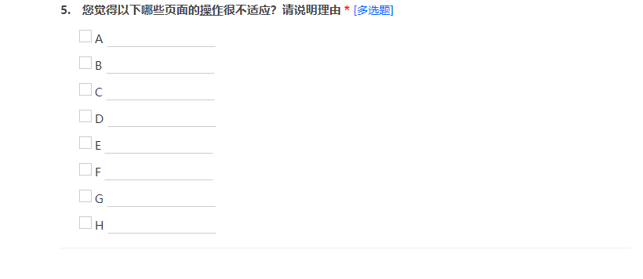
03
Evaluation
04
Query evaluation

Slide 41
03
Evaluation
04
Query evaluation
“The error info of registration is not very timely.”
“The contrast between the background color and the selection box is not obvious enough”
……

Slide 42
THANKS

