Slide 1
15-440 Distributed Systems
Lecture 3 – 15-441 in 2 Days

Slide 2
Last Time
Modularity, Layering, and Decomposition
  Example: UDP layered on top of IP to provide application demux (“ports”)
Resource sharing and isolation
  Statistical multiplexing - packet switching
Dealing with heterogenity
  IP “narrow waist” -- allows many apps, many network technologies
  IP standard -- allows many impls, same proto

Slide 3
Goals [Clark88]
Connect existing networks
  initially ARPANET and ARPA packet radio network
Survivability
  ensure communication service even in the presence of network and router failures
Support multiple types of services
Must accommodate a variety of networks
Allow distributed management
Allow host attachment with a low level of effort
Be cost effective
Allow resource accountability

Slide 4
Goal 1: Survivability
If network is disrupted and reconfigured…
  Communicating entities should not care!
  No higher-level state reconfiguration
How to achieve such reliability?
  Where can communication state be stored?
 | Network | Host
Failure handing | Replication | “Fate sharing”
Net Engineering | Tough | Simple
Switches | Maintain state | Stateless
Host trust | Less | More

Slide 5
Fate Sharing
Connection State
No State
State
Lose state information for an entity if and only if the entity itself is lost.
Examples:
  OK to lose TCP state if one endpoint crashes
    NOT okay to lose if an intermediate router reboots
  Is this still true in today’s network?
    NATs and firewalls
Tradeoffs
  Survivability: Heterogeneous network → less information available to end hosts and Internet level recovery mechanisms
  Trust: must trust endpoints more

Slide 6
Today’s Lecture
Internet design
Transport protocols
Application design

Slide 7
IP Packets/Service Model
Low-level communication model provided by Internet
Datagram
  Each packet self-contained
    All information needed to get to destination
    No advance setup or connection maintenance
  Analogous to letter or telegram
0
4
8
12
16
19
24
28
31
version
HLen
TOS
Length
IPv4 Packet
Format
Identifier
Flag
Offset
TTL
Protocol
Checksum
Header
Source Address
Destination Address
Options (if any)
Data

Slide 8
Aside: Interaction with Link Layer
How does one find the Ethernet address of a IP host?
ARP
  Broadcast search for IP address
    E.g., “who-has 128.2.184.45 tell 128.2.206.138” sent to Ethernet broadcast (all FF address)
  Destination responds (only to requester using unicast) with appropriate 48-bit Ethernet address
    E.g, “reply 128.2.184.45 is-at 0:d0:bc:f2:18:58” sent to 0:c0:4f:d:ed:c6

Slide 9
IP Addresses: How to Get One?
Network (network portion):
Get allocated portion of ISP’s address space:
ISP's block 11001000 00010111 00010000 00000000 200.23.16.0/20
Organization 0 11001000 00010111 00010000 00000000 200.23.16.0/23
Organization 1 11001000 00010111 00010010 00000000 200.23.18.0/23
Organization 2 11001000 00010111 00010100 00000000 200.23.20.0/23
... ….. …. ….
Organization 7 11001000 00010111 00011110 00000000 200.23.30.0/23

Slide 10
IP Addresses: How to Get One?
How does an ISP get block of addresses?
  From Regional Internet Registries (RIRs)
    ARIN (North America, Southern Africa), APNIC (Asia-Pacific), RIPE (Europe, Northern Africa), LACNIC (South America)
How about a single host?
  Hard-coded by system admin in a file
  DHCP: Dynamic Host Configuration Protocol: dynamically get address: “plug-and-play”
    Host broadcasts “DHCP discover” msg
    DHCP server responds with “DHCP offer” msg
    Host requests IP address: “DHCP request” msg
    DHCP server sends address: “DHCP ack” msg
Notes:
IANA (Internet Assigned Numbers Authority) really has control over addresses and allocates them to the RIRs
Currently, ICANN (Internet Corporation for Assigned Names and Numbers) has contract to run IANA

Slide 11
CIDR IP Address Allocation
Provider is given 201.10.0.0/21
Provider
201.10.0.0/22
201.10.4.0/24
201.10.5.0/24
201.10.6.0/23

Slide 12
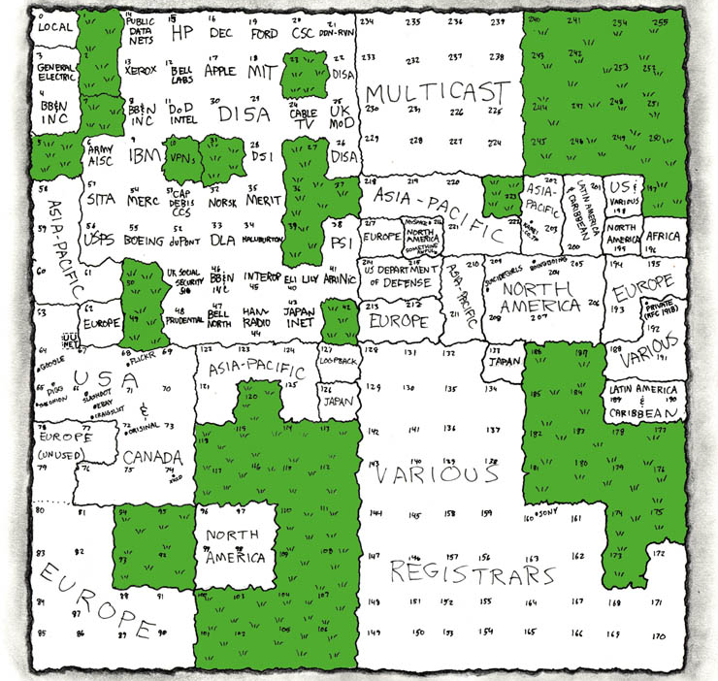
IP Address Utilization (‘06)
http://xkcd.com/195/

Slide 13
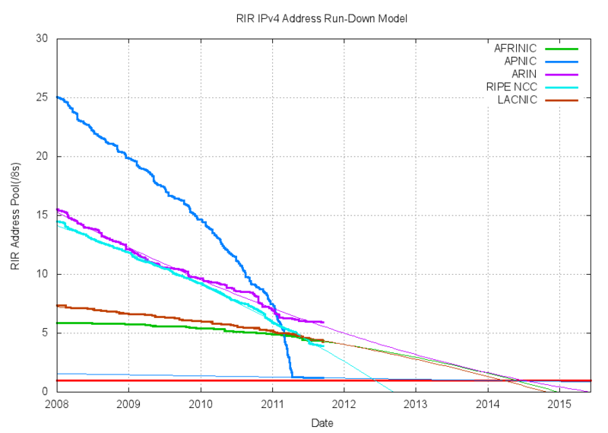

Slide 14
What Now?
Last /8 given to RIR in 1/2011
Mitigation
  Reclaim addresses (e.g. Stanford gave back class A in 2000)
  More NAT?
  Resale markets
  Slow down allocation from RIRs to LIRs (i.e. ISPs)
IPv6?

Slide 15
Host Routing Table Example
Destination Gateway Genmask Iface
128.2.209.100 0.0.0.0 255.255.255.255 eth0
128.2.0.0 0.0.0.0 255.255.0.0 eth0
127.0.0.0 0.0.0.0 255.0.0.0 lo
0.0.0.0 128.2.254.36 0.0.0.0 eth0
From “netstat –rn”
Host 128.2.209.100 when plugged into CS ethernet
Dest 128.2.209.100 → routing to same machine
Dest 128.2.0.0 → other hosts on same ethernet
Dest 127.0.0.0 → special loopback address
Dest 0.0.0.0 → default route to rest of Internet
  Main CS router: gigrouter.net.cs.cmu.edu (128.2.254.36)

Slide 16
Today’s Lecture
Internet design
Transport protocols
Application design

Slide 17
Networks [including end points]
Implement Many Functions
Link
Multiplexing
Routing
Addressing/naming (locating peers)
Reliability
Flow control
Fragmentation
Etc….

Slide 18

Design Question
If you want reliability, etc.
Where should you implement it?
Option 1: Hop-by-hop
Host
Host
Switch
Switch
Switch
Switch
Option 2: end-to-end

Slide 19
Options
Hop-by-hop: Have each switch/router along the path ensure that the packet gets to the next hop
End-to-end: Have just the end-hosts ensure that the packet made it through
What do we have to think about to make this decision??

Slide 20
A question
Is hop-by-hop enough?
  [hint: What happens if a switch crashes? What if it’s buggy and goofs up a packet?]

Slide 21
End-to-End Argument
Deals with where to place functionality
  Inside the network (in switching elements)
  At the edges
Guideline not a law
Argument
  If you have to implement a function end-to-end anyway (e.g., because it requires the knowledge and help of the end-point host or application), don’t implement it inside the communication system
  Unless there’s a compelling performance enhancement
Further Reading: “End-to-End Arguments in System Design.” Saltzer, Reed, and Clark.

Slide 22
Internet Design: Types of Service
Principle: network layer provides one simple service: best effort datagram (packet) delivery
  All packets are treated the same
Relatively simple core network elements
Building block from which other services (such as reliable data stream) can be built
Contributes to scalability of network
No QoS support assumed from below
  In fact, some underlying nets only supported reliable delivery
    Made Internet datagram service less useful!
  Hard to implement without network support
  QoS is an ongoing debate…

Slide 23
Types of Service
TCP vs. UDP
  Elastic apps that need reliability: remote login or email
  Inelastic, loss-tolerant apps: real-time voice or video
  Others in between, or with stronger requirements
  Biggest cause of delay variation: reliable delivery
    Today’s net: ~100ms RTT
    Reliable delivery can add seconds.
Original Internet model: “TCP/IP” one layer
  First app was remote login…
  But then came debugging, voice, etc.
  These differences caused the layer split, added UDP

Slide 24
User Datagram Protocol (UDP):
An Analogy
UDP
Single socket to receive messages
No guarantee of delivery
Not necessarily in-order delivery
Datagram – independent packets
Must address each packet
Postal Mail
Single mailbox to receive messages
Unreliable ☺
Not necessarily in-order delivery
Each letter is independent
Must address each reply
Postal Mail
Single mailbox to receive letters
Unreliable ☺
Not necessarily in-order delivery
Letters sent independently
Must address each letter
Example UDP applications
Multimedia, voice over IP

Slide 25
Transmission Control Protocol (TCP): An Analogy
TCP
Reliable – guarantee delivery
Byte stream – in-order delivery
Connection-oriented – single socket per connection
Setup connection followed by data transfer
Telephone Call
Guaranteed delivery
In-order delivery
Connection-oriented
Setup connection followed by conversation
Example TCP applications
  Web, Email, Telnet

Slide 26
Rough view of TCP
(This is a very incomplete view - take 15-441. :)
Source
Dest
Data pkt
ACKnowledgement
Time
  What TCP does:
  1) Figures out which packets got through/lost
  2) Figures out how fast to send packets to use all of the unused capacity,
  - But not more
  - And to share the link approx. equally with other senders

Slide 27
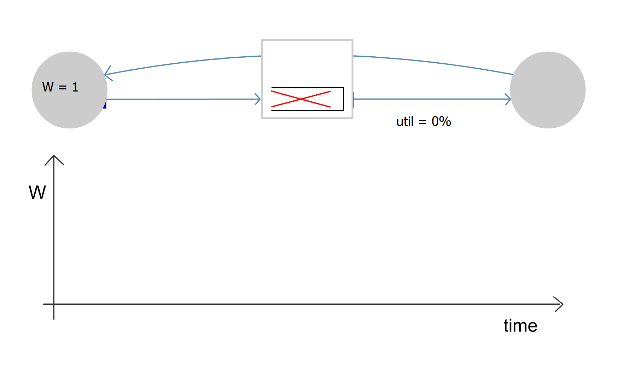
Single TCP Flow
Router without buffers

Slide 28
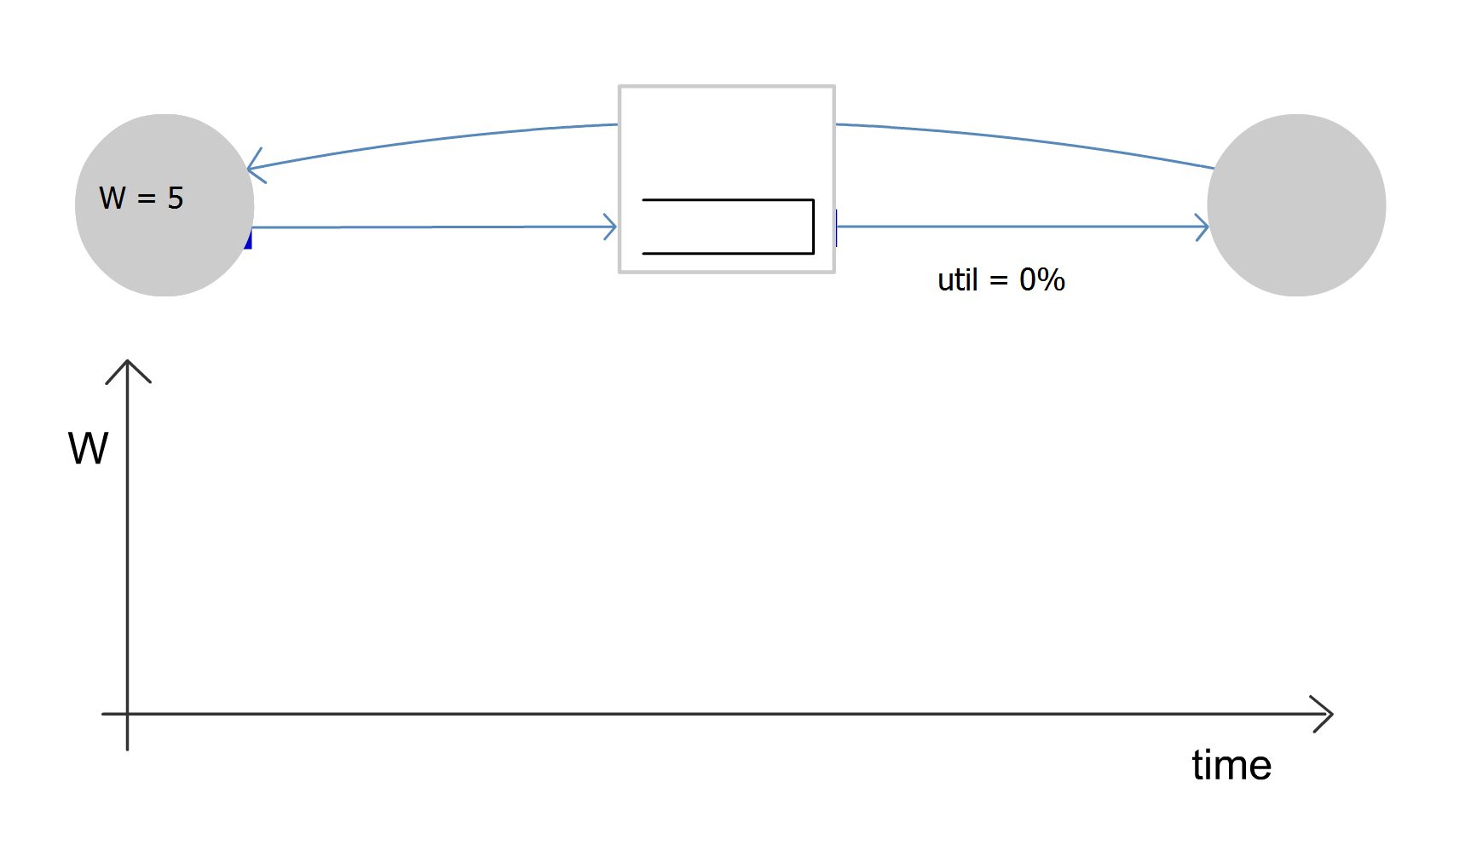
Single TCP Flow
Router with large enough buffers for full link utilization

Slide 29
Today’s Lecture
Internet design
Transport protocols
Application design

Slide 30





Client-Server Paradigm
Typical network app has two pieces: client and server
Client:
Initiates contact with server (“speaks first”)
Typically requests service from server,
For Web, client is implemented in browser; for e-mail, in mail reader
Server:
Provides requested service to client
e.g., Web server sends requested Web page, mail server delivers e-mail
application
transport
network
data link
physical
request
reply
application
transport
network
data link
physical

Slide 31
What Service Does an Application Need?
Data loss
Some apps (e.g., Internet telephony, interactive games) require low delay to be “effective”
Some apps (e.g., audio) can tolerate some loss
Other apps (e.g., file transfer, telnet) require 100% reliable data transfer
Timing
Some apps (e.g., multimedia) require minimum amount of bandwidth to be “effective”
Other apps (“elastic apps”) make use of whatever bandwidth they get
Bandwidth

Slide 32
Transport Service Requirements of Common Apps
Application
Data loss
Bandwidth
Time Sensitive
file transfer
e-mail
web documents
interactive
audio/video
non-interactve
audio/video
interactive games
financial apps
no loss
no loss
no loss
loss-tolerant
(often)
loss-tolerant
(sometimes)
loss-tolerant
no loss
elastic
elastic
elastic
audio: 5Kb-1Mb
video:10Kb-5Mb
same as above
few Kbps
elastic
no
no
no
yes, 100’s msec
yes, few secs
yes, 100’s msec
yes and no: μs?

Slide 33
Transport Protocols
UDP provides just integrity and demux
TCP adds…
  Connection-oriented
  Reliable
  Ordered
  Point-to-point
  Byte-stream
  Full duplex
  Flow and congestion controlled

Slide 34
Why not always use TCP?
TCP provides “more” than UDP
Why not use it for everything??
A: Nothing comes for free...
  Connection setup (take on faith) -- TCP requires one round-trip time to setup the connection state before it can chat...
  How long does it take, using TCP, to fix a lost packet?
    At minimum, one “round-trip time” (2x the latency of the network)
    That could be 100+ milliseconds!
  If I guarantee in-order delivery,
  what happens if I lose one packet in a stream of packets?

Slide 35
One lost packet
Sent packets
Packet #
Received packets (delivered to application)
Delay,
burst
Time to retransmit lost packet
Time

Slide 36
Design trade-off
If you’re building an app...
Do you need everything TCP provides?
If not:
  Can you deal with its drawbacks to take advantage of the subset of its features you need?
  OR
  You’re going to have to implement the ones you need on top of UDP
    Caveat: There are some libraries, protocols, etc., that can help provide a middle ground.
    Takes some looking around - they’re not as standard as UDP and TCP.

Slide 37
Socket API Operation Overview
Client
Server
socket
socket
bind
open_listenfd
open_clientfd
listen
Connection
request
connect
accept
Client / Server
Session
write
read
read
write
close
EOF
read
close

Slide 38
Blocking sockets
What happens if an application write()s to a socket waaaaay faster than the network can send the data?
  TCP figures out how fast to send the data...
  And it builds up in the kernel socket buffers at the sender... and builds...
  until they fill. The next write() call blocks (by default).
  What’s blocking? It suspends execution of the blocked thread until enough space frees up...

Slide 39
In contrast to UDP
UDP doesn’t figure out how fast to send data, or make it reliable, etc.
So if you write() like mad to a UDP socket...
It often silently disappears. Maybe if you’re lucky the write() call will return an error. But no promises.

Slide 40
Questions to ponder
If you have a whole file to transmit,
how do you send it over the Internet?
  You break it into packets (packet-switched medium)
  TCP, roughly speaking, has the sender tell the receiver “got it!” every time it gets a packet. The sender uses this to make sure that the data’s getting through.
  But by e2e, if you have to acknowledge the correct receipt of the entire file... why bother acknowledging the receipt of the individual packets???
This is a bit of a trick question -- it’s not asking e2e vs in-network. :)
The answer: Imagine the waste if you had to retransmit the entire file because one packet was lost. Ow.

Slide 41
Summary: Internet Architecture
Packet-switched datagram network
IP is the “compatibility layer”
  Hourglass architecture
  All hosts and routers run IP
Stateless architecture
  no per flow state inside network
TCP
UDP
IP
Satellite
Ethernet
ATM

Slide 42
Summary: Minimalist Approach
Dumb network
  IP provide minimal functionalities to support connectivity
    Addressing, forwarding, routing
Smart end system
  Transport layer or application performs more sophisticated functionalities
    Flow control, error control, congestion control
Advantages
  Accommodate heterogeneous technologies (Ethernet, modem, satellite, wireless)
  Support diverse applications (telnet, ftp, Web, X windows)
  Decentralized network administration

Slide 43
Rehashing all of that...
TCP is layered on top of IP
  IP understands only the IP header
  The IP header has a “protocol” ID that gets set to TCP
  The TCP at the receiver understands how to parse the TCP information
IP provides only “best-effort” service
TCP adds value to IP by adding retransmission, in-order delivery, data checksums, etc., so that programmers don’t have to re-implement the wheel every time. It also helps figure out how fast to send data. This is why TCP sockets can “block” from the app perspective.
The e2e argument suggests that functionality that must be implemented end-to-end anyway (like retransmission in the case of dead routers) should probably be implemented only there -- unless there’s a compelling perf. optimization

Slide 44
Proj 1 and today’s material
You’ll use UDP. Why?
  A1: The course staff is full of sadists who want you to do a lot of work. This is true in part: timeouts and retransmission are a core aspect of using the network.
  A2: The communication needed is very small, and you have to implement a lot of reliability stuff anyway to ensure that the work gets done...
  Honestly? This one seems to me like a middle ground. You might use TCP for “other” reasons (firewalls that block everything but TCP), or to avoid the need for the “job ack” part of the protocol. Or you might stick with UDP to reduce the overhead at the server.

Slide 45
Web Page Retreival
Static configuration
  IP address, DNS server IP address, IP address of routers,
ARP for router
DNS lookup for web server
  Several packet exchanges for lookup
TCP SYN exchange
HTTP Get request
HTTP response
  Slow start, retransmissions, etc.

Slide 46
Caching Helps
Static configuration
  IP address, DNS server IP address, IP address of routers,
ARP for router
DNS lookup for web server
  Several packet exchanges for lookup
TCP SYN exchange
HTTP Get request
HTTP response
  Slow start, retransmissions, etc.

Slide 47
Packet Delay
_x0003__x0016_
_x0003__x0016_
Prop + xmit
2*(Prop + xmit)
2*prop + xmit
_x0003__x0016_
_x0003__x0016_
_x0003__x0016_
Store & Forward_x0003_
_x0003__x0016_
_x0003__x0016_
_x0003__x0016_
Cut-through_x0003_
When does cut-through matter?
Next: Routers have finite speed (processing delay)
Routers may buffer packets (queueing delay)
F' 11
Lecture 3: Applications

Slide 48
Packet Delay
Sum of a number of different delay components.
Propagation delay on each link.
  Proportional to the length of the link
Transmission delay on each link.
  Proportional to the packet size and 1/link speed
Processing delay on each router.
  Depends on the speed of the router
Queuing delay on each router.
  Depends on the traffic load and queue size
D
B
C
B
A
A
F' 11
Lecture 3: Applications

Slide 49
A Word about Units
What do “Kilo” and “Mega” mean?
  Depends on context
Storage works in powers of two.
  1 Byte = 8 bits
  1 KByte = 1024 Bytes
  1 MByte = 1024 Kbytes
Networks work in decimal units.
  Network hardware sends bits, not Bytes
  1 Kbps = 1000 bits per second
  To avoid confusion, use 1 Kbit/second
Why? Historical: CS versus ECE.
F' 11
Lecture 3: Applications

Slide 50

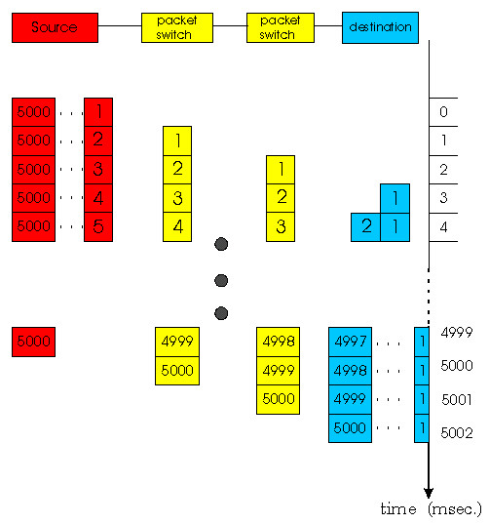
Application-level Delay
Delay of
one packet
Size
Delay* +
Throughput
Average
sustained
throughput
Units: seconds +
bits/(bits/seconds)
* For minimum sized packet
F' 11
Lecture 3: Applications

Slide 51
Some Examples
How long does it take to send a 100 Kbit file?
  Assume a perfect world
  And a 100 Kbit file
10 Kbit file
Throughput
Latency
100 Kbit/s
1 Mbit/s
100 Mbit/s
500 μsec
1.0005
0.1005
0.1005
0.1005
0.0015
0.0015
0.1005
0.0105
0.0015
0.0006
0.11
1.01
1.01
1.01
0.02
0.11
0.11
0.11
0.0101
0.011
0.011
10 msec
0.011
0.2
0.11
0.1001
1.1
1.1
1.1
0.2
0.2
0.2
0.101
0.101
100 msec
0.101
F' 11
Lecture 3: Applications

Slide 52
Some Examples
How long does it take to send a 100 Kbit file?
  Assume a perfect world
  And a 100 Kbit file
Throughput
Latency
100 Kbit/s
1 Mbit/s
100 Mbit/s
500 μsec
1.0005
0.1005
0.1005
0.0015
0.0015
1.01
1.01
0.11
0.11
0.011
10 msec
0.011
1.1
1.1
0.2
0.2
0.101
100 msec
0.101
F' 11
Lecture 3: Applications

Slide 53
Some Examples
How long does it take to send a 10 Kbit file?
  Assume a perfect world
  And a 10 Kbit file
Throughput
Latency
100 Kbit/s
1 Mbit/s
100 Mbit/s
500 μsec
1.0005
0.1005
0.1005
0.1005
0.0105
0.0015
0.0015
0.0006
1.01
1.01
0.11
0.11
0.11
0.02
0.011
0.011
10 msec
0.0101
1.1
1.1
0.2
0.2
0.2
0.11
0.101
0.101
100 msec
0.1001
F' 11
Lecture 3: Applications

Slide 54
Sustained Throughput
When streaming packets, the network works like a pipeline.
  All links forward different packets in parallel
Throughput is determined by the slowest stage.
  Called the bottleneck link
Does not really matter why the link is slow.
  Low link bandwidth
  Many users sharing the link bandwidth
50
37
59
17
267
30
104
F' 11
Lecture 3: Applications

