Slide 1
Project Announcement
Grading:
  Part A: 3/4 of total grade
  Part B: 1/4 of total grade
Actual grade formula:
  3/4*(Max(A1, 0.7*A2)) + 1/4*(Max(B_self, 0.9B_with_staff_code)))
  A1 is submission for P1a on or before the part A deadline.
  A2 is version of P1a submitted *any time* before the part B deadline.
  B_self is part B running against your own implementation of LSP
  0.9*B_with_staff_code is part B running against the reference LSP

Slide 2
15-440 Distributed Systems
Lecture 13 – RAID
Thanks to Greg Ganger and Remzi Arapaci-Dusseau for slides

Slide 3
Replacement Rates
HPC1 |  | COM1 |  | COM2
Component | % | Component | % | Component | %
Hard drive | 30.6 | Power supply | 34.8 | Hard drive | 49.1
Memory | 28.5 | Memory | 20.1 | Motherboard | 23.4
Misc/Unk | 14.4 | Hard drive | 18.1 | Power supply | 10.1
CPU | 12.4 | Case | 11.4 | RAID card | 4.1
motherboard | 4.9 | Fan | 8 | Memory | 3.4
Controller | 2.9 | CPU | 2 | SCSI cable | 2.2
QSW | 1.7 | SCSI Board | 0.6 | Fan | 2.2
Power supply | 1.6 | NIC Card | 1.2 | CPU | 2.2
MLB | 1 | LV Pwr Board | 0.6 | CD-ROM | 0.6
SCSI BP | 0.3 | CPU heatsink | 0.6 | Raid Controller | 0.6

Slide 4
Outline
Using multiple disks
  Why have multiple disks?
  problem and approaches
RAID levels and performance
Estimating availability

Slide 5
Motivation:
Why use multiple disks?
Capacity
  More disks allows us to store more data
Performance
  Access multiple disks in parallel
  Each disk can be working on independent read or write
  Overlap seek and rotational positioning time for all
Reliability
  Recover from disk (or single sector) failures
  Will need to store multiple copies of data to recover
So, what is the simplest arrangement?

Slide 6
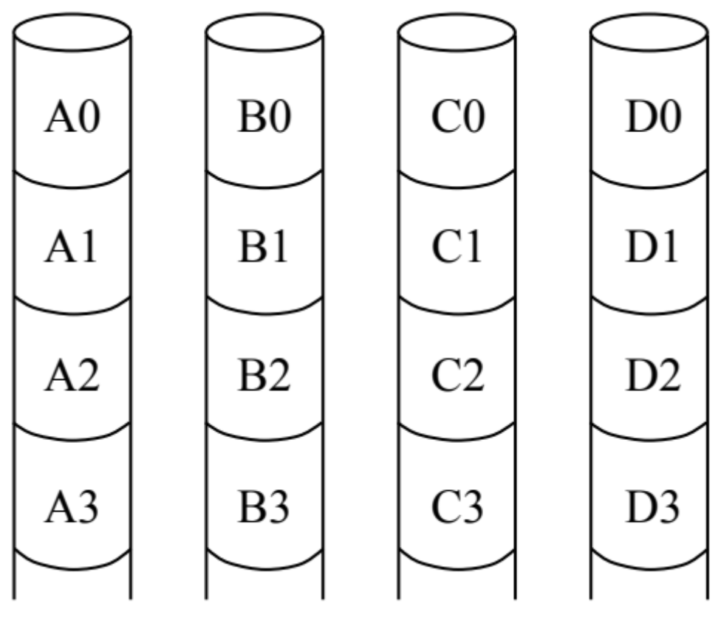
Just a bunch of disks (JBOD)
Yes, it’s a goofy name
  industry really does sell “JBOD enclosures”

Slide 7
Disk Subsystem Load Balancing
I/O requests are almost never evenly distributed
  Some data is requested more than other data
  Depends on the apps, usage, time, ...
What is the right data-to-disk assignment policy?
  Common approach: Fixed data placement
    Your data is on disk X, period!
    For good reasons too: you bought it or you’re paying more...
  Fancy: Dynamic data placement
    If some of your files are accessed a lot, the admin(or even system) may separate the “hot” files across multiple disks
      In this scenario, entire files systems (or even files) are manually moved by the system admin to specific disks
  Alternative: Disk striping
    Stripe all of the data across all of the disks

Slide 8
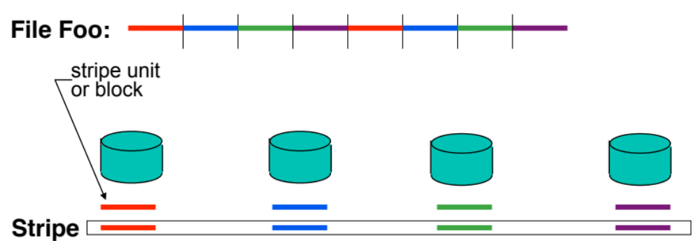
Disk Striping
Interleave data across multiple disks
  Large file streaming can enjoy parallel transfers
  High throughput requests can enjoy thorough load balancing
    If blocks of hot files equally likely on all disks (really?)

Slide 9
Disk striping details
How disk striping works
  Break up total space into fixed-size stripe units
  Distribute the stripe units among disks in round-robin
  Compute location of block #B as follows
    disk# = B%N (%=modulo,N = #ofdisks)
    LBN# = B / N (computes the LBN on given disk)

Slide 10
Now, What If A Disk Fails?
In a JBOD (independent disk) system
  one or more file systems lost
In a striped system
  a part of each file system lost
Backups can help, but
  backing up takes time and effort
  backup doesn’t help recover data lost during that day
    Any data loss is a big deal to a bank or stock exchange

Slide 11
Tolerating and masking disk failures
If a disk fails, it’s data is gone
  may be recoverable, but may not be
To keep operating in face of failure
  must have some kind of data redundancy
Common forms of data redundancy
  replication
  erasure-correcting codes
  error-correcting codes

Slide 12
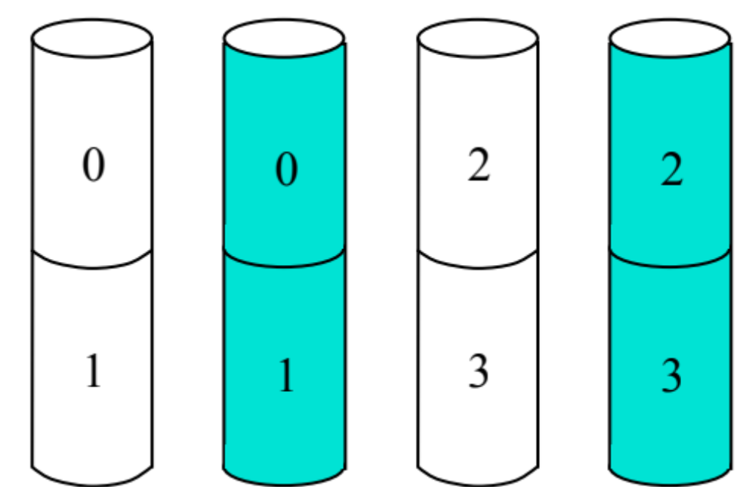
Redundancy via replicas
Two (or more) copies
  mirroring, shadowing, duplexing, etc.
Write both, read either

Slide 13
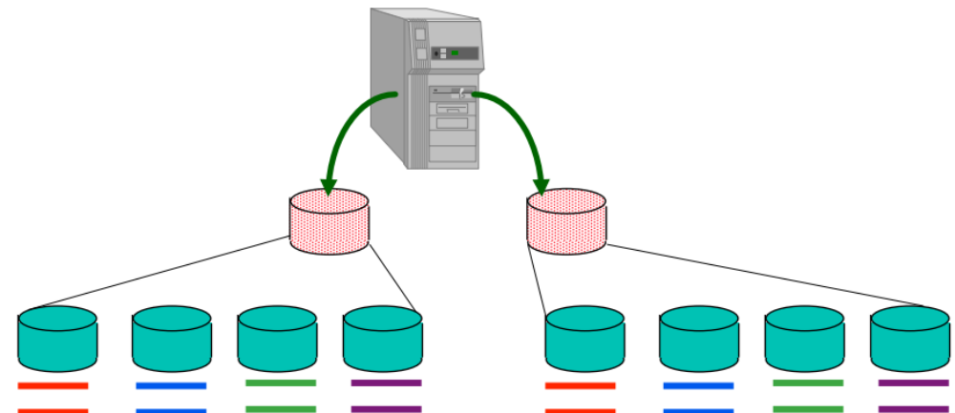
Mirroring & Striping
Mirror to 2 virtual drives, where each virtual drive is really a set of striped drives
  Provides reliability of mirroring
  Provides striping for performance (with write update costs)

Slide 14
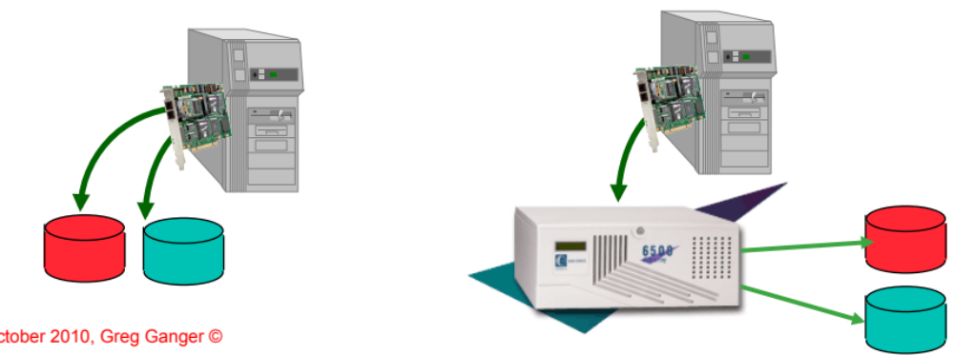
Implementing Disk Mirroring
Mirroring can be done in either software or hardware
Software solutions are available in most OS’s
  Windows2000, Linux, Solaris
Hardware solutions
  Could be done in Host Bus Adaptor(s)
  Could be done in Disk Array Controller

Slide 15
Hardware vs. Software RAID
Hardware RAID
  Storage box you attach to computer
  Same interface as single disk, but internally much more
    Multiple disks
    More complex controller
    NVRAM (holding parity blocks)
Software RAID
  OS (device driver layer) treats multiple disks like a single disk
  Software does all extra work
Interface for both
  Linear array of bytes, just like a single disk (but larger)

Slide 16
Lower Cost Data Redundancy
Single failure protecting codes
  general single-error-correcting code is overkill
    General code finds error and fixes it
Disk failures are self-identifying (a.k.a. erasures)
  Don’t have to find the error
Fact: N-error-detecting code is also N-erasure-correcting
  Error-detecting codes can’t find an error,just know its there
  But if you independently know where error is, allows repair
Parity is single-disk-failure-correcting code
  recall that parity is computed via XOR
  it’s like the low bit of the sum

Slide 17
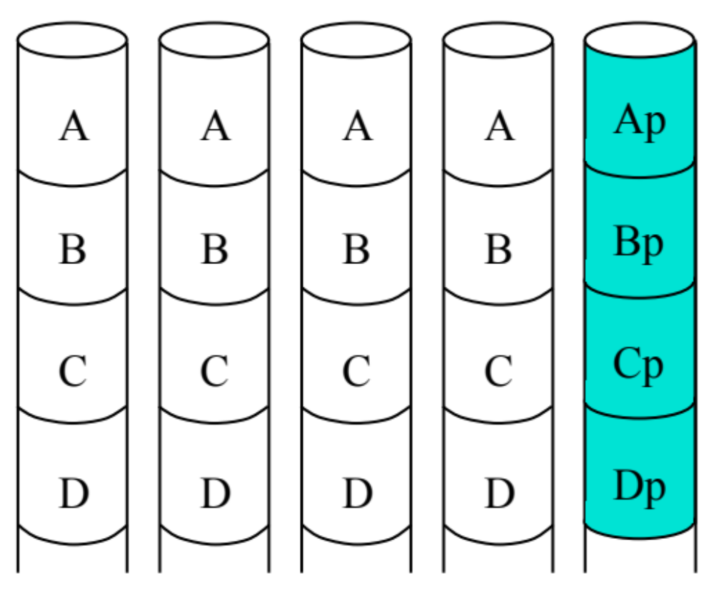
Simplest approach: Parity Disk
One extra disk
All writes update parity disk
  Potential bottleneck

Slide 18
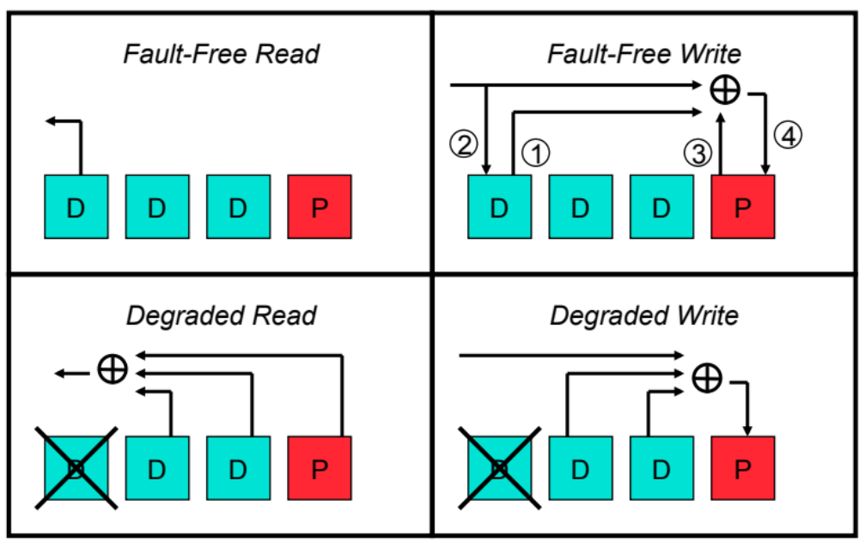
Updating and using the parity

Slide 19
The parity disk bottleneck
Reads go only to the data disks
  But, hopefully load balanced across the disks
All writes go to the parity disk
  And, worse, usually result in Read-Modify-Write sequence
  So, parity disk can easily be a bottleneck

Slide 20
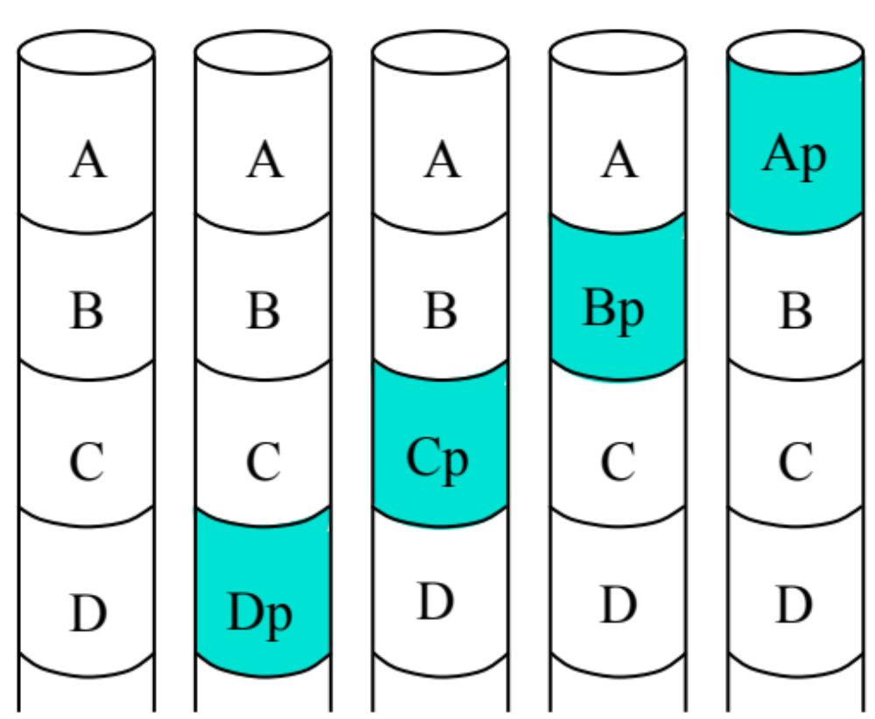
Solution: Striping the Parity
Removes parity disk bottleneck

Slide 21
Outline
Using multiple disks
  Why have multiple disks?
  problem and approaches
RAID levels and performance
Estimating availability

Slide 22
RAID Taxonomy
Redundant Array of Inexpensive Independent Disks
  Constructed by UC-Berkeley researchers in late 80s (Garth)
RAID 0 – Coarse-grained Striping with no redundancy
RAID 1 – Mirroring of independent disks
RAID 2 – Fine-grained data striping plus Hamming code disks
  Uses Hamming codes to detect and correct multiple errors
  Originally implemented when drives didn’t always detect errors
  Not used in real systems
RAID 3 – Fine-grained data striping plus parity disk
RAID 4 – Coarse-grained data striping plus parity disk
RAID 5 – Coarse-grained data striping plus striped parity
RAID 6 – Coarse-grained data striping plus 2 striped codes

Slide 23
RAID-0: Striping
Stripe blocks across disks in a “chunk” size
  How to pick a reasonable chunk size?
0
4
1
5
2
6
3
7
8
12
9
13
10
14
11
15
How to calculate where chunk # lives?
Disk:
Offset within disk:

Slide 24
RAID-0: Striping
0
4
1
5
2
6
3
7
8
12
9
13
10
14
11
15
Evaluate for D disks
Capacity: How much space is wasted?
Performance: How much faster than 1 disk?
Reliability: More or less reliable than 1 disk?
Notes:
Cap = N
Reliability = 0

Slide 25
RAID-1: Mirroring
Motivation: Handle disk failures
Put copy (mirror or replica) of each chunk on another disk
0
2
0
2
1
3
1
3
4
6
4
6
5
7
5
7
Capacity:
Reliability:
Performance:

Slide 26
RAID-4: Parity
Motivation: Improve capacity
Idea: Allocate parity block to encode info about blocks
  Parity checks all other blocks in stripe across other disks
Parity block = XOR over others (gives “even” parity)
  Example: 0 1 0 → Parity value?
How do you recover from a failed disk?
  Example: x 0 0 and parity of 1
  What is the failed value?
0
3
1
4
2
5
P0
P1
6
9
7
10
8
11
P2
P3

Slide 27
RAID-4: Parity
0
3
1
4
2
5
P0
P1
6
9
7
10
8
11
P2
P3
Capacity:
Reliability:
Performance:
  Reads
  Writes: How to update parity block?
    Two different approaches
      Small number of disks (or large write):
      Large number of disks (or small write):
    Parity disk is the bottleneck

Slide 28
RAID-5: Rotated Parity
Rotate location of parity across all disks
0
3
1
4
2
P1
P0
5
6
P3
P2
9
7
10
8
11
Capacity:
Reliability:
Performance:
  Reads:
  Writes:
  Still requires 4 I/Os per write, but not always to same parity disk

Slide 29
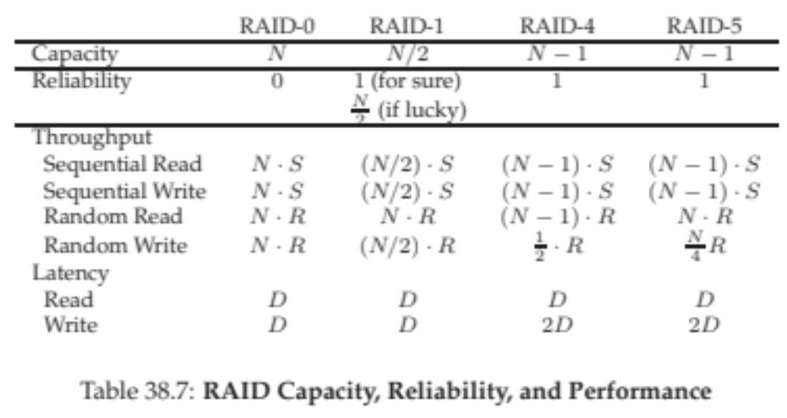
Comparison

Slide 30
Advanced Issues
What happens if more than one fault?
  Example: One disk fails plus “latent sector error” on another
  RAID-5 cannot handle two faults
  Solution: RAID-6 (e.g., RDP) Add multiple parity blocks
Why is NVRAM useful?
  Example: What if update 2, don’t update P0 before power failure (or crash), and then disk 1 fails?
  NVRAM solution: Use to store blocks updated in same stripe
    If power failure, can replay all writes in NVRAM
  Software RAID solution: Perform parity scrub over entire disk
0
3
1
4
2’
5
P0
P1
6
9
7
10
8
11
P2
P3

Slide 31
RAID 6
P+Q Redundancy
  Protects against multiple failures using Reed-Solomon codes
  Uses 2 “parity” disks
    P is parity
    Q is a second code
    It’s two equations with two unknowns, just make “biggerbits”
      Group bits into “nibbles” and add different coefficients to each equation (two independent equations in two unknowns)
Similar to parity striping
  De-clusters both sets of parity across all drives
  For small writes, requires 6 I/Os
    Read old data, old parity1, old parity2
    Write new data, new parity1, new parity2

Slide 32
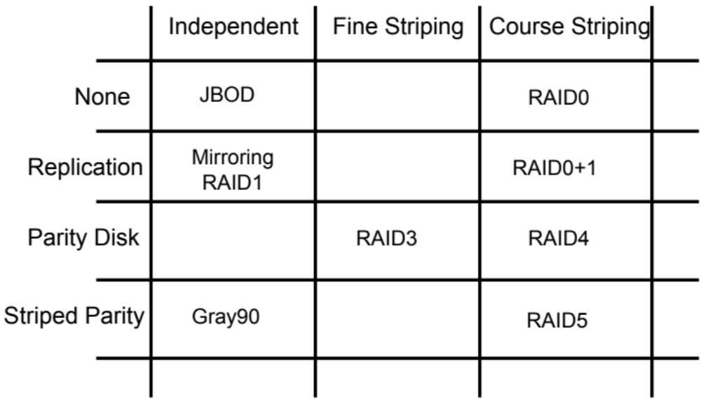
The Disk Array Matrix

Slide 33
Outline
Using multiple disks
  Why have multiple disks?
  problem and approaches
RAID levels and performance
Estimating availability

Slide 34
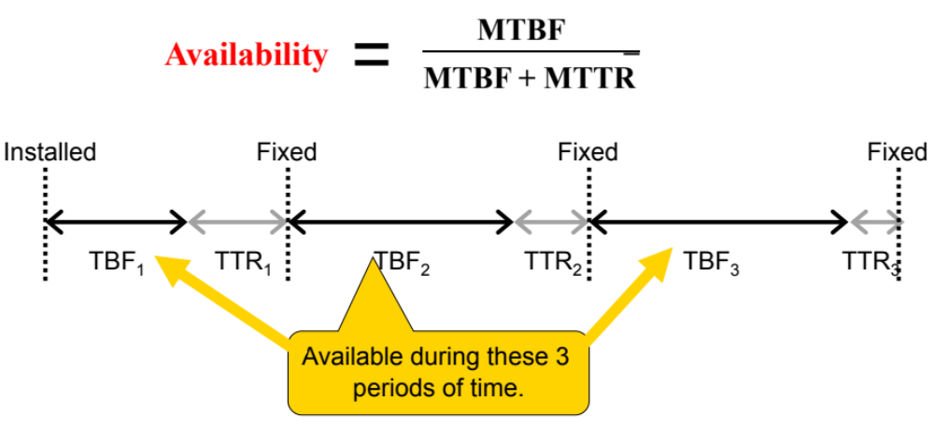
Sidebar: Availability metric
Fraction of time that server is able to handle requests
  Computed from MTBF and MTTR (Mean Time To Repair)

Slide 35
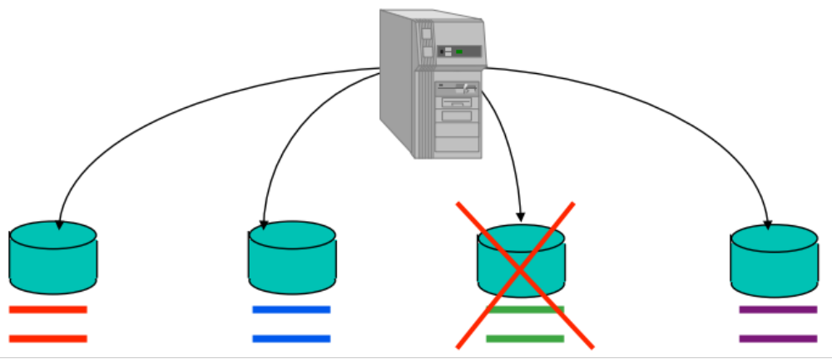
How often are failures?
MTBF (Mean Time Between Failures)
  MTBF_{disk} ~ 1,200,00 hours (~136 years, <1% per year)
MTBF_{mutli-disk system} = mean time to first disk failure
  which is MTBF_{disk} / (number of disks)
  For a striped array of 200 drives
  MTBF_{array} = 136 years / 200 drives = 0.65 years

Slide 36
Back to Mean Time To Data Loss (MTTDL)
MTBF (Mean Time Between Failures)
  MTBF_{disk} ~ 1,200,00 hours (~136 years, <1% per year)
MTBF_{mutli-disk system} = mean time to first disk failure
  which is MTBF_{disk} / (number of disks)
  For a striped array of 200 drives
  MTBF_{array} = 136 years / 200 drives = 0.65 years

Slide 37
Reliability without rebuild
200 data drives with MTBFdrive
  MTTDL_{array} = MTBF_{drive} / 200
Add 200 drives and do mirroring
  MTBF_{pair} = (MTBF_{drive} / 2) + MTBF_{drive} = 1.5 * MTBF_{drive}
  MTTDL_{array} = MTBF_{pair} / 200 = MTBF_{drive} / 133
Add 50 drives, each with parity across 4 data disks
  MTBF_{set} = (MTBF_{drive} / 5) + (MTBF_{drive} / 4) = 0.45 * MTBF_{drive}
  MTTDL_{array} = MTBF_{set} / 50 = MTBF_{drive} / 111

Slide 38
Rebuild: restoring redundancy after failure
After a drive failure
  data is still available for access
  but, a second failure is BAD
So, should reconstruct the data onto a new drive
  on-line spares are common features of high-end disk arrays
    reduce time to start rebuild
  must balance rebuild rate with foreground performance impact
    a performance vs. reliability trade-offs
How data is reconstructed
  Mirroring: just read good copy
  Parity: read all remaining drives (including parity) and compute

Slide 39
Reliability consequences of adding rebuild
No data loss, if fast enough
  That is, if first failure fixed before second one happens
New math is...
  MTTDL_{array} = MTBF_{firstdrive} * (1 / prob of 2nd failure before repair)
  ... which is MTTR_{drive} / MTBF_{seconddrive}
For mirroring
  MTBF_{pair} = (MTBF_{drive} / 2) * (MTBF_{drive} / MTTR_{drive})
For 5-disk parity-protected arrays
  MTBF_{set} = (MTBF_{drive} / 5) * ((MTBF_{drive} / 4 )/ MTTR_{drive})

Slide 40
Three modes of operation
Normal mode
  everything working; maximum efficiency
Degraded mode
  some disk unavailable
  must use degraded mode operations
Rebuild mode
  reconstructing lost disk’s contents onto spare
  degraded mode operations plus competition with rebuild

Slide 41
Mechanics of rebuild
Background process
  use degraded mode read to reconstruct data
  then, write it to replacement disk
Implementation issues
  Interference with foreground activity and controlling rate
    Rebuild is important for reliability
    Foreground activity is important for performance
  Using the rebuilt disk
    For rebuilt part, reads can use replacement disk
    Must balance performance benefit with rebuild interference

Slide 42
Conclusions
RAID turns multiple disks into a larger, faster, more reliable disk
RAID-0: Striping
Good when performance and capacity really matter, but reliability doesn’t
RAID-1: Mirroring
Good when reliability and write performance matter, but capacity (cost) doesn’t
RAID-5: Rotating Parity
Good when capacity and cost matter or workload is read-mostly
  Good compromise choice

