Slide 1
Penalized spline models for functional principal component analysis By: Fang Yao and Thomas C. M. Lee Presented by: Eric (Tian Han) Guan

Slide 2
Introduction and Overview

Slide 3
Problem statement
In functional data, the repeated measurements from the same subject are sometimes correlated (i.e. within-subject correlation)
The goal is to reduce the dependence between repeated measurements by transforming the original correlated data to a set of independent data through functional principal component analysis (FPCA)

Slide 4
Key idea of the paper
Propose a new iterative smoothing procedure for fitting functional principal component models known as the iterative penalized spline (IPS) procedure
IPS fitting is shown to be able to transform the original correlated data such that the resulting data is asymptotically equivalent (in probability) to a set of independent data (i.e. addresses the within-subject correlation in the original functional data)

Slide 5
Data and Model

Slide 6
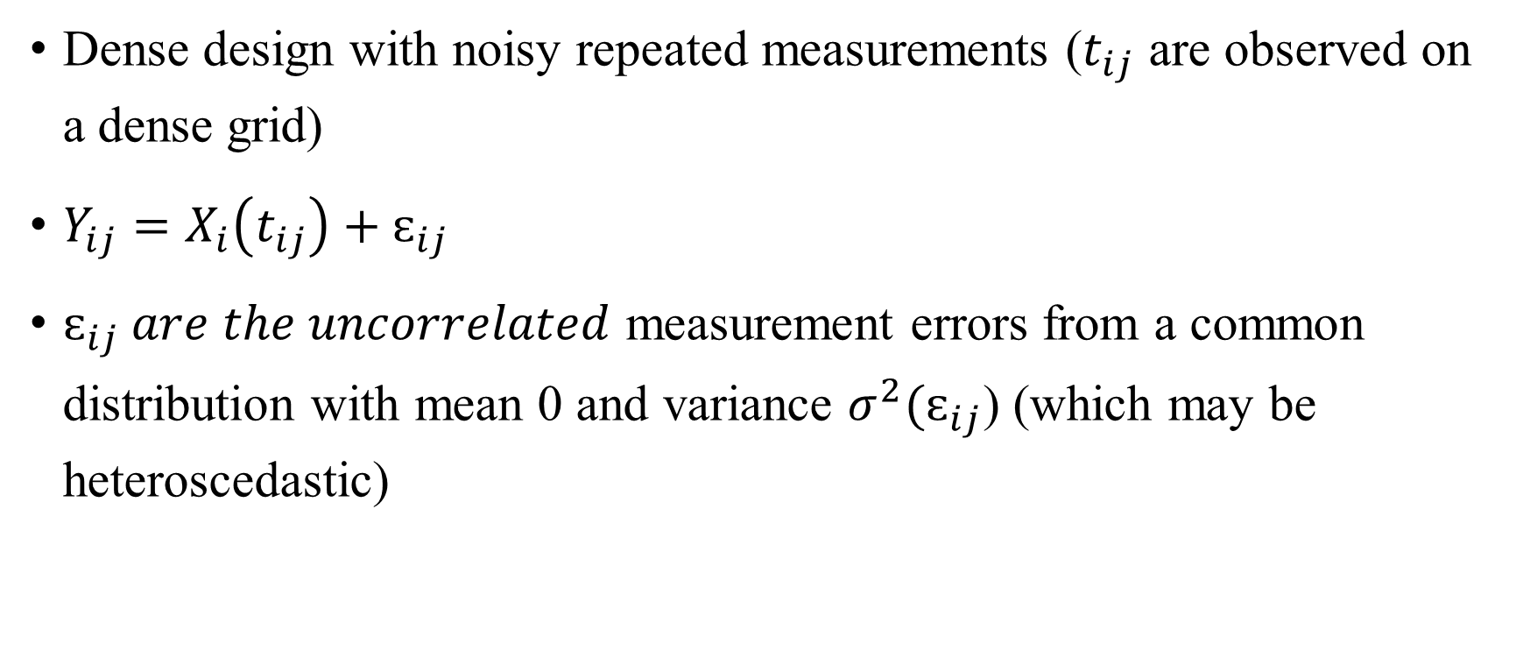
Functional Data Design (1)
Dense design with noisy repeated measurements ($t_{ij}$ are observed on a dense grid)
$Y_{ij}=X_{i}\left(t_{ij}\right)+ɛ_{ij}$
$ɛ_{ij} are the uncorrelated$ measurement errors from a common distribution with mean 0 and variance $σ^{2}{(ɛ}_{ij}$) (which may be heteroscedastic)

Slide 7
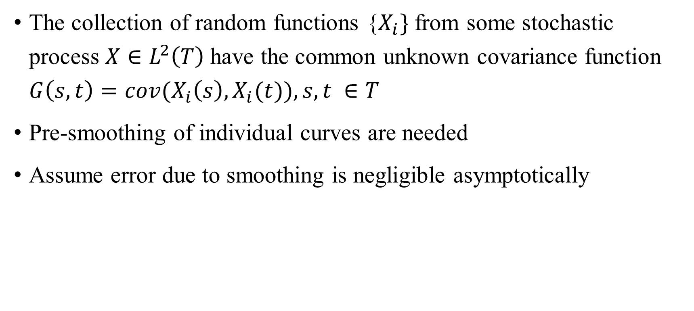
Functional Data Design (2)
The collection of random functions {$X_{i}\}$ from some stochastic process $X∈L^{2}\left(T\right)$have the common unknown covariance function $G\left(s,t\right)={cov(X}_{i}\left(s\right),X_{i}(t)), s,t ∈T$
Pre-smoothing of individual curves are needed
Assume error due to smoothing is negligible asymptotically

Slide 8
Functional Principal Components Analysis (FPCA)

Slide 9
Why FPCA in functional data?
Dimension reduction (reducing random curves to a set of functional principal component scores)
Exploratory data analysis (characterize the dominant modes of variation of the sample around the mean trends)

Slide 10
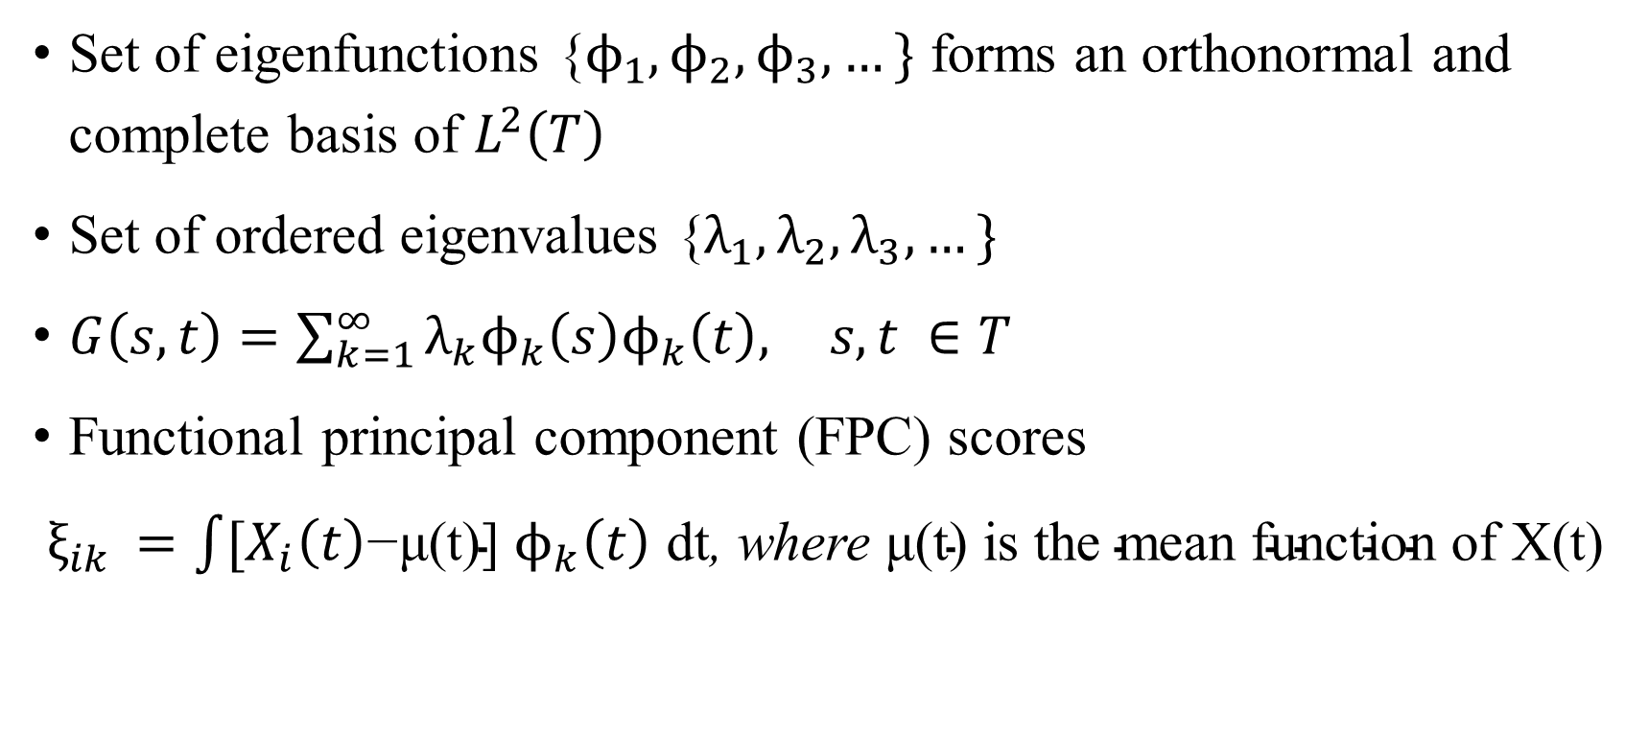
Basics of FPCA (1)
Set of eigenfunctions {$ϕ_{1},ϕ_{2},ϕ_{3},…\}$ forms an orthonormal and complete basis of $L^{2}\left(T\right)$
Set of ordered eigenvalues {$λ_{1},λ_{2},λ_{3},…\}$
$G\left(s,t\right)=\sum_{k=1}^{∞}{λ_{k}ϕ_{k}\left(s\right)ϕ_{k}\left(t\right), } s,t ∈T$
Functional principal component (FPC) scores
$ξ_{ik }=\int{{[X}_{i}\left(t\right)\text{−}\text{μ}\text{(}\text{t}\text{)]} ϕ_{k}\left(t\right) \text{dt}}$, where $\text{μ}\text{(}\text{t}\text{) }\text{is} \text{the} \text{mean} \text{function} \text{of} \text{X}\text{(}\text{t}\text{)}$

Slide 11
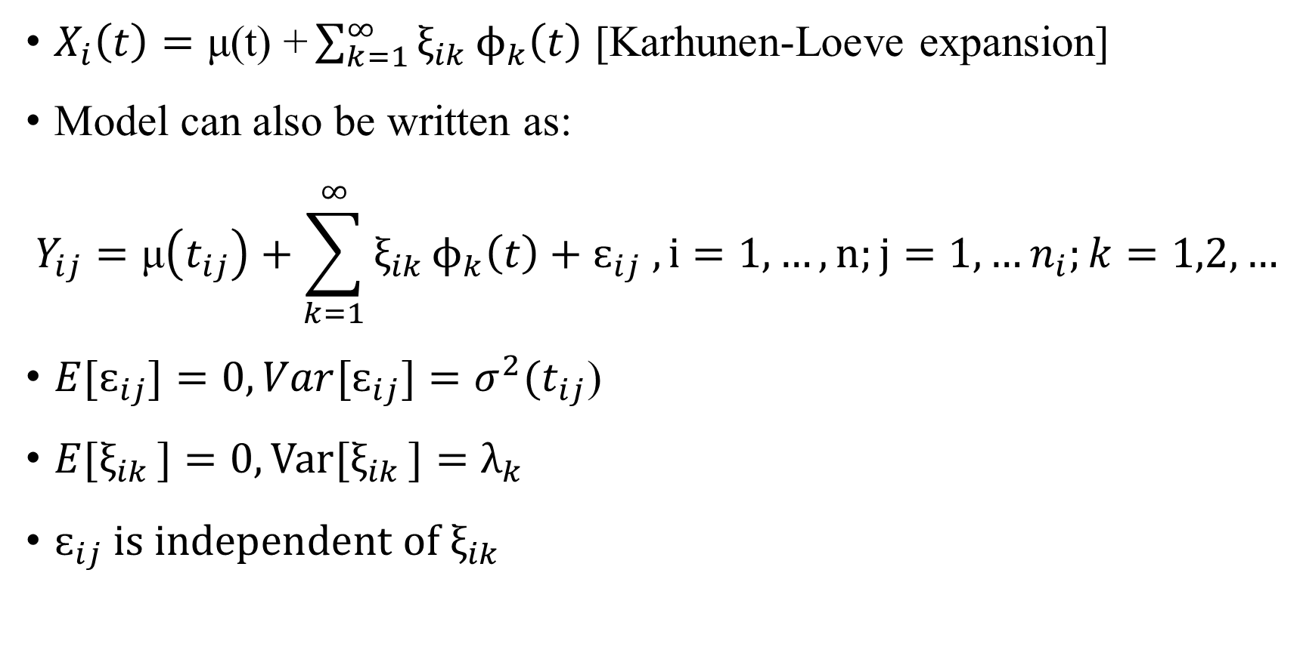
Basics of FPCA (2)
$X_{i}\left(t\right)=\text{μ}\text{(}\text{t}\text{) +}\sum_{k=1}^{∞}{ξ_{ik }ϕ_{k}\left(t\right)}$ [Karhunen-Loeve expansion]
Model can also be written as:
$$Y_{ij}=\text{μ}\left(t_{ij}\right)+{\sum_{k=1}^{∞}{ξ_{ik }ϕ_{k}\left(t\right)}+ɛ}_{ij} , i=1,…,n;j=1,…n_{i};k=1,2,…$$
${E[ɛ}_{ij}]=0, {Var[ɛ}_{ij}]=σ^{2}{(t}_{ij}\text{)}$
${E[ξ}_{ik }]=0,Var[ξ_{ik }]=λ_{k}$
$ɛ_{ij} is independent of{ ξ}_{ik }$

Slide 12
Penalized spline models

Slide 13
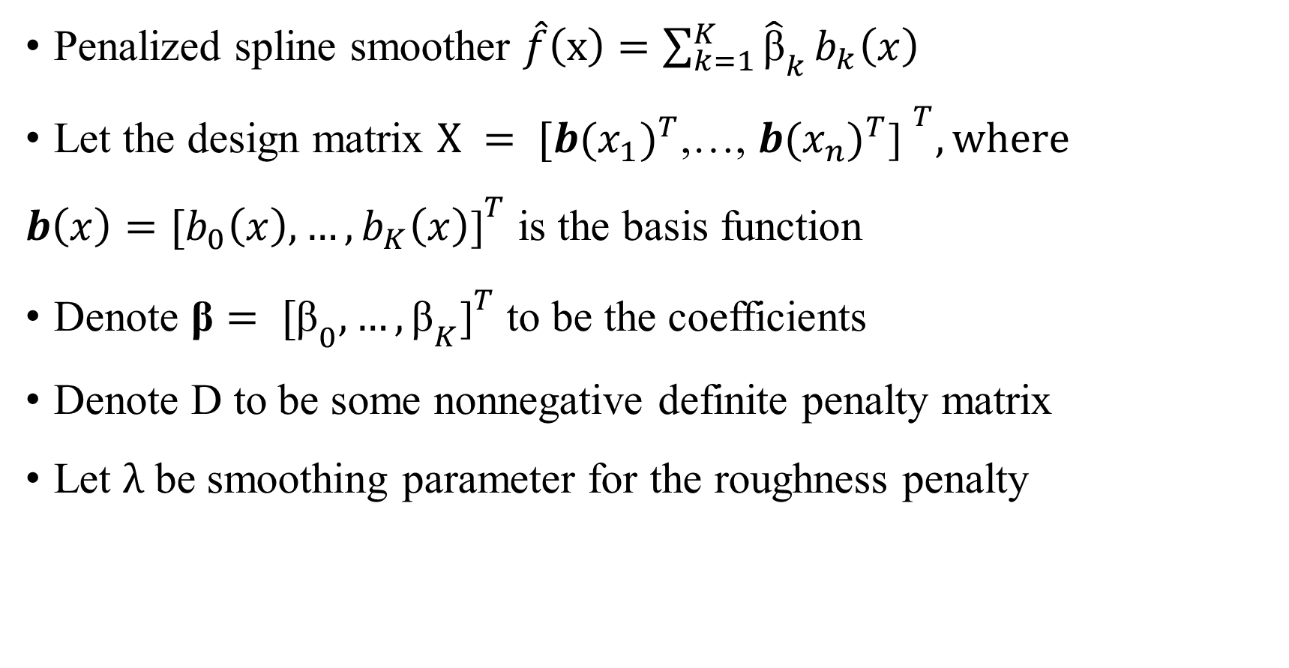
Basics of penalized spline models (1)
Penalized spline smoother $\hat{f}\left(x\right)=\sum_{k=1}^{K}{{\hat{\text{β}}}_{k}}b_{k}\left(x\right)$
Let the design matrix ${X = [{{b(x}_{1})}^{T}\text{,…, }{{b(x}_{n})}^{T}\text{] }}^{T}, where$
${{b\left(x\right)=[b}_{0}\left(x\right),…,b_{K}\left(x\right)\text{]}}^{T}$ is the basis function
Denote ${{\text{β}= [\text{β}}_{0},…,{\text{β}}_{K}\text{]}}^{T}$ to be the coefficients
Denote D to be some nonnegative definite penalty matrix
Let $λ$ be smoothing parameter for the roughness penalty

Slide 14
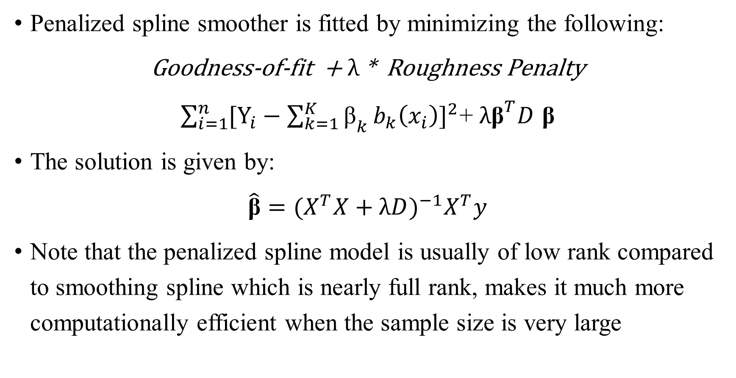
Basics of penalized spline models (2)
Penalized spline smoother is fitted by minimizing the following:
Goodness-of-fit + $λ$ * Roughness Penalty
$\sum_{i=1}^{n}{{[{\text{Y}}_{i}−\sum_{k=1}^{K}{{\text{β}}_{k}}b_{k}\left(x_{i}\right)]}^{2}}$+ $λ{\text{β}}^{T}D$ $\text{β}$
The solution is given by:
$\hat{\text{β}}={{{(X}^{T}X+λD)}^{−1}X}^{T}y$
Note that the penalized spline model is usually of low rank compared to smoothing spline which is nearly full rank, makes it much more computationally efficient when the sample size is very large

Slide 15
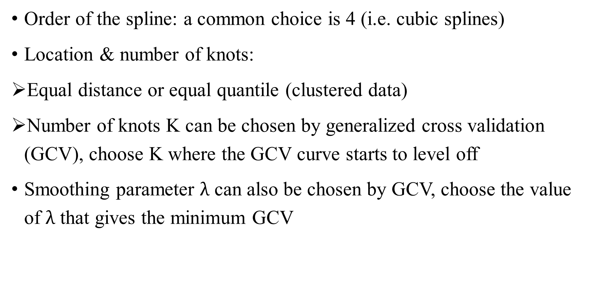
How to fit a penalized spline regression (1)
Order of the spline: a common choice is 4 (i.e. cubic splines)
Location & number of knots:
Equal distance or equal quantile (clustered data)
Number of knots K can be chosen by generalized cross validation (GCV), choose K where the GCV curve starts to level off
Smoothing parameter $λ$ can also be chosen by GCV, choose the value of $λ$ that gives the minimum GCV

Slide 16
How to fit a penalized spline regression (2)
Alternatives of GCV include:
Residual Sum of Squares (RSS) – often results in overfitting
Alkaike’s Information Criterion (AIC) – uses RSS and corrects for sample size
Corrected AIC (AICC) – additional terms for correcting the sample size
Root Mean Squared Error (RMSE)

Slide 17
A short example

Slide 18
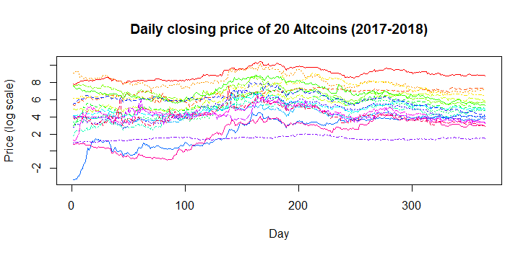
Raw data: Daily closing price of 20 Altcoins

Slide 19
Some comments about the raw data
The raw data is on a dense and equally spaced grid (each sample has 365 observations)
The raw data is very noisy (as the closing price varies on a daily basis)
The price is on a log scale so that there is not a very strong difference in amplitude (need this for the functional PCA stage)
Need pre-smoothing on the individual curves

Slide 20
Pre-smoothing of the raw data
Penalized spline models are used for the pre-smoothing of the raw data
Bsplines are used as the data is aperiodic
The order of the splines is chosen to be 4 (i.e. cubic splines)
Both the number of knots and the smoothing parameter are chosen using the GCV approach
Chose 48 knots (i.e. 50 basis)
Smoothing parameter is set to be 8.1

Slide 21
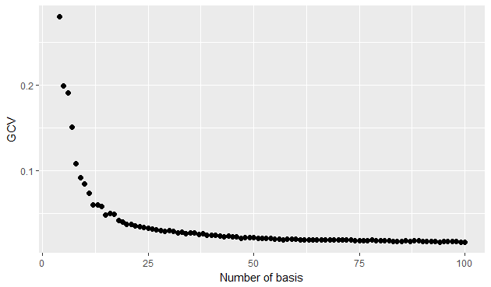
Choose the number of knots

Slide 22
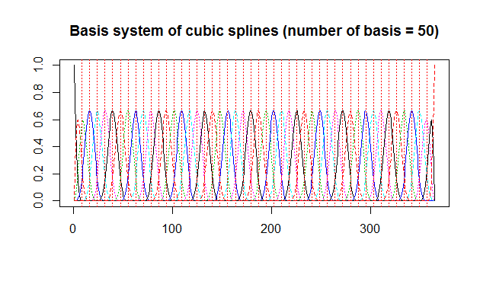

Slide 23
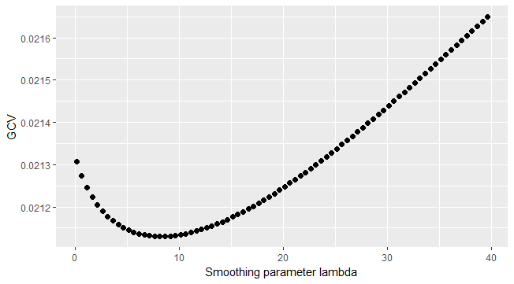
Choose the smoothing parameter

Slide 24
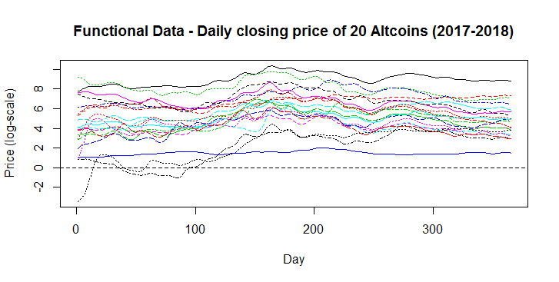
Functional data: Daily closing price of 20 Altcoins

Slide 25
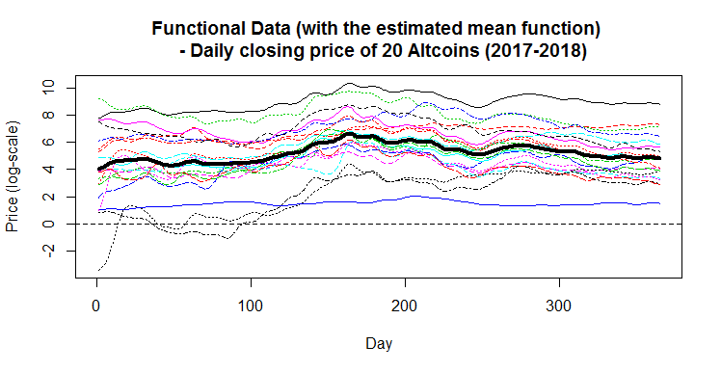
Functional data: Daily closing price of 20 Altcoins with the mean curve

Slide 26
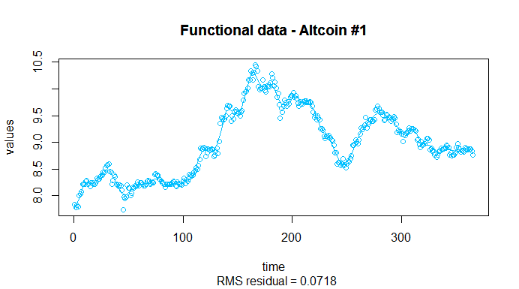
Penalized spline fit (1)

Slide 27
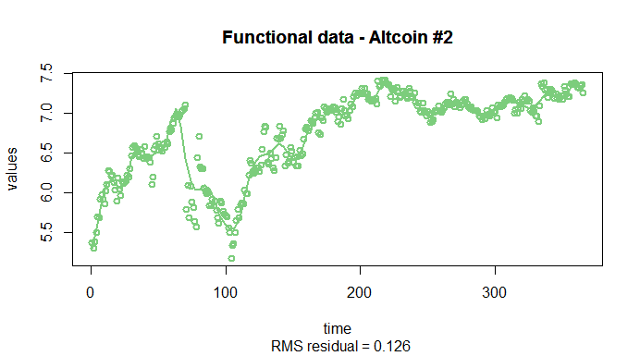
Penalized spline fit (2)

Slide 28
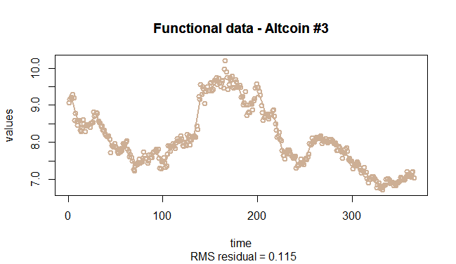
Penalized spline fit (3)

Slide 29
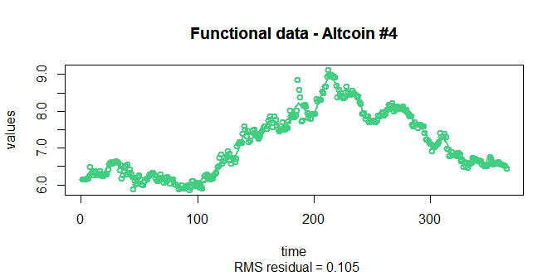
Penalized spline fit (4)

Slide 30
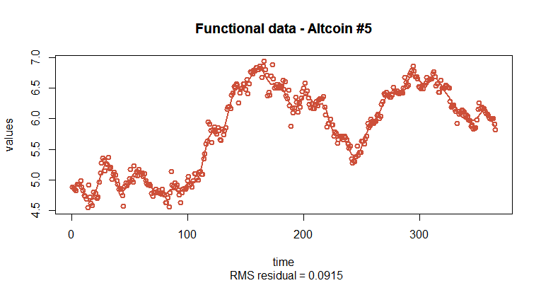
Penalized spline fit (5)

Slide 31
Some comments on the penalized spline models
It can be seen that the measurements in each sample are very noisy and therefore a spline model can easily overfit the data if no roughness penalty is considered
Here although the number of knots is large, the large smoothing parameter allows the splines to be relatively less smooth so that they don’t overfit the noisy data
Computation time is very fast given this is a low rank approximation method

Slide 32
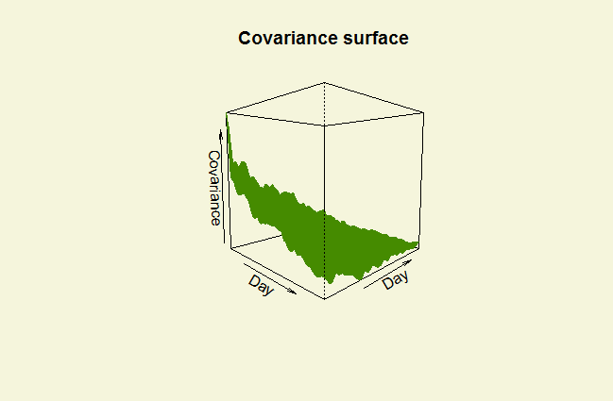
Covariance surface (1)

Slide 33
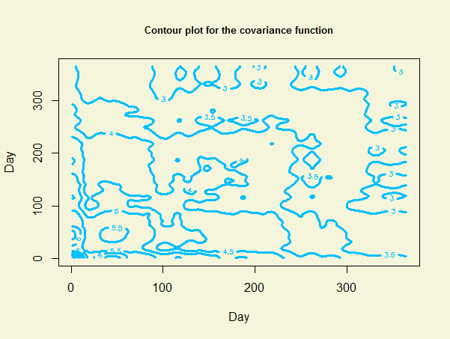
Covariance surface (2)

Slide 34
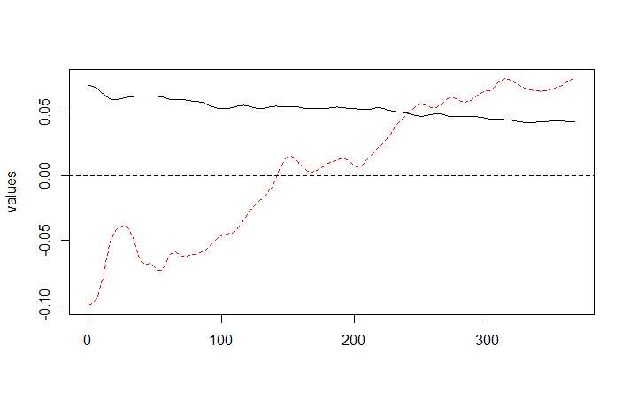
Functional principal component analysis for the data

Slide 35
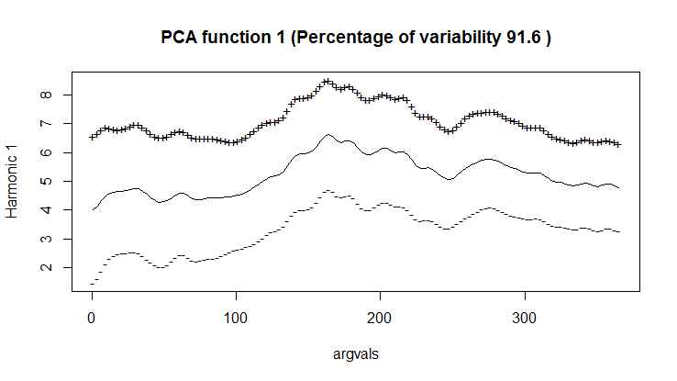
Add the mean curve to the PCs (1)

Slide 36
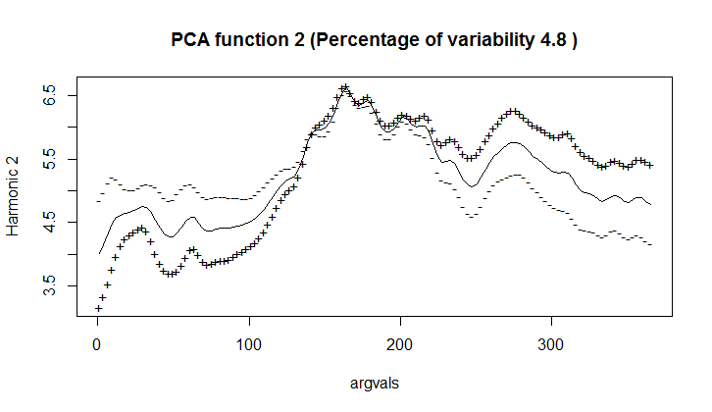
Add the mean curve to the PCs (2)

Slide 37
Some interpretations on the FPCA
The first FPC explains 91.6% of the variation. It contrasts early stage (slightly higher variation) with later stage (slightly lower variation) (i.e. slightly more weights are placed on the early prices which lead to higher variability).
The second FPC explains 4.8% of the variation. It contrasts the early stage and later stage of the price (which is quite typical for the second FPC).

Slide 38
In plain language
Results from FPC1 tell us that Altcoins with high positive FPC scores tend to do better in both the early and later stage (while Altcoins with high negative FPC scores tend to do poorly in both stages)
Results from FPC2 tell us that Altcoins with high positive FPC scores tend to do poorly in early stage but will do better in later stage (while Altcoins with high negative FPC scores tend to do better in early stage but poorly in later stage)
Results actually make sense as nowadays there are over 1600 Altcoins in the cryptocurrency market, and many of the Altcoins have big fluctuation in their prices (often after they get stabilized)

Slide 39
How to improve the modelling?
In the last example, no within-subject correlation is being captured (i.e. assume different Altcoin prices are uncorrelated to each other)
But what if there is actually some within-subject correlation in the functional data? (then the fitted spline models will not the optimal estimates)
Solution: need a new approach to capture the within-subject correlation that generalizes the theory of penalized spline models to correlated data
This leads to the iterative penalized spline (IPS) procedure!

Slide 40
Estimation of covariance surface, variance of errors, and functional principal components

Slide 41
Local polynomial method (1)
In this paper, the estimations are done using the local polynomial method proposed by Yao et al. (2003)
Overall idea of the local polynomial method is outlined in the next few slides

Slide 42
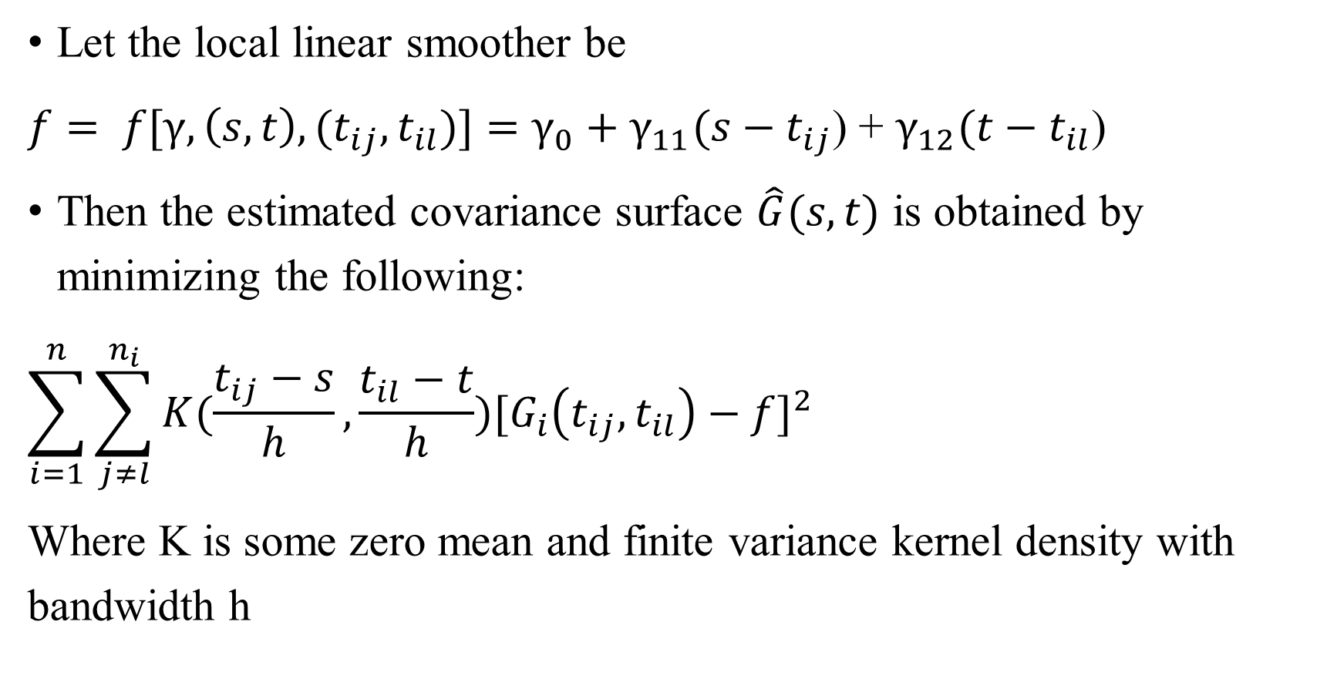
Estimate the covariance surface
Let the local linear smoother be
$f= f[γ, \left(s,t\right), (t_{ij},t_{il})]=$ $γ_{0}+$ $γ_{11}(s−t_{ij}$) + $γ_{12}(t−t_{il}$)
Then the estimated covariance surface $\hat{G}(s,t)$ is obtained by minimizing the following:
$$\sum_{i=1}^{n}{\sum_{j≠l}^{n_{i}}{K(\frac{t_{ij}−s}{h}}},\frac{t_{il}−t}{h}{)[G_{i}\left(t_{ij},t_{il}\right)−f]}^{2}$$
Where K is some zero mean and finite variance kernel density with bandwidth h

Slide 43
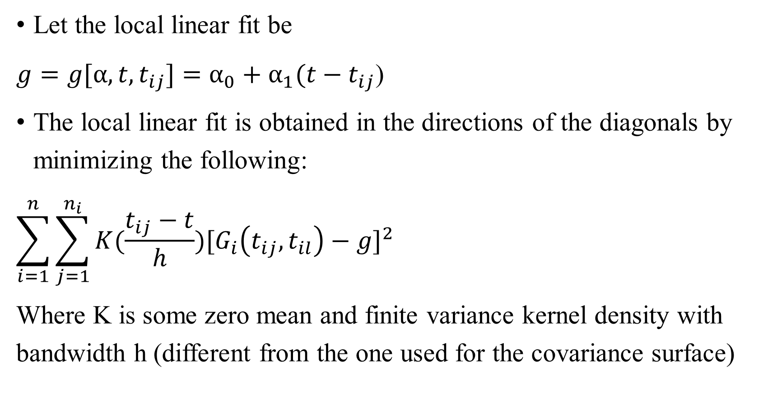
Estimate the variance of errors (1)
Let the local linear fit be
$g=g[α,t,t_{ij}]=$ $α_{0}+$ $α_{1}(t−t_{ij}$)
The local linear fit is obtained in the directions of the diagonals by minimizing the following:
$$\sum_{i=1}^{n}{\sum_{j=1}^{n_{i}}{K(\frac{t_{ij}−t}{h}}}{)[G_{i}\left(t_{ij},t_{il}\right)−g]}^{2}$$
Where K is some zero mean and finite variance kernel density with bandwidth h (different from the one used for the covariance surface)

Slide 44

Estimate the variance of errors (2)
The estimated variance of errors ${\hat{σ}}^{2}$is:
$${\hat{σ}}^{2}\left(t\right)= \int{max⁡\{0,\left[\hat{g}\left(t\right)−\hat{G}\left(t,t\right)\right]\}dt}$$

Slide 45
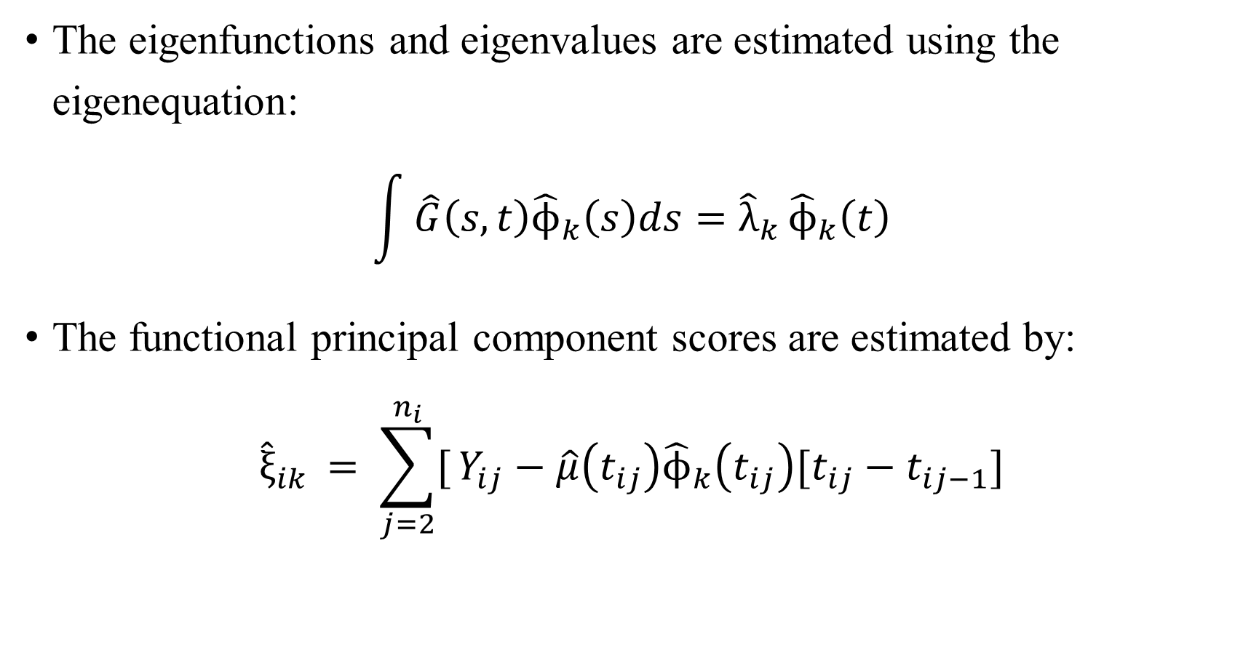
Estimate the functional principal component scores
The eigenfunctions and eigenvalues are estimated using the eigenequation:
$$\int{\hat{G}\left(s,t\right){\hat{ϕ}}_{k}\left(s\right)ds={\hat{λ}}_{k}}{\hat{ϕ}}_{k}\left(t\right)$$
The functional principal component scores are estimated by:
$${\hat{ξ}}_{ik }= \sum_{j=2}^{n_{i}}{[}Y_{ij}−\hat{μ}\left(t_{ij}\right){\hat{ϕ}}_{k}\left(t_{ij}\right)[t_{ij}−t_{ij−1}]$$

Slide 46
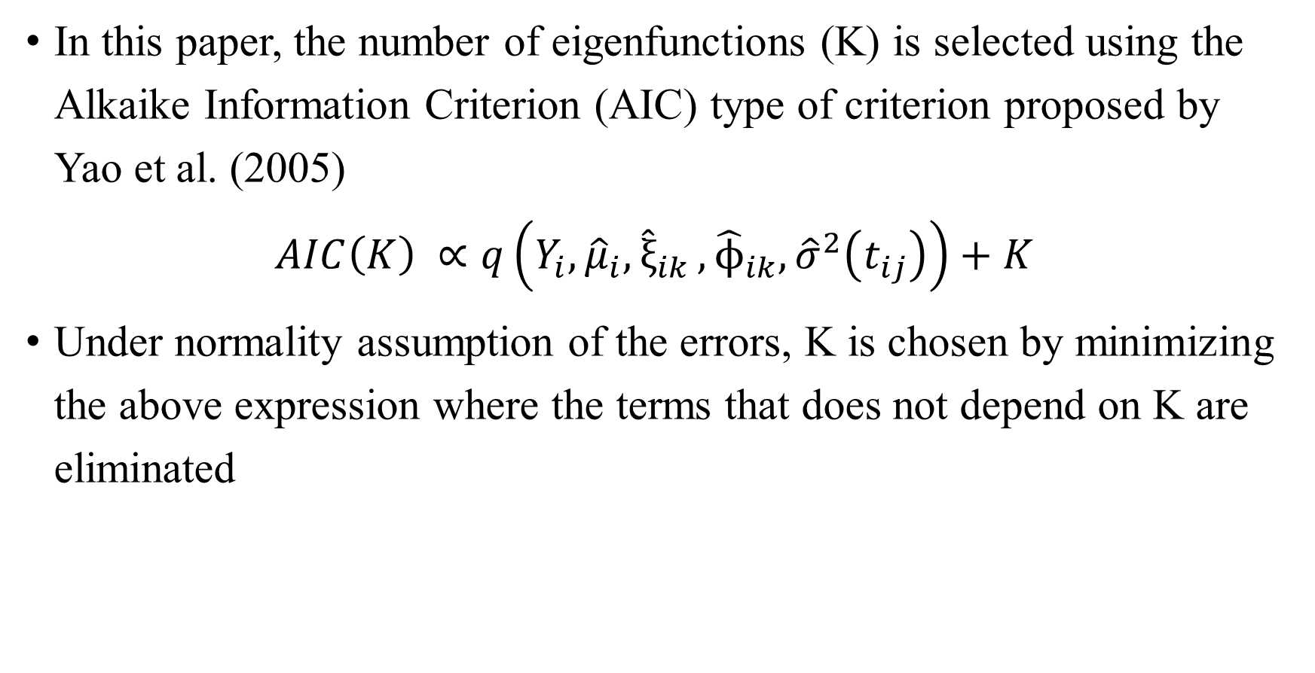
Number of eigenfunctions
In this paper, the number of eigenfunctions (K) is selected using the Alkaike Information Criterion (AIC) type of criterion proposed by Yao et al. (2005)
$$AIC\left(K\right) ∝q\left(Y_{i},{\hat{μ}}_{i}, {\hat{ξ}}_{ik },{\hat{ϕ}}_{ik},{\hat{σ}}^{2}\left(t_{ij}\right)\right)+K$$
Under normality assumption of the errors, K is chosen by minimizing the above expression where the terms that does not depend on K are eliminated

Slide 47
Iterative Penalized Spline (IPS)

Slide 48
Why IPS procedure?
Using penalized spline models for estimating the mean function allows easy incorporation of covariates
A naive use of penalized splines will not lead to optimal estimates when within-subject correlation exists
Also allows a theoretical study of the asymptotic properties of penalized spline methods as an extension of independent data

Slide 49
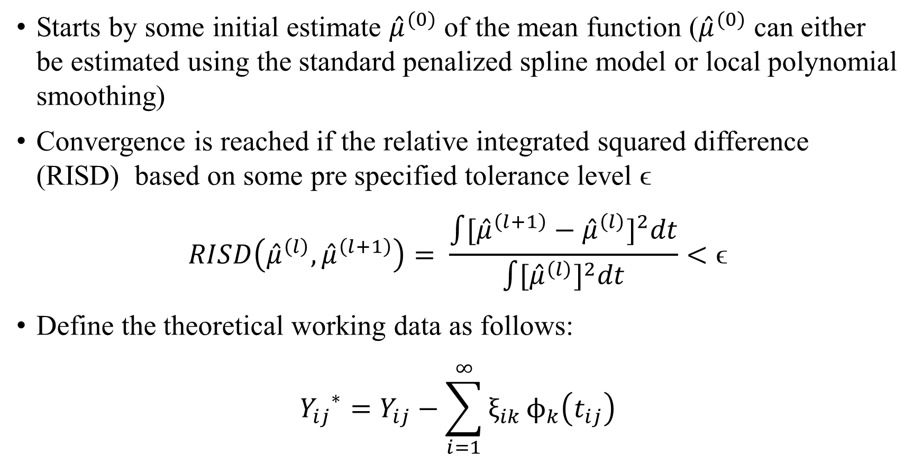
The actual procedure (1)
Starts by some initial estimate ${\hat{μ}}^{(0)}$ of the mean function (${\hat{μ}}^{(0)}$ can either be estimated using the standard penalized spline model or local polynomial smoothing)
Convergence is reached if the relative integrated squared difference (RISD) based on some pre specified tolerance level ϵ
$$RISD\left({\hat{μ}}^{\left(l\right)},{\hat{μ}}^{\left(l+1\right)}\right)= \frac{\int{{[{\hat{μ}}^{\left(l+1\right)}−{\hat{μ}}^{\left(l\right)}]}^{2}dt}}{\int{{[{\hat{μ}}^{\left(l\right)}]}^{2}dt}}<\text{ϵ}$$
Define the theoretical working data as follows:
$${Y_{ij}}^{∗}=Y_{ij}−\sum_{i=1}^{∞}{ξ_{ik }ϕ_{k}\left(t_{ij}\right)}$$

Slide 50
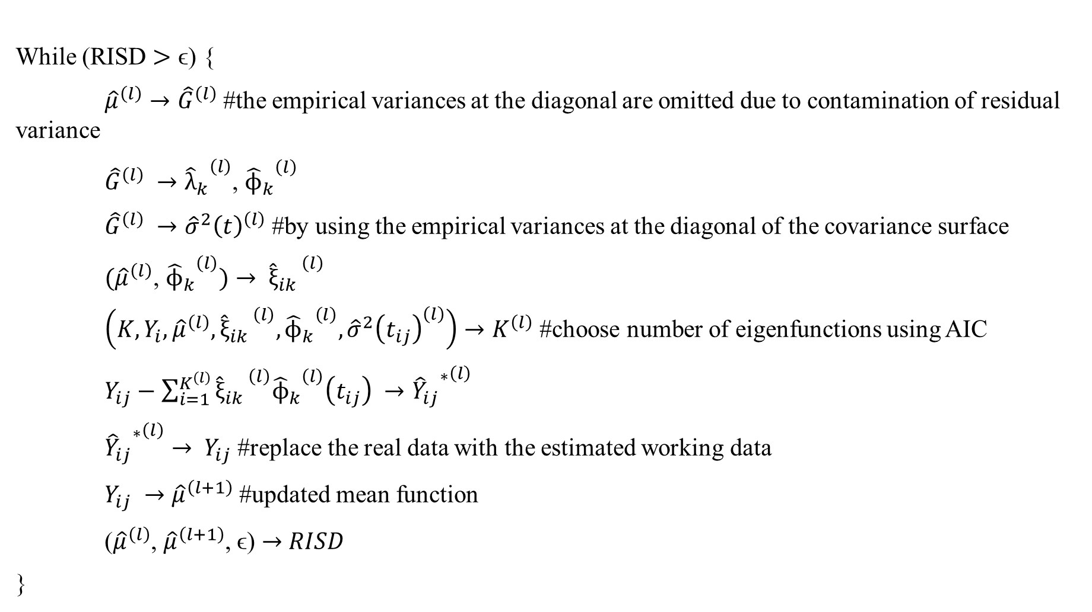
The actual procedure (2)
While (RISD $>\text{ϵ}\text{)}$ {
${\hat{μ}}^{\left(l\right)}→{\hat{G}}^{\left(l\right)}$ #the empirical variances at the diagonal are omitted due to contamination of residual variance
${\hat{G}}^{\left(l\right)} →{{\hat{λ}}_{k}}^{\left(l\right)}$, ${{\hat{ϕ}}_{k}}^{\left(l\right)}$
${\hat{G}}^{\left(l\right)} →{{\hat{σ}}^{2}\left(t\right)}^{\left(l\right)}$ #by using the empirical variances at the diagonal of the covariance surface
${(\hat{μ}}^{\left(l\right)}$, ${{\hat{ϕ}}_{k}}^{\left(l\right)})→ {{\hat{ξ}}_{ik }}^{\left(l\right)}$
$\left({K,Y}_{i},{\hat{μ}}^{\left(l\right)},{{\hat{ξ}}_{ik }}^{\left(l\right)},{{\hat{ϕ}}_{k}}^{\left(l\right)} ,{{\hat{σ}}^{2}\left(t_{ij}\right)}^{\left(l\right)}\right)→K^{\left(l\right)}$ #choose number of eigenfunctions using AIC
$Y_{ij}−\sum_{i=1}^{K^{\left(l\right)}}{{{\hat{ξ}}_{ik }}^{\left(l\right)}{{\hat{ϕ}}_{k}}^{\left(l\right)}\left(t_{ij}\right) →{{{\hat{Y}}_{ij}}^{∗}}^{\left(l\right)}}$
${{{\hat{Y}}_{ij}}^{∗}}^{\left(l\right)}→ Y_{ij}$ #replace the real data with the estimated working data
$Y_{ij} →{\hat{μ}}^{\left(l+1\right)}$ #updated mean function
(${\hat{μ}}^{\left(l\right)}$, ${\hat{μ}}^{\left(l+1\right)}$, $\text{ϵ}$) $→$ $RISD$
}

Slide 51
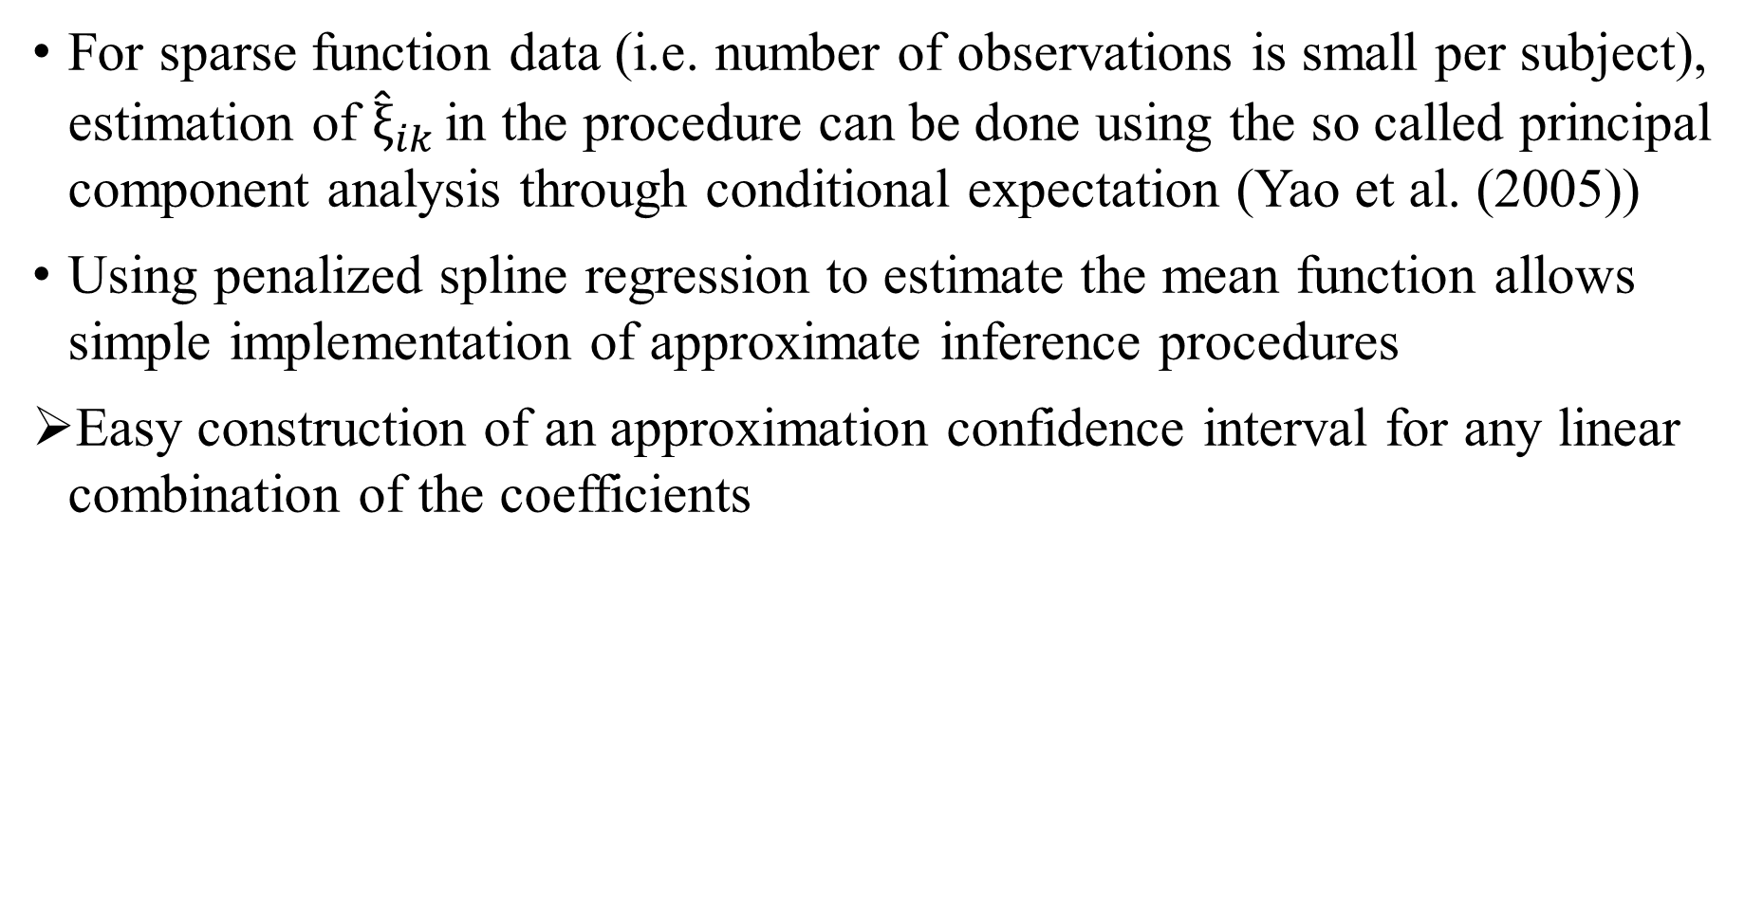
Remarks on the IPS procedure
For sparse function data (i.e. number of observations is small per subject), estimation of ${\hat{ξ}}_{ik }$in the procedure can be done using the so called principal component analysis through conditional expectation (Yao et al. (2005))
Using penalized spline regression to estimate the mean function allows simple implementation of approximate inference procedures
Easy construction of an approximation confidence interval for any linear combination of the coefficients

Slide 52
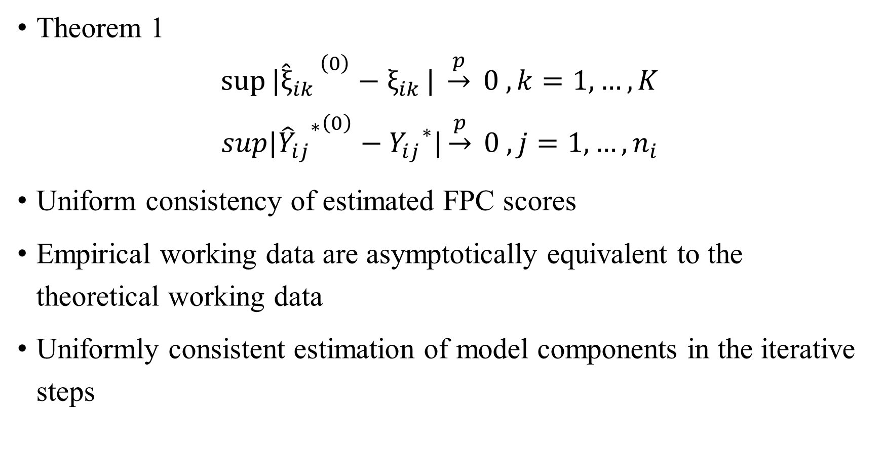
Theoretical properties of IPS (1)
Theorem 1
$${{sup⁡|\hat{ξ}}_{ik }}^{\left(0\right)}−ξ_{ik }| \underset{→}{p} 0 , k=1,…,K$$
$${{{sup|\hat{Y}}_{ij}}^{∗}}^{\left(0\right)}−{Y_{ij}}^{∗}|\underset{→}{p} 0 , j=1,…,n_{i}$$
Uniform consistency of estimated FPC scores
Empirical working data are asymptotically equivalent to the theoretical working data
Uniformly consistent estimation of model components in the iterative steps

Slide 53
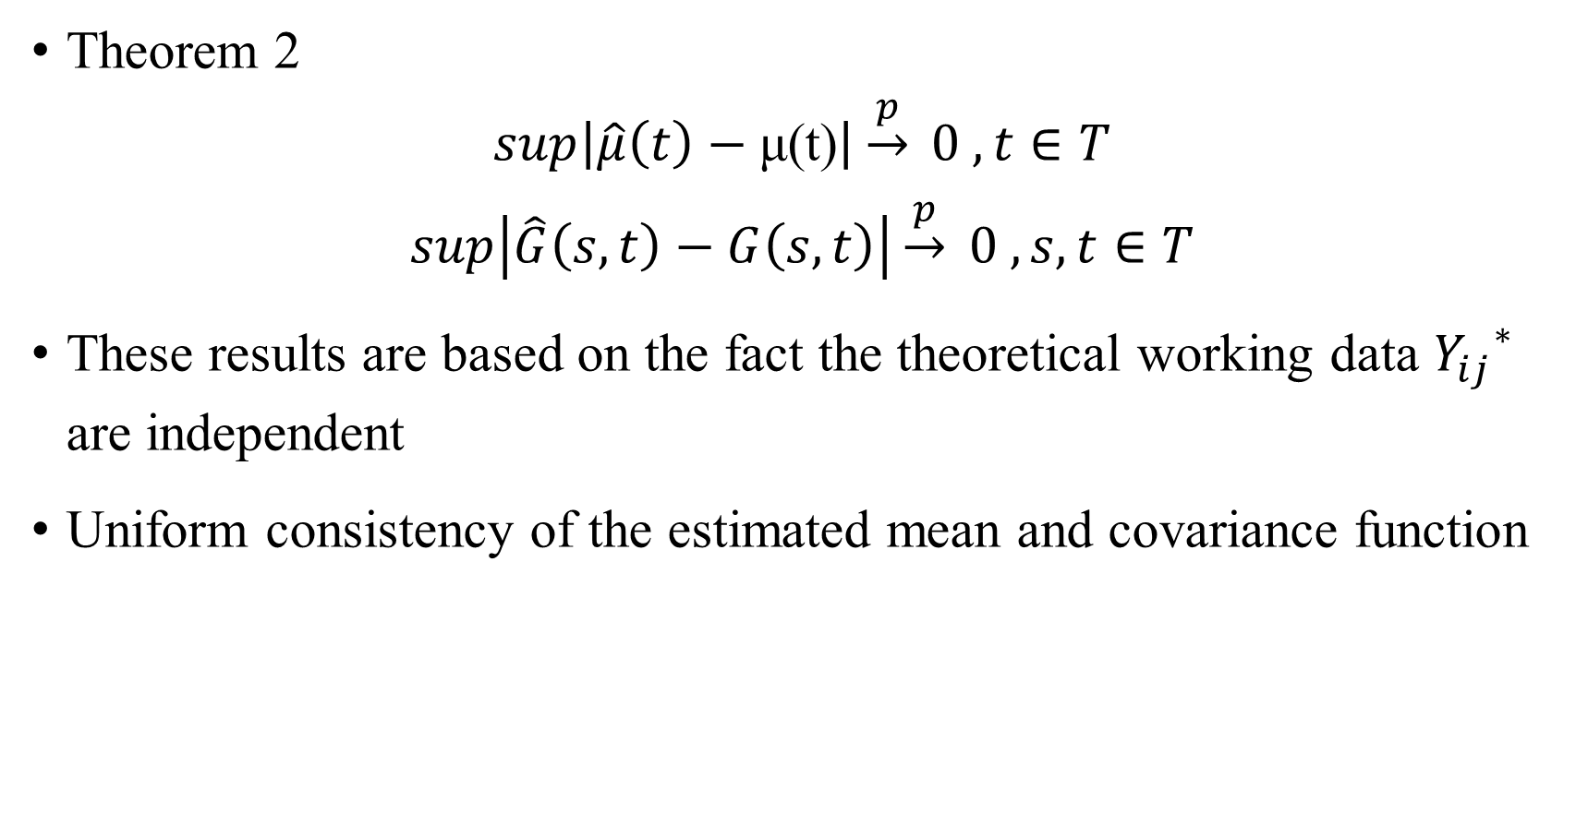
Theoretical properties of IPS (2)
Theorem 2
$$sup\left|\hat{μ}\left(t\right)−\text{μ}\text{(}\text{t}\text{)}\right|\underset{→}{p} 0 , t∈T$$
$$sup\left|\hat{G}\left(s,t\right)−G\left(s,t\right)\right|\underset{→}{p} 0 ,s,t∈T$$
These results are based on the fact the theoretical working data ${Y_{ij}}^{∗}$ are independent
Uniform consistency of the estimated mean and covariance function

Slide 54
Simulation Studies

Slide 55
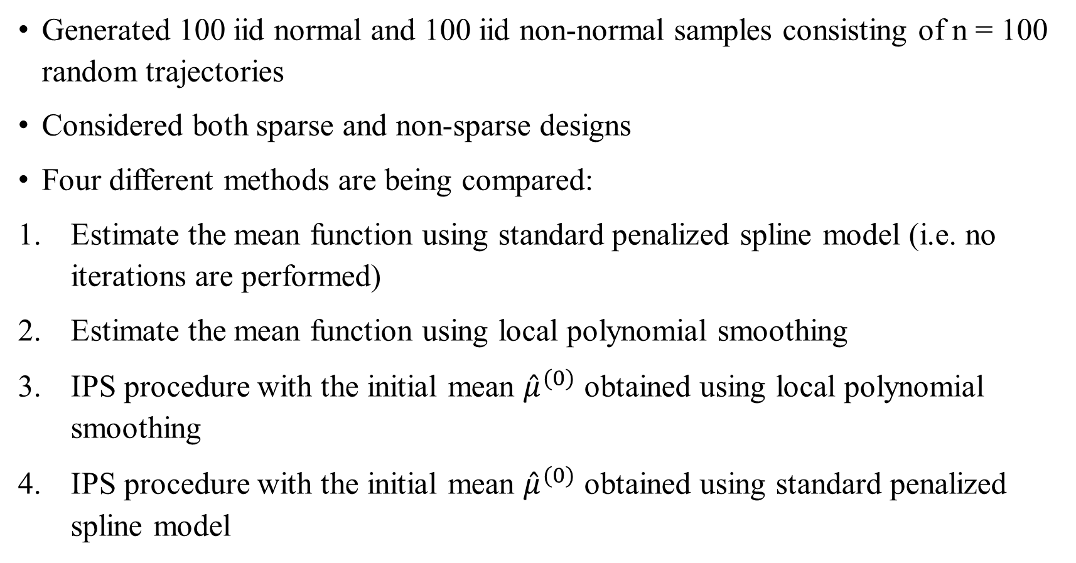
Simulation study
Generated 100 iid normal and 100 iid non-normal samples consisting of n = 100 random trajectories
Considered both sparse and non-sparse designs
Four different methods are being compared:
Estimate the mean function using standard penalized spline model (i.e. no iterations are performed)
Estimate the mean function using local polynomial smoothing
IPS procedure with the initial mean ${\hat{μ}}^{(0)}$ obtained using local polynomial smoothing
IPS procedure with the initial mean ${\hat{μ}}^{(0)}$ obtained using standard penalized spline model

Slide 56
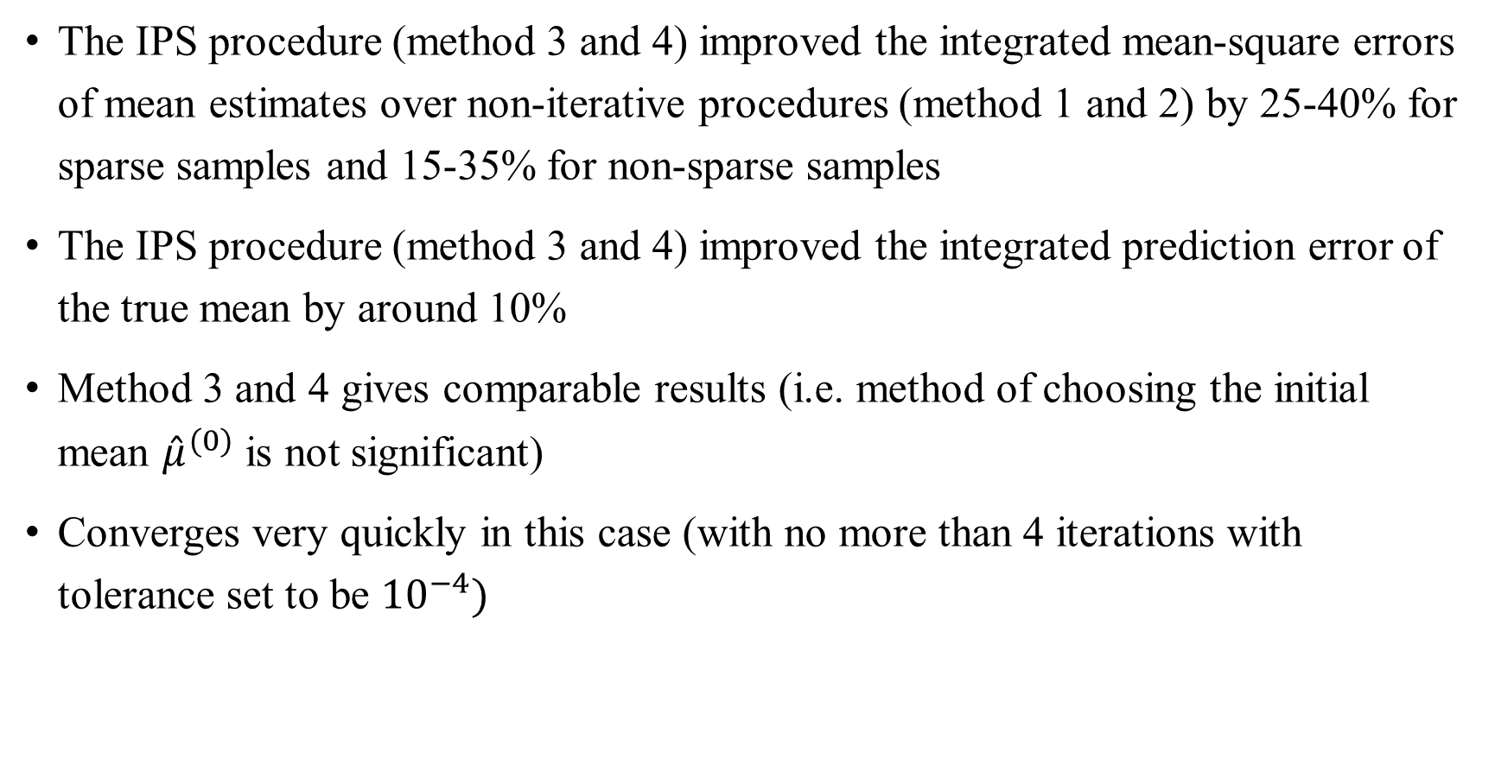
Results from the simulation study
The IPS procedure (method 3 and 4) improved the integrated mean-square errors of mean estimates over non-iterative procedures (method 1 and 2) by 25-40% for sparse samples and 15-35% for non-sparse samples
The IPS procedure (method 3 and 4) improved the integrated prediction error of the true mean by around 10%
Method 3 and 4 gives comparable results (i.e. method of choosing the initial mean ${\hat{μ}}^{(0)}$ is not significant)
Converges very quickly in this case (with no more than 4 iterations with tolerance set to be ${10}^{−4})$

Slide 57
Application to real data

Slide 58
Yeast cell cycle gene expression data
43 genes related to G1 phase are analyzed from a total of 6178 genes
Each gene expression profile consists of 18 data points (measured every 7 mins between 0 and 119 mins, covering two cell cycles)
2 different approaches are compared in this analysis:
Proposed IPS procedure with initial estimate using local polynomial smoothing
Traditional polynomial smoothing with no iterations

Slide 59
Results (1)
Mean function estimate
IPS method reveals more clearly the features of peaks or valleys (i.e. regions of high curvature) for the G1 phase genes than the traditional method
Covariance surface estimate
IPS method reveals more clearly the periodic structure of variation patterns of the underlying process for the yeast cell cycle
Prediction errors
The mean prediction error has been improved by the IPS method over the traditional non-iterative method

Slide 60
Results (2)
Message of the story: IPS outperforms the traditional non-iterative method!

Slide 61
Summary
A new method so called the iterative penalized splines (IPS) procedure is proposed for performing functional principal component analysis
The iterative procedure improves the estimation of the mean function and therefore reduces the within-subject correlation in the functional data
By studying its theoretical properties, IPS is shown to provide a sample of transformed data that is asymptotically equivalent to independent data
Through a simulation study and a real data application, IPS is shown to provide significant improvement over traditional non-iterative method

Slide 62
References
Yao, F., and Lee, T. C. M. (2006). Penalized spline models for functional principal component analysis. Journal of the Royal Statistical Society, Series B, 68, 3-25.
Gasparrini, A. (2015, May 29). Smoothing with penalized splines. Retrieved October 14, 2018, from https://csm.lshtm.ac.uk/wp-content/uploads/sites/6/2016/04/Antonio-Gasparrini-29-05-2015.pdf
Hooker, G. (2017, October 11). Functional Data Analysis - A short course. Retrieved October 14, 2018, from http://faculty.bscb.cornell.edu/~hooker/ShortCourseHandout.pdf

Slide 63
Thank you!

