Slide 1
Covid_case_death_report
File created on: 2023/1/30 GMT-5 19:39:51

Slide 2
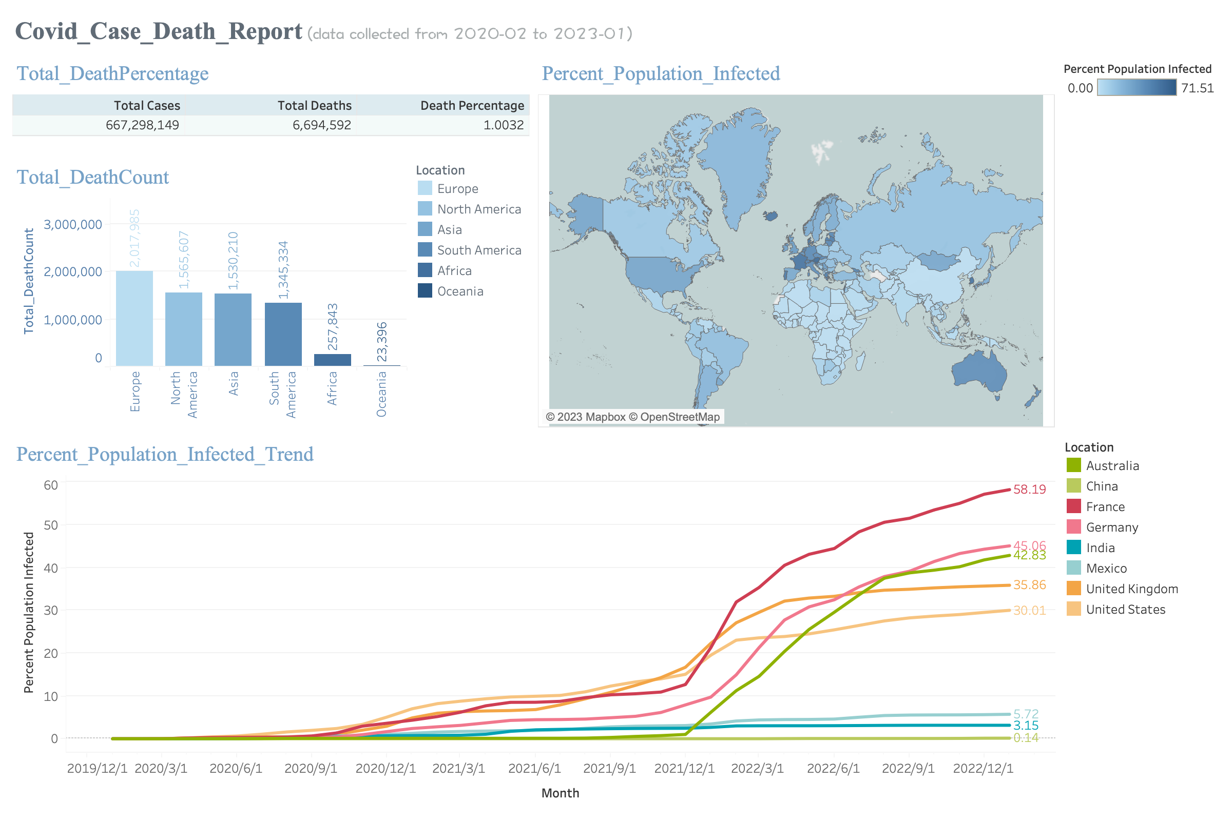

Slide 3


Slide 4
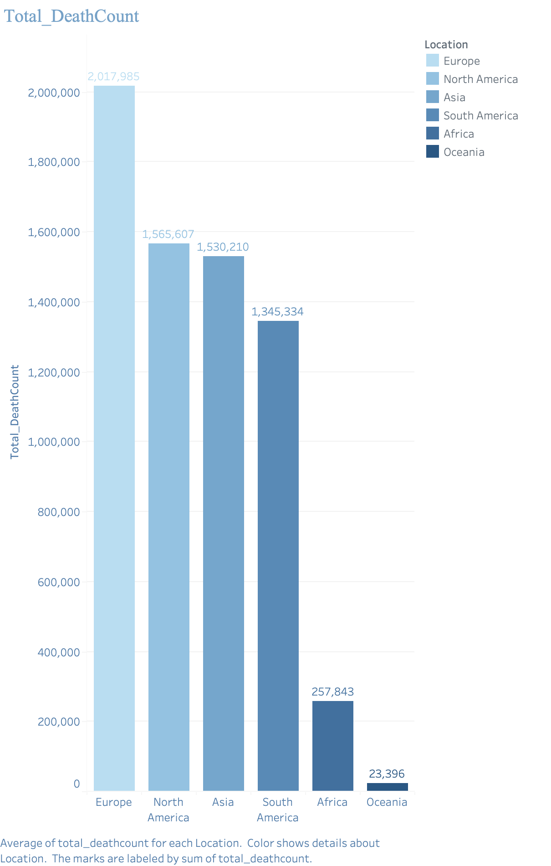

Slide 5
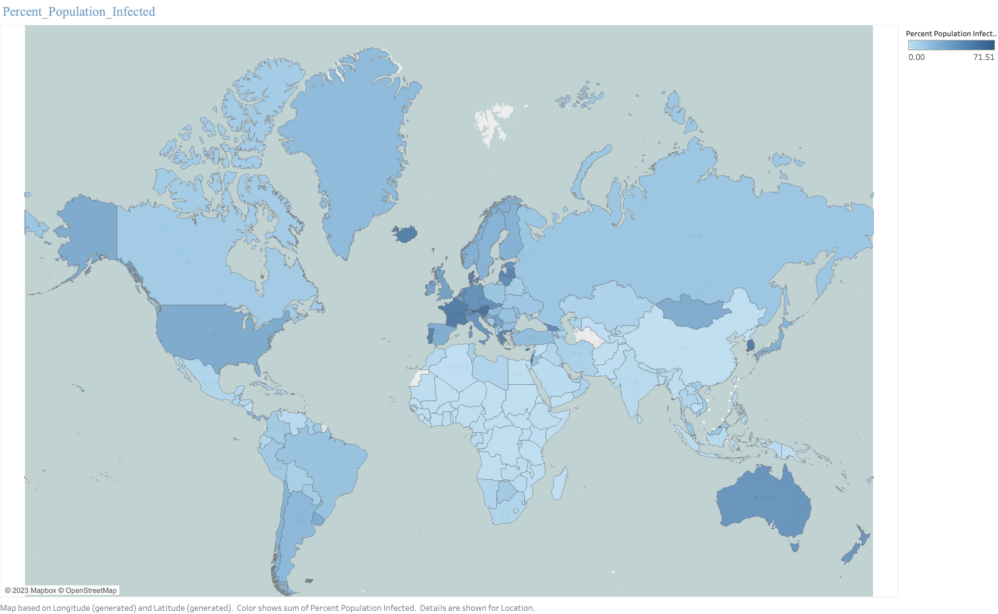

Slide 6
