Slide 1
FREE-FORM DEFORMATION
Tianyu Huang

Slide 2
Overview
What is Free-Form Deformation (FFD)
Applications of FFD
Main concept of FFD
Demo

Slide 3
What is Free-Form Deformation
A technique for deforming solid geometric models in a free-form manner
Uses parametric surfaces
Can be used with any solid modeling system
Idea proposed by Thomas W. Sederberg, Scott R. Parry
Published by SIGGRAPH

Slide 4
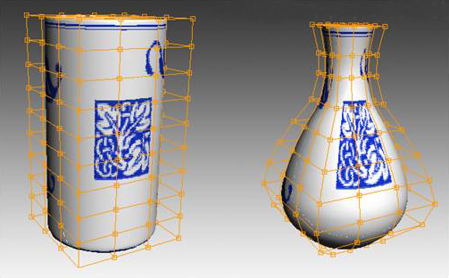
FFD Application

Slide 5
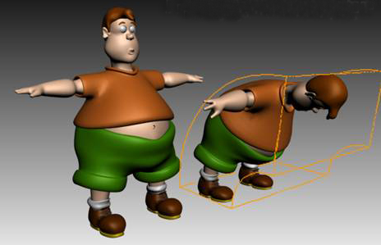
FFD Application

Slide 6
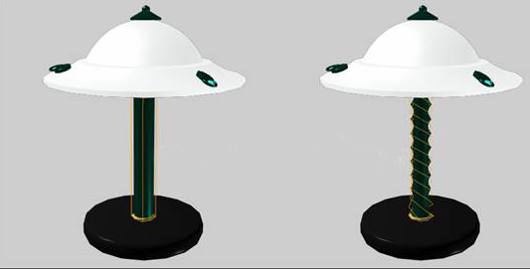
FFD Application

Slide 7
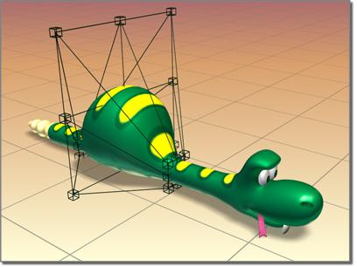
FFD Application

Slide 8
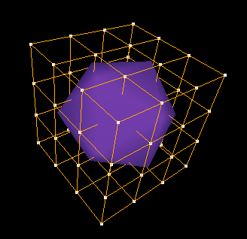
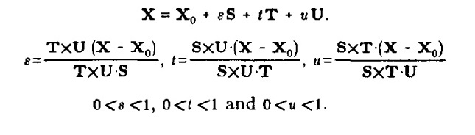
FFD Concept
T
Impose a local coordinate system on a parallelepiped
Compute the (s, t, u) coordinates of the model points in the region
S
U
Xo

Slide 9

FFD Concept
T
Impose a (l, m, n) grid of control points on the parallelepiped
Computer coordinates for control points
m=3
S
U
l=3
n=3
Xo

Slide 10
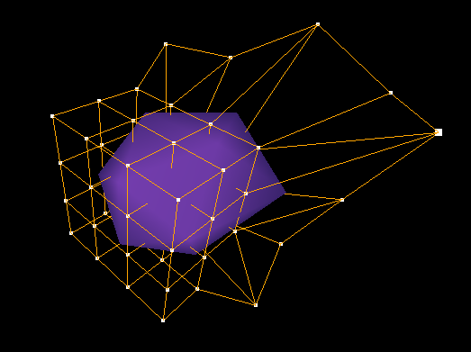

FFD Concept
T
m=3
Move the control points around
Evaluate new position of model point based on Trivariate Bernstein Polynomials
S
U
l=3
n=3
Xo

Slide 11
Demo

