Slide 1

Informatitek
Request for Proposal: Tableau vs D3
Presented by: Tiania Chan
Friday, May 7, 2021

Slide 2

Introduction
Data Analyst – Tiania Chan, TekSystems Data Analytics Bootcamp
Problem: InformatiTek needs to find a data visualization tool to bridge the gap between their analysts and developers
Solution: Demonstrate how the combination of Alteryx and Tableau are a more user friendly alternative to D3.js

Slide 3
Table of Contents
Background
Alteryx as a data manipulation tool
Tableau vs D3.js
Tableau Demonstration and Analysis
Conclusion

Slide 4
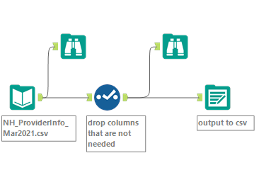
Alteryx
Notes:
Alteryx vs python for data clean up?

Slide 5
Tableau vs D3.js
Tableau | D3.js
Easy to learn | Difficult to learn
Short Development time | Long Development time
Drag and Drop Visualizations | Trial and Error Visualizations
Great online community support | Stackoverflow
Free version is limited | Very few limitations
Expensive | Free

Slide 6
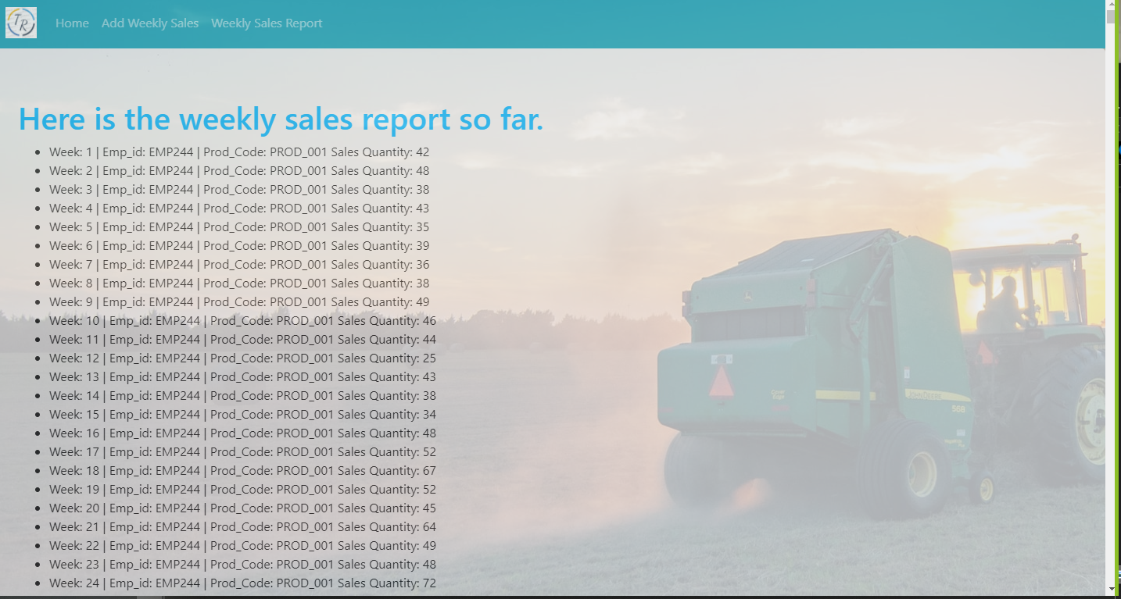
TractorTek Database Web App

Slide 7
Conclusion
Problem: InformatiTek needs to find a data visualization tool to bridge the gap between their analysts and developers
Solution: Demonstrate how the combination of Alteryx and Tableau are a more user friendly alternative to D3.js
Value: Alteryx and Tableau are complements of each other that have a smaller learning curve than d3.js to process, analyze, and visualize data.

Slide 8
Questions?

