Slide 1

Informatitek
Request for Proposal: Tableau vs D3
Presented by: Tiania Chan
Friday, May 7, 2021

Slide 2

Introduction
Data Analyst – Tiania Chan, TekSystems Data Analytics Bootcamp
Problem: InformatiTek needs to find a data visualization tool to bridge the gap between their analysts and developers
Solution: Demonstrate how the combination of Alteryx and Tableau are a more user friendly alternative to D3.js

Slide 3
Table of Contents
Background
Alteryx as a data manipulation tool
Tableau vs D3.js
Tableau Demonstration and Analysis

Slide 4
Question to Answer
Question
What factors contribute to a better rated nursing home? Identify those factors and you can improve quality of care, increase trust, and ultimately, increase revenue.
Background
Our nation begins to age, we will start being the care taker of older adults in our lives. We need to start preparing for what happens as they are no longer able to perform their ADLs (activities of daily living). At that point, we need to start weighing the options between having an at home caregiver to allow them to age in place or finding a nursing home. This can be an overwhelming decision so finding the factors that determine a successful nursing home via visuals will help draw prospects to our business as well as aid in our own decisions.

Slide 5
Resources
Nursing Home Stats: https://data.cms.gov/provider-data/search?theme=Nursing%20homes%20including%20rehab%20services
US State Sizes (US census): https://github.com/jakevdp/data-USstates/blob/master/state-areas.csv
US Population: https://www.census.gov/data/tables/time-series/demo/popest/2010s-state-total.html
Nursing Home Rating Terms and explanations:
https://www.cms.gov/Medicare/Provider-Enrollment-and-Certification/CertificationandComplianc/FSQRS#:~:text=Quality%20Measures%20(QMs)%20%E2%80%93%20The,residents'%20physical%20and%20clinical%20needs.
https://health.mo.gov/safety/nursinghomesinspected/index.php

Slide 6
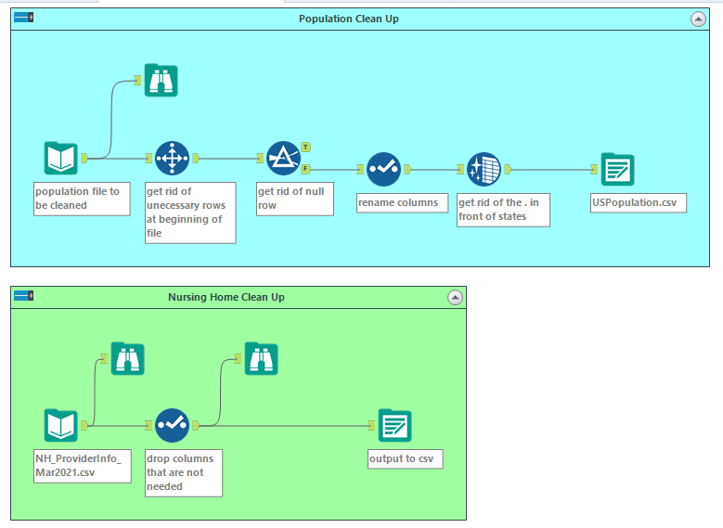
Alteryx
Notes:
Alteryx vs python for data clean up?

Slide 7
Tableau vs D3.js
Tableau | D3.js
Easy to learn | Difficult to learn
Short Development time | Long Development time
Drag and Drop Visualizations | Trial and Error Visualizations
Great online community support | Stackoverflow
Free version is limited | Very few limitations
Expensive | Free
Tableau vs D3.js – https://www.arkatechture.com/blog/tableau-vs.-d3

Slide 8
Questions?

