Slide 1
COMP10020 INTERNET TECHNOLOGIES
FastAPI
app/main.py
from fastapi import FastAPI
app = FastAPI()
@app.get("/tasks")
def list_tasks():
return tasks
Building a Simple Task Management REST API
FastAPI is a Python framework for web APIs.
This Task Manager shows how it works.
GROUP PRESENTATION
Notes:
Owner: Member 1
Suggested time: 0:30
Key points:
1. Introduce FastAPI as the topic.
2. Name the Task Manager example.
3. Preview routes, validation, documentation and testing.
Technical terms: REST API, route
Order: Topic, project, presentation structure.
中文理解提示：先说主题，再说我们用一个小型任务管理 API 来解释 FastAPI。不要逐字读副标题。

Slide 2
FASTAPI OVERVIEW
What is FastAPI?
A Python framework for building web APIs with clear data rules.
PYTHON
Web API framework
Each API route is a normal Python function. This makes the project easy to read.
REST
Resource routes
The method and path describe the action and identify the task resource.
TYPES
Type hints
Python type hints define the expected data. They also support automatic validation.
USES
Typical applications
FastAPI is useful for web backends, internal tools and data services.
COMP10020 · FASTAPI
02
Notes:
Owner: Member 1
Suggested time: 0:45
Key points:
1. FastAPI is a Python framework for web APIs.
2. REST routes use HTTP methods and paths.
3. Type hints describe expected data and support common API projects.
Technical terms: framework, REST API, type hint
Order: Definition, REST idea, types, common uses.
中文理解提示：把 FastAPI 理解成用 Python 建立接口的框架，重点不是网页外观，而是客户端与服务器交换数据。
Source: https://fastapi.tiangolo.com/features/

Slide 3
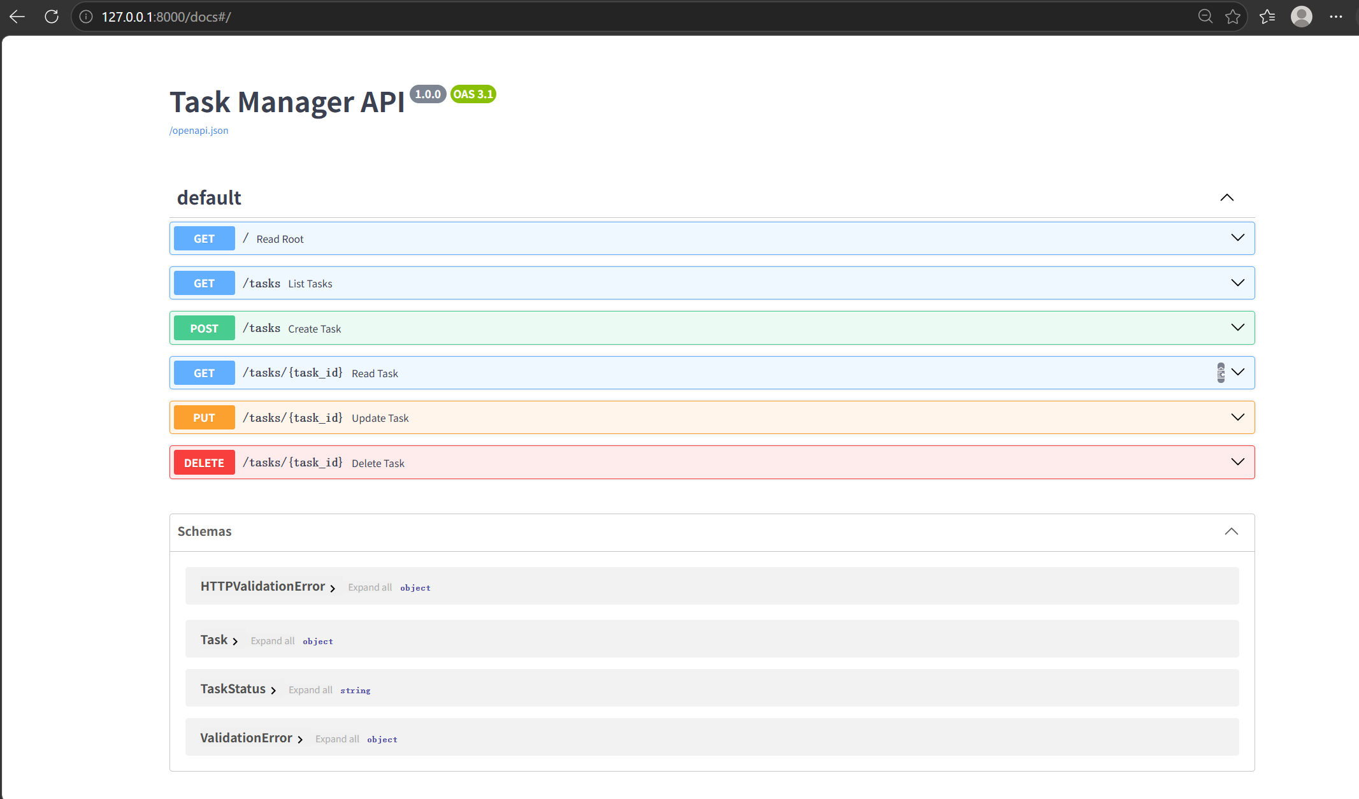
FASTAPI OVERVIEW
Key features
FastAPI connects the route, data model and documentation.
This reduces setup work and mistakes.
01
Simple routes
A decorator links the URL and HTTP method to a Python function.
02
Automatic validation
Pydantic checks request data before the function runs. Invalid values stop early.
03
Automatic documentation
FastAPI generates Swagger UI and ReDoc directly from the route definitions.
COMP10020 · FASTAPI
03
Notes:
Owner: Member 1
Suggested time: 0:45
Key points:
1. Decorators make route declarations short.
2. Pydantic validates declared request data.
3. FastAPI generates OpenAPI documentation automatically.
Technical terms: decorator, validation, OpenAPI, Swagger UI
Order: Routes, validation, documentation.
中文理解提示：三个功能按从写代码到测试接口的顺序讲，每项只解释一句。
Source: https://fastapi.tiangolo.com/features/
Source: https://fastapi.tiangolo.com/tutorial/first-steps/

Slide 4
HOW FASTAPI WORKS
How a request moves through the app
Each component has one clear job in the request path.
CLIENT
UVICORN
FASTAPI
PYDANTIC
REPOSITORY
JSON
Sends an HTTP request
Receives the connection
Selects the matching route
Checks and converts data
Reads or changes tasks
Returns JSON and status
The response includes JSON data and an HTTP status code.
COMP10020 · FASTAPI
04
Notes:
Owner: Member 1
Suggested time: 0:55
Key points:
1. The client sends an HTTP request through Uvicorn.
2. FastAPI selects the route and Pydantic checks data.
3. The repository returns task data as JSON.
Technical terms: client, Uvicorn, Pydantic, repository, JSON
Order: Follow the diagram from left to right.
中文理解提示：按箭头顺序讲，不需要深入解释 ASGI。最后说明返回 JSON 和状态码。
Source: https://www.uvicorn.org/
Source: https://docs.pydantic.dev/latest/

Slide 5
HTTP REQUEST EXAMPLE
GET /tasks from request to response
The client asks for the current task list. FastAPI returns JSON.
SHORTENED JSON RESPONSE
REQUEST
200 OK
[
{
"id": 1,
"title": "Rehearse the demo",
"status": "todo",
"priority": 5
}
]
GET /tasks
Accept: application/json
FASTAPI ROUTE
list_tasks()
FastAPI serialises the response model as JSON.
The client also receives the 200 status code.
COMP10020 · FASTAPI
05
Notes:
Owner: Member 2
Suggested time: 0:45
Key points:
1. GET /tasks requests the task list.
2. FastAPI matches the list_tasks route.
3. The response contains status 200 and JSON data.
Technical terms: GET, JSON response, serialise
Order: Request, route, response.
中文理解提示：指出右侧 JSON 是缩短后的示例，真实响应还包含其他模型字段。

Slide 6
APPLICATION SCENARIO
A task tracker for presentation work
Small enough for one lab, complete enough to show a REST workflow.
REAL TASK
A VALID TASK
Check references, rehearse the demo and upload slides.
{
"title": "Rehearse the demo",
"description": "Practise demo",
"status": "todo",
"priority": 5
}
FOUR FIELDS
Title, description, status and priority from 1 to 5.
TEACHING BOUNDARY
Tasks stay in memory. Restarting the server clears them, so we can reset the classroom demo quickly.
COMP10020 · FASTAPI
06
Notes:
Owner: Member 2
Suggested time: 0:40
Key points:
1. The scenario supports real presentation tasks.
2. Each task uses four editable fields.
3. Memory storage keeps the teaching setup simple.
Technical terms: in-memory storage, workflow status
Order: Scenario, fields, deliberate limitation.
中文理解提示：强调这是教学示例。服务器重启后数据清空，SQLite 只是后续扩展。

Slide 7
REST DESIGN
CRUD operations
The HTTP method describes the action. The path identifies the task resource. Together they form a clear REST interface.
METHOD
ENDPOINT
TASK MANAGER ACTION
GET
/tasks
List all tasks.
GET
/tasks/{task_id}
Read one task.
POST
/tasks
Create a validated task.
PUT
/tasks/{task_id}
Replace the editable fields.
DELETE
/tasks/{task_id}
Remove one task.
COMP10020 · FASTAPI
07
Notes:
Owner: Member 2
Suggested time: 0:50
Key points:
1. GET reads tasks.
2. POST creates and PUT replaces.
3. DELETE removes a task.
Technical terms: CRUD, HTTP method, resource path
Order: Read the lifecycle from GET to DELETE.
中文理解提示：把 CRUD 当作任务生命周期来讲，不需要现场演示全部五个路由。

Slide 8
REST DESIGN
HTTP status codes
Each response code gives the client a short, standard result. This makes success and errors easy to understand.
SUCCESS
CLIENT ERRORS
200
OK
The request succeeded and returns data.
404
Not Found
The requested task ID does not exist.
201
Created
POST /tasks created a new task.
422
Validation Error
204
No Content
The request breaks a Pydantic validation rule.
DELETE succeeded. No response body is needed.
COMP10020 · FASTAPI
08
Notes:
Owner: Member 2
Suggested time: 0:45
Key points:
1. 200, 201 and 204 show successful requests.
2. 404 means the task ID is missing.
3. 422 means request data failed validation.
Technical terms: HTTP status code, response body, validation error
Order: Success codes first, then client errors.
中文理解提示：不要逐个长讲。重点记住 POST 成功是 201，非法 priority 是 422。

Slide 9
CODE EXAMPLES
Routes connect HTTP requests to Python functions
FastAPI keeps the route declaration close to the Python function. The decorator links each HTTP request to the correct code.
Step 1 · list tasks
Step 2 · create a task
@app.get("/tasks")
def list_tasks():
return repository.list_all()
@app.post(
"/tasks",
response_model=TaskRead,
status_code=201,
)
def create_task(data: TaskCreate):
return repository.create(data)
→
PATH + METHOD
MODEL + STATUS
COMP10020 · FASTAPI
09
Notes:
Owner: Member 3
Suggested time: 0:35
Key points:
1. A decorator combines the method and path.
2. The function contains the Python behaviour.
3. The POST route declares its models and 201 status.
Technical terms: decorator, response model, status_code
Order: Simple GET example, then the richer POST example.
中文理解提示：只比较左右两段代码的差别，不需要逐行解释。

Slide 10
PYDANTIC VALIDATION
Pydantic data model
The model describes the fields that a task request may contain. Type hints and Field rules define valid input.
app/models.py
title
Required text from 1 to 120 characters.
class TaskData(BaseModel):
title: str = Field(
min_length=1, max_length=120
)
description: str | None = None
status: TaskStatus = TaskStatus.TODO
priority: int = Field(
default=3, ge=1, le=5
)
description
Optional text. It may be left empty.
status
One value: todo, in_progress or done.
priority
A whole number from 1 to 5. Default is 3.
COMP10020 · FASTAPI
10
Notes:
Owner: Member 3
Suggested time: 0:35
Key points:
1. TaskData defines the shared request fields.
2. Status has three allowed workflow values.
3. Priority accepts only integers from 1 to 5.
Technical terms: BaseModel, Field, enum, constraint
Order: Model purpose, four fields, priority rule.
中文理解提示：重点讲 priority 的 ge=1 和 le=5，因为下一页和 Demo 都会用到。
Source: https://docs.pydantic.dev/latest/

Slide 11
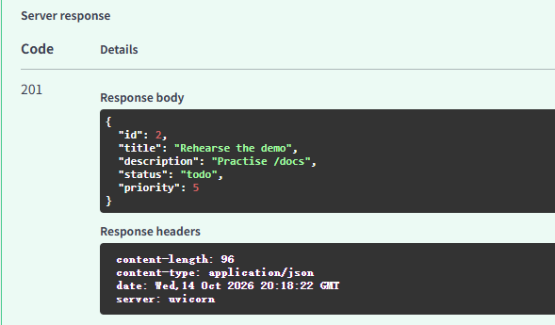
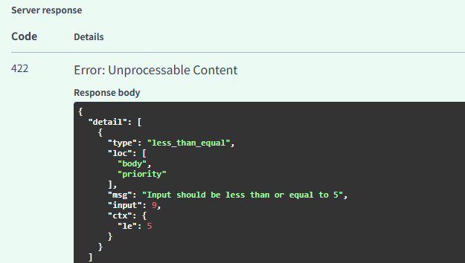
PYDANTIC VALIDATION
Validation example
FastAPI checks the request against the Pydantic model automatically. Valid data continues; invalid data stops early.
VALID REQUEST
INVALID REQUEST
priority = 5
priority = 9
422 Validation Error
201 Created
The task passes every field rule.
Rejected before repository logic.
Invalid data stops before repository code runs. The client receives a clear 422 response.
COMP10020 · FASTAPI
11
Notes:
Owner: Member 3
Suggested time: 0:30
Key points:
1. Priority 5 satisfies the model.
2. Priority 9 breaks the maximum value.
3. FastAPI returns 422 before repository code runs.
Technical terms: 201 Created, 422 Validation Error
Order: Valid request, invalid request, automatic check.
中文理解提示：左右对比即可。不要解释完整错误 JSON，只说 9 超出 1 到 5。

Slide 12
LIVE DEMONSTRATION
Three requests in Swagger UI
The server starts before class. We send only three requests, so the live demo stays under three minutes.
1
GET /tasks
Open GET /tasks, choose Try it out, then Execute. Confirm 200 and view the list.
DEMO CHECKLIST
✓ Uvicorn already running
✓ Browser open at /docs
✓ Valid JSON copied
✓ Backup slide ready
2
POST /tasks
Open POST /tasks, paste the valid JSON, then Execute. Confirm 201 Created.
3
POST invalid data
Change only priority to 9, Execute again and point out the 422 message.
STOP AFTER 422
COMP10020 · FASTAPI
12
Notes:
Owner: Member 3
Suggested time: 2:15
Key points:
1. GET /tasks returns 200.
2. A valid POST returns 201.
3. Priority 9 returns 422 automatically.
Technical terms: Swagger UI, Try it out, Execute
Order: GET, valid POST, invalid POST, then stop.
中文理解提示：课前启动服务器并打开 /docs。不要现场写代码，不要演示 PUT 或 DELETE。出错时留在本页口头说明结果。
Source: https://fastapi.tiangolo.com/tutorial/first-steps/

Slide 13
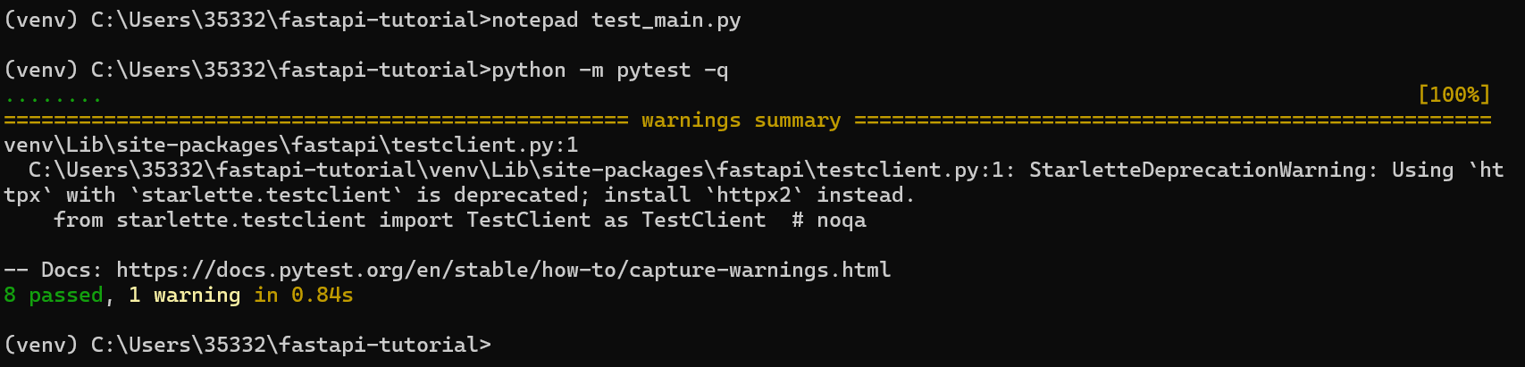
AUTOMATED VERIFICATION
Eight tests verify the main API behaviour
DOCS
Each test uses a fresh in-memory repository. Eight passing results confirm that the main routes work as expected.
/docs and OpenAPI schema
CRUD
Create, read, replace, delete
FILTERS
Status and priority queries
TestClient sends normal HTTP-style requests without starting Uvicorn. A fresh repository keeps each test independent.
ERRORS
404 and 422 responses
COMP10020 · FASTAPI
13
Notes:
Owner: Member 4
Suggested time: 0:40
Key points:
1. The suite contains eight API tests.
2. It covers docs, CRUD, errors and filters.
3. The current project result is 8 passed.
Technical terms: pytest, TestClient, repeatable test
Order: Result, coverage, why the repository resets.
中文理解提示：展示结果即可，不需要打开测试代码。当前复核结果是 8 passed in 0.47s。
Source: https://fastapi.tiangolo.com/tutorial/testing/

Slide 14
EVALUATION
Advantages of FastAPI
FastAPI reduces repeated work and keeps the main parts of a small API connected.
01
Connected contracts
One model guides validation, responses and API documentation, so the parts stay consistent.
02
Fast feedback
Swagger UI lets us inspect and call each route immediately, without building a separate client.
03
Room to grow
The project can later add routers, services and a database without changing its basic API design.
COMP10020 · FASTAPI
14
Notes:
Owner: Member 4
Suggested time: 0:40
Key points:
1. Types connect validation, responses and documentation.
2. Swagger UI gives fast feedback.
3. The structure can grow beyond the teaching example.
Technical terms: contract, Swagger UI, router
Order: Contract, feedback, growth.
中文理解提示：用项目中的实际例子说明优点，避免夸大性能。
Source: https://fastapi.tiangolo.com/features/

Slide 15
EVALUATION
Limitations to plan for
FastAPI supports API development, but it does not design, secure or deploy the whole system for us.
01
Security needs design
Authentication, authorisation, permissions and safe deployment still need careful design.
02
Some concepts take time
Type hints, Pydantic models and asynchronous Python may take time for beginners to learn.
03
Production needs more
Real systems also need persistent storage, migrations, logging, monitoring and backups.
COMP10020 · FASTAPI
15
Notes:
Owner: Member 4
Suggested time: 0:40
Key points:
1. Security still requires application design.
2. Some Python concepts may be unfamiliar.
3. Production systems need storage and operations work.
Technical terms: authentication, authorisation, persistence, monitoring
Order: Security, learning curve, production needs.
中文理解提示：说明框架不能自动解决所有问题，这体现批判性分析。

Slide 16
PRACTICAL USE CASES
Where FastAPI fits well
FastAPI works well when a clear Python API is the main product or connects other components.
01
REST backends
JSON endpoints can serve web applications, mobile clients and internal tools.
02
Data and ML services
Typed inputs and outputs can wrap existing Python or machine-learning logic.
03
Teaching and prototypes
Generated documentation gives learners quick feedback and makes testing easier.
Production systems still need security, persistent storage, deployment and monitoring.
COMP10020 · FASTAPI
16
Notes:
Owner: Member 4
Suggested time: 0:40
Key points:
1. FastAPI fits REST backends.
2. It also fits data and ML services.
3. Generated docs help teaching and prototypes.
Technical terms: backend, typed contract, prototype
Order: Three use cases, then the production reminder.
中文理解提示：说适用场景，不要说 FastAPI 永远是最佳选择。

Slide 17

CONCLUSION
FastAPI in three ideas
Continue with our GitHub Pages resource for online information and the step-by-step tutorial.
1
2
3
Types become a contract
The docs are executable
Simple can still be complete
Types guide validation, schema generation and consistent responses.
Swagger UI makes the API visible, testable and easier to explain.
Five routes, clear errors and tests show a complete learning example.
ONLINE LEARNING RESOURCE
Scan the QR code or open:
https://tianjianzou123.github.io/fastapi-cw1/
Online Information: overview · architecture · examples · evaluation
Online Tutorial: setup · CRUD · validation · exercises
COMP10020 · FASTAPI
17
Notes:
Owner: Member 4
Suggested time: 0:45
Key points:
1. Types support a clear API contract.
2. Swagger UI makes the API visible and testable.
3. The GitHub Pages site continues with information and a tutorial.
Technical terms: GitHub Pages, Online Information, Online Tutorial
Order: Three ideas, URL and QR code, thank the audience.
中文理解提示：最后指向真实网址和二维码，说明网站分为知识介绍与分步教程。

Slide 18
REFERENCES
Official documentation used
These official sources support our definitions, examples, testing and status-code explanations. Full citations also appear online.
01
FastAPI (2026) Features — fastapi.tiangolo.com/features/
02
FastAPI (2026) First Steps — fastapi.tiangolo.com/tutorial/first-steps/
03
FastAPI (2026) Testing — fastapi.tiangolo.com/tutorial/testing/
04
Pydantic (2026) Documentation — docs.pydantic.dev/latest/
05
Uvicorn (2026) Documentation — uvicorn.org/
06
OpenAPI Initiative (2026) Specification v3.2.1 — spec.openapis.org/oas/v3.2.1.html
Accessed 14 October 2026 · Full reference list: tianjianzou123.github.io/fastapi-cw1/#references
COMP10020 · FASTAPI
18
Notes:
Owner: Reference slide
Suggested time: 0:00 planned
Key points:
1. The main claims use official FastAPI documentation.
2. Pydantic, Uvicorn and OpenAPI sources are included.
3. The online resource contains the full reference list.
Technical terms: official documentation, access date
Order: Display briefly before questions if needed.
中文理解提示：此页不计入正式讲解时间，需要时停留几秒即可。

