Slide 1
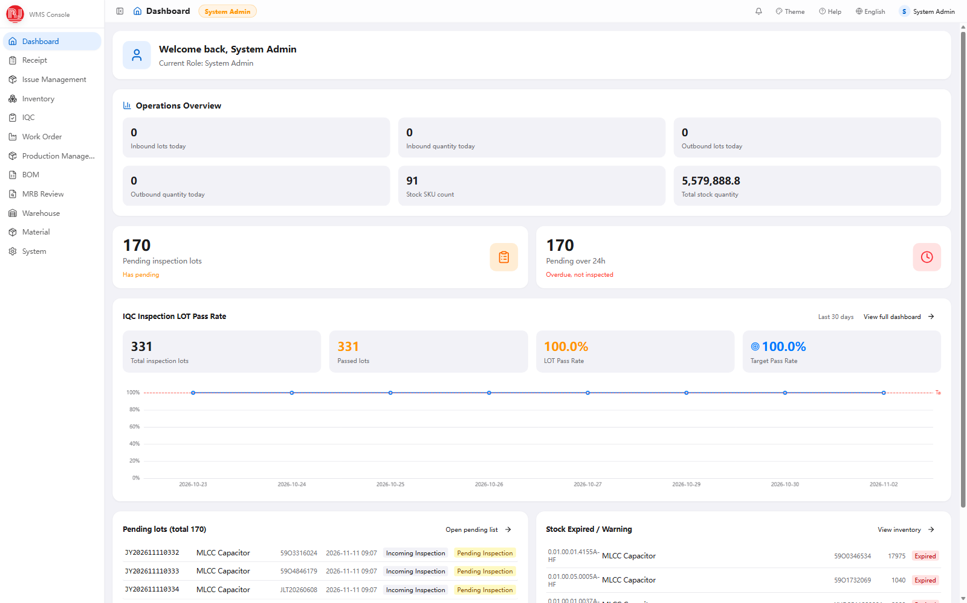
Warehouse Management System · Customer Review
Receiving, inspection,
inventory and issuing
Walked through in the order the warehouse actually works. Screenshots are from the running system.
Receiving · IQC · Inventory & Expiry · MES & Issuing
Demo environment · test data
WMS Functional Briefing · November 2026
01
Notes:
Cover.

Slide 2
AT A GLANCE
A truckload, from gate to line: eight steps
Each step below shows where the system stops you.
01
02
03
04
Scan and receive
Hold for QC
Submit for QC
IQC
carton and location
one record per carton
goods stay in receiving
nothing can be issued
same item and lot merge
into one inspection order
plan from the system
verdict on measured values
05
06
07
08
Approval
Putaway
Issue to order
Line returns
supervisor signs off
stock turns good
location scanned again
moved to the good bin
system names location
oldest first, no over-issue
surplus and rejects
back to their own bins
Four hard stops: not inspected · failed QC · expired · over-issue
WMS Functional Briefing · November 2026
02
Notes:
Eight steps, expanded one section at a time later.

Slide 3
AGENDA
Five topics, in the order of the work
From receiving through issuing, then limits and next steps.
Receiving and putaway
01
Three things we will demo
receive, hold, submit
Scan and receive
IQC
One carton, including the three cases the system refuses.
02
sampling, verdict, report
An IQC verdict
Inventory and expiry
03
From the pending list to the printed report.
stock status, shelf life
Issuing and line side
Issuing to an order
04
How the system picks the location and the lot.
MES demand, issue, return, trace
Rollout and roadmap
05
limits, value, next steps
WMS Functional Briefing · November 2026
03
Notes:
IQC gets the most time. The last section lists what needs a decision.

Slide 4
SECTION 01
01
Receiving and Putaway
From the first scan to a released inspection order.
WMS Functional Briefing · November 2026
04
Notes:
Receiving and Putaway. From the first scan to a released inspection order.

Slide 5
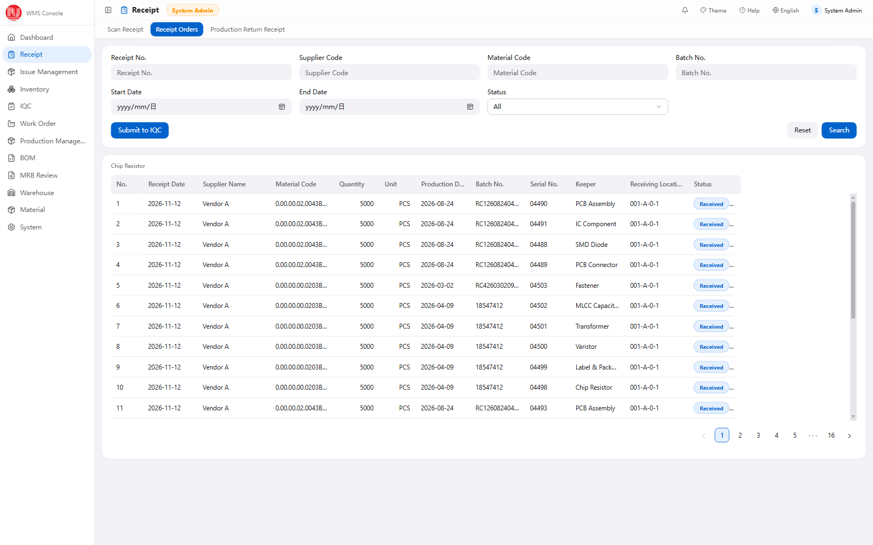
01 · RECEIVING
Receiving: one carton, one record
A carton label carries six fields: supplier, part number, production date, quantity, lot, serial.
Three cases are refused: unapproved item, unapproved supplier, duplicate scan.
Scanning the location books it in. PDA scans run back to back, no trip to a desk.
Cartons of the same item and lot merge on their own, no manual consolidating.
Receiving documents (demo data)
WMS Functional Briefing · November 2026
05
Notes:
Scan one carton live: wrong code, wrong supplier, duplicate scan are all refused on the spot.

Slide 6
01 · RECEIVING
What receiving does on its own
Hold, merge and status — all at receiving, before any inspection result exists.
1
Booked as pending
2
Cartons merge into one order
3
Status switches when QC ends
Goods stay in receiving. Stock is flagged pending and locked, so no issue order can pick it.
Same item, supplier, production date and lot become one inspection lot with a JY number.
Pass turns it good and unlocks; fail turns it reject, locks it and opens an MRB.
Received
Pending QC
Pending approval
Pass / Fail
scanned, not booked
locked in stock
inspection submitted
stock status updated
Receipt status: Received → Pending QC → Pass / Fail, written back automatically
One point that is often misunderstood: a pass does not put the goods on the shelf. Approval changes status in place. They stay in the receiving location until a storage location is scanned.
WMS Functional Briefing · November 2026
06
Notes:
A pass is not a putaway. This is the point people argue about after go-live, so say it early.

Slide 7
01 · RECEIVING
Every location has a code
Five segments — warehouse, area, rack, level, position — make one code.
Warehouse
Area
Rack
Level
Position
THREE WAYS TO FIND STOCK
WH01
A
03
2
0012
You know the part
Filter inventory by part number; the row gives the location code, lot, quantity and status.
WH01 - A - 03 - 2 - 0012
You only know the place
Segments joined by hyphens; the position pads to four digits.
Filter by location code or a prefix and see everything stored on that rack.
Create a block at once
You are at the rack
Pick warehouse, area, rack and level, then a start and end number: up to 500 locations in one pass. Existing codes are skipped.
Scan the location label; the PDA lists what sits there and in which lot.
Label it: 40 × 60 mm QR
Locations are typed good, pending or reject. Issuing only reaches good locations.
The code prints as a QR label for the rack beam. The PDA reads the label instead of someone typing the string.
Receiving, putaway, transfer, count and issuing all use the same code. A wrong location or a wrong item is refused on the spot.
WMS Functional Briefing · November 2026
07
Notes:
Location codes: show the five segments, then the three ways to find stock.

Slide 8
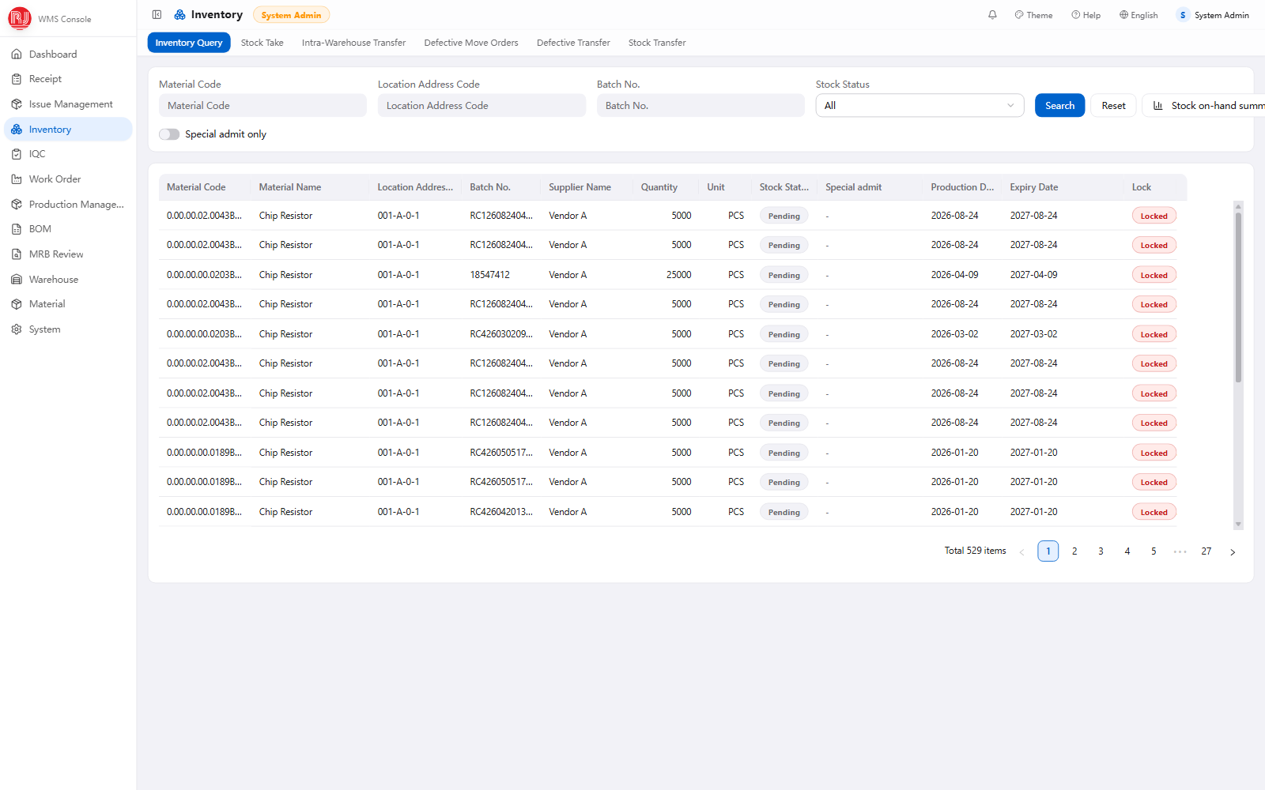
01 · RECEIVING
Inventory: one row, down to lot and status
One row is item + location + lot + status. Good, pending and reject stock of the same lot stay apart.
Five statuses: good, pending QC, reject, rework, awaiting disposal.
Every lock has a reason: pending QC, expiry recheck, IQC fail, MRB disposition. Open the row to see it.
Three transfers: within the warehouse, between warehouses, rejects to the reject area. PC and PDA.
Inventory inquiry (demo data)
WMS Functional Briefing · November 2026
08
Notes:
Same lot, different statuses, separate rows. Locks always carry a reason.

Slide 9
SECTION 02
02
IQC — Incoming Inspection
The sampling plan comes from a table. The verdict comes from the server.
WMS Functional Briefing · November 2026
09
Notes:
IQC — Incoming Inspection. The sampling plan comes from a table. The verdict comes from the server.

Slide 10
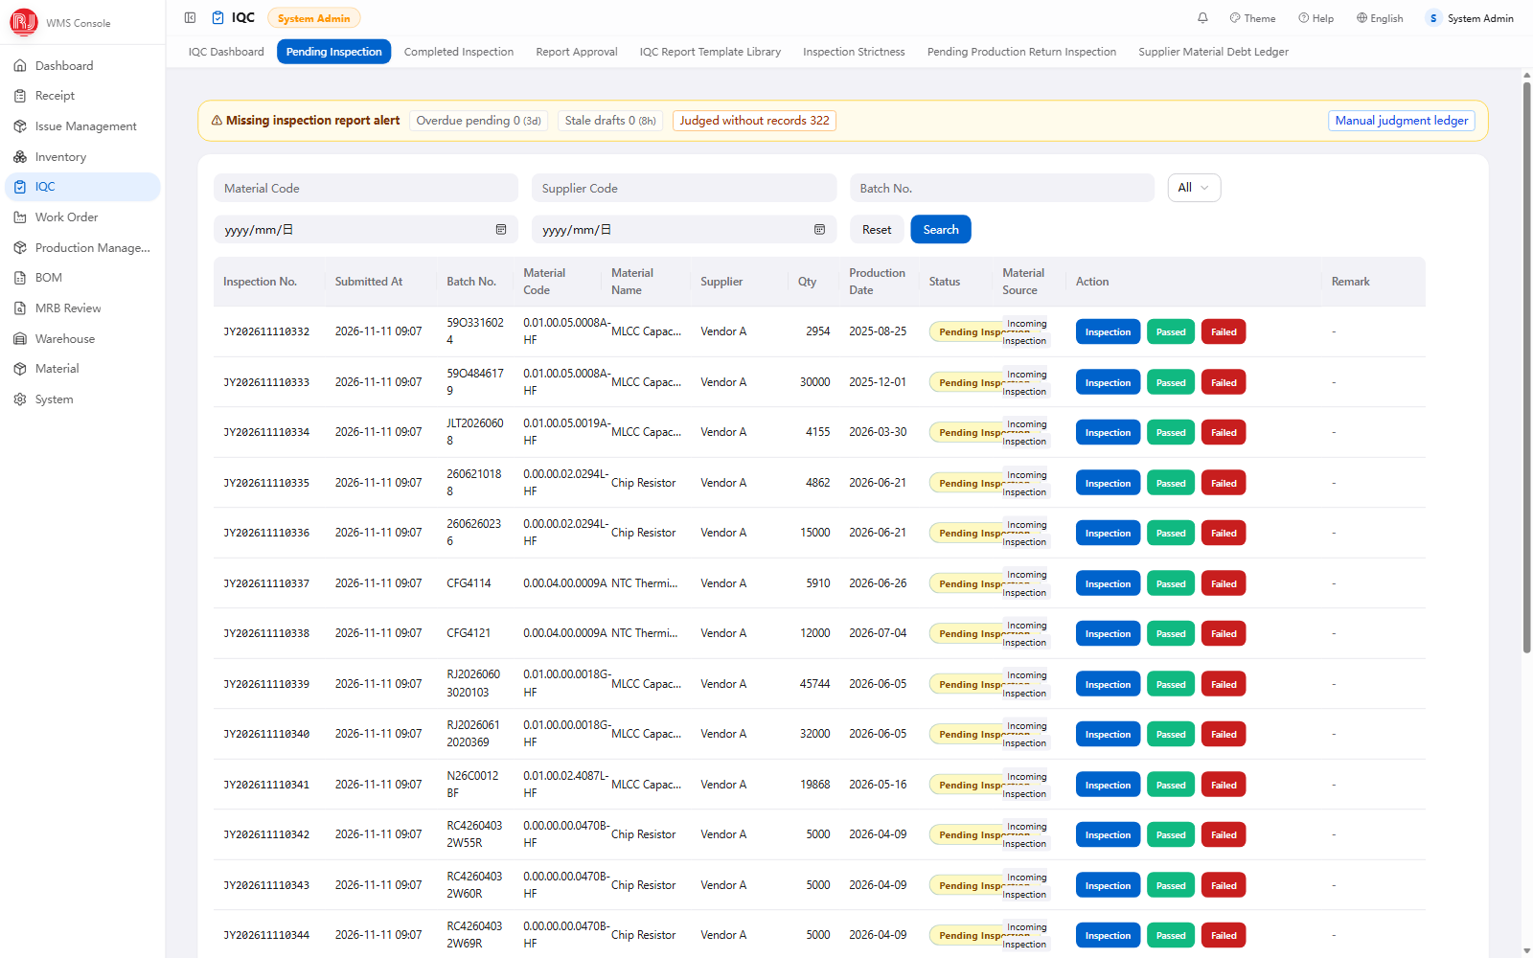
02 · IQC
One incoming inspection, six steps
1
Pending list
filter by item, supplier, lot; overdue lots and stale drafts flagged
2
Pick a template
pulled in by item, not rebuilt each time
3
Get the plan
sample size, Ac and Re calculated; not editable
4
Enter results
measured values or defect counts; a fail needs a type
5
Submit and approve
supervisor approves or rejects, in batch if needed
6
Release or block
pass unlocks the stock; fail opens an MRB
IQC pending list (demo data)
WMS Functional Briefing · November 2026
10
Notes:
Step 3 is the hinge: the sampling plan is not the inspector's to work out.

Slide 11
02 · IQC
Sampling plan: the system reads the table
Give it the lot size and the inspection level. It returns the sample size, Ac and Re.
Lot size
Inspection level
AQL
The whole standard table sits behind it
how many pieces arrived
general I/II/III
or S-1 to S-4
how many defects allowed
7 inspection levels
special S-1 to S-4, general I / II / III
Looks up GB/T 2828.1-2012, Table 1 and Table 2
16 code letters
A to R, mapped from the lot size
WORKED EXAMPLE
Lot 5,000 · general level II · AQL 0.65
26 AQL values
0.010 to 1000; 8 shown on screen
Code L
200 pcs
Ac 5
Re 6
Arrow rules
sample code
pieces
allowed
rejects the lot
↓ / ↑ move to the nearest plan that exists
Not editable
The same code under reduced inspection draws only 80. Sample size and acceptance follow the strictness level.
sample size, Ac and Re are read-only on site
WMS Functional Briefing · November 2026
11
Notes:
Lot 5,000 at level II gives code L, sample 200, Ac 5 / Re 6 at AQL 0.65. The inspector cannot edit these.

Slide 12
02 · IQC
The sampling plan shifts on its own
Steady supply loosens it, a problem tightens it. The rules live on the server.
Strictness change
Trigger (applied automatically)
A chip resistor, over three months
Normal → Tightened
2 of the last 5 lots failed
10 lots pass in a row
10 consecutive lots passed
moves to reduced; the sample drops from 200 to 80
Normal → Reduced
Tightened → Normal
5 consecutive lots passed
Lot 11 fails
back to normal at once; the sample returns to 200
Tightened → Halt
5 lots failed in total
1 lot failed
2 of the next 5 fail
Reduced → Normal
moves to tightened; stricter acceptance, same sample
Reduced → Skip-lot
10 lots passed, plus supervisor approval
Every change is logged: who, when, automatic or manual.
Strictness is tracked per item. A steady part loosens; the next problem tightens it again.
WMS Functional Briefing · November 2026
12
Notes:
The strongest page in the IQC section. Rules run server-side; strictness is tracked per item, not per supplier.

Slide 13
02 · IQC
How a lot gets its verdict
From a single characteristic to the whole lot, in three layers.
1
Each characteristic first
Dimensions take values
The measured value or defect count is compared with its Ac. At or below Ac, the item passes.
Specs like 10±0.1, ≤5 or 3.15–4.15. Out-of-tolerance is counted for you.
2
Then the whole lot
A fail needs a type
Any single failed characteristic fails the lot. No averaging, no pro-rating.
packaging, appearance, dimension, function, safety, reliability, RoHS, no data.
3
The server recomputes
The verdict is fixed
Whatever the screen submits, the server recomputes it before storing.
The inspector cannot change Ac/Re, or the conclusion the system reached.
Measured values and the verdict go into the report together: who inspected, when, and which lot.
WMS Functional Briefing · November 2026
13
Notes:
The usual misconception is pro-rating by defect rate. The system compares against Ac and does not average.

Slide 14
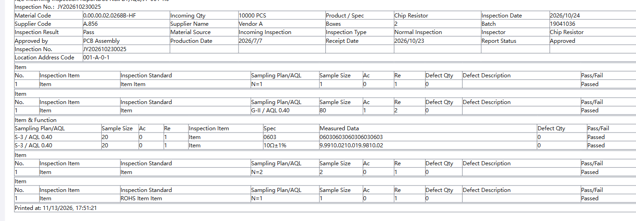
02 · IQC
Inspection report: one sheet per lot
Header carries item, supplier, lot, quantity and the production, receipt and inspection dates.
Body runs in five sections: packaging, appearance, dimension and function, reliability and safety, RoHS.
Every row shows the plan, sample size, Ac/Re, measured value, defect count and verdict.
The report number is the inspection number. What is on screen is what prints.
IQC incoming inspection report (demo data)
WMS Functional Briefing · November 2026
14
Notes:
This sheet is what an auditor sees. Where the data came from, who inspected, who approved.

Slide 15
02 · IQC
After inspection: release or block
One approval button, two different outcomes.
PASS
FAIL
Pending stock becomes good and unlocks
Stock becomes reject and locks; issuing cannot reach it
The receipt is written back as passed
An MRB is opened automatically
Can be put away and picked by issue orders
Disposition: concession, return, rework or scrap
The report is filed for later traceability
The outcome changes stock status directly, fully logged
Skip-lot items are confirmed and released with no report, but the action is logged.
Expired lots get one more gate: record a new expiry date before a pass is allowed.
Both stock transitions are made by the system. Nobody edits inventory in the back end.
WMS Functional Briefing · November 2026
15
Notes:
Both branches are automatic. Nobody adjusts inventory by hand.

Slide 16
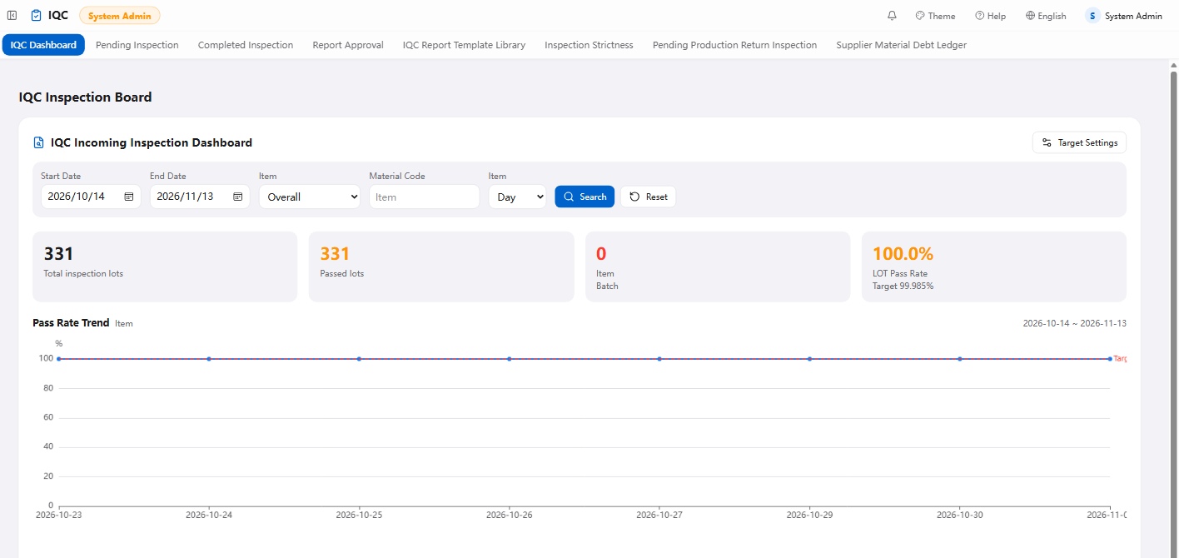
02 · IQC
Quality data without waiting for a summary
Pass rate on demand: daily, weekly or monthly against a target line (settable, 95% by default).
Grouped by supplier and by item type, so a weak supplier stands out.
Pass-rate ranking for items and suppliers, plus the defect-type mix.
Three exceptions counted separately: overdue lots, stale drafts, single-characteristic verdicts.
This is quality statistics. SPC control charts and CPK are on the roadmap, not in the product.
IQC dashboard (demo data)
WMS Functional Briefing · November 2026
16
Notes:
Said as it is: pass rate, trend, ranking, defect mix. No control charts, no CPK. Both are on the roadmap.

Slide 17
SECTION 03
03
Inventory and Expiry
How shelf life is calculated, and what stops you at expiry.
WMS Functional Briefing · November 2026
17
Notes:
Inventory and Expiry. How shelf life is calculated, and what stops you at expiry.

Slide 18
03 · INVENTORY
Expiry: stopped before the date, not after
Shelf life calculated, warehouse scanned daily, stock locked automatically.
Production date
30 days left
Expired
Extension
captured from the carton label
recheck lot raised, row highlighted
stock locked, issuing refused
capped by the scrap date
Shelf life = production date + the item shelf-life days. An extended lot uses its latest extension.
A scan runs across the warehouse at 08:30 every day, and once more after a service restart.
At 30 days left it raises a recheck lot and shows "N days left" on the stock row.
Past the date the stock is locked: the issue order is refused and told which lot expired.
Extensions are capped by the mandatory scrap date; the system shows the days still available.
Without a new expiry date the system will not accept a pass.
WMS Functional Briefing · November 2026
18
Notes:
The audit favourite: the system scans daily, locks at expiry, and caps extensions.

Slide 19
SECTION 04
04
MES, Issuing and Line Side
Demand comes from MES; the system names the location and lot.
WMS Functional Briefing · November 2026
19
Notes:
MES, Issuing and Line Side. Demand comes from MES; the system names the location and lot.

Slide 20
04 · MES
MES says what it needs, we issue to it
Demand arrives from MES, actual issues go back. Nobody retypes a sheet in between.
① MES → WMS
② WMS → MES
③ MES → WMS
Material demand
Issue write-back
Read-only queries
MES splits each list by section: SMT / DIP / ASM / PACK / AUX.
On completion: item, lot, qty, picker and issue time are snapshotted.
Four queries: stock on hand, summary, picking orders, returns.
Pulled every 5 minutes on an updated-since cursor; interval configurable.
Failures retry at 1/2/5/15/30/60 minutes, up to 8 attempts.
Filter by item, warehouse, location, lot or status.
Idempotent by MES order number — a repeat pull adds nothing.
The queue shows why a push failed; retry a single entry by hand.
X-Api-Key, 500 rows per page, ISO 8601 timestamps.
Only orders awaiting issue; closed or cancelled ones are skipped.
Write-back ships off until MES opens its write endpoint.
Read-only: writes no business table, cannot disturb WMS.
No sheet, no phone call: MES splits the order, the warehouse issues against it, the result goes back.
Since 13 November 2026 WMS no longer pulls MES work orders or re-explodes a BOM: MES already splits to work section, so WMS does not compute it twice.
WMS Functional Briefing · November 2026
20
Notes:
Three directions: pull demand, push results, read-only queries. Close on the write-back switch being off.

Slide 21
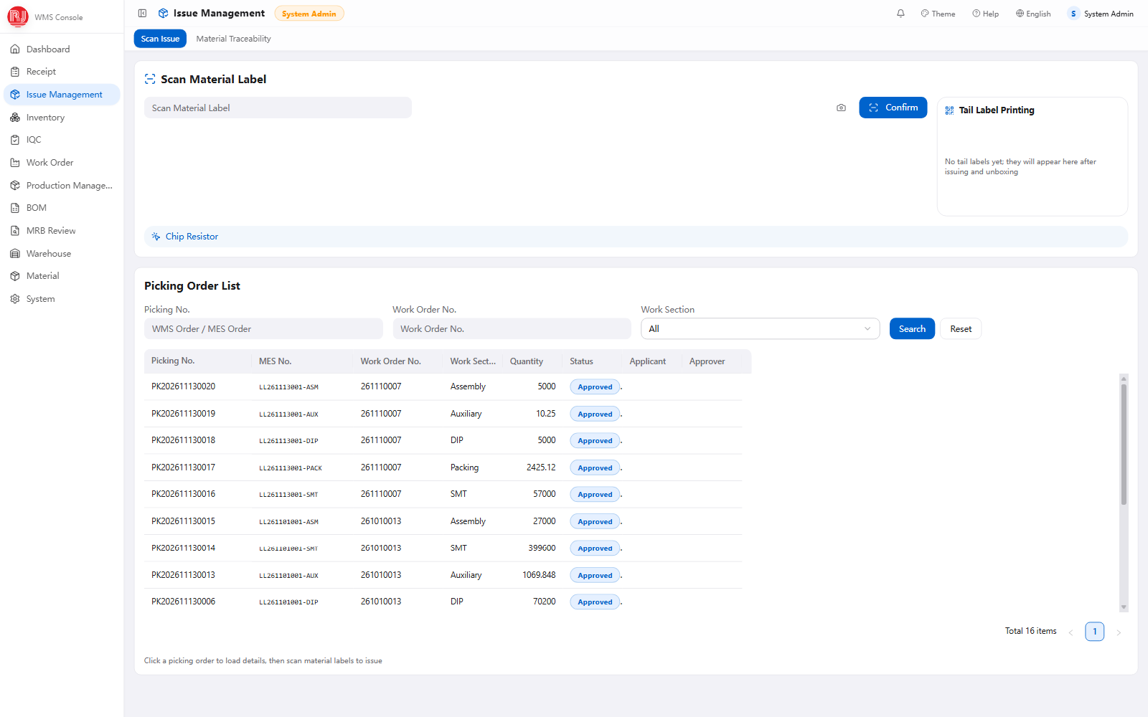
04 · ISSUING
Issuing: which carton to take first
A work order is exploded against the BOM and issue lists are raised for each section in one click.
Oldest first: sorted by production date, the system names the location to go to.
Four gates: good stock only, unlocked only, good bin only, not expired.
Over-issue is refused. If more is genuinely needed, a separate request goes to the supervisor.
One scan, one carton. Splitting a carton prints two labels: balance stays, balance goes.
If the main part is short, substitutes and available stock are suggested.
Issuing (demo data)
WMS Functional Briefing · November 2026
21
Notes:
The four gates matter: locked and expired stock simply cannot be picked.

Slide 22
04 · ISSUING
Between warehouse and line: four documents
Line confirmation, returns, replenishment, reel surplus. Each has its own form.
Line confirmation
Production returns
The line confirms the quantity received: a shortfall is recorded, an excess is refused.
No more "issued in the system, never arrived".
Returns are inspected and split into good, supplier defect and process defect.
Good goes to the good bin, reject to the reject bin; a wrong scan is refused.
Replenishment
Reel surplus
Extra material gets its own request; over-issue goes through approval.
What was added and what was over-drawn stays on record.
Each SMT reel has its own ID, tracking issued, returned and consumed.
Surplus is scanned back into good stock.
Issued, returned and replenished quantities all reconcile to the same work order.
WMS Functional Briefing · November 2026
22
Notes:
Returns split into three types. Most sites dump everything back into the warehouse and sort by hand.

Slide 23
04 · TRACEABILITY
One lot number, from gate to disposal
Receipt, inspection, stock, issue, return, disposition — a document for each.
Carton / lot
Receipt
IQC report
Stock row
Issue / return
Disposition
created at receiving, the index for everything after
supplier, production date, quantity, QC status
sampling plan, measured values, verdict, signature
location, status, lock reason, expiry
work order, picking list, quantity, picker
reject transfer, MRB outcome, scrap
How the trace screen searches
What it covers today
item code · lot · production date · supplier · date range
One page: issue, reject transfer and MRB decisions, merged into a single timeline.
What each row returns
Looked up separately: receipts by lot in the receipt list, returns in the return list.
Time, type, item code and name, lot, quantity, unit, production date, supplier, document number, remark.
Kept behind the scenes: the stock ledger records every movement, but has no inquiry page yet.
One row per movement; the document number leads back to the original.
Every question an auditor asks has a document: when this carton arrived, who inspected it, which order it went to, how it was disposed of.
WMS Functional Briefing · November 2026
23
Notes:
The chain page. Be explicit that receipts and returns are looked up in their own lists today.

Slide 24
SECTION 05
05
Rollout and Roadmap
Limits, value, next steps.
WMS Functional Briefing · November 2026
24
Notes:
Rollout and Roadmap. Limits, value, next steps.

Slide 25
05 · ROLLOUT
Stocktake, and what happens to rejects
STOCKTAKE
REJECT DISPOSITION (MRB)
Raised per warehouse; split by area, rack or level so several people count at once.
An IQC fail opens an MRB automatically. Nobody raises the form by hand.
Scan the carton to count. A wrong item or a wrong location is refused.
Four gates: SQE proposes → reviewers vote → IQC supervisor pre-approves → quality manager closes.
Lines never counted are posted as a shortage instead of being dropped.
Concession to good; return frozen for shipment; rework to rework stock; scrap frozen for disposal.
The variance list goes to the supervisor. Stock is not frozen during the count, so stop movements first.
The disposition quantity must equal the reviewed quantity. No more, no less.
The system reports variances only. Adjustments are posted by the supervisor, not automatically.
Both lines leave an audit trail you can hand to an auditor.
WMS Functional Briefing · November 2026
25
Notes:
Be straight about stocktake: stock is not frozen, no blind count, no automatic posting.

Slide 26
05 · ROLLOUT
What changes on the floor
The way work is done first. Numbers wait for a pilot baseline.
Area
Today, manual
With the system
Receiving
paper forms, keyed in later
scanned at the dock, booked in the same pass
Inspection
sample size looked up by hand
plan pulled in, report produced on decision
Inventory
variance found at month end
by location code anytime; locks explained; expiry flagged
Issuing
picked from memory, newest first
MES lists arrive; location named; oldest first
Expiry
dates remembered by people
scanned daily, locked at expiry
Traceability
paper files and asking around
lot history: receipt, QC, issue, return, disposal
Accuracy and inspection cycle time get measured in the pilot before any target is set. No numbers are promised here.
WMS Functional Briefing · November 2026
26
Notes:
No percentages on purpose. Measure the baseline in the pilot instead.

Slide 27
05 · ROLLOUT
What it does not do yet, and what comes next
Stated up front, so the pilot is not surprised by them.
CURRENT LIMITS (ALIGN BEFORE THE PILOT)
SUGGESTED SEQUENCE
No ASN or purchase-order receiving; quantities are not matched to an order
0–3 months
A receipt cannot be voided or reversed, and carton labels cannot be printed
configurable expiry window, stock movement inquiry, variance posting, multilingual master data
Stock movements have no inquiry screen; trace covers issue, transfer, MRB
3–12 months
Issuing cannot target a specific lot; it follows oldest-first only
ASN and order-based receiving, SPC and capability, lot-specific issuing, serial genealogy
Stock is not frozen during a count, and variances are not posted automatically
The expiry warning is fixed at 30 days and not yet configurable
12+ months
multi-site, WCS / AGV, ERP interface, single sign-on
No SPC control charts and no CPK process capability
All seven can be fed into the next phase, ordered by their impact on the business.
WMS Functional Briefing · November 2026
27
Notes:
Credibility page. Listing what is missing makes the rest easier to believe.

Slide 28
05 · ROLLOUT
The platform, for IT
One page, no deep dive.
One system, two clients
Stack
Deployment
PC web and PDA share one service and one database — not two systems keeping two sets of books.
NestJS 10, React 19, PostgreSQL 18. Typed schema, versioned migrations.
A single Node.js process, HTTP 3000 / HTTPS 3443, offline install, Windows or Linux.
Integrations
Access and audit
Three languages
MES picking pull and issue write-back, read-only query API, OA approval flow.
Role-to-menu permissions. The operation log records who, when, document and action.
English, Chinese and Vietnamese UI, with localized export headers.
Architecture, interfaces and security can be covered separately, in a technical review.
WMS Functional Briefing · November 2026
28
Notes:
Conclusions only. Go deeper if the customer IT asks.

Slide 29
NEXT STEP
One warehouse,
two weeks
Run receiving, inspection and issuing on your own goods, then decide whether to roll it out.
pilot scope · baseline definition · interface owner · go-live window
WMS delivery team
WMS Functional Briefing · November 2026
29
Notes:
Close on the pilot, not on thanks. Ask for the four decisions.

