Slide 1
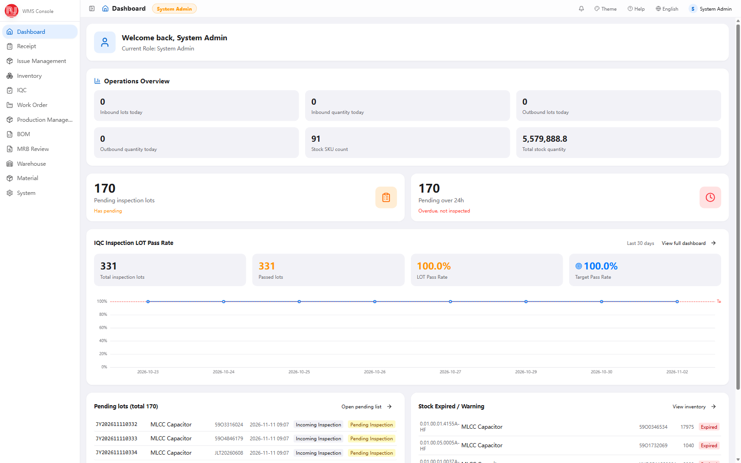
CUSTOMER CAPABILITY BRIEFING
Warehouse
Management System
Architecture, differentiators, value and roadmap
Technical Roadmap · System Differentiators · Business Advantages · Continuous Improvement
Prepared for customer review · November 2026
WMS Capability Briefing · November 2026
01
Notes:
Open with the purpose: a working, standalone WMS already running in production. Preview the four sections and note that screenshots use a demo dataset with an English UI.

Slide 2
EXECUTIVE SUMMARY
One platform, dock to dispatch
Quality, inventory and shop-floor execution share one data model.
23
109
650
78
domain modules
PC screens + 15 PDA
UI keys × 3 languages
typed database tables
Configured, not re-coded: inspection templates, AQL rules, roles and menus are parameters in the delivered build.
Figures describe the delivered build, not a customer benchmark. Screenshots in this deck use a demo dataset.
WMS Capability Briefing · November 2026
02
Notes:
Give the audience four scale anchors, then the key message: this is a delivered, configured system rather than a prototype. Clarify that demo figures are not customer results.

Slide 3
AGENDA
What we will cover
Four questions, in order.
Technical Roadmap
01
Architecture, stack, security and deployment
System Differentiators
02
Quality gate, traceability, mobile execution, configurability
Business Advantages
03
What changes on the floor and in the numbers
Continuous Improvement
04
Three-horizon roadmap, risks and next steps
WMS Capability Briefing · November 2026
03
Notes:
Set expectations: sections 2 and 3 carry most of the discussion time; section 4 ends with decisions we need from the customer.

Slide 4
SECTION 01
01
Technical Roadmap
A four-layer architecture, shipped as one portable package.
WMS Capability Briefing · November 2026
04
Notes:
Introduce section 01: Technical Roadmap. A four-layer architecture, shipped as one portable package.

Slide 5
01 · TECHNICAL ROADMAP
Four layers, one deployable package
01
Experience
PC web (React 19) · PDA scan client · EN / ZH / VI interface
02
API & Security
NestJS 10 REST · JWT · X-API-Key · RBAC · audit interceptor · Swagger
03
Domain Services
Receiving · IQC · Inventory · Issuing · Work Order · MRB · BOM · Stocktake
04
Data
PostgreSQL 18 · Drizzle ORM · transactional stock · operation log
One Node.js 22 process · HTTP 3000 / HTTPS 3443 · offline install · Windows or Linux
WMS Capability Briefing · November 2026
05
Notes:
Walk top to bottom. Emphasise that the PC and PDA clients hit the same domain services and one database. ISA-95: this is Level 3 execution; MES stays the production system of record.

Slide 6
01 · TECHNICAL ROADMAP
Modern stack, conservative operations
Current versions, with operational simplicity at deployment time.
NestJS 10 + TS 5.9
React 19 + Vite 8
PostgreSQL 18 + Drizzle ORM
Typed modules, DTO validation, Swagger docs
Ant Design 5 and Tailwind CSS 4
Typed schema, versioned SQL migrations
Node.js 22 runtime
Token & password security
Transactional inventory
Single process, offline installation
7-day tokens, salted password hashes
CAS updates, row locks, quantity checks
Shared TypeScript contracts, versioned migrations and attributable writes keep change controlled.
WMS Capability Briefing · November 2026
06
Notes:
Keep this short. The point is not the version list, it is that the stack is current while the deployment footprint stays small enough for a single-site go-live.

Slide 7
01 · TECHNICAL ROADMAP
Security and integration are designed in
One control plane for people, machines and audit evidence.
Identity & access
Machine interfaces
Audit & attribution
JWT Bearer tokens, salted password hashes, forced first-login change, role × menu permissions and token invalidation.
X-API-Key machine authentication, read-only /api/mes/v1 endpoints, pull-based MES sync and outbox write-back to MES / OA.
A global interceptor records operator, IP, business number and action detail; secrets are masked and tables carry attribution.
ISA-95: WMS runs at Level 3; MES stays the production system of record.
WMS Capability Briefing · November 2026
07
Notes:
Call out that machine-to-machine traffic is separated from user sessions, and that the audit log is a global interceptor rather than per-page logging. No ERP interface exists today; do not imply one.

Slide 8
SECTION 02
02
System Differentiators
Where the system checks the work, not the operator.
WMS Capability Briefing · November 2026
08
Notes:
Introduce section 02: System Differentiators. Where the system checks the work, not the operator.

Slide 9
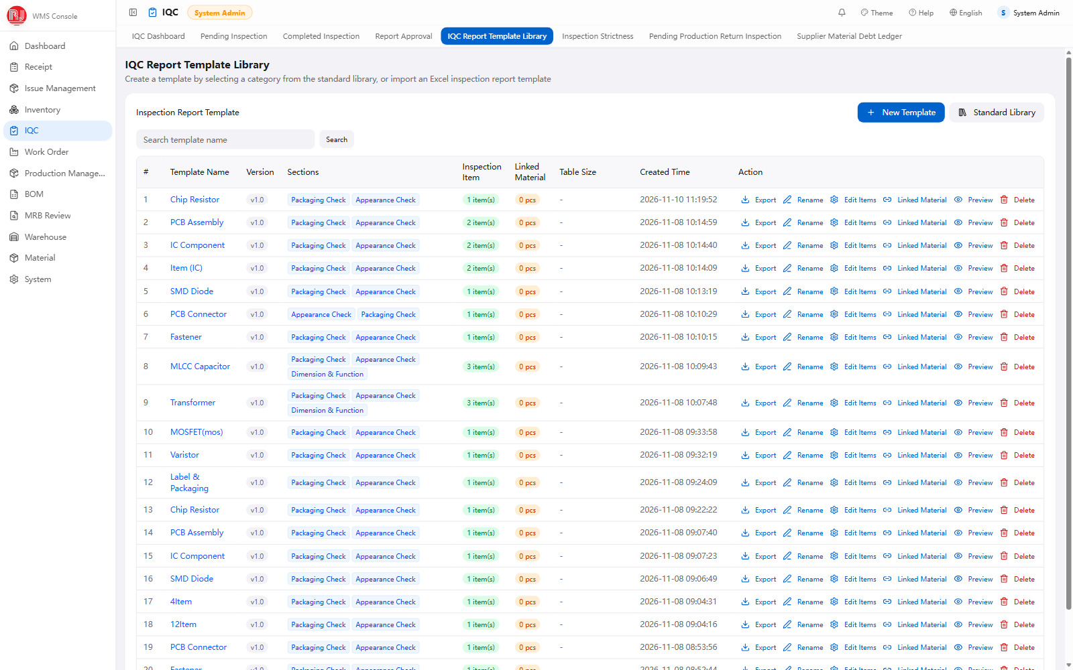
02 · SYSTEM DIFFERENTIATORS
Incoming quality is a gate, not a form
AQL sampling per GB/T 2828.1-2012: 7 levels, code letters A-R, three plan types.
Templates are versioned; edits archive prior items for reproducible history.
Pass / fail is derived server-side from defect counts vs Ac / Re.
Expired lots stay locked until a new expiry date is recorded.
Screenshot: IQC Report Template Library — versioned templates, English UI, demo data.
WMS Capability Briefing · November 2026
09
Notes:
This is the strongest differentiator. Explain AQL as a standard sampling discipline, not a custom rule, and stress that judgement happens on the server. Template versioning protects historical reports.

Slide 10
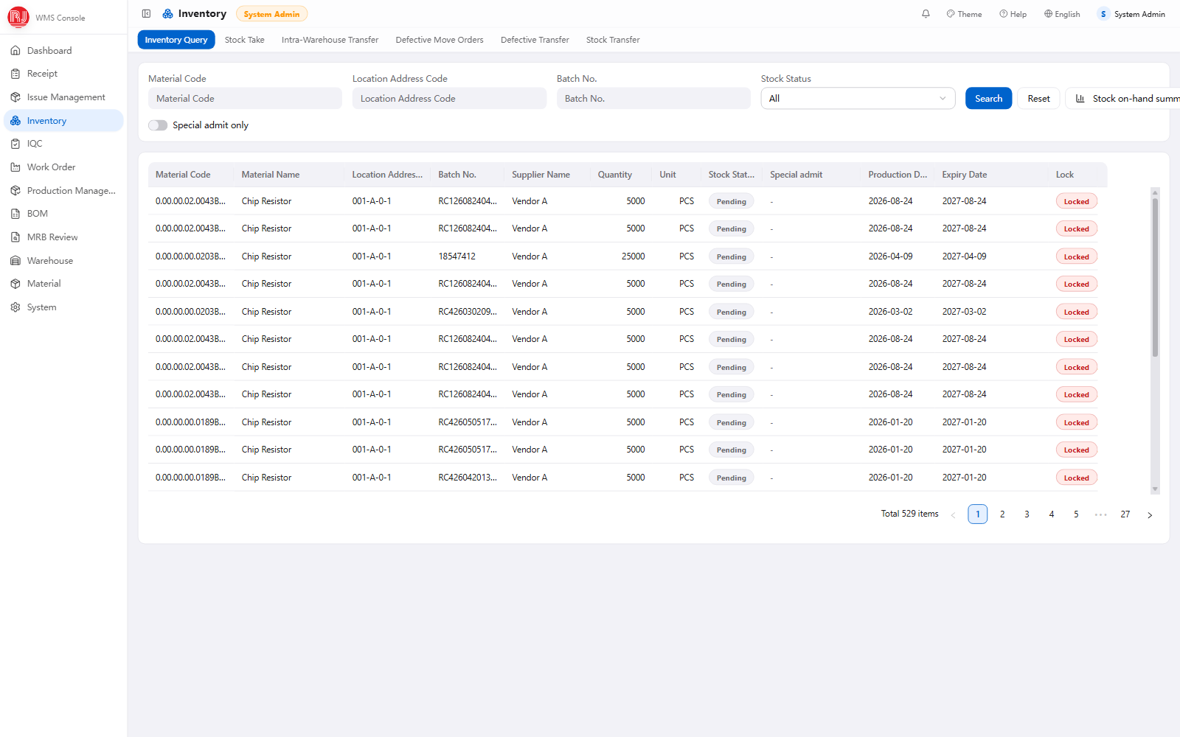
02 · SYSTEM DIFFERENTIATORS
Every lot is accounted for
Batch-level traceability with serial numbers on labels and moves.
Conditional updates and row locks prevent negative or double issue.
Locked stock is automatically excluded from picking and issuing.
Excel / CSV exports carry localized column headers.
Screenshot: Inventory Query — batch-level stock records, English UI, demo data.
WMS Capability Briefing · November 2026
10
Notes:
Be precise: traceability is batch-level with serial-number capture, not a full serial genealogy. That gap is explicitly on the roadmap. Mention the transactional guarantees.

Slide 11
02 · SYSTEM DIFFERENTIATORS
Live visibility from dock to dispatch
Operations overview: inbound / outbound lots and stock quantity.
IQC alerts: pending lots and lots overdue beyond 24 hours.
LOT pass-rate trend against target, last 30 days.
Role-based landing page with in-browser charts.
Screenshot: Operations Dashboard — English UI; figures are demo data.
WMS Capability Briefing · November 2026
11
Notes:
Use the dashboard to show that alerts are operational, not decorative: overdue inspection and missing-report counts drive daily work. Remind the audience the numbers are demo values.

Slide 12
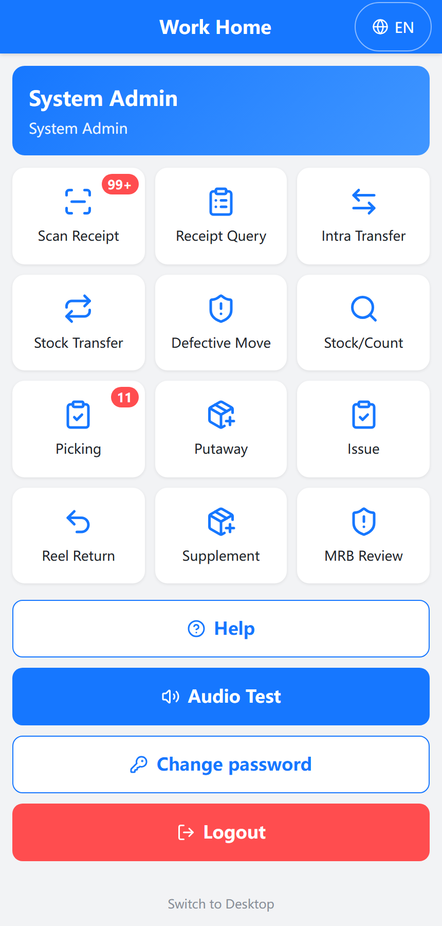
02 · SYSTEM DIFFERENTIATORS
Shop-floor execution in one hand
14 PDA routes / 15 screens cover dock-to-stock transactions.
Camera QR and barcode scanning over HTTPS, with device enrolment.
Scanner user agents route to the mobile layout automatically.
Mobile and PC clients share the same domain services.
Screenshot: PDA Work Home — English mobile UI.
WMS Capability Briefing · November 2026
12
Notes:
Show the phone-style screen: an operator sees only task-sized actions. Stress that it is not a separate lightweight app with its own data; it shares the same services.

Slide 13
02 · SYSTEM DIFFERENTIATORS
Configurable where it counts
Versioned inspection templates
Role × menu permissions
Sections, items, sampling plans and linked materials are maintained without code changes.
17+ role codes and dynamic permissions decide what each operator sees and can do.
Three-language interface
Open integration surface
English, Chinese and Vietnamese UI with 650 aligned keys and localized exports.
Swagger-documented REST, /api/mes/v1 read API, MES sync and OA callbacks.
Known gap: item, supplier and warehouse master-data names are single-language — scheduled as a Quick Win.
WMS Capability Briefing · November 2026
13
Notes:
Group the four configuration levers under one message: local teams can adapt rules and permissions without a release. Be upfront about the master-data language gap; the roadmap addresses it.

Slide 14
SECTION 03
03
Business Advantages
What changes on the floor and in the numbers.
WMS Capability Briefing · November 2026
14
Notes:
Introduce section 03: Business Advantages. What changes on the floor and in the numbers.

Slide 15
03 · BUSINESS ADVANTAGES
Six advantages, mapped to outcomes
Capability
Operational change
Business impact
Server-side quality gate
No manual pass / fail override
Fewer escaped defects
Batch & serial capture
Lot history: receipt to issue
Faster recall containment
Transactional stock
No negative or double issue
Higher inventory accuracy
PDA scan execution
Paperless dock transactions
Shorter cycle time
RBAC + audit log
Every action attributed
Audit-ready evidence
Portable offline install
No cloud dependency at go-live
Lower infrastructure cost
WMS Capability Briefing · November 2026
15
Notes:
Read the matrix left to right: a technical capability produces an operational change, which produces a business outcome. Ask the customer which of the six matters most in their operation.

Slide 16
03 · BUSINESS ADVANTAGES
From paper trails to closed-loop control
TYPICAL MANUAL BASELINE
WITH WMS
Paper or spreadsheet receipts
Scan-driven dock transaction
Pass / fail signed after the fact
Server-side judgement, audit record
Stock reconciled weekly
Transactional, current stock
Traceability assembled at audit
Lot history on demand
≥ 99%
30–50%
15–30%
inventory accuracy
cycle-time reduction
stock variance reduction
Illustrative ISO 22400-style target ranges. Baseline and targets are agreed in a pilot; these are not guaranteed outcomes.
WMS Capability Briefing · November 2026
16
Notes:
Frame the comparison as operating-model change, then give ranges with the caveat that they must be baselined in a pilot. Avoid presenting demo numbers as achieved customer results.

Slide 17
SECTION 04
04
Continuous Improvement
A roadmap with owners, not a wish list.
WMS Capability Briefing · November 2026
17
Notes:
Introduce section 04: Continuous Improvement. A roadmap with owners, not a wish list.

Slide 18
04 · CONTINUOUS IMPROVEMENT
Three horizons
Quick Win · 0–3 mo
Mid-term · 3–12 mo
Long-term · 12+ mo
Multilingual master-data names
Serial-level genealogy and recall
Multi-site, HA / DR, backups
Scheduled KPI exports and alerts
ERP / PLM adapter (if in scope)
Predictive expiry analytics
Barcode label standard + enrolment
WCS / AGV replenishment triggers
SSO and certificate lifecycle
Role / permission cleanup
Sync-failure and audit dashboards
ISA-95 L3/L4 planning alignment
Quick Win priority: UI text is localized, but master-data names are single-language.
WMS Capability Briefing · November 2026
18
Notes:
Sequence the work by dependency: master-data language first, then genealogy and interfaces, then platform scale. Flag ERP/PLM as scope-dependent — no such interface exists today.

Slide 19
04 · CONTINUOUS IMPROVEMENT
Risks, ownership and next steps
WHAT WE WILL MANAGE
PROPOSED NEXT STEPS
Master-data quality and migration cutover
1 Agree pilot scope: one warehouse, one product family
Interface ownership with MES / OA teams
2 Baseline inventory accuracy and inspection cycle time
Shop-floor adoption and scanner training
3 Interface workshop and data-migration dry run
4 Go-live readiness review and sign-off
Decision points: pilot scope · KPI baseline · interface ownership · go-live window
WMS Capability Briefing · November 2026
19
Notes:
Close on decisions, not on features. Ask for a pilot scope, a KPI baseline owner, an interface counterpart and a target go-live window.

Slide 20
NEXT CONVERSATION
Thank you
We are ready to scope a pilot on your warehouse data.
Pilot scope · KPI baseline · interface ownership · go-live window
WMS Delivery Team · November 2026
WMS Capability Briefing · November 2026
20
Notes:
Thank the room and move straight to the four decisions. Offer a short pilot on one warehouse and one product family.

