Slide 1

Graph
MST

Slide 2

MST
Prim’s Algorithm
  依照Vi的順序一一尋找每一組Vi的最短路徑，畫出spanning tree
Kruskal Algorithm
  尋找整個圖中的最短路徑，在一一將其連接起來

Slide 3
Prim’s Algorithm
Prim's algorithm has the property that the edges in the set A always form a single tree.
We begin with some vertex v in a given graph G =(V, E)
Defining the initial set of vertices A.
Then, in each iteration, we choose a minimum-weight edge (u, v), connecting a vertex v in the set A to the vertex u outside of set A. Then vertex u is brought in to A. This process is repeated until a spanning tree is formed.

Slide 4
Prim’s Algorithm (cont.)
Prim-MST(G)
Select an arbitrary vertex to start the tree from.
  While (there are still non-tree vertices)
    Select the edge of minimum weight between a tree and non-tree vertex
    Add the selected edge and vertex to the tree .
Analysis: O(n²)

Slide 5
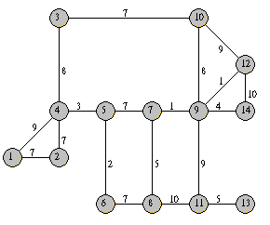
Prim’s Algorithm (cont.)
Total cost: 66

Slide 6
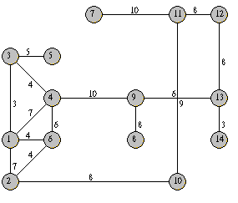
練習

Slide 7
Kruskal’s Algorithm
The Kruskal Algorithm starts with a forest which consists of n trees.
Each and everyone tree,consists only by one node and nothing else.
In every step of the algorithm,two different trees of this forest are connected to a bigger tree.
Therefore ,we keep having less and bigger trees in our forest until we end up in a tree which is the minimum spanning tree

Slide 8
Kruskal’s Algorithm (cont.)
The forest is constructed - with each node in a separate tree.
The edges are placed in a priority queue.
Until we've added n-1 edges,
Extract the cheapest edge from the queue,
If it forms a cycle, reject it,
Else add it to the forest. Adding it to the forest will join two trees together.
Every step will have joined two trees in the forest together, so that at the end, there will only be one tree in T.

Slide 9
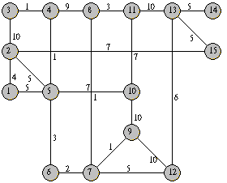
Kruskal’s Algorithm (cont.)
Total cost: 49

Slide 10
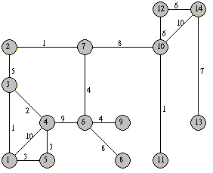
練習

Slide 11
Shortest Path
在一個有向圖形G=(V,E)，G中每一個邊都有一個比例常數W(Weight)與之對應，若想求G圖形中某一個頂VO到其它頂點的最少W總和之值，這類問題就稱為最短路徑問題(The Shortest Path Problem)
單點對全部頂點的最短距離及所有頂點兩兩之間的最短距離。

Slide 12
Dijkstra’s Algorithm
一個頂點到多個頂點通常使用Dijkstra演算法求得，Dijkstra的演算法如下：
假設S={Vi|Vi∈V}，且Vi在已發現的最短路徑，其中V0 ∈S是起點。
假設w∉S，定義Dist(w)是從V0到w的最短路徑，這條路徑除了w外必屬於S。且有下列幾點特性：
  如果u是目前所找到最短路徑之下一個節點，則u必屬於V-S集合中最小花費成本的邊。

Slide 13
Dijkstra’s Algorithm (cont.)
  若u被選中，將u加入S集合中，則會產生目前的由V0到u最短路徑，對於w∉S ，DIST(w)被改變成DIST(w)←Min{DIST(w),DIST(u)+COST(u,w)}
Dijkstra的方法只能求出某一點到其他頂點的最短距離，如果要求出圖形中任兩點甚至所有頂點間最短的距離，就必須使用Floyd演算法。

Slide 14
Dijkstra’s Algorithm (cont.)
Dijkstra's algorithm can be expressed formally as follows:
  G - arbitrary connected graph
  v0 - is the initial beginning vertex
  V - is the set of all vertices in the graph G
  S - set of all vertices with permanent labels
  n - number of vertices in G
  D - set of distances to v0
  C - set of edges in G

Slide 15
Dijkstra’s Algorithm (cont.)
Dijkstra Algorithm (graph G, vertex v0)
{
S={v0}
For i = 1 to n
D[i] = C[v0,i]
For i = 1 to n-1
Choose a vertex w in V-S such that D[w] is minimum
Add w to S
For each vertex v in V-S
D[v] = min(D[v], D[w] + C[w,v])
}

Slide 16
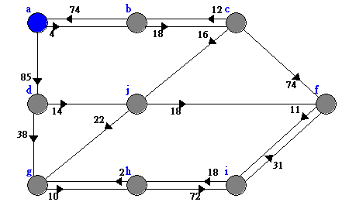
練習

Slide 17
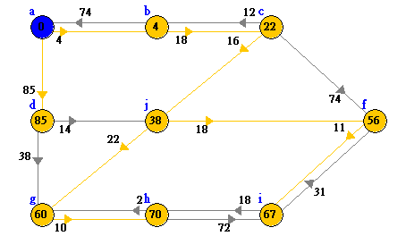

Slide 18
Floyd Algorithm
Floyd演算法定義：
Ak[i][j]=min{A^{k-1}[i][j],A^{k-1}[i][k]+A^{k-1} [k][j]}，1≤i，j ≤n
其中A^{k}[i][j]為從i到j不以註標大於k之頂點為間接路徑頂點時之最短路徑的花費。
  A0[i][j]=COST[i][j]（即A0便等於COST）
A0為頂點i到j間的直通距離。
An[i,j]代表i到j之最短路距離，即A^{n}便是我們所要求的最短路徑成本矩陣。

Slide 19
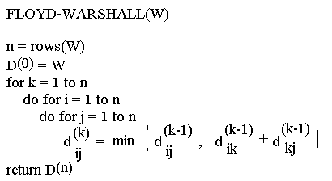
Floyd Algorithm (cont.)

Slide 20
Example
1
2
3
1
0
4
5
W = D⁰ =
1
2
2
0
∝
5
3
∝
-3
0
4
2
3
1
2
3
2
-3
1
0
0
0
P =
2
0
0
0
3
0
0
0

Slide 21
k = 1
Vertex 1 can be intermediate node
1
1
2
3
5
D⁰ =
1
0
4
5
4
2
3
2
2
0
∝
2
-3
3
∝
-3
0
1
2
3
1
0
4
5
D¹ =
2
2
0
7
D¹[2,3] = min( D⁰[2,3], D⁰[2,1]+D⁰[1,3] )
= min (∝, 7)
= 7
D¹[3,2] = min( D⁰[3,2], D⁰[3,1]+D⁰[1,2] )
= min (-3,∝)
= -3
3
∝
-3
0
1
2
3
1
0
0
0
P =
2
0
0
1
3
0
0
0

Slide 22
k = 2
Vertices 1, 2 can be intermediate
1
2
3
1
5
D¹ =
1
0
4
5
4
2
3
2
2
0
7
2
-3
3
∝
-3
0
1
2
3
D²[1,3] = min( D¹[1,3], D¹[1,2]+D¹[2,3] )
= min (5, 4+7)
= 5
D²[3,1] = min( D¹[3,1], D¹[3,2]+D¹[2,1] )
= min (∝, -3+2)
= -1
1
0
4
5
D² =
2
2
0
7
3
-1
-3
0
1
2
3
1
0
0
0
P =
2
0
0
1
3
2
0
0

Slide 23
k = 3
Vertices 1, 2, 3 can be intermediate
1
1
2
3
5
D² =
1
0
4
5
4
2
3
2
2
0
7
2
-3
3
-1
-3
0
1
2
3
D³[1,2] = min(D²[1,2], D²[1,3]+D²[3,2] )
= min (4, 5+(-3))
= 2
D³[2,1] = min(D²[2,1], D²[2,3]+D²[3,1] )
= min (2, 7+ (-1))
= 2
1
0
2
5
D³ =
2
2
0
7
3
-1
-3
0
1
2
3
1
0
3
0
P =
2
0
0
1
3
2
0
0

Slide 24
練習
1
1
2
4
2
3
3
4
5

Slide 25
Transitive Closure (cont.)
Given a digraph G, the transitive closure of G is the digraph G* such that
  G* has the same vertices as G
  if G has a directed path from u to v (u ≠ v), G* has a directed edge from u to v
The transitive closure provides reachability information about a digraph
D
E
B
G
C
A
D
E
B
C
A
G*

Slide 26
Transitive Closure (cont.)
建立一個路徑矩陣P，從這個矩陣中可以輕易的判斷圖形G中的任一兩點I跟j是否存在一路徑
先求得A1…An An(a_{ij})表示圖形node i 跟j存在為n的路徑總數
將矩陣A1..An全部相加，將總和存放在B
將B矩陣中所有大於0的設定為1，將元素設定為0根1的矩陣，此矩陣的圖形G＊就是個長度為n的Transtive closure

Slide 27
Transitive Closure (cont.)
Warshall (int N, int [][]A, int[][]P){
int i,j,k; for (i = 0; i < N; i++)
for (j = 0; j < N; j++)
  /* There's a path if there's an edge */
  P[i][j] = A[i][j];
  for (k = 0; k < N; k++)
    for (i = 0; i < N; i++)
      for (j = 0; j < N; j++)
      if (! P[i][j]) P[i][j] = P[i][k] && P[k][j];
} /* Warshall */

Slide 28
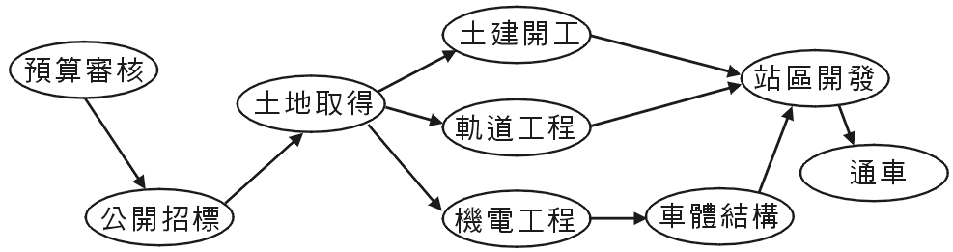
AOV網路基本定義
以圖形嚴謹的定義來說，AOV網路就是一種有向圖形，在這個有向圖形中的每一個節點代表一項工作或必須執行的動作，而那些有方向性的邊則代表了工作與工作之間存在的先後關係順序。也就是說，<Vi→Vj>表示必須處理先完Vi的工作，才可以進行Vj的工作。

Slide 29
拓樸排序
拓樸排序的功能是將部分的排序（partial ordering）的關係轉換為線性的次序
具有這種特性的線性次序稱為拓樸序列topologcal order
  拓樸序列需是個acyclic graph
  產生的拓樸序列必非唯一

Slide 30
拓樸排序的步驟：
步驟1
  尋找圖形中任何一個沒有先行者 predecessor 的點。
步驟2
  輸出此頂點，並將此頂點的所有邊刪除。
步驟3
  重複上兩個步驟處理所有頂點。
B
C
D
A
E
F
K
J
G
H
I

Slide 31
範例
先選取沒有predecessor的A，將其移除並宜出其相關的edge
B
C
D
E
F
K
J
G
H
I
Topological order:A
BEG
CFH
DI
J
K

Slide 32
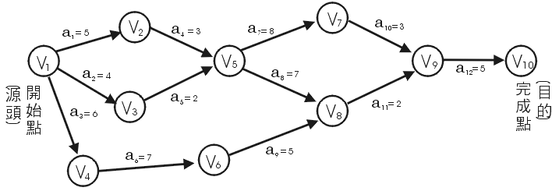
AOE網路和臨界路徑(critical path)
臨界路徑就是AOE有向圖形從源頭頂點到目的頂點間所需花費時間最長的一條有方向性的路徑，當有一條以上的花費時間相等，而且都是最長，則這些路徑都稱為此AOE有向圖形的臨界路徑。

Slide 33
相关练习
1048 106 miles to Chicago
1068 Islands and Bridges
1153 The Bottom of a Graph

