Slide 1
大数与数论
主讲：吴昊

Slide 2
不是所有能计算的都有价值
不是所有有价值的能被计算
爱因斯坦

Slide 3
大数运算
大数是指计算的数值非常大或者对运算的精度要求非常高，用已知的数据类型无法表示的数值。
[例1：]求Fibonacci数列的第1000个数。
[例2：]计算pi到小数点后第2000位。

Slide 4
大数一般方法
用数组模拟大数的运算。
开一个比较大的整型数组，数组的元素代表数组的某一位。
通过对数组元素的运算模拟大数的运算。
将数组输出。

Slide 5
常用的大数算法
1。大数的加；
2。大数的减；
3。大数的乘；
4。超大数的乘积；
5。大数的除法；
6。任意精度计算。

Slide 6
大数的加
大数的加减处理是相同的（why?将减法可以变为加法，注意减法中减数每一位都是负数，而且进位也与加法不一样，都是负数进位）
案例1：Integer Inquiry

Slide 7
案例1：Integer Inquiry
Time Limit:1000MS
Memory Limit:10000K

Slide 8
Description
One of the first users of BIT's new supercomputer was Chip Diller. He extended his exploration of powers of 3 to go from 0 to 333 and he explored taking various sums of those numbers.
``This supercomputer is great,'' remarked Chip. ``I only wish Timothy were here to see these results.'' (Chip moved to a new apartment, once one became available on the third floor of the Lemon Sky apartments on Third Street.)

Slide 9
Input
The input will consist of at most 100 lines of text, each of which contains a single VeryLongInteger. Each VeryLongInteger will be 100 or fewer characters in length, and will only contain digits (no VeryLongInteger will be negative).
The final input line will contain a single zero on a line by itself.

Slide 10
Output
Your program should output the sum of the VeryLongIntegers given in the input.

Slide 11
Sample Input
123456789012345678901234567890
123456789012345678901234567890
123456789012345678901234567890
0

Slide 12
Sample Output
370370367037037036703703703670

Slide 13
Integer Inquiry
时间限制:1000MS 内存限制:10000K

Slide 14
描述
Chip Diller 是一种新的超级计算机BIT的最早用户之一，他研究3的幂次（丛0倒333）和这些不同数的和。
“超级计算机太了不起了”， Chip Diller认为：“我只希望Timothy能看到这结果” （Chip换了公寓，是第三大街柠檬天公寓的三楼）。

Slide 15
输入
输入最多100行，每行一个超长整数。
每个整数最多100位。
没有负数输入。
最后输入0结束

Slide 16
输出
输出所有输入超长整数的和。

Slide 17
输入样例
123456789012345678901234567890
123456789012345678901234567890
123456789012345678901234567890
0

Slide 18
输出样例
370370367037037036703703703670

Slide 19
解题思路
题目很明确告诉是很长的大整数相加，所以采用大数的加法；
开一个整型数组，模拟加法：
注意加法是尾对齐的。

Slide 20
解题思路（续）
首先将所有位对齐相加。如：
1 2 3 4 5 6 7 8 9 0
1 2 3 4 5 6 7 8 9 0
1 2 3 4 5 6 7 8 9 0
+ ______________________________
3 6 9 12 15 18 21 24 27 0
最后处理进位
→3 7 0 3 7 0 3 6 7 0

Slide 21
数据结构与算法
不需要特殊的数据结构；
大数一般使用数组模拟。

Slide 22
核心代码及解释
#define SIZE 101
char s[SIZE];int sum[SIZE];
//s是输入的整数，以字符串形式存储；
//sum是整型数组，存储结果----大数之和
//因为每行不超过100个字符，所以数组大小101

Slide 23
核心代码及解释（续一）
while(gets(s),strcmp(s,"0"))
//依次读入大数，直至为0
for(i=(j=strlen(s))-1;i>=0;--i)
sum[j-1-i]+=(s[i]-'0');
//每位数字对齐相加
//注意，s[I]是字符，需要将它转换为数字

Slide 24
核心代码及解释（续二）
for(i=c=0;i<100;++i)//处理进位,c表示进位
{c+=sum[i]; //计算第i位的值
sum[i]=j%10; //结果的第i位。
c/=10;} //第i位的进位
sum[100]+=c; //最高位

Slide 25
核心代码及解释（续三）
j=100;while(!sum[j])--j;
//处理前导的0，不输出
if(j<0)printf("0");
//特殊情况
for(i=j;i>=0;--i)printf("%d",sum[i]);
//将数组每位依次输出

Slide 26
大数的乘积
大数的乘法与除法不相同(why?)
首先考虑乘积的一方是大数，另一方不是：
案例2：相连游戏
两个乘数都是大数
案例3： Bull Math

Slide 27
案例2：相连游戏
Source :Shanghai 2004 Preliminary
Time Limit:1000MS
Memory Limit:30000K

Slide 28
Description
This is a small but ancient game. You are supposed to write down the numbers 1, 2, 3, . . . , 2n - 1, 2n consecutively in clockwise order on the ground to form a circle, and then, to draw some straight line segments to connect them into number pairs. Every number must be connected to exactly one another.
And, no two segments are allowed to intersect.
It's still a simple game, isn't it? But after you've written down the 2n numbers, can you tell me in how many different ways can you connect the numbers into pairs? Life is harder, right?

Slide 29
Input
Each line of the input file will be a single positive number n, except the last line, which is a number -1.
You may assume that 1 <= n <= 100.

Slide 30
Output
For each n, print in a single line the number of ways to connect the 2n numbers into pairs.

Slide 31
Sample Input
2
3
-1

Slide 32
Sample Output
2
5

Slide 33
案例2：相连游戏
时间限制:1000MS
内存限制:30000K

Slide 34
描述
这是一个小而古老的游戏。 假设你将1到2n个数按顺时针方向写下来组成一个圆环，然后用一些线段将这些数组成一个个数对。每个数只仅仅与另一个相连。
而且，所有线段不能相交。
现在还是一个简单游戏，是吗？但当你写下2n个数，您能告诉我有多少种不同的相连方式吗？生活是艰难的，有体会吧？

Slide 35
输入
每行输入是一个正整数n，除了最后一行是-1。
假定1 <= n <= 100 。

Slide 36
输出
对于每个n，输出一行数字，表示2n个数相连的可能数目。

Slide 37
输入样例
2
3
-1

Slide 38
输出样例
2
5

Slide 39
解题思路
假设2n个数的相连方式An种,注意,任意相连数中间隔的个数一定也是偶数.否则,一定有一个数要穿过这条线,假设左边有2k个数,则左边有Ak种相连方式,右边An-k-1种.这种情况下相连方式有Ak*An-k-1种.k可以从0到n-1.

Slide 40
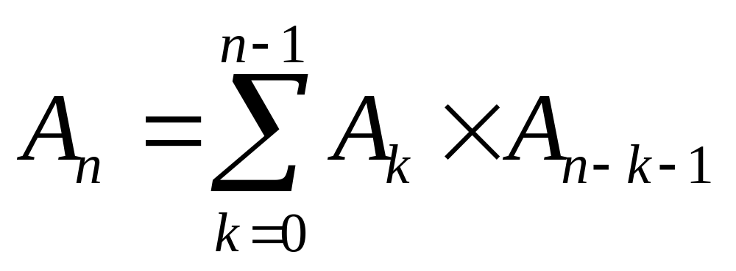
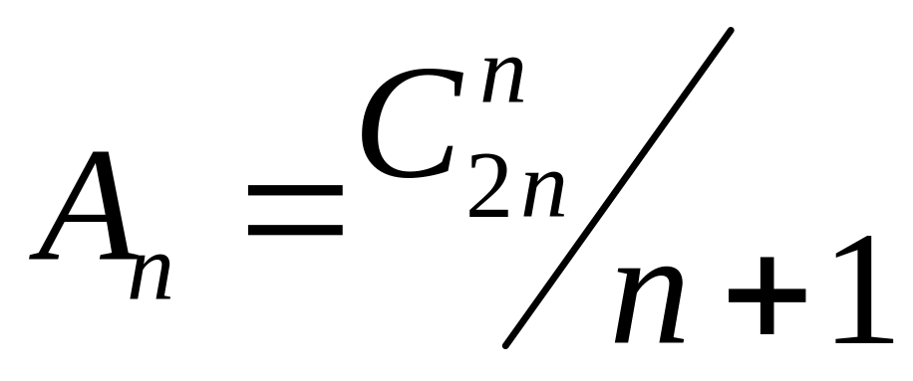
解题思路（续一）
总数是
注意,这就是著名的Catalan数.所以:

Slide 41
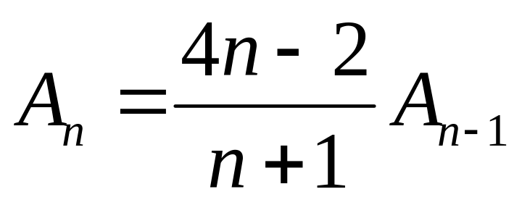
解题思路（续二）
估计一下1 <= n <= 100,1<=An<=?
用Strling公式,A100约2^200约10^60
所以需要用大数表示。
An与An-1的关系：

Slide 42
数据结构与算法
用一个数组表示结果。
需要大数的乘法和大数的除法。

Slide 43
核心代码及解释
int r[60] //数组存放结果
for(i=1;i<60;++i)r[i]=0;r[0]=j=1;
//A0=1,j表示非0位数
for(i=2;i<=n;++i){ //计算A2→An
for(k=0;k<j;++k)r[k]*=(4*i-2);
//大数乘法，从低位到高位
for(k=c=0;k<j;++k)
{t=r[k]+c;r[k]=t%10;c=t/10;}
//处理乘法的进位

Slide 44
核心代码及解释（续）
while(c){r[j]=c%10;c/=10;++j;}
//乘法最高进位
for(k=j-1,c=0;k>=0;--k)
{t=c*10+r[k];r[k]=t/(i+1);c=t%(i+1);}
//大数除法，从高位到低位
while(!r[j-1])--j;}
//除法最高位

Slide 45
案例3：Bull Math
Time Limit:1000MS
Memory Limit:65536K

Slide 46
Description
Bulls are so much better at math than the cows. They can multiply huge integers together and get perfectly precise answers ... or so they say. Farmer John wonders if their answers are correct. Help him check the bulls' answers. Read in two positive integers (no more than 40 digits each) and compute their product. Output it as a normal number (with no extra leading zeros).
FJ asks that you do this yourself; don't use a special library function for the multiplication.

Slide 47
Input
* Lines 1..2: Each line contains a single decimal number.

Slide 48
Output
* Line 1: The exact product of the two input lines

Slide 49
Sample Input
11111111111111
1111111111

Slide 50
Sample Output
12345679011110987654321

Slide 51
Bull Math
时间限制:1000MS
内存限制:65536K

Slide 52
描述
公牛的数学比奶牛好得多。它们可以计算大整数的乘积，得到非常完美的结果。农夫约翰怀疑它们的结果是否正确。请你帮助他检查公牛的结果。输入2个正整数（不超过40位），计算它们的乘积，并且作为正常数输出。（不要有前导0）
农夫约翰要求你自己验证，而不是特殊库函数作乘法。

Slide 53
输入
输入2行：每行一个数字。

Slide 54
输出
输出1行：输入2个数的乘积。

Slide 55
输入样例
11111111111111
1111111111

Slide 56
输出样例
12345679011110987654321

Slide 57
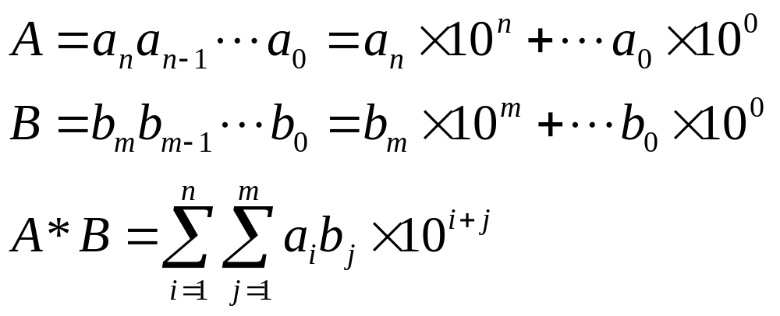
解题思路
乘数很大，达到10^40,没有数据类型可以精确表示，所以只能用大数乘法。

Slide 58
核心代码及解释
short s1[40],s2[40],s[85] //s1,s2表示2乘数，s表示结果
char line1[45],line2[45]; //输入的2行
gets(line1);gets(line2);
for(i=l=strlen(line1)-1;i>=0;--i)s1[i]=i1[l-i]-'0';
for(i=l=strlen(line2)-1;i>=0;--i)s2[i]=i2[l-i]-'0';
//将字符数组转换为长的整数数组，注意要反过来
j=strlen(line1)+strlen(line2);for(i=0;i<85;++i)s[i]=0;
//为乘法准备

Slide 59
核心代码及解释（续一）
for(i=0;i<strlen(line1);++i)
for(k=0;k<strlen(line2);++k)
s[i+k]+=s1[i]*s2[k];
//大数乘积
for(i=0,c=0;i<85;++i)
{k=s[i]+c;s[i]=k%10;c=k/10;}
//处理进位

Slide 60
时间复杂度
很显然是O(n^2)
n=40,所以时间可以接受
考虑n=1000,10000,……1000000.

Slide 61
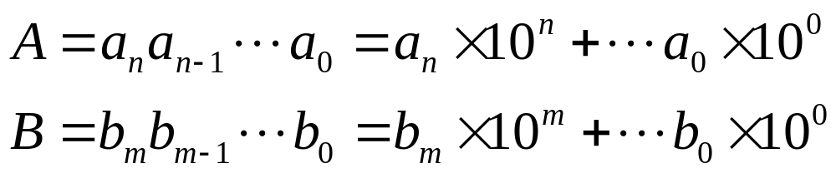
用FFT作大数乘法
做大数乘法，当规模非常大时，计算复杂度为O(n^2)的一般算法就不行了。
计算A*B可以看作两个数字串作卷积。而计算卷积可以用快速Fourier变换（FFT）。

Slide 62
用FFT作大数乘法一般步骤
把长整数变为长双精度复数数组，注意实部虚部用相邻两个元素表示。
A→FFT→A’
B→FFT→B’
A,B对应元素相乘得到C
C作Fourier逆变换,得到的就是乘积
如此,时间复杂度为O(NlogN).

Slide 63
案例4:The X Problem
Time Limit: 5000ms
Memory Limit:65536KB

Slide 64
Description
We are not alone.
In the year 3000, scientists have eventually found another planet which has intelligent being living on. Let's say, Planet X. And we call the intelligent being there ‘XMen'. To learn advanced technology from Planet X, we want to exchange information with XMen. Unfortunately, XMen use a very strange data format when sending message, which is called m-encoding (m is for multiplication). Scientists on earth have successfully found out the algorithm of m-encoding, defining as following:
For each data package from XMen, there are two non-negative integer numbers, A and B. And the actual data XMen want to send is the product of A and B (A * B).
So, in this problem, you are to implement a decoder for data packages from XMen.

Slide 65
Input
There are multiple test cases. Input data starts with an integer N, indicating the number of test cases.
Each test case occupies just one line, and contains two non-negative integers A and B (0 <= A, B <= 10¹⁰⁰⁰⁰⁰⁰), separated by just one space.

Slide 66
Output
For each test case, output the actual data XMen want to send, one in a line.

Slide 67
Sample Input
3
1 1
100 123
12345678901234567890 54321

Slide 68
Sample Output
1
12300
670629623593962962352690

Slide 69
解题思路
数据很大(0 <= A, B <= 10¹⁰⁰⁰⁰⁰⁰),没有别的方法.
就是用快速Fourier变换做乘法.

Slide 70
核心代码及解释
void FFT(Real * Coef, long Length, Complex * FFT, long NFFT)
{ long i; /* Transform array of real coefficient into array of complex */
for (i=0; i<Length; i++)
{ ComplexCoef[i].R = Coef[i];
ComplexCoef[i].I = 0.; }
for (; i<NFFT; i++)
ComplexCoef[i].R = ComplexCoef[i].I = 0.;
RecursiveFFT(ComplexCoef,FFT,NFFT,1,1); }

Slide 71
核心代码及解释（续一）
/* Compute the inverse Fourier Transform of FFT into Coef */
void InverseFFT(Complex * FFT, long NFFT, Real * Coef, long Length)
{ long i;
Real invNFFT = 1./(Real) NFFT, tmp;
RecursiveFFT(FFT, ComplexCoef, NFFT, 1, -1); for (i=0; i < Length; i++)
{ /* Closest integer to ComplexCoef[i].R/NFFT */ tmp = invNFFT * ComplexCoef[i].R;
Coef[i] = floor(0.5+tmp); } }

Slide 72
核心代码及解释（续二）
FFT(ACoef, ASize, ArrayFFT0, NFFT);
FFT(BCoef, BSize, ArrayFFT1, NFFT);
Convolution(ArrayFFT0,ArrayFFT1,NFFT,ArrayFFT0);
InverseFFT(ArrayFFT0,NFFT,CCoef, ASize+BSize-1);

Slide 73
大数的除法
所谓特殊需要大数的除法,使指除数非常大、精度要求高，或则被除数和除数都是如此。
用整数数组模拟，不是很容易。我们先求出除数的倒数，然后用大数乘积，用被除数乘以倒数就是结果。倒数用大数乘法，通过迭代得到

Slide 74
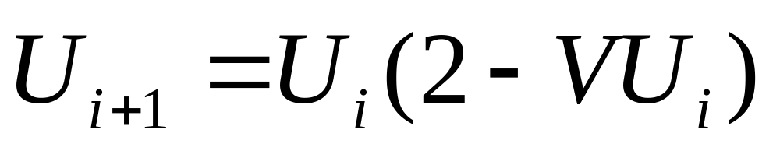
大数的除法（续一）
采用牛顿迭代法(求V的倒数)：

Slide 75
任意精度计算
一。用数组模拟。去掉小数点，还是整数运算。
二。利用各种展开式，计算如pi,e的任意精度。
案例5：Exponentiation

Slide 76
Exponentiation
Time Limit:500MS
Memory Limit:10000K

Slide 77
Description
Problems involving the computation of exact values of very large magnitude and precision are common. For example, the computation of the national debt is a taxing experience for many computer systems.
This problem requires that you write a program to compute the exact value of Rn where R is a real number ( 0.0 < R < 99.999 ) and n is an integer such that 0 < n <= 25.

Slide 78
Input
The input will consist of a set of pairs of values for R and n. The R value will occupy columns 1 through 6, and the n value will be in columns 8 and 9.

Slide 79
Output
The output will consist of one line for each line of input giving the exact value of R^n. Leading zeros should be suppressed in the output. Insignificant trailing zeros must not be printed. Don't print the decimal point if the result is an integer.

Slide 80
Sample Input
95.123 12
0.4321 20
5.1234 15
6.7592 9
98.999 10
1.0100 12

Slide 81
Sample Output
548815620517731830194541.899025343415715973535967221869852721
.00000005148554641076956121994511276767154838481760200726351203835429763013462401
43992025569.928573701266488041146654993318703707511666295476720493953024
29448126.764121021618164430206909037173276672
90429072743629540498.107596019456651774561044010001
1.126825030131969720661201

Slide 82
解题思路
将小数点去掉，计算整数的幂次。
用大数模拟整数运算。
将小数点的位置计算出来，放置合适位置。
注意小数点前没有前导0，小数点后面没有尾0。

Slide 83
核心代码及解释
unsigned int fl(char *s,unsigned int *s1)
//函数将输入数字字符数组s,转化为整数数组，并返回小数点位数
{for(i=0,j=0;i<6&&s[i];++i)
if(s[i]!='.')ss[j++]=s[i]-'0';
for(j=0;j<5;++j)s1[j]=ss[4-j]; // 得到整数数组
i=0;while((s[i]!='.') &&s[i])++i; j=5-i;
return j;} //返回小数点位数

Slide 84
核心代码及解释（续一）
void mul(unsigned int *s1,unsigned int *s2)
{//函数返回s2=s1*s2,都是大数
for(i=0;i<5;++i)
for(j=0;j<155;++j)
ss[i+j]+=s1[i]*s2[j]; //大数相乘
for(i=0,c=0;i<155;++i)
{s2[i]=(c+ss[i])%10;c=(c+ss[i])/10;}}
//处理进位

Slide 85
核心代码及解释（续二）
int main() {
j=fl(s,s1);fl(s,s2);//将输入变为数组，s2存放结果
for(i=1;i<n;++i)mul(s1,s2); //计算乘积
i=154;while((!s2[i])&&i)--i;//开始非0
k=0;while((!s2[k])&&(k<155))++k;//尾部0
for(m=i;m>=n*j;--m)printf("%d",s2[m]);
if(j&&n*j>=k+1)printf(".");
for(m=n*j-1;m>=k;--m)printf("%d",s2[m]);
printf("\n");}}

Slide 86
数论
一。模的运算

Slide 87
案例6：Raising Modulo Numbers
Time Limit:1000MS
Memory Limit:30000K

Slide 88
Description
People are different. Some secretly read magazines full of interesting girls' pictures, others create an A-bomb in their cellar, others like using Windows, and some like difficult mathematical games. Latest marketing research shows, that this market segment was so far underestimated and that there is lack of such games. This kind of game was thus included into the KOKODáKH. The rules follow:
Each player chooses two numbers Ai and Bi and writes them on a slip of paper. Others cannot see the numbers. In a given moment all players show their numbers to the others. The goal is to determine the sum of all expressions Ai^{Bi} from all players including oneself and determine the remainder after division by a given number M. The winner is the one who first determines the correct result. According to the players' experience it is possible to increase the difficulty by choosing higher numbers.
You should write a program that calculates the result and is able to find out who won the game.

Slide 89
Input
The input consists of Z assignments. The number of them is given by the single positive integer Z appearing on the first line of input. Then the assignements follow. Each assignement begins with line containing an integer M (1 <= M <= 45000). The sum will be divided by this number. Next line contains number of players H (1 <= H <= 45000). Next exactly H lines follow. On each line, there are exactly two numbers Ai and Bi separated by space. Both numbers cannot be equal zero at the same time.

Slide 90
Output
For each assingnement there is the only one line of output. On this line, there is a number, the result of expression
(A₁^{B}₁+A₂^{B}₂+ ... +A_{H}^{B}_{H})mod M.

Slide 91
Sample Input
3
16
4
2 3
3 4
4 5
5 6
36123
1
2374859 3029382
17
1
3 18132

Slide 92
Sample Output
2
13195
13

Slide 93
解题思路
一。取模运算可以与加、减、乘、乘方交换次序；
（a+b）%m=a%m+b%m
a*b%m=(a%m)*(b%m)
a^{b}%m=(a%m)^{b}

Slide 94
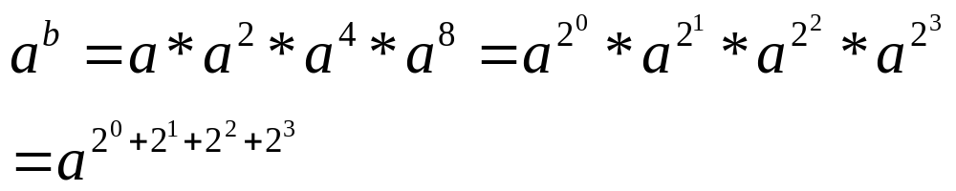
解题思路（续一）
二。计算方法：
a^{b} =a*a* *a 时间复杂度O(b)
如果b=15
将b的二进制形式表示，计算乘方的时间复杂度O(log2b)

Slide 95
核心代码及解释
void cal(unsigned *r,long unsigned a,unsigned m)
计算a的2^{j}次方对m取模的结果,用数组r保存
{r[0]=a%m;f
or(i=1;i<32;++i)r[i]=(long)r[i-1]*r[i-1]%m;
}
//r_{i+1}=r_{i}*r_{i}

Slide 96
核心代码及解释（续一）
unsigned calc(unsigned m,long unsigned a,long unsigned b)
//计算a^{b}%m的值
{int bl[32],r[32];//bl是b的二进制结果
cal(r,a,m); //计算a^{b}%m的值
while(b){bl[i++]=b%2;b>>=1;}
for(j=0,k=a%m;j<i;++j)if(bl[j])k=k*r[j]%m;
return k;}

Slide 97
核心代码及解释（续二）
int main(){
scanf("%d",&z);
while(z--)
{scanf("%u%d",&m,&i);
for(j=0,s=0;j<i;++j)
{scanf("%lu%lu",&a,&b);
s=((long)s+calc(m,a,b))%m;}
printf("%u\n",s);}}

