Slide 1
LOGO
华南理工大学
毕业答辩
基于Pubmed数据库的蛋白质翻译后修饰信息挖掘
我们毕业啦
其实是答辩的标题地方
答辩人
周莅
指导老师
李粤

Slide 2
论文绪论
需求分析
系统设计
程序实现
CONTANTS
系统测试
论文总结

Slide 3


论文绪论
It was the best of times, it was the worst of times; it was the age of wisdom, it was the age of foolishness.

Slide 4

论文绪论
研究背景
研究方法
研究结果
问题讨论
论文总结
图片
文本
视频
音频
近十几年来，计算机领域发展迅猛，互联网用户产生的数据正以惊人的速度增涨。这些逐年增长的数据中绝大多数的数据都是非结构化的数据，这些数据主要存储的形式都是文本、网页、图片、视频、音频等非结构化的形式。
如何把这些非结构化数据转换为直观地，可视化的数据，以便我们从中获取有用的价值？

Slide 5
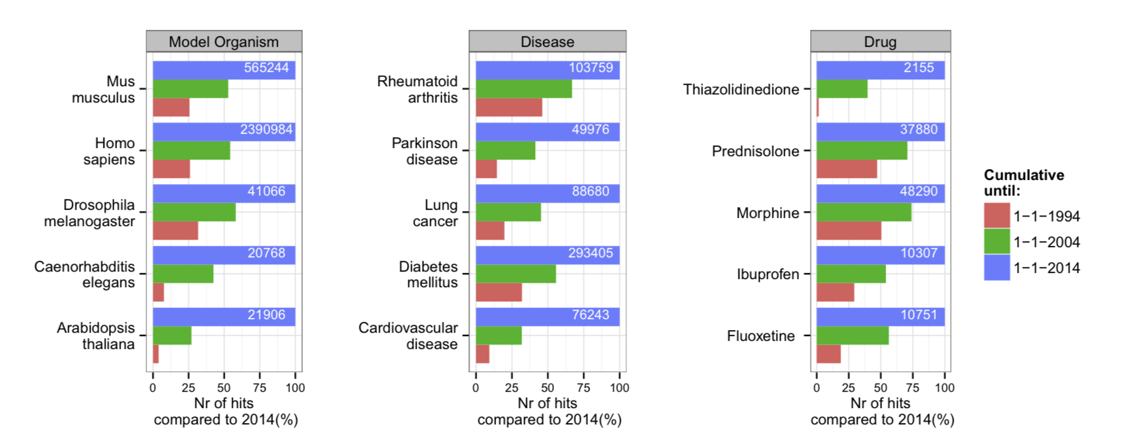
论文绪论
研究背景
研究方法
研究结果
问题讨论
论文总结
Growth of the PubMed database

Slide 6
需求分析
It was the best of times, it was the worst of times; it was the age of wisdom, it was the age of foolishness.

Slide 7
论文绪论
研究背景
研究方法
研究结果
问题讨论
论文总结
Pubmed Article
G protein-coupled receptor kinases (GRKs) comprise a family of seven serine/threonine kinases that phosphorylate agonist-activated G protein-coupled receptors (GPCRs). It has recently been reported that GRKs regulate GPCR-independent signaling through the phosphorylation of intracellular proteins. To date, several intracellular substrates for GRK2 and GRK5 have been reported. However, those for GRK6 are poorly understood. Here we identified IκBα, a negative regulator of NF-κB signaling, as a substrate for GRK6. GRK6 directly phosphorylated IκBα at Ser(32)/Ser(36), and the kinase activity of GRK6 was required for the promotion of NF-κB signaling after TNF-α stimulation. Knockout of GRK6 in peritoneal macrophages remarkably attenuated the transcription of inflammatory genes after TNF-α stimulation. In addition, we developed a bioluminescence resonance energy transfer (BRET) probe to monitor GRK6 activity. Using this probe, we revealed that the conformational change of GRK6 was induced by TNF-α. In summary, our study demonstrates that TNF-α induces GRK6 activation, and GRK6 promotes inflammatory responses through the phosphorylation of IκBα.
G protein-coupled receptor kinases (GRKs) comprise a family of seven serine/threonine kinases that phosphorylate agonist-activated G protein-coupled receptors (GPCRs). It has recently been reported that GRKs regulate GPCR-independent signaling through the phosphorylation of intracellular proteins. To date, several intracellular substrates for GRK2 and GRK5 have been reported. However, those for GRK6 are poorly understood. Here we identified IκBα, a negative regulator of NF-κB signaling, as a substrate for GRK6. GRK6 directly phosphorylated IκBα at Ser(32)/Ser(36), and the kinase activity of GRK6 was required for the promotion of NF-κB signaling after TNF-α stimulation. Knockout of GRK6 in peritoneal macrophages remarkably attenuated the transcription of inflammatory genes after TNF-α stimulation. In addition, we developed a bioluminescence resonance energy transfer (BRET) probe to monitor GRK6 activity. Using this probe, we revealed that the conformational change of GRK6 was induced by TNF-α. In summary, our study demonstrates that TNF-α induces GRK6 activation, and GRK6 promotes inflammatory responses through the phosphorylation of IκBα.
蛋白质
激酶
位点
 | 蛋白质 | 激酶 | 位点
关系1 | GPCRs | GRKs | /
关系2 | IκBα | GRK6 | Ser(32)/Ser(36)

Slide 8
系统设计
It was the best of times, it was the worst of times; it was the age of wisdom, it was the age of foolishness.

Slide 9
论文绪论
研究背景
研究方法
研究结果
问题讨论
论文总结
Preprocess
识别实体
Relation
可视化
文本预处理
NER
关系提取
visualize
Step 1
Step 2
Step 3
Step 4
预处理Pubmed文献检索系统中文献，生成对应的文档集。
识别出文献中的实体名词，比如蛋白质实体，激酶实体，位点实体
根据识别出来的实体词语，进一步找出其中的关系
将实体名词，和实体之间的关系通过可视的图标形式展现出来

Slide 10
论文绪论
研究背景
研究方法
研究结果
问题讨论
论文总结
TEXT
TEXT
TEXT
TEXT
It was the best of times, it was the worst of times; it was the age of wisdom, it was the age of foolishness. It was the epoch of belief, and it was the epoch of incredulity.
It was the best of times, it was the worst of times; it was the age of wisdom, it was the age of foolishness. It was the epoch of belief, and it was the epoch of incredulity.
It was the best of times, it was the worst of times; it was the age of wisdom, it was the age of foolishness. It was the epoch of belief, and it was the epoch of incredulity.
It was the best of times, it was the worst of times; it was the age of wisdom, it was the age of foolishness. It was the epoch of belief, and it was the epoch of incredulity.

Slide 11
论文绪论
研究背景
研究方法
研究结果
问题讨论
论文总结
ADD YOUR TITLE
It was the best of times, it was the worst of times; it was the age of wisdom, it was the age of foolishness. It was the epoch of belief, and it was the epoch of incredulity. It was the season of light, and it was the season of darkness. It was the spring of hope, and it was the winter of despair.
Preprocess
文本预处理
解析XML
It was the best of times, it was the worst of times; it was the age of wisdom, it was the age of foolishness. It was the epoch of belief, and it was the epoch of incredulity. It was the season of light, and it was the season of darkness. It was the spring of hope, and it was the winter of despair.
Step 1

Slide 12

论文绪论
研究背景
研究方法
研究结果
问题讨论
论文总结
ADD TITLE
ADD TITLE
It was the best of times, it was the worst of times; it was the age of wisdom, it was the age of foolishness.
It was the best of times, it was the worst of times; it was the age of wisdom, it was the age of foolishness.
ADD TITLE
ADD TITLE
It was the best of times, it was the worst of times; it was the age of wisdom, it was the age of foolishness.
It was the best of times, it was the worst of times; it was the age of wisdom, it was the age of foolishness.

Slide 13
研究结果
It was the best of times, it was the worst of times; it was the age of wisdom, it was the age of foolishness.

Slide 14
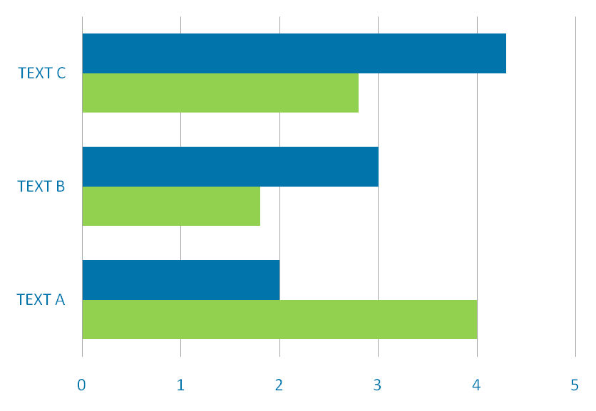
论文绪论
研究背景
研究方法
研究结果
问题讨论
论文总结
It was the best of times, it was the worst of times; it was the age of wisdom, it was the age of foolishness.
It was the best of times, it was the worst of times; it was the age of wisdom, it was the age of foolishness.

Slide 15
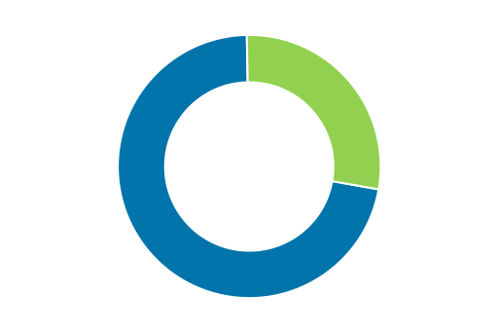
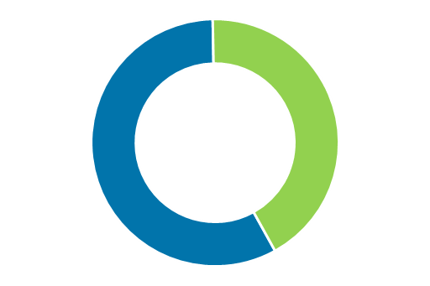
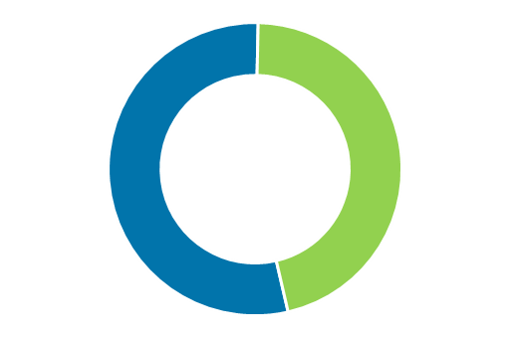
论文绪论
研究背景
研究方法
研究结果
问题讨论
论文总结
TEXT
TEXT
TEXT
It was the best of times, it was the worst of times; it was the age of wisdom, it was the age of foolishness. It was the epoch of belief, and it was the epoch of incredulity. It was the season of light, and it was the season of darkness. It was the spring of hope, and it was the winter of despair.
毕业论文题目

Slide 16
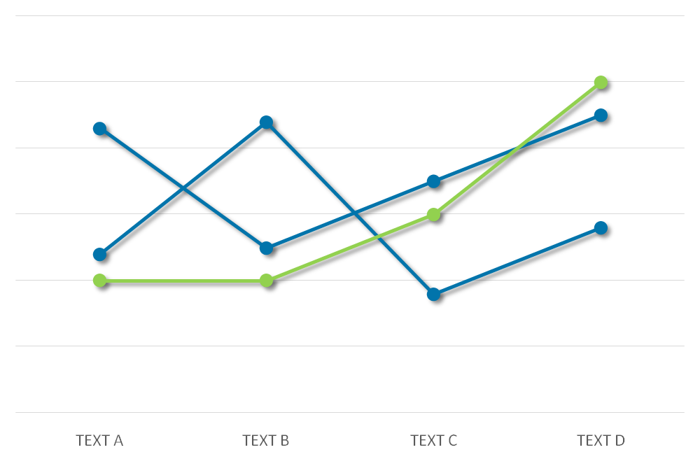
论文绪论
研究背景
研究方法
研究结果
问题讨论
论文总结
It was the best of times, it was the worst of times; it was the age of wisdom, it was the age of foolishness.

Slide 17
问题讨论
It was the best of times, it was the worst of times; it was the age of wisdom, it was the age of foolishness.

Slide 18
论文绪论
研究背景
研究方法
研究结果
问题讨论
论文总结
ADD TITLE
ADD TITLE
It was the best of times, it was the worst of times; it was the age of wisdom, it was the age of foolishness.
s
It was the best of times, it was the worst of times; it was the age of wisdom, it was the age of foolishness.
T
TEXT
w
o
ADD TITLE
ADD TITLE
It was the best of times, it was the worst of times; it was the age of wisdom, it was the age of foolishness.
It was the best of times, it was the worst of times; it was the age of wisdom, it was the age of foolishness.

Slide 19
论文绪论
研究背景
研究方法
研究结果
问题讨论
论文总结
ADD YOUR TITLE
1
It was the best of times, it was the worst of times; it was the age of wisdom, it was the age of foolishness. It was the epoch of belief, and it was the epoch of incredulity. It was the season of light, and it was the season of darkness. It was the spring of hope, and it was the winter of despair.
TEXT
ADD YOUR TITLE
It was the best of times, it was the worst of times; it was the age of wisdom, it was the age of foolishness. It was the epoch of belief, and it was the epoch of incredulity. It was the season of light, and it was the season of darkness. It was the spring of hope, and it was the winter of despair.
2
3
ADD YOUR TITLE
It was the best of times, it was the worst of times; it was the age of wisdom, it was the age of foolishness. It was the epoch of belief, and it was the epoch of incredulity. It was the season of light, and it was the season of darkness. It was the spring of hope, and it was the winter of despair.

Slide 20
论文总结
It was the best of times, it was the worst of times; it was the age of wisdom, it was the age of foolishness.

Slide 21

论文绪论
研究背景
研究方法
研究结果
问题讨论
论文总结
ADD YOUR TITLE
A
It was the best of times, it was the worst of times; it was the age of wisdom, it was the age of foolishness. It was the epoch of belief, and it was the epoch of incredulity. It was the season of light, and it was the season of darkness. It was the spring of hope, and it was the winter of despair.
ADD YOUR TITLE
B
It was the best of times, it was the worst of times; it was the age of wisdom, it was the age of foolishness. It was the epoch of belief, and it was the epoch of incredulity. It was the season of light, and it was the season of darkness. It was the spring of hope, and it was the winter of despair.
ADD YOUR TITLE
C
It was the best of times, it was the worst of times; it was the age of wisdom, it was the age of foolishness. It was the epoch of belief, and it was the epoch of incredulity. It was the season of light, and it was the season of darkness. It was the spring of hope, and it was the winter of despair.

Slide 22

THANKS
NAME
DAMEN

