Slide 1
Boundary Element Method for elastic analysis
[1]A Short Course on Boundary Element Methods
[2]Direct computation of cauchy principal value integrals in advanced boundary elements
[3]A General Algorithm for the Numerical Solution of Hypersingular Boundary Integral Equations
[4]A self-adaptive co-ordinate transformation for efficient numerical evaluation of general boundary integrals

Slide 2
Boundary Element Method

Slide 3
Navier-Cauchy Equation
Stress Equation
Navier-Cauchy Equation
Generalized Hooke Law
Strain Tensor

Slide 4
Kelvin Fundamental Solution
Kelvin Solution
Assuming a unit concentrated force f applied on a point s in the infinite domain, we seek u(z) and t(z) for any point z.
f
2D Expressions:
f
s
s
y
y
x
z
z
z
x
3D Expressions:
z

Slide 5

Boundary integral equation: direct method
Betti’s reciprocity theorem
State(1): auxiliary state, using Kelvin solution,
State(2): real state, neglecting body force,
$$t_{j}^{\left(1\right)}\left(x\right)=T_{ij}\left(s,x\right)e_{i},u_{j}^{\left(1\right)}\left(x\right)=U_{ij}\left(s,x\right)e_{i}$$

Slide 6
Boundary integral equation: direct method
Betti’s reciprocity theorem + Kelvin fundamental solution
Dirac delta distribution
Somigliana's boundary equation

Slide 7
Boundary integral equation: direct method
Let source point s approach to the boundary
limit
s
: Jump Term or Free Term
n
n
2D
3D

Slide 8
Boundary integral equation: direct method
Discrete formulation
Matrix formulation
A is a full, non-symmetric matrix.
Gaussian elimination method

Slide 9
Direct computation of cauchy principal value integrals in advanced boundary elements Singularity Subtraction Technique (SST)
Massimo Guiggiani, Paolo Casalini
Department of Nuclear Engineering, University of pisa

Slide 10
Jump Term
Jump Term
Arise from the limiting process of the boundary integral and is dependent on the geometry at the source point.
Smooth Boundary

Slide 11
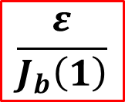
Computation of Cauchy Principal Value Integrals
Taylor Expansion
$$\frac{ε}{J_{b}\left(1\right)}$$

Slide 12
Computation of Cauchy Principal Value Integrals

Slide 13
A self-adaptive co-ordinate transformation for efficient numerical evaluation of general boundary integrals [Telles transformation]
J. C. F. Telles
Federal University of Rio de Janeiro

Slide 14
Singular Integrals
Consider the integral
in which is singular at a point
Second-degree relation
The main advantage is that since the Jacobian cancels the singularity, standard Gaussian integration can be employed.

Slide 15


Singular Integrals
Another non-linear transformation which always remains valid (without partition) for any position of the singularity.
Third-degree relation
$$\left(γ−{\overline{γ}}^{2}\right)$$
VS.
$${\left(γ−\overline{γ}\right)}^{2}$$

Slide 16
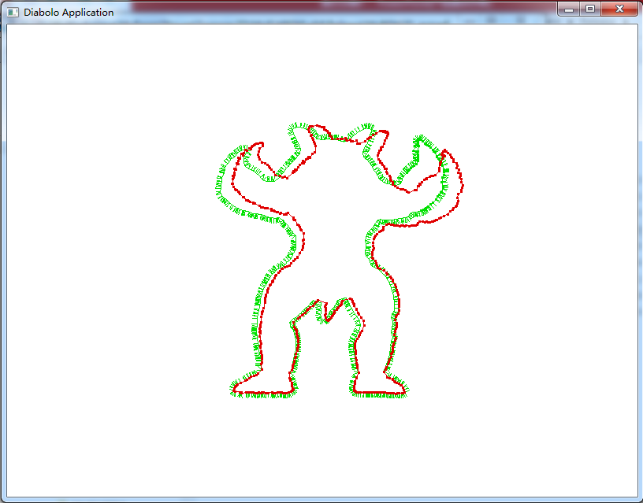

Slide 17
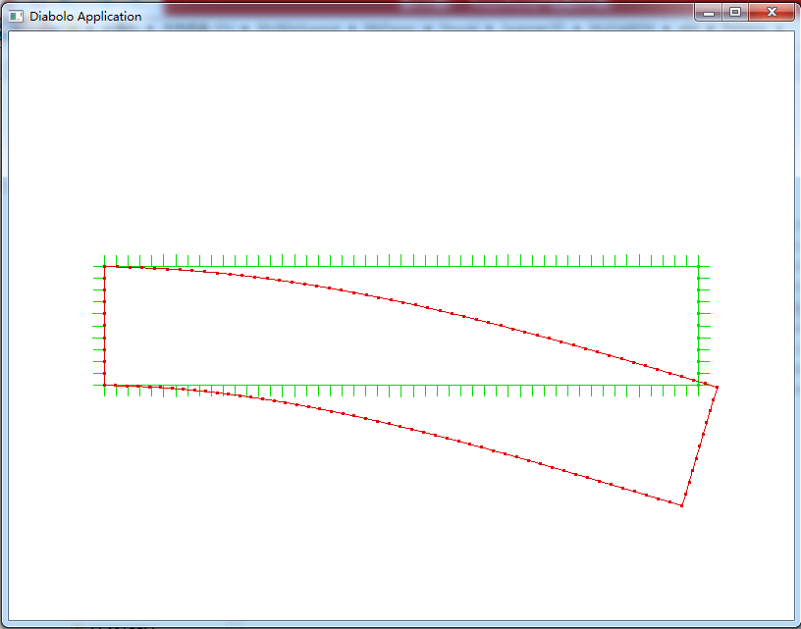

Slide 18
