Slide 1
Formula unsed in the CBI_Iter Code

Slide 2
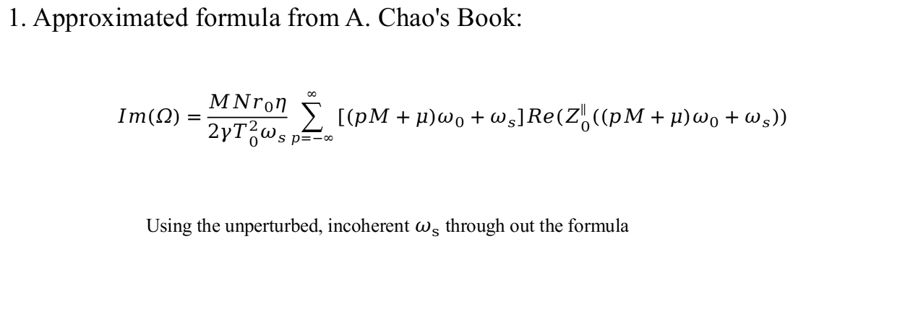
Approximated

Slide 3
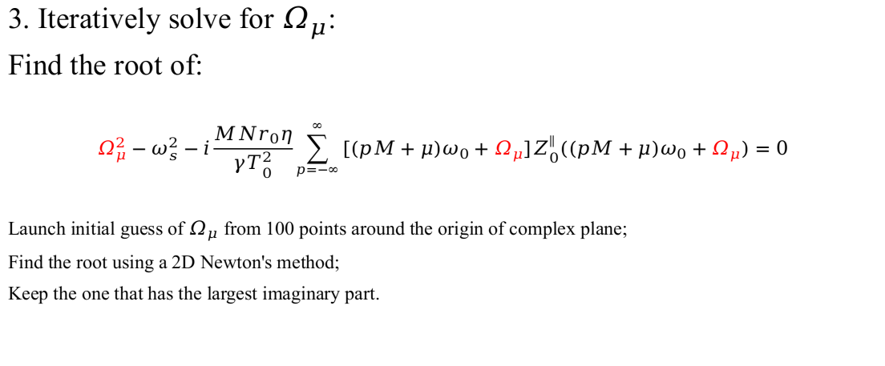
Old Iterative

Slide 4
New Iterative 20210111
Modes of storage ring coherent
instabilities
From J. M. Wang’s 1998 Paper:
Original:
Where m is the mode index, 1 means dipole mode, 2 means quad mode and so on.
is the incoherent synchrotron oscillation frequency.
Plug these expressions and after some massage:

